Slide 1
Time meeting
Accelerator Operations Support

Slide 2
1st full Maintenance for run ‘24
Large number of jobs
Beam available from AGS despite delayed turn on following fire alarm panel replacement
Power supply repairs and spin rotator commissioning were among the larger efforts
Power supply failure, ramp issues delayed RHIC recovery
Good effort for successful day

Slide 3
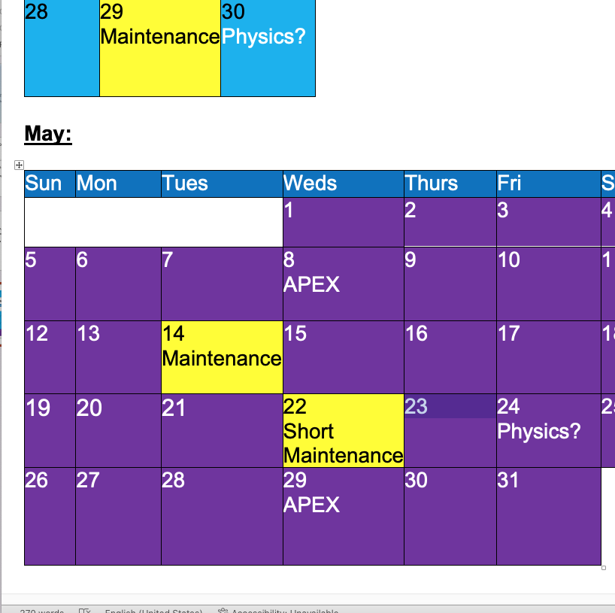
Maintenance Schedule :

