Slide 1
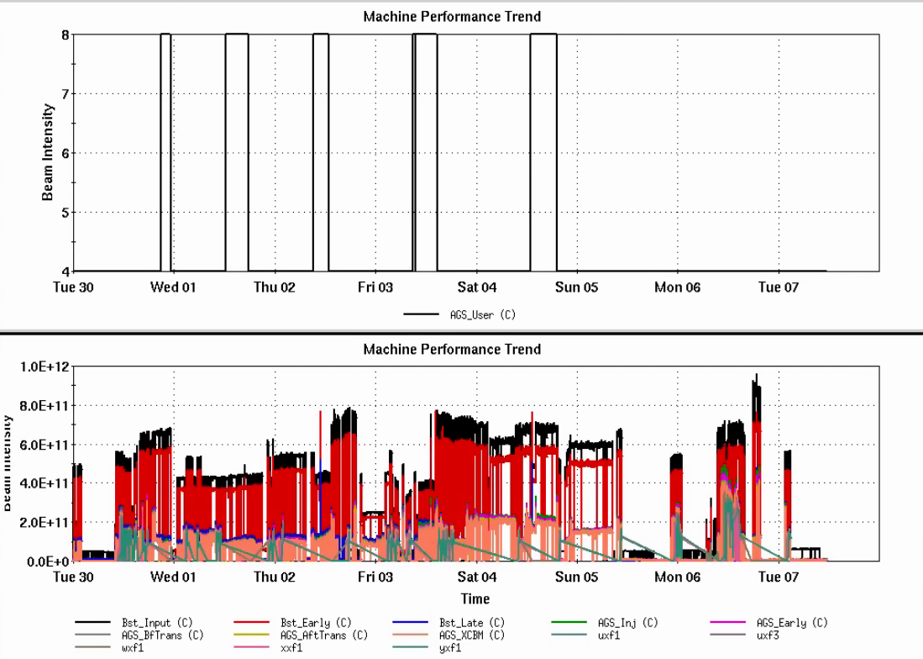
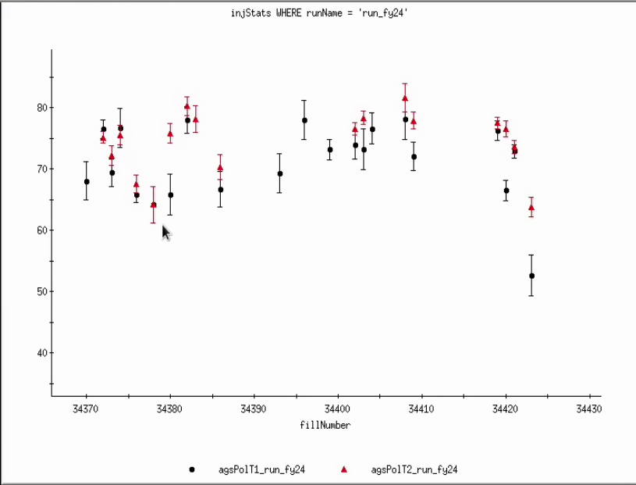
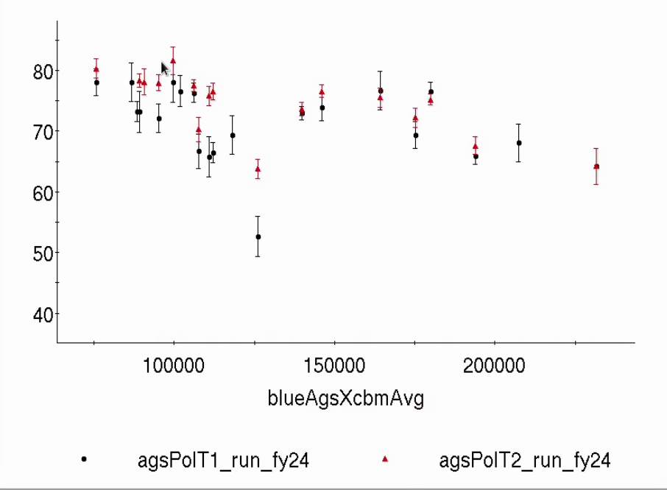
Injector Status Time meeting, 5/7/24
AGS operations supporting
RHIC fills ~1.3x10¹¹/bunch
High intensity for scrubbing and APEX (up to 3.9x10¹¹/bunch at AGS extraction)
Polarization development on user 8
Booster input from OPPIS > 6x10¹¹
Good conditioning progress
Average polarization for stores ~71% (fixed target, AGS extraction)
AGS User
RHIC scrubbing
Intensity
~71%
Pol (%)
Leftover scrubbing settings
Fill
RHIC bunch int (10⁶)

Slide 2
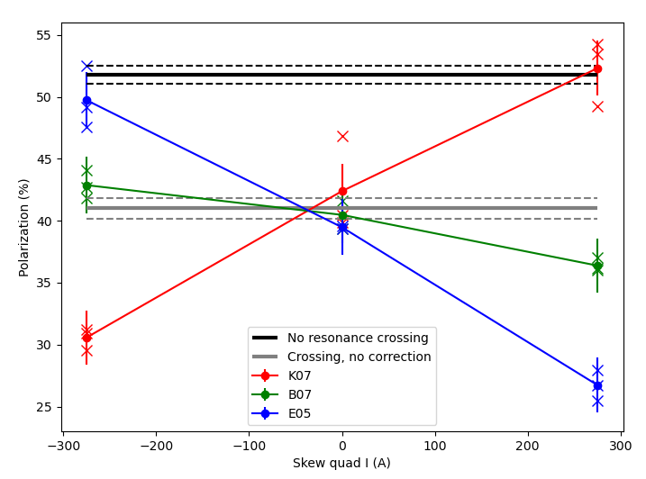
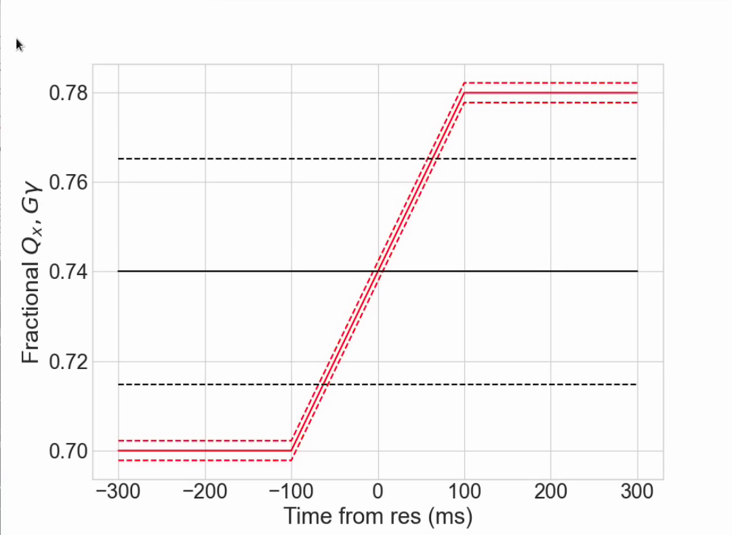
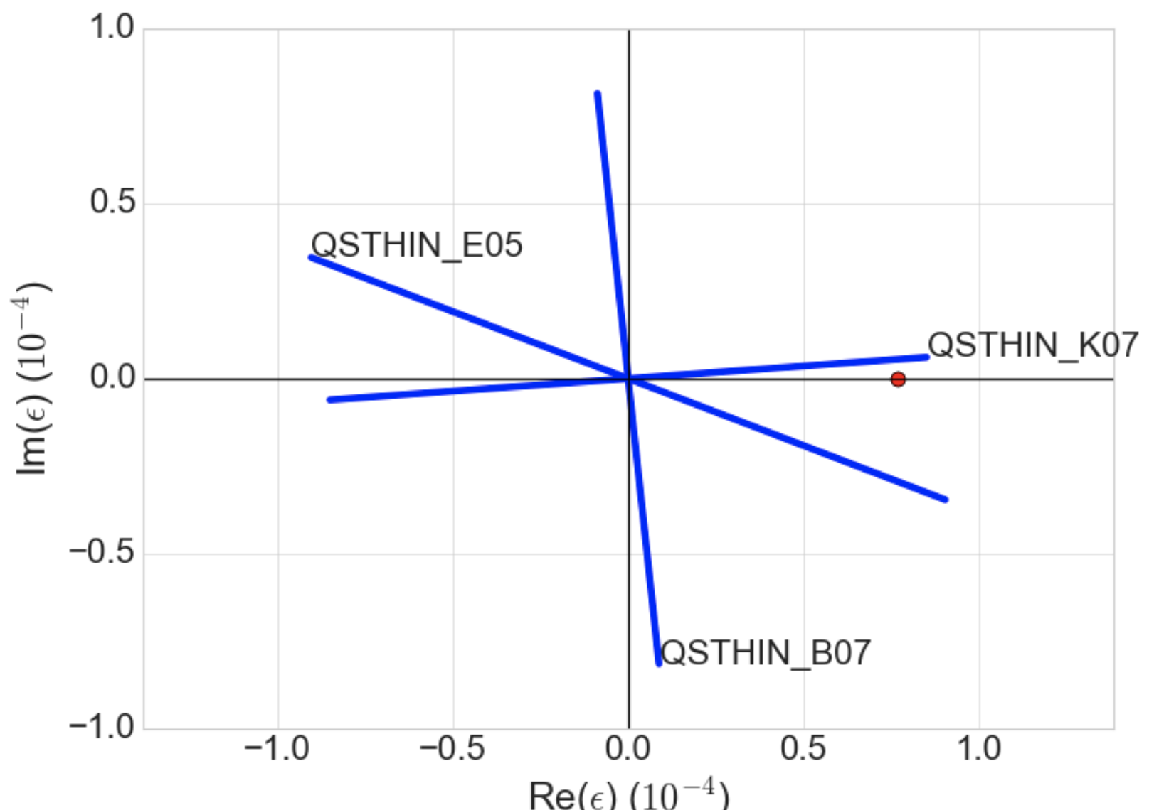
Resonance correction
Setup a slow horizontal resonance crossing on the flattop Gg = 45.72, Qx ramps from 8.70 to 8.78 over 200 ms
Crossing rate reduced (relative to acceleration ramp) by ~10², polarization loss ~20% (easily measurable compared to resonance on the ramp (~0.1% loss)
Scan three skew squads (with a 200 ms pulse width): one parallel to resonance, one anti-parallel and one orthogonal.
First proof-of-principle correction of partial snake hybrid resonances with betatron coupling!
Skew quad current scans
Resonance crossing
Resonance vectors
Snake drive term

Slide 3
Resonance correction: Next steps
Power supplies
5 of 15 supplies modified for optimized switching behavior to reduce heating
Rest done by end of week (just in time for summer)
Beam work
Check more scenarios with the flattop crossing
correction with multiple skew quads
Try to infer phase/amplitude errors from scans
Orbit control scripts ready for testing
Facilitates improved centering during acceleration : will greatly improve ability to do tests on the ramp (where it matters)

