Slide 1
sPHENIX status
Kin Yip
sPHENIX Director of Operations
Time meeting
May 7, 2024

Slide 2
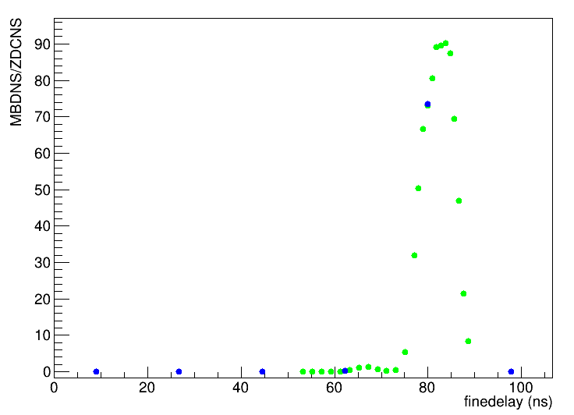
Excellent progress on sPHENIX Commissioning
The sPHENIX commissioning is basically divided into two parts:
TPC (finding the optimal settings with beam collisions, and exercising zero-suppression running)
Trigger, DAQ and the rest of the subsystems.
Non-tracking detectors can run at ~15 kHz in the multi-event buffering mode.
We have needed to write script to adjust the phase
in every store to time-in sPHENIX by script.
It’s hopefully resolved by the C-AD RF group.
We’re also discussing when to turn on the sPHENIX Magnet --- trying to avoid turning it on and then shutting it down soon afterwards.

Slide 3
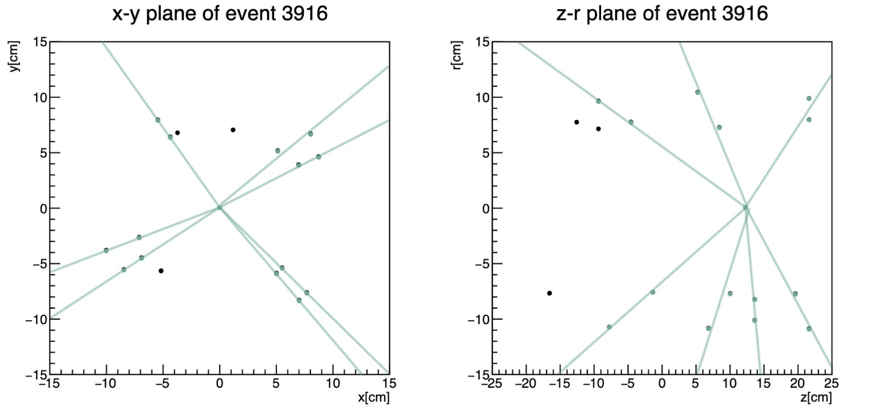
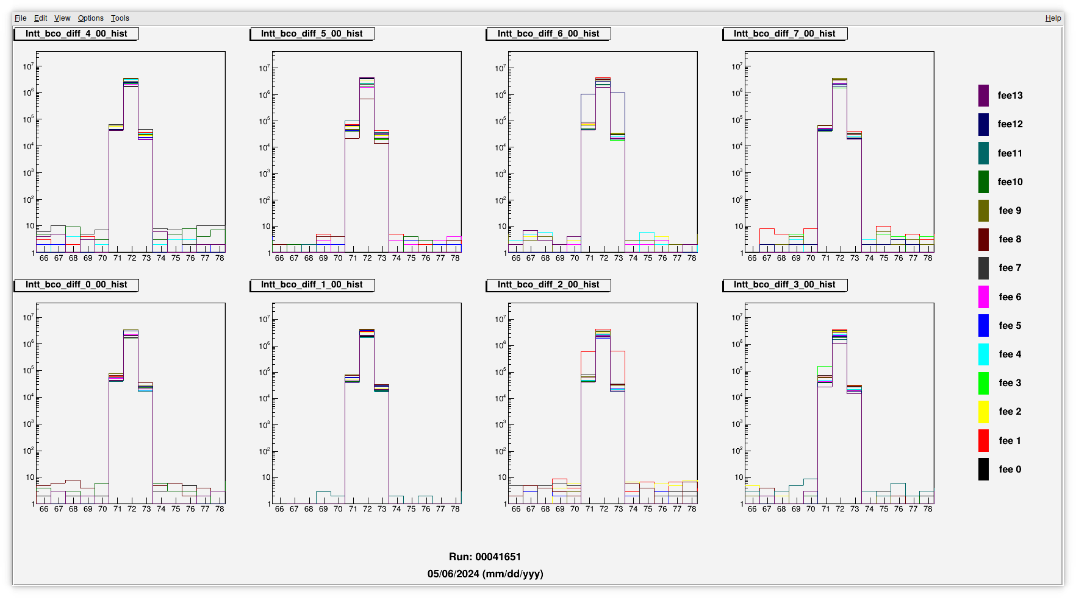
INTT timing-in, finding vertices …
INTT trigger collisions presently timed-in within 3 RHIC Bunch Crossings.
Need 56x56 to time-in within 1 Bunch Crossing …

Slide 4
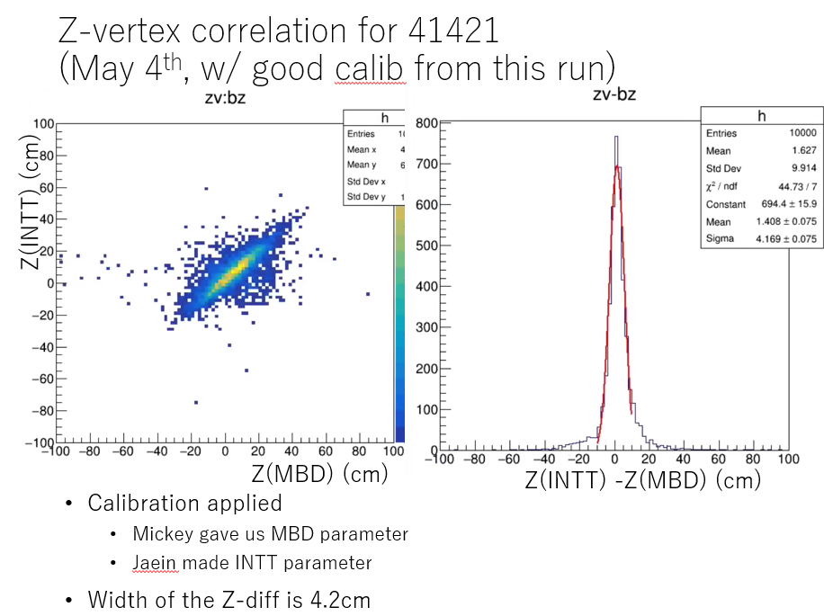
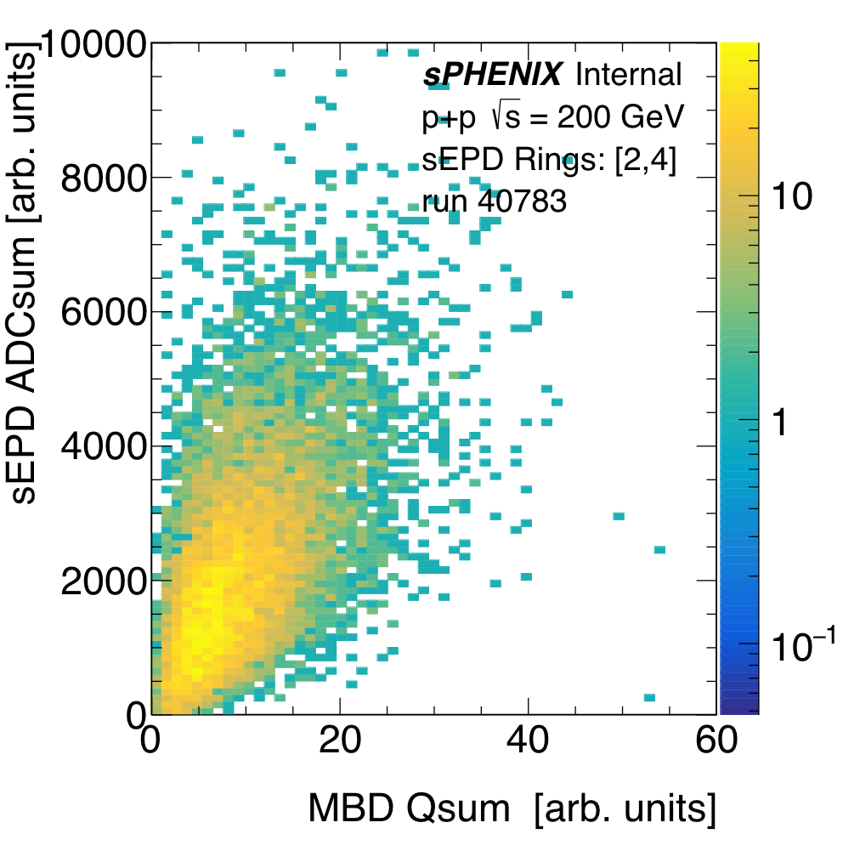
Early detector correlation plots :

Slide 5
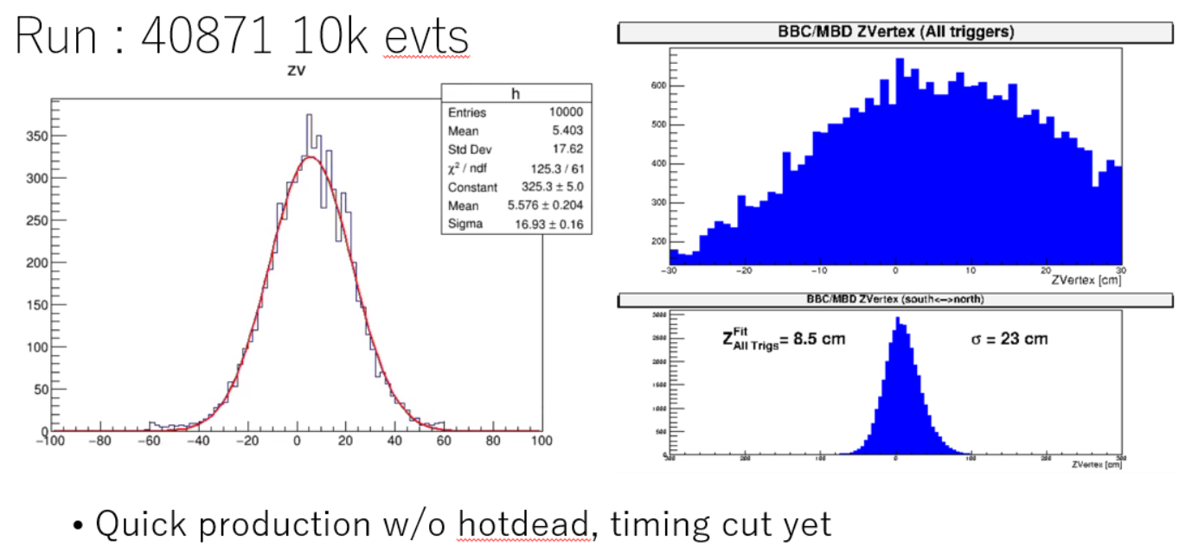
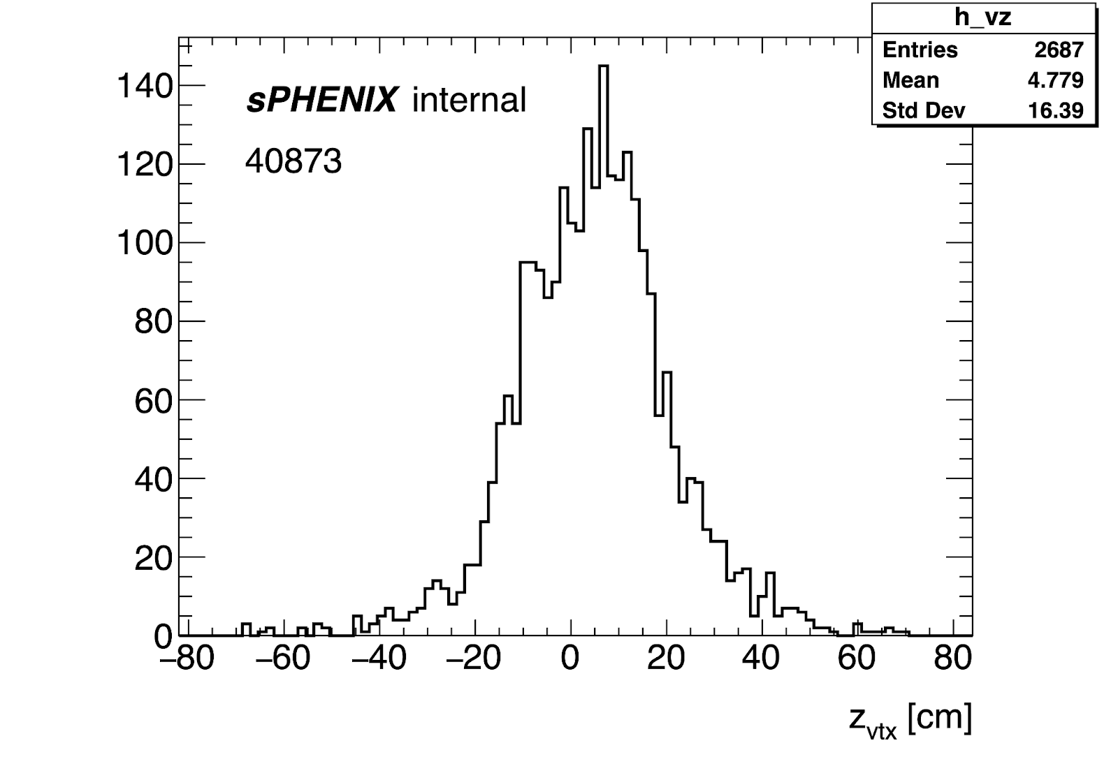
Finding vertices by different detectors, MBD, INTT and MVTX
INTT
MBD
MVTX

