Slide 1
Data courtesy C. Naylor

Slide 2
Data courtesy C. Naylor

Slide 3
Data courtesy C. Naylor

Slide 4
Data courtesy C. Naylor

Slide 5
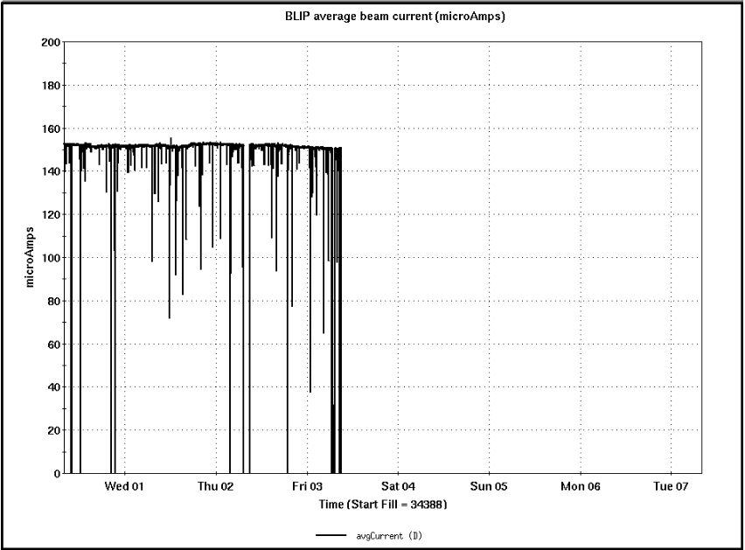
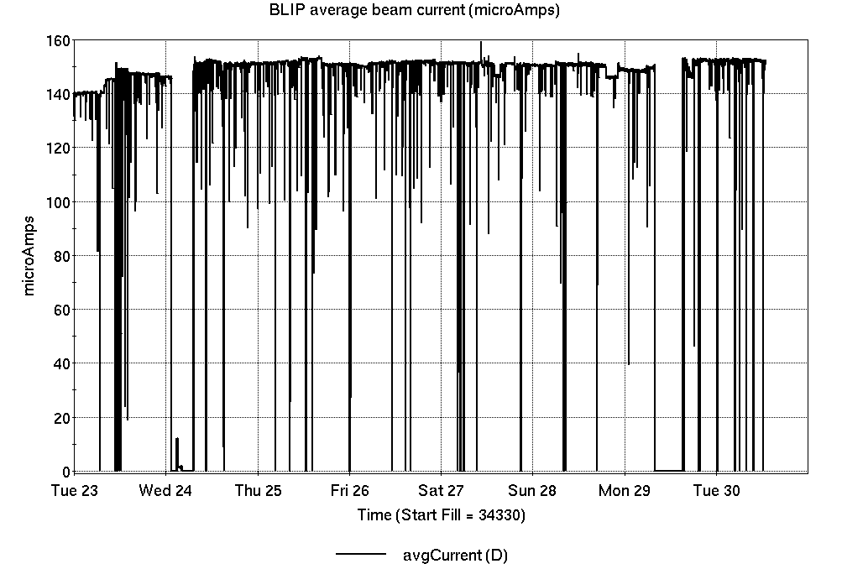
Operations for BLIP
4/30-5/7/2024:
BLIP 200 MeV target
production continued until
5/3 09:00.
Next runs:
BLIP 117MeV 5/7-5/10,
BLIP 200MeV 5/10-5/21.
70.3 hr Production
2.7 hr Failure
95.0 hr Shutdown
Availability: 96.3%
No BLIP
this past week

Slide 6
NSRL activity past week: 4/30-5/7/2024 (as of 0800)
NSRL: NASA biology continues, as primary user in GCR mode; additional users this week.
Protons, 8 EBIS ions in use. (He, C, O, Si, Fe, Ag, Bi, Au)
Run 24-A/B schedule continues until 21 May.
Run 24-C follows 22 May. Schedule posted, details forthcoming; beam into November.
Availability: 99.7%

Slide 7
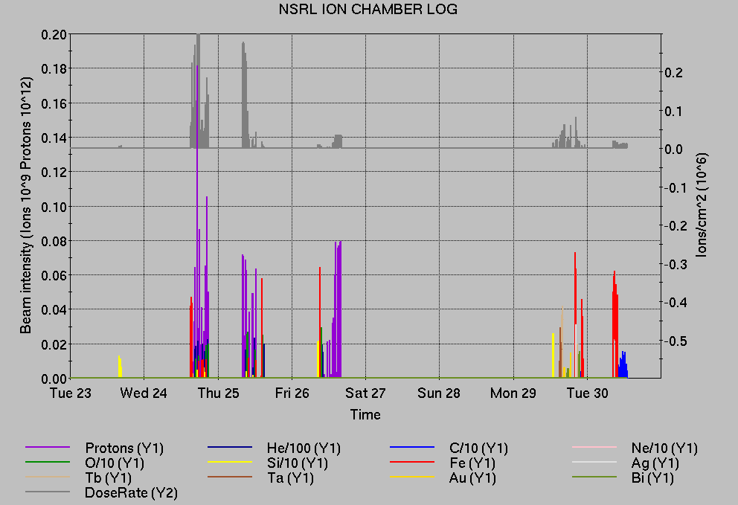
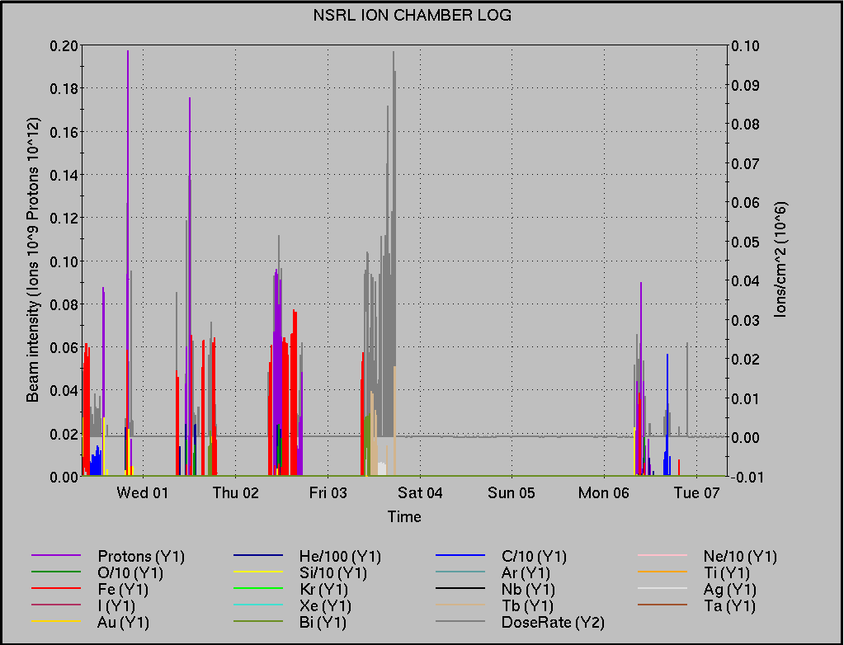
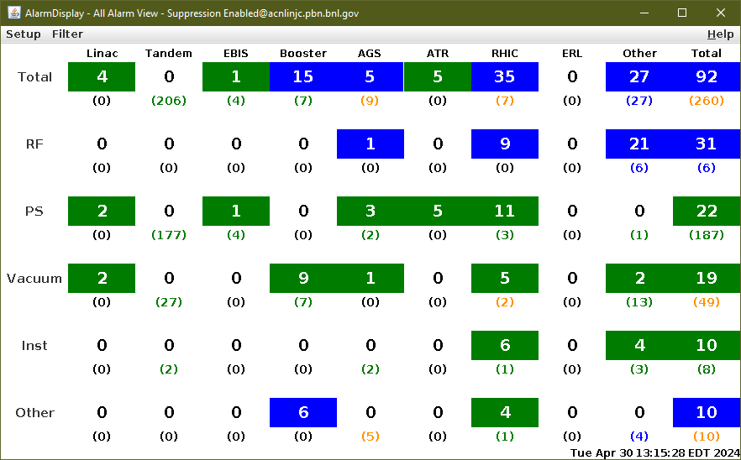
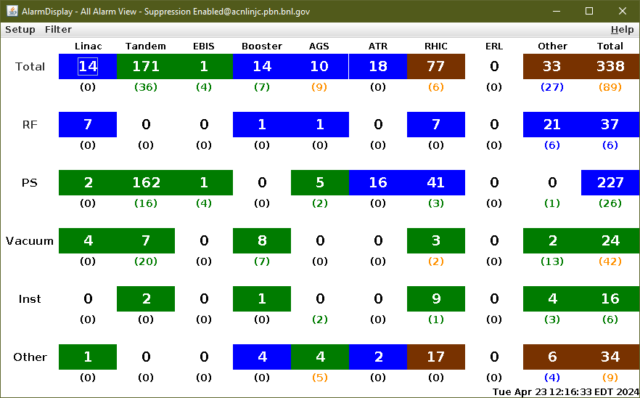
Notes from Operations
Notable failures (>1 hr)
AGS extraction bump G09C blown fuses (x2), fuses replaced.
Lost sweep 6z2 A-Div (x2), fixed connection on crash controller.
Beam aborts, BLM interlocks & BPM permit trips.
AGS G10 firing issue, replaced trigger PS for
module 1.
AGS J5 JumpQuad LVPS fault, repaired main
contactor.
yo9-snk7-1.4 (outer) tripped on quench fault.
Booster F3 kicker tripped on vacuum fault
closing valves, ion gauge reporting issue.
Cooling trouble alcove 1C, HVAC condensate issue.
Switching Magnet changing polarity, power cycled PS
Other notes
Lost sweeps during
access
Please continue to address

Slide 8
Reminder from Operations
MCR continues Operations for:
BLIP – startup 7 May and run until 21 May.
NSRL user running scheduled Mon-Sat, NASA Biology this week and next.
AGS/Booster polarized proton setup continues, additional to RHIC physics.
Setting up multiple (proton) AGS PPM Users, polarization scans.
Injector Au setup as yet untested.
Skew quad testing continues.
RHIC beam for Physics stores.
Maintenance today 09:00 – 15:00.
Tomorrow APEX 08:00 – 23:00.
Remember to coordinate with MCR. We need proper contacts when systems require experts
CHECK AND EDIT YOUR OWN CONTACT INFO
http://directory.pbn.bnl.gov/
CHECK YOUR CALLIN LIST: WCC and ECP updates needed
https://www.cadops.bnl.gov/Operations/personnel/call_in_lists/

Slide 9
Data courtesy C. Naylor

Slide 10
Availability, expected beam hours
$$Availability=\frac{actual beam time}{scheduled beam time}≡\frac{Beam use time}{Calendar time−scheduled interruptions}$$
$$RHIC \\ Availability=\frac{Physics+Machine Development+Machine Setup+Experiment Setup+Accelerator Experiments}{(Physics+Machine Development+Machine Setup+Experiment Setup+Accelerator Experiments)+Failures}$$
$$\text{DOE} \text{expected} \text{beam} \text{hours}=(\# of weeks −1 week overhead)×\left(\frac{160 available hours}{1 week}\right)×0.8$$
Notes:
Normally hidden. Explains how the 85% from DOE comes in to play & general availability metrics

