Slide 1
12x150 A RHIC leads New helium flow logic
E.Becker, A.Marusic, C.Mi, R.Michnoff, F.Micolon, P.Talty, T. Samms
May 2024

Slide 2
Why ?
The Aug 1st QLI event lead to extensive repairs and a 6 month RHIC shutdown.
It was attributed to an electrical breakdown in the blue VB4 12x150 A superconducting lead – Review link for details
The faillure was attributed to structural fatigue of the lead due to high temperature variations in operation (IPAC24 paper TUPR56)

Slide 3
Temperature variations in operation – Q2
Store
+19%
-23%
Injection
+2’
Resistance is a good image of the lead temperature profile.
The helium was coming 2+’ after the current ramp. The Q2 conductor was heating up in the meantime (R+19%).
Then an abrupt flood of helium was overcooling the conductor (R -23 %)

Slide 4
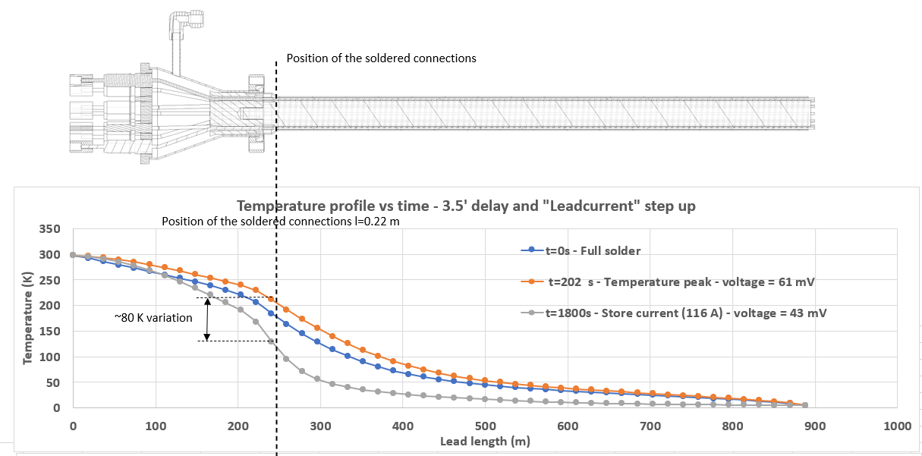
Resulting temperature on the lead
ANSYS simulations
Injection steady state
Max R (2’ after current ramp)
Store steady state
We estimate a temperature variation of 80 K at the solder joint location at every ramp.
This generates intense frictional stress in the conductor bundle assembly.
We estimate between 10 000 and 20 000 injection-store cycles to date (if you have a solid number, I am interested…)

Slide 5
Modification of the helium flow logic
An update of the control system has reduced the latency from 2’ to a few seconds (almost no flow delay). Thank you Patrick !
The flow at low current (park – injection) was originally set very low to prevent frosting. But heaters have been implemented in 2011 and have been effective.
The minimum flow is now set to its thermodynamic ideal
A large number of simulations were run to find the right flow setpoint at high current. The main challenge is operating the leads closer to the thermal runaway point (unstable resistive heating of the conductor).
A lot of this year commissioning effort was to make sure we were not going to be in runaway territory by choking the flow too much ! This needed a very careful check…lead by lead…
Here again operation in summer will be a stress test (hotter T of the warm end of the lead)…

Slide 6
Y4Q4Q7Q8QB – Old helium flow logic – 1st Aug 23
Helium flow kicks in
+70 µΩ
7 A/cond
10 A/cond
Ramp starts 12:03pm
Store current
145 A/cond
-180 µΩ
Injection current
-250 µΩ
62 A/cond
ΔR=320 µΩ !
-280 µΩ
ΔR=100 µΩ
A resistance variation of 100 µΩ is equivalent to 120 µm of conductor thermal expansion.
In this case the mismatch between conductors expansion reached 0.38 mm.

Slide 7
Y4Q4Q7Q8QB – New helium flow logic – 1st Aug 23
+113 µΩ
149 A/cond
7 A/cond
10 A/cond
16 A/cond
Injection
Ramp starts 22:47pm
ΔR=130 µΩ
Injection current
Store current
In this case the conductor expansion mismatch was 0.16 mm (down from 0.38 mm in the old law).
That is a reduction ~60% of the pull on the conductors.

Slide 8
Conlusion
The leads resistance mismatch was reduced by a factor 2x
The leads more at risk (with all circuits) are now stable thanks to the low operating current at 100 GeV pp (but 100 GeV Au will change that…)
The role of the warm cable in the transient needs to be clarified (tests are planned later).

Slide 9
Why ?
Aug 1st 2023 at 12:30pm a QLI started on blue due to a glitch (t=0).
t=0.11 ms – The QF/QD circuits got shorted together at VB4
t=0.5 ms – The dipole bus got shorted to QD/QF and to ground
t=0.8 ms – the DX quench heaters were triggered due to the high dI/dt
A massive helium release occurred soon after on VB4 blue.
When the dust settled, the QF/QD and dipole circuits were shorted together and to ground.

Slide 10
Why ?
A 12x150 A lead at VB4 was found burned, its conductor vaporized and it containing bellow had a through hole.
DX connections were damaged beyond repair. The DX magnet had to be replaced by its spare.

