Slide 1
sPHENIX status
Kin Yip
sPHENIX Director of Operations
Time meeting
May 14, 2024

Slide 2
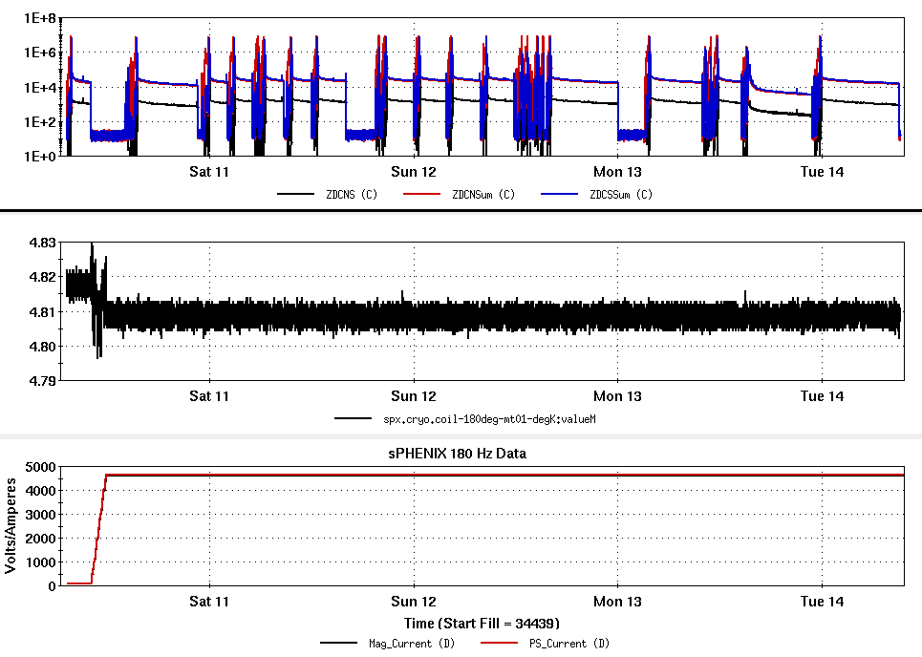
Status of sPHENIX Commissioning
ZDC rates (Hz)
sPHENIX Magnet was ramped to the top field ~1.4 T last Friday to help TPC operation; and it has remained on ever since
DAQ/trigger: generally in good shape and working to resolve a couple remaining readout issues of INTT & MVTX
Pushing to complete online
monitoring (with award)
Also emphasizing to collaborators on looking at the data taken
Magnet Coil Temperature (K)
Magnet/Power Supply Currents (A)

Slide 3
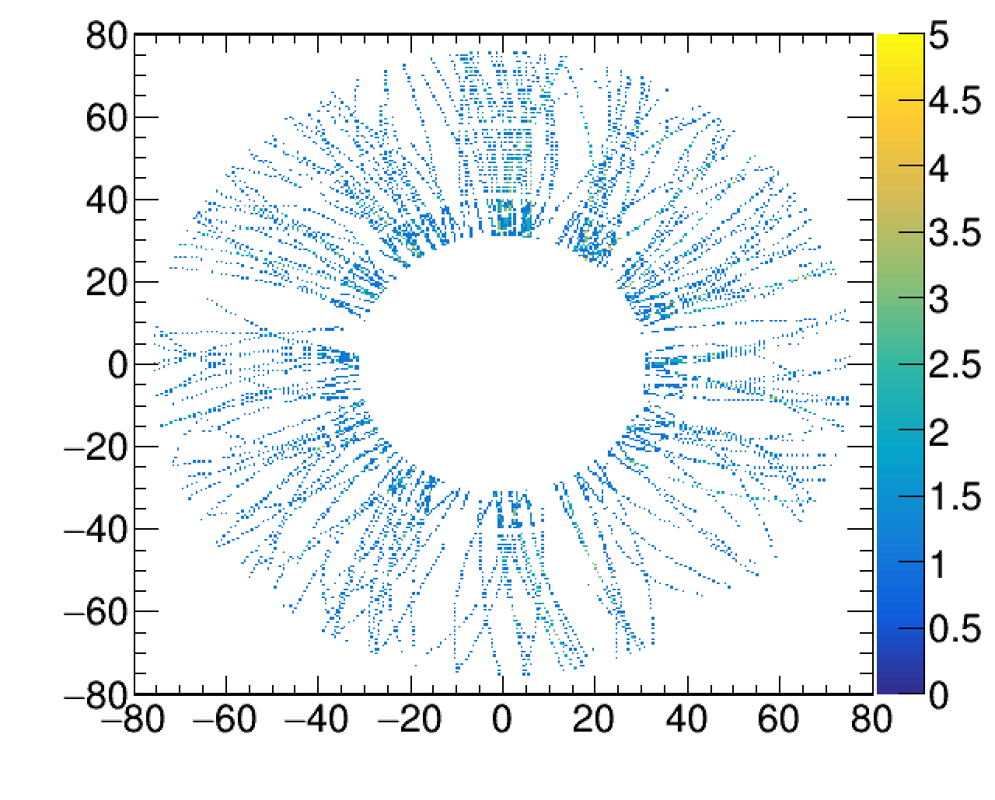
TPC (tracking) operation in beam collisions in magnetic filed
The magnetic field of 1.4 T has helped stabilize the TPC operation during beam collisions.
The TPC group will further adjust the operating voltages to improve the gains after changing resistors during the Maintenance Day.

Slide 4
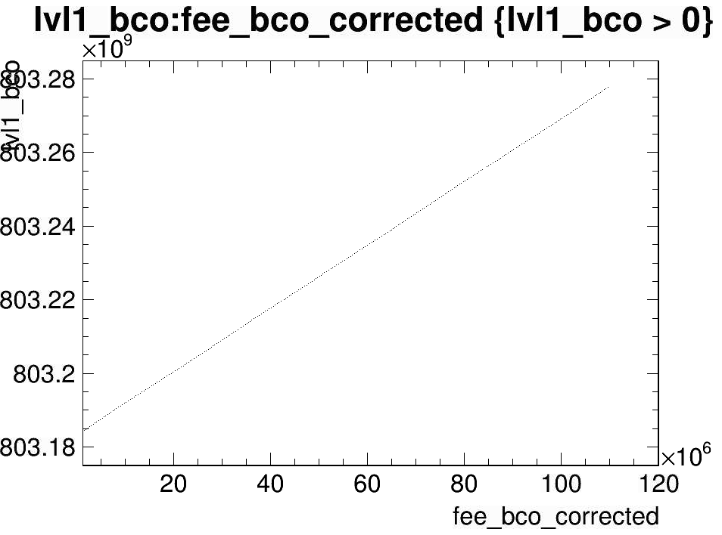
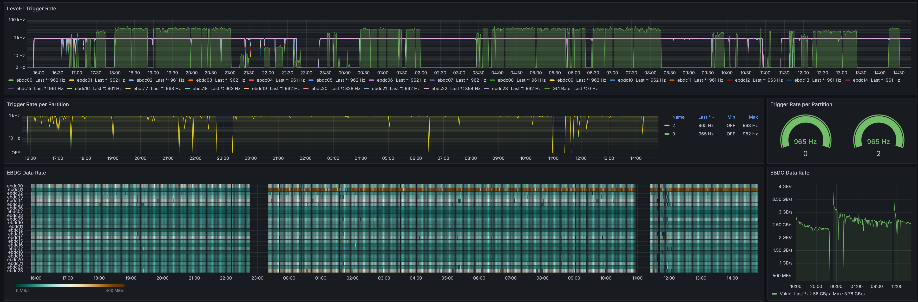
TPC firmware/zero-suppression status
Clock synchronization was successful
  FEE and FELIX communicate at the frequency of 56MHz, instead of 60MHz.
DAQ was stably operated at 1kHz at a threshold of 75 ADU
  pedestal is 60 ADU. Typically, RMS is ~2-3 ADU.
Turned on so-called baseline correction which forces the baseline of a fixed value

Slide 5
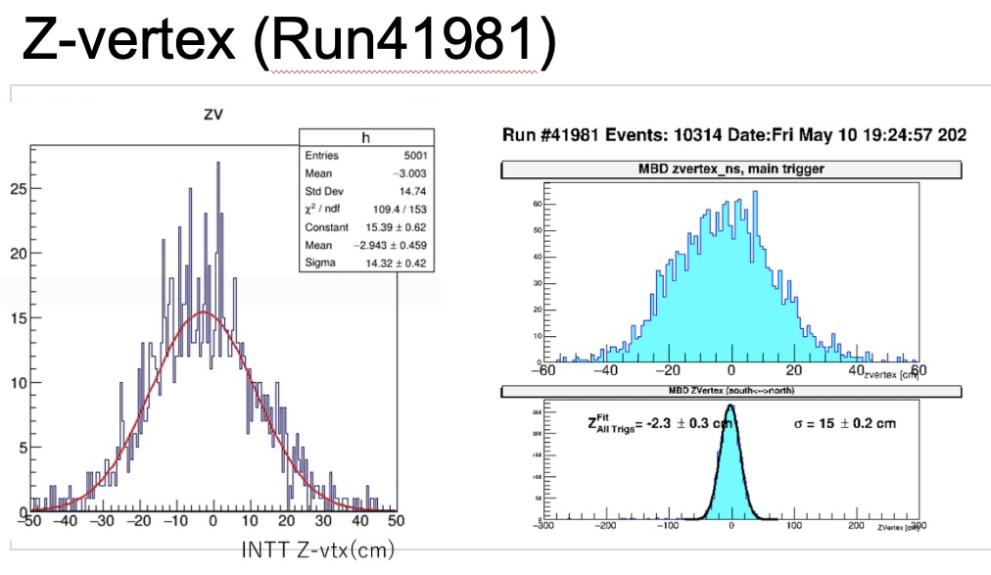
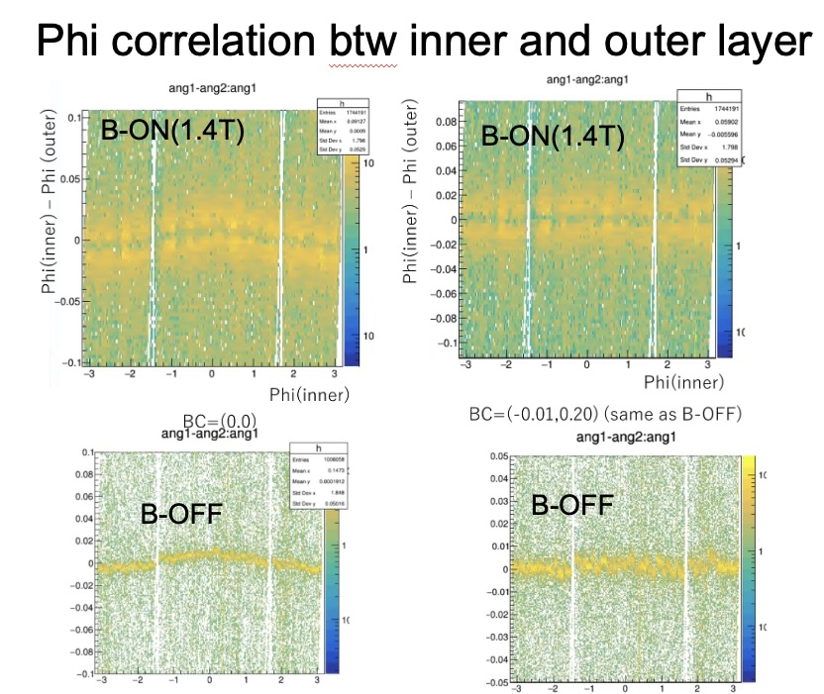
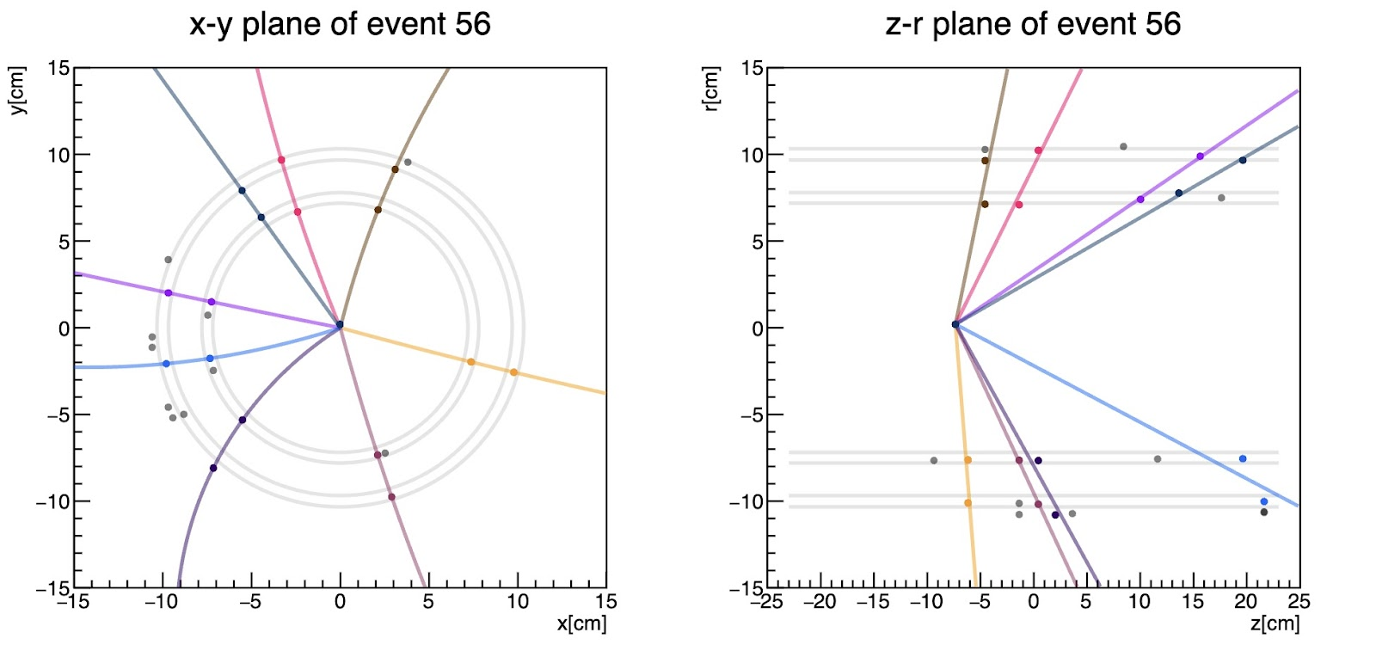
INTT beam-center correction: before and afterwards
Vertices are reconstructed from data successfully by INTT after the magnet is set to full field.

Slide 6
Examples of reconstructions of η, π and K masses from recent data (before calibration)

