Slide 1
Preinjectors Status
D. Raparia
Time Meeting
May 21, 2024

Slide 2
Tandem
External Users :
- Last week: Honeywell, three days
- This week: No user

Slide 3
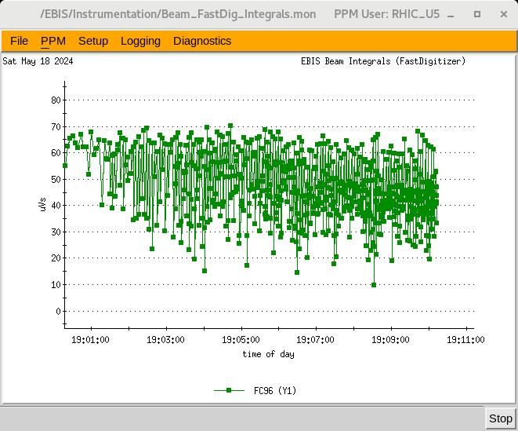
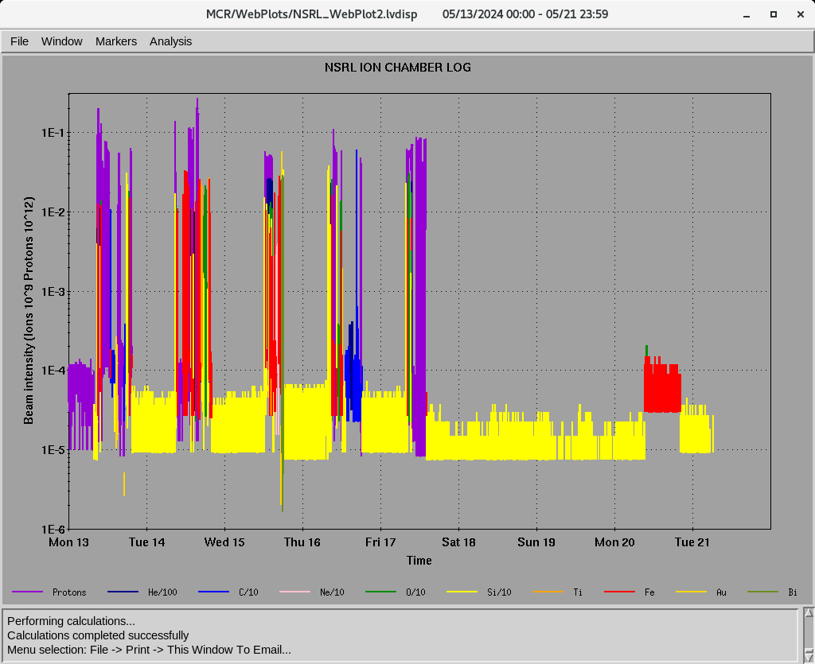
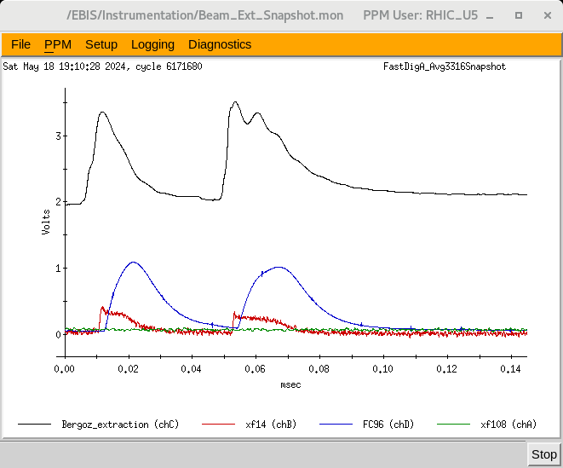
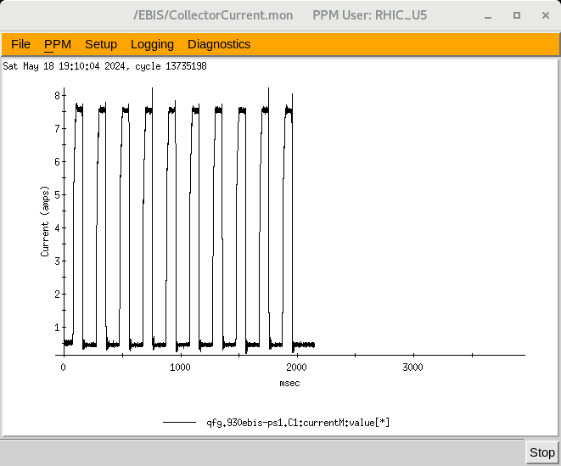
EBIS
Au development for RHIC
12 pulses at 5 Hz ,
Last week ions for NSRL : H, He⁺² ,C^{+5 ,}Ne⁺⁸, O⁺⁷,Si⁺¹¹ Ti⁺¹⁷ Fe⁺²⁰, Au⁺³², Bi⁺⁴³
16hours/day , 5 days/week
7.1 A e-current
Ion to NSRL

Slide 4
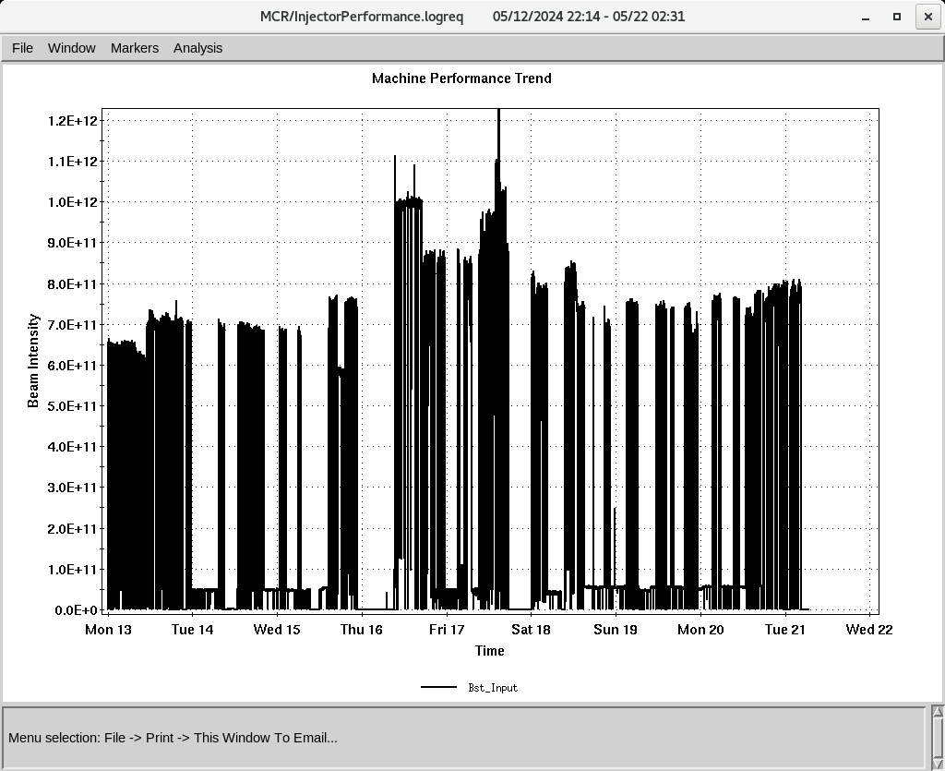
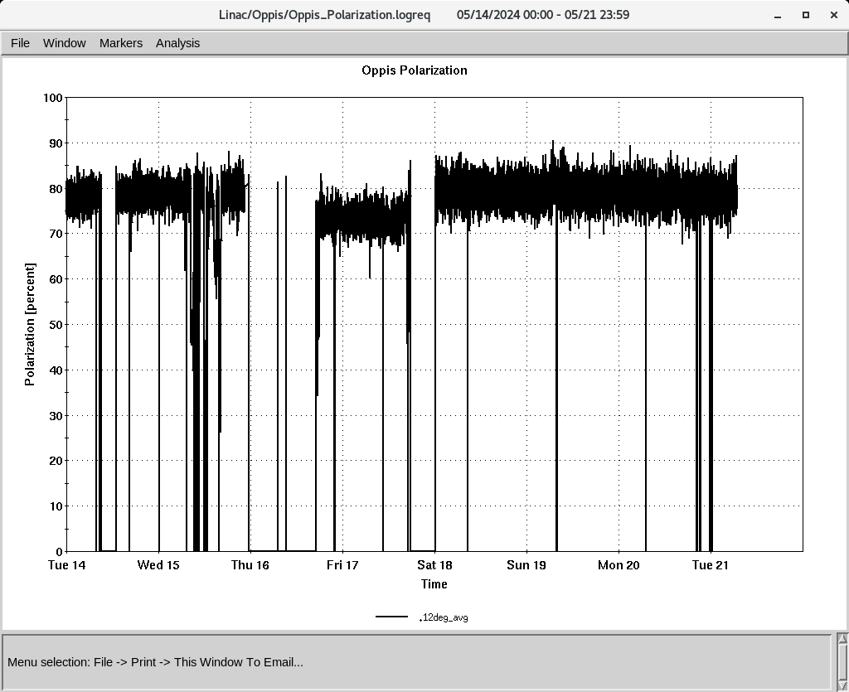
Linac 200 MeV Beam to BLIP , NSRL, Booster , AGS
BLIP
5/10-5/21: Th, 200 MeV, 150 𝞵A (extended to 4 PM)
6/3-6/14: Th, 200 MeV, 150 𝞵A
polarized H-
To Booster
Unpolarized
OPPIS
Normal current and polarization
Polarization @ 200 MeV
Down time (<18 HRS)
- RF trips and reset: RFQ, Mod 6, mod7
Mod 3 quads , mis-pulsing
Mod 2: tube change 8616 , 10:30 HRS
Mod 8: three phase monitor relay, 7 HRS

