Slide 1
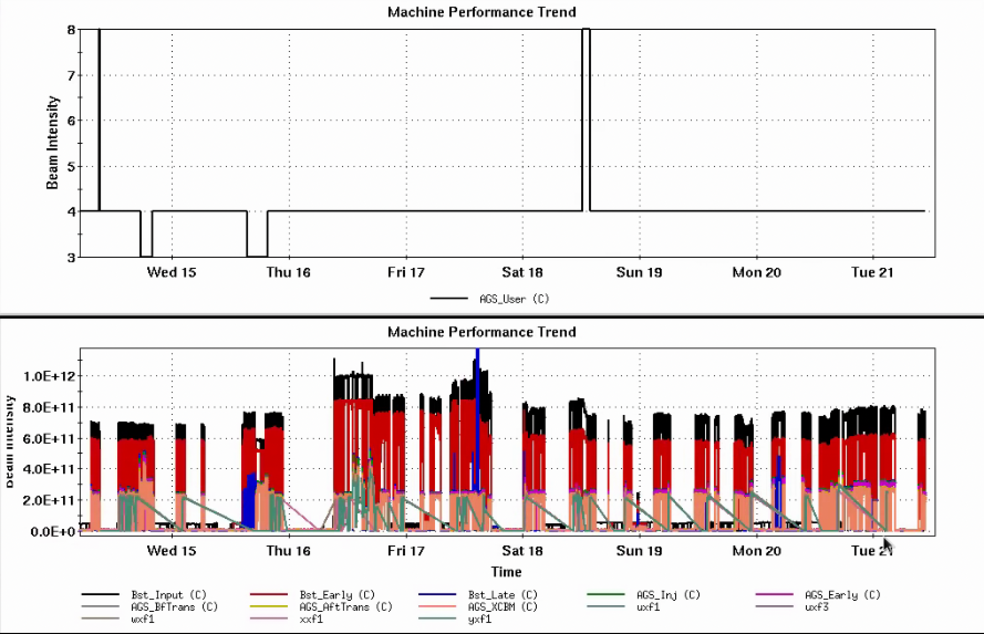
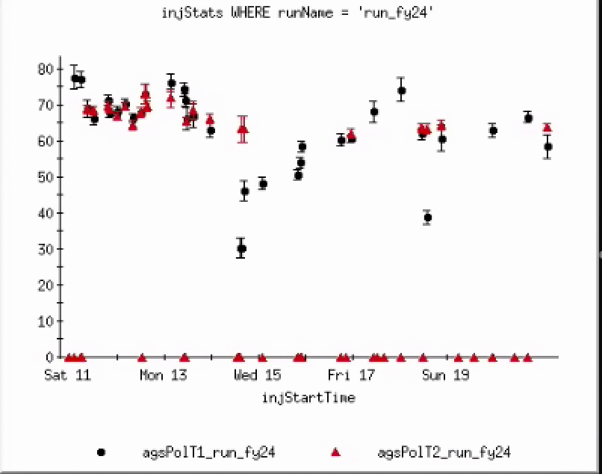
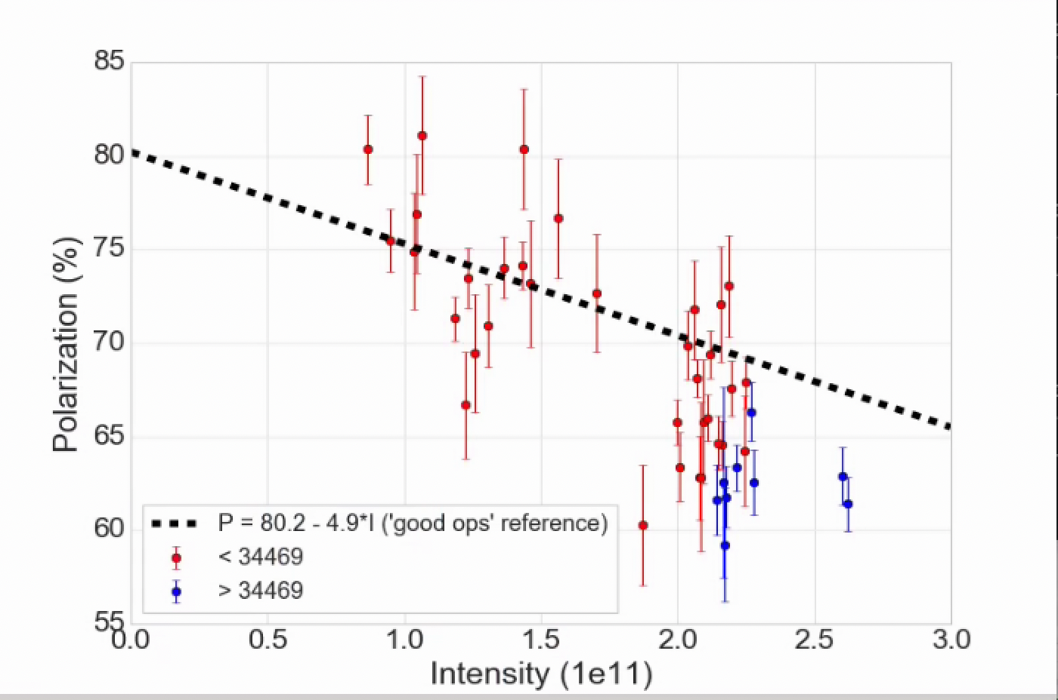
Injector Status, 5/21/24
Operations overview
Operations
RHIC Stores taking 2.6x10¹¹ AGS late
Polarization is low 60’s, even for fills closer to 2.0x10¹¹ intensity
Polarization is below a “good operating” reference line
Polarization appears not to have recovered from a drop around 5/14-15 (roughly fill 34469). Though dividing line is far from clear. Scatter in polarization in the 2-2.2x10¹¹ range is large
Tune jump effect is 9% relative (this is as expected)
AGS User
Intensity
Development
RHIC work (MD/APEX/failure) prevented most development work last week.
Current evelopment should mainly focus on standard user polarization
Linac pulse for fills is 360 us, was 300 us in previous runs. Not clear that longer pulse is best for figure of merit.
AGS Pol by Fill
AGS Pol by Intensity (for fills)

