Slide 1
APEX Report
May 21, 2024

Slide 2
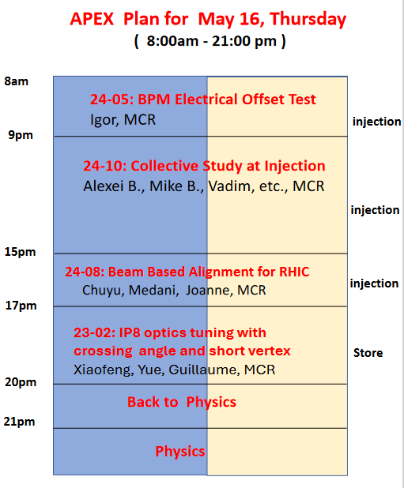
1 hr
6 hr
We started APEX around 10:30am. We got bema back at 21pm to physics.
skipped
3 hr

Slide 3
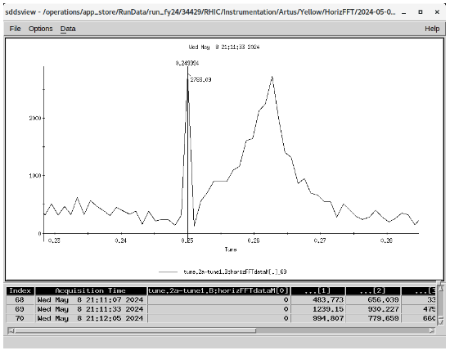
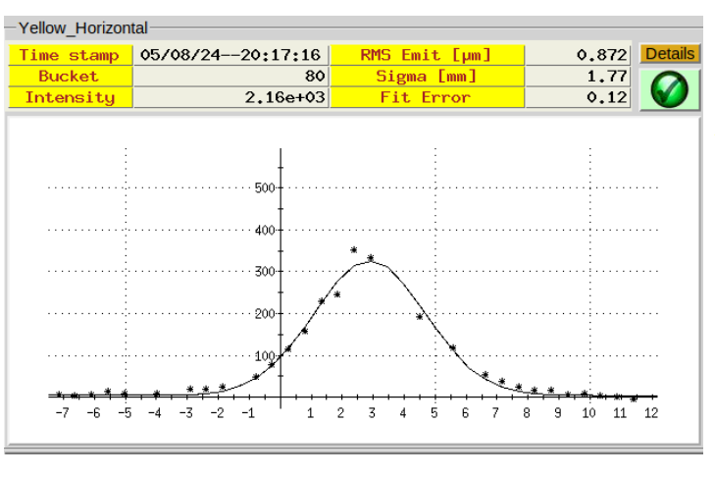
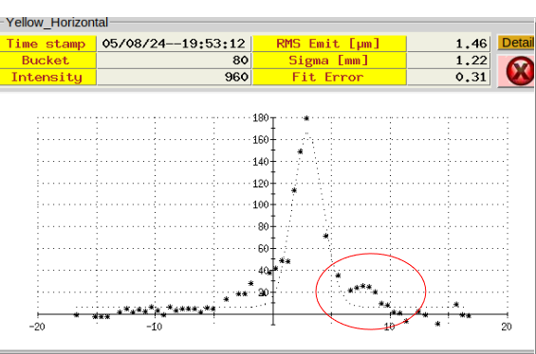
FFT of kicked bunch
From May 5 session
Slowing increasing horizontal tune to 0.75 for create 4th order resonance islands.

Slide 4
Measurement of the BPM Electrical Center: Igor

Slide 5
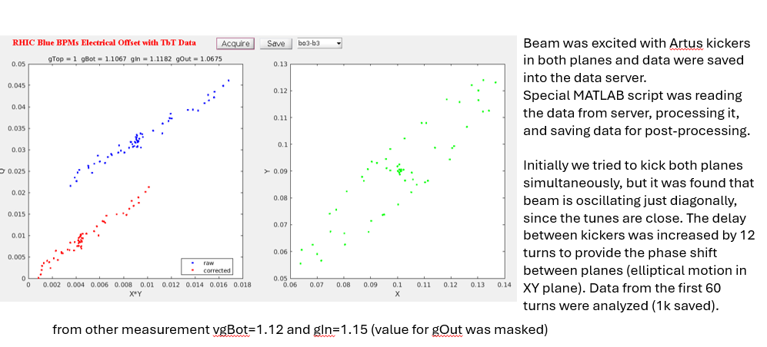
The measurements were performed with both yellow and blue rings
We need more thorough study on the delay between kickers
The data will be re-processed, and analyses optimized (number of turns to process)
We can take another 1-hour slot during next APEX session

Slide 6
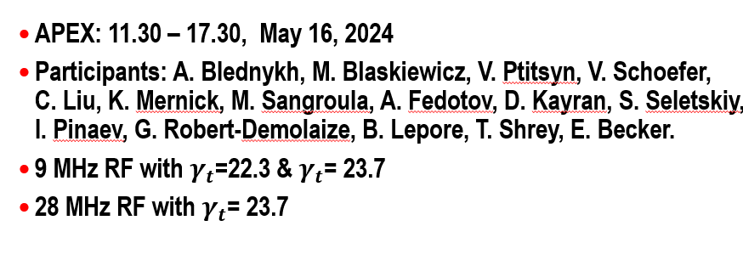
APEX Collective Effects Studies in RHIC: Alexei B.

Slide 8
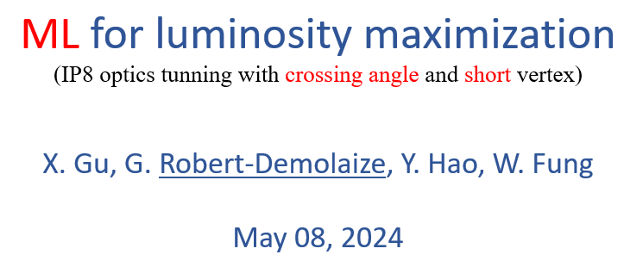

Slide 10
Proposed to defer May 29 session to June 6:

