Slide 1
Preinjectors Status
D. Raparia
Time Meeting
May 28, 2024

Slide 2
Tandem
External Users :
- Last week: No user , Operator training
- This week: Heated wafer production run postpone to next week

Slide 3
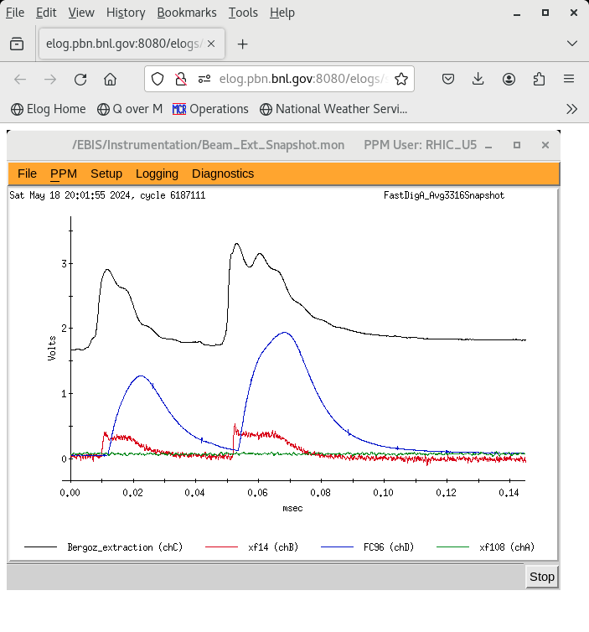
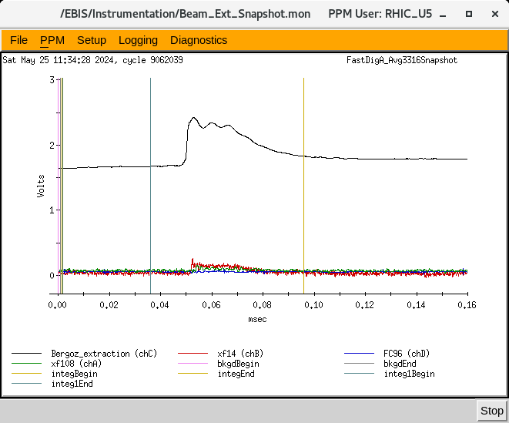
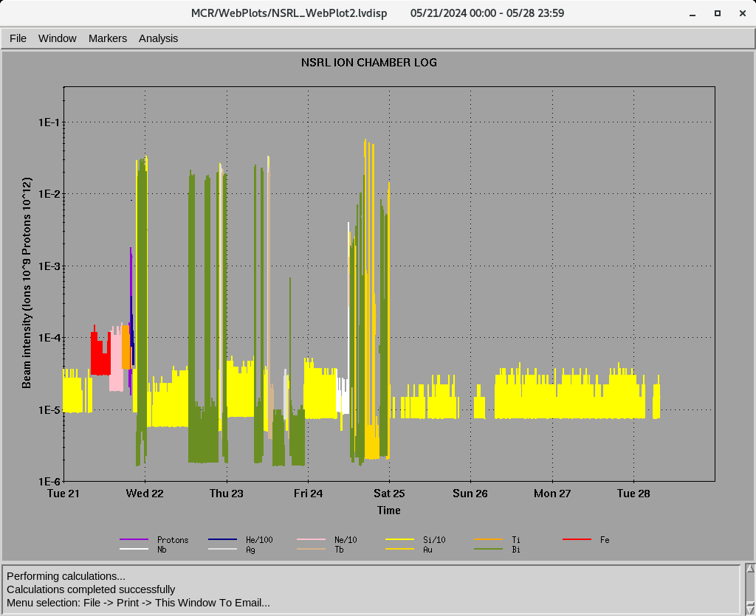
EBIS
Au development for RHIC
- Short Trap Behlke 8 was not firing. Beam was tuned only from the long trap
- Bob Schoepfer replacing the Behlke 8
Last week ions for NSRL : H, He⁺² ,Ne⁺⁸,Si⁺¹¹ Ti⁺¹⁷ Fe⁺²⁰, Nb⁺²³, Ag⁺²⁹ , Tb⁺³⁵, Au⁺³², Bi⁺⁴³
16hours/day , 5 days/week
5/18/24
5/24/24
Ion to NSRL

Slide 4
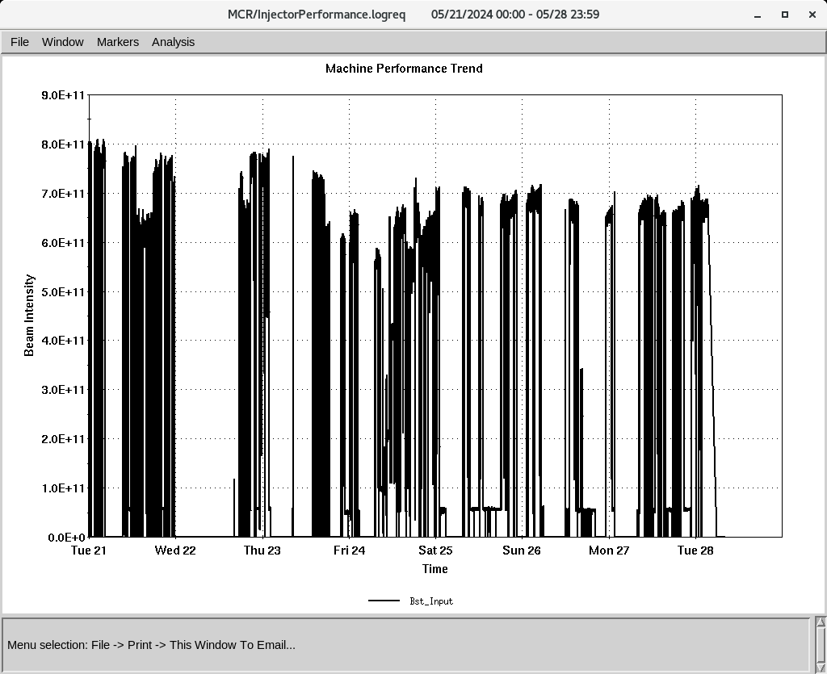
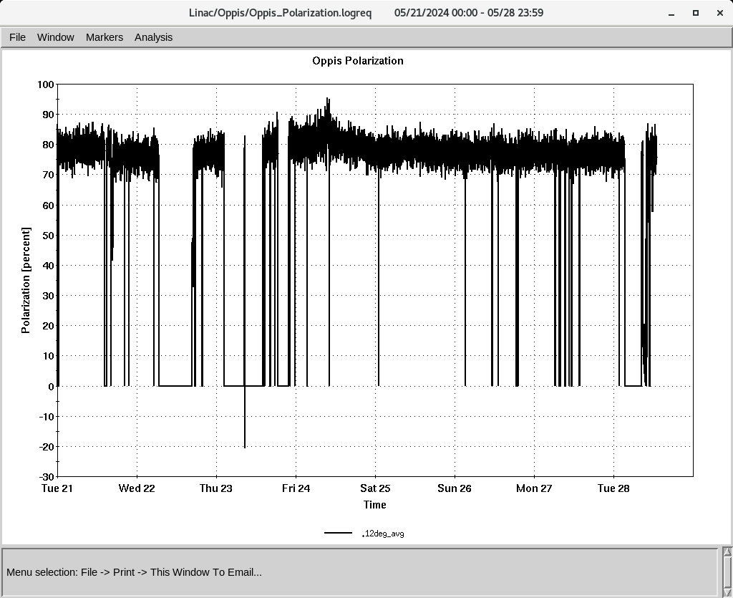
Linac 200 MeV Beam to BLIP , NSRL, Booster
BLIP
5/10-5/21: Th, 200 MeV, 150 𝞵A (was extended to 4 PM)
6/3-6/14: Th, 200 MeV, 150 𝞵A
polarized H-
To Booster
OPPIS
Normal current and polarization
Added Rb on Friday
H-Jet: lost turbo Pump
Warm up , started and will finish by tomorrow morning
- Turbo change by vacuum group : 5-6 HRS
Polarization @ 200 MeV
Polarization @ 200 MeV
Down time (<10 HRS)
- RF trips and reset: RFQ, Mod 5, mod2
Mod 6: LLRF , 1 HRS
Mod 7: Breaker reset ( 3 HRS)
Mod 7: Jenning relay replaced (3.5 HRS)

