Slide 1
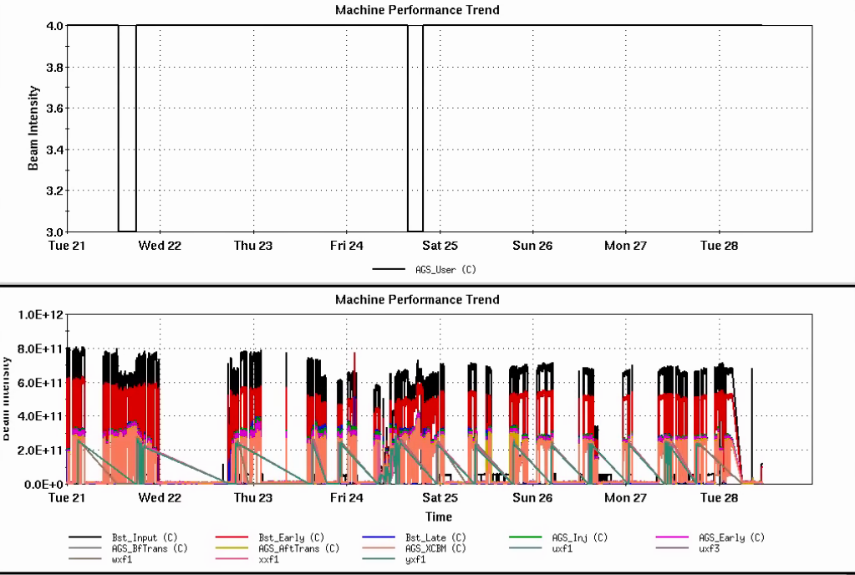
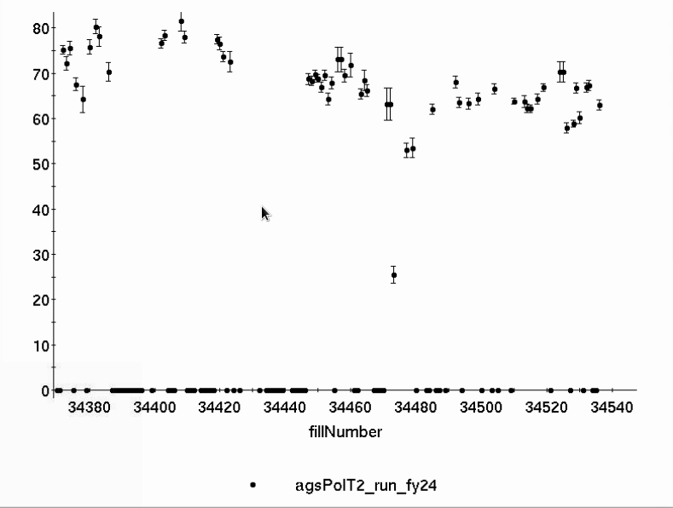
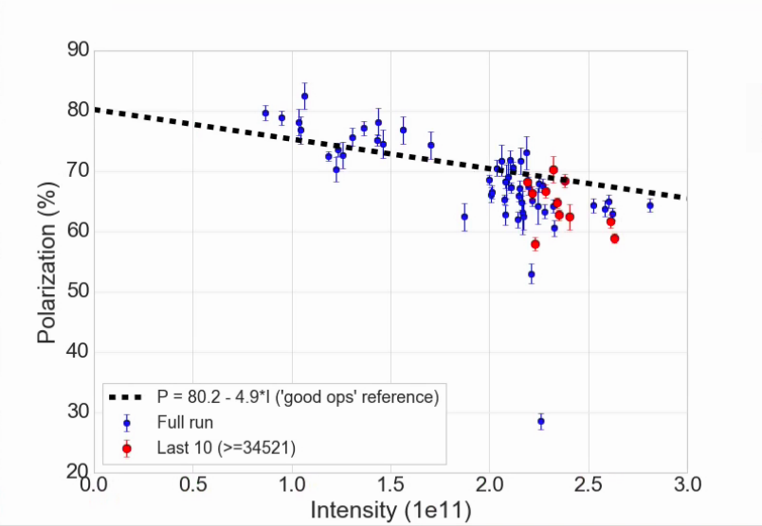
Injector Status, 5/28/24
Operations overview
Operations
RHIC Stores taking 2.2-2.4x10¹¹ AGS late
Polarization is mid 60’s. Slightly closer to ‘good reference line than last week)
Tune jump effect is ~10% relative (this is as expected)
Power Dip last night:
Cold snake lost inventory, but can remain cold at zero current
Upolarized beam development possible, requires setup in AGS
AGS User
Intensity
AGS Pol by Fill
AGS Pol by Intensity (for fills)
Development
Mainly focused on reviewing the AGS configuration/performance (see next slides)
(not a fit)

Slide 2
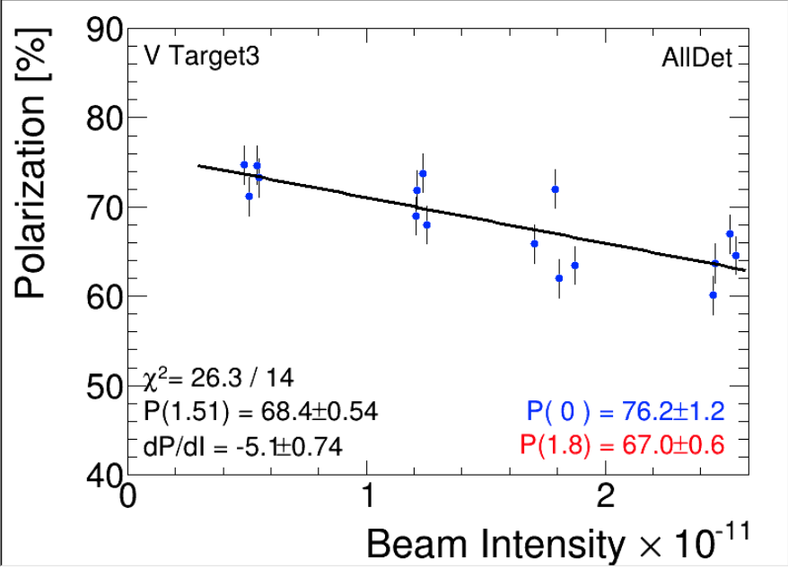
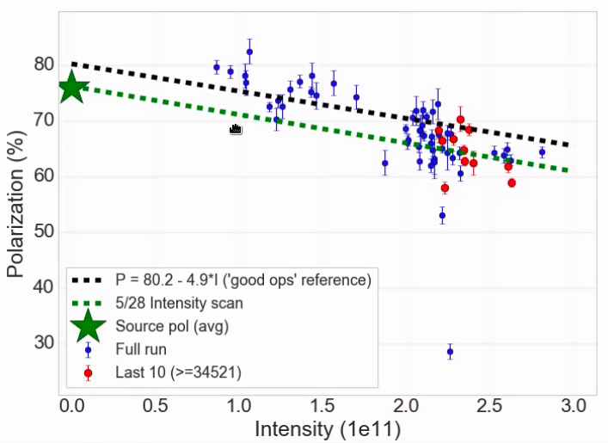
AGS Intensity scan
Adjust AGS extraction intensity with vertical scraping in Booster (fixed Linac output ~6.7e11), measure polarization
Slope -5.1 %/1x10¹¹ very consistent with previous run nominal operation: transmission in AGS ok
Projected zero intensity polarization consistent with measured avg source polarization
Overlaid on the “polarization for fill” plots, very consistent with recent performance

Slide 3
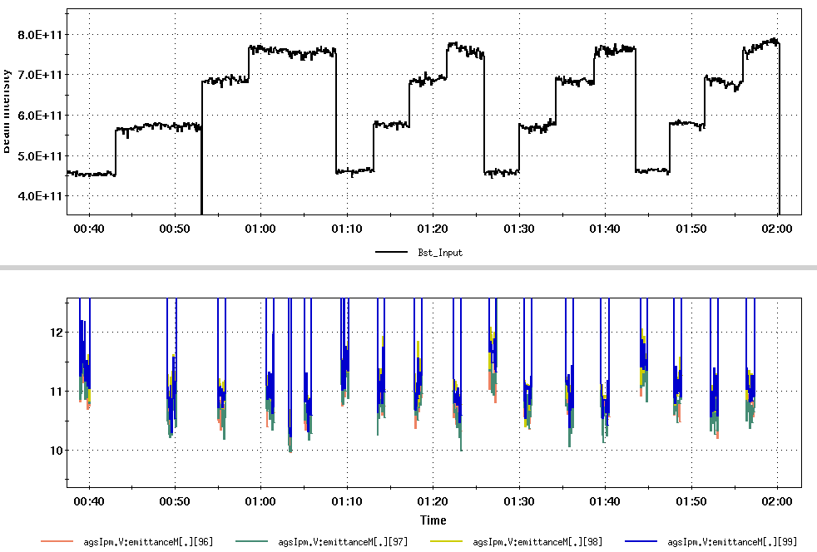
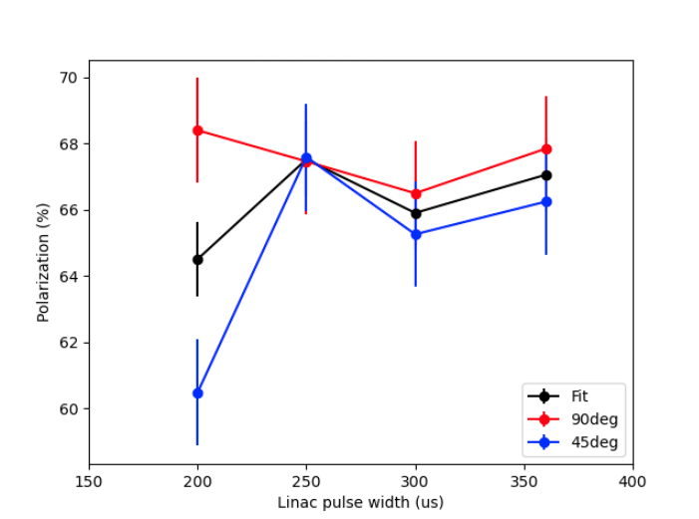
Linac Pulse width study
Vary Booster input via pulse width (take varying beam from Linac)
Scrape transversely to same AGS output (2.5e11)
Measure emittance and polarization
Results
Emittance in AGS constant over a very large range of input (scraping). A clue: Implies emittance blowup in AGS --> can study space charge effects: injection tunes, optimization of RF defocusing etc).
Polarization also constant over broad range
At lowest input intensity: not understood noise in the 45 deg detectors.
Study important for both luminosity and polarization optimization
Booster input
AGS V emit
AGS Pol (%)

Slide 4
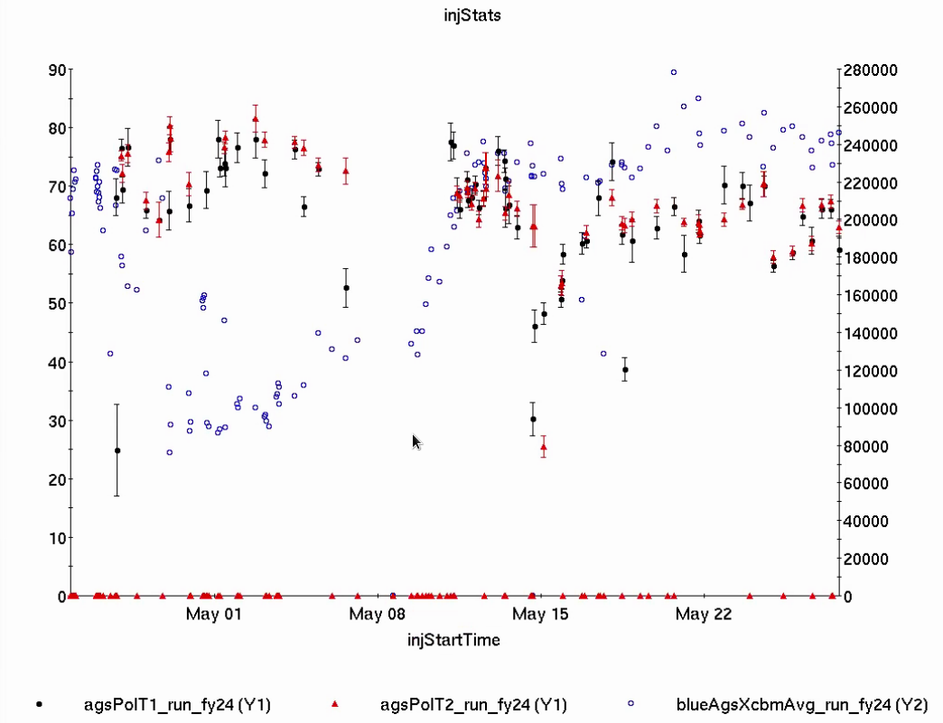
AGS Polarization in Run 24
Two periods of abrupt step down in polarization 5/14, 5/24
Causes not clear: No obvious equipment differences
K. Zeno tracking down noisy tune supply signals (noisy periods correlate with beam losses)
Ops recording more ‘reference’ data (tunes at resonance,etc)
More systematic control of Booster input (7e11, 300 us every fill)
Polarization (%)
Intensity (1e6)
Step down, slow recovery

Slide 5
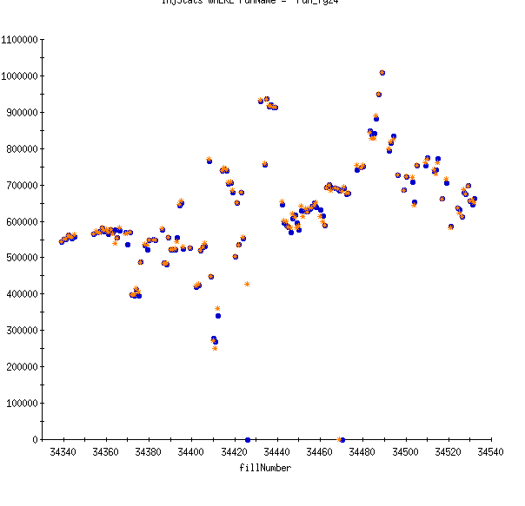
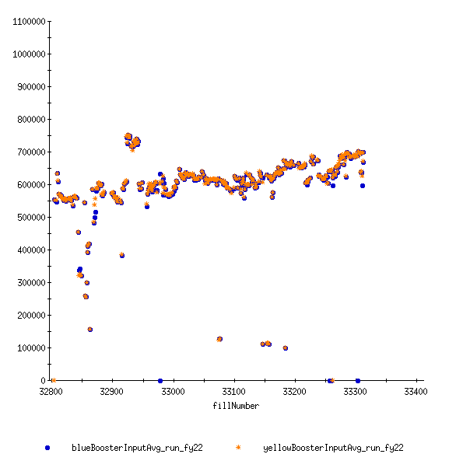
Booster input stability
Booster input
Downstream performance heavily determined by Booster injection, early acceleration
Stable, incremental changes necessary for optimization of both emittance and polarization
Run 24
Run 22

Slide 6
Conclusions
AGS transmission efficiency for intensity and polarization is consistent with historical performance provided:
Stable inputs
No non-understood ‘lurches’
Going forward:
Optimizing pulse width/scraping recipe for emittance (and polarization)
Can we make use of the extended 360 us pulse?
Investigate AGS emittance behavior at injection energy
So far in Run 24 ~80% of AGS time used for standard setup, 20% for development of new configurations (mostly earlier in the run, very little in the last 2-3 weeks
Developments should resume: dual pulse Linac (for luminosity and polarization), skew quad resonance correction (reduce emittance dependent depolarization).

