Slide 1
Brookhaven National Laboratory Collider Accelerator Dept 5.28.2024 TIME MEETING CRYOGENICS
R. Feder, R. Than

Slide 2
5/22 Maintenance Day:
Helium leak checking continues
Corrector flow thermistors calibration: sector 6 and sector 12
AGS Coldsnake helium liquefaction during day (powered down)
5/23 56MHZ MPS interlock trip: High damper temperature: ➔Cryostat Insulating vacuum: Turbo tripped
5/23 QLI Yellow-6 ROTATOR
SPHENIX LN2 dewar Insulating vacuum
5/28: 2:30 AM Liquid Helium delivery
5/28: 3:00 AM Power Outage: AGS Cold snake off-line 3.5 hours
Loss all inventory ➔ LHe delivery tomorrow.

Slide 3
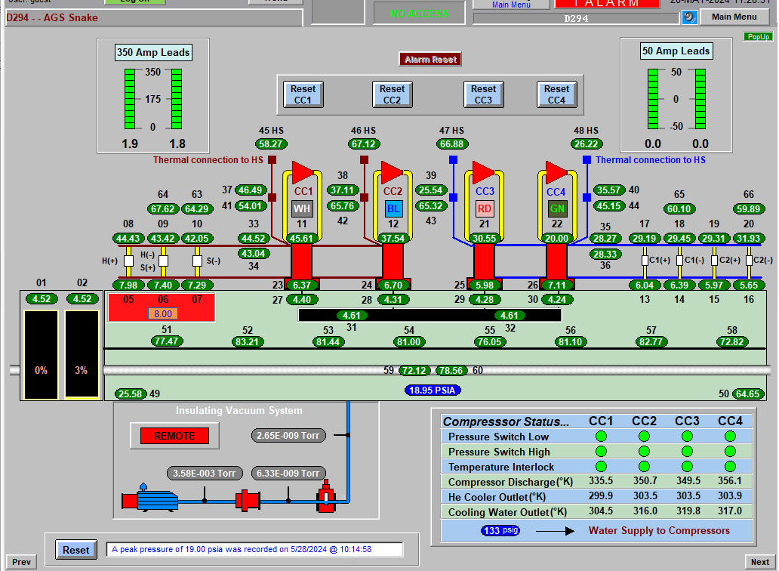
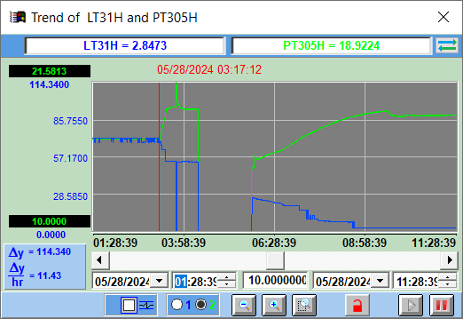
UPS
empty

