Slide 1
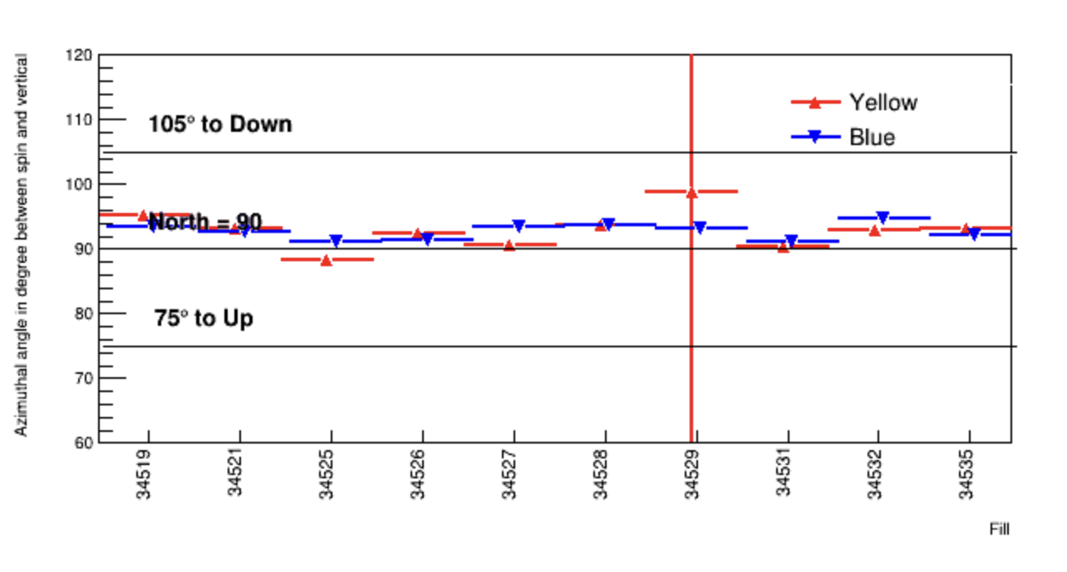
STAR Weekly Time Report, 05/21 – 05/27 Zilong Chang (CEEM, Indiana University)
High luminosity data taking with radially polarized beams
Smooth STAR operation, ~ 18 hours a day last weekend
ZDC local polarimetry shows the beam polarization direction < $5^{°}$within the horizonal axis

Slide 2
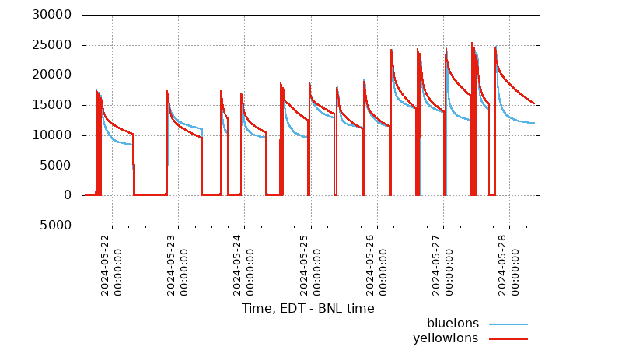
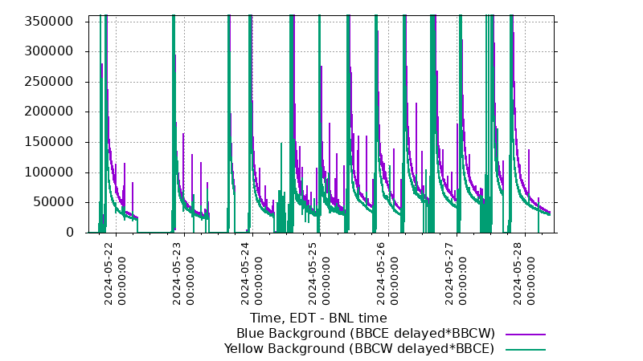
Beam conditions
Significant ion loss for blue beam
More blue bkg.
New collimator setting
Poor lifetime for blue beam at the beginning of the store
Blue beam background improved with new collimator setting, but recently it has become worse
Blue beam is important because STAR forward detector are seeing it, forward physics is a key component of STAR physics program

Slide 3
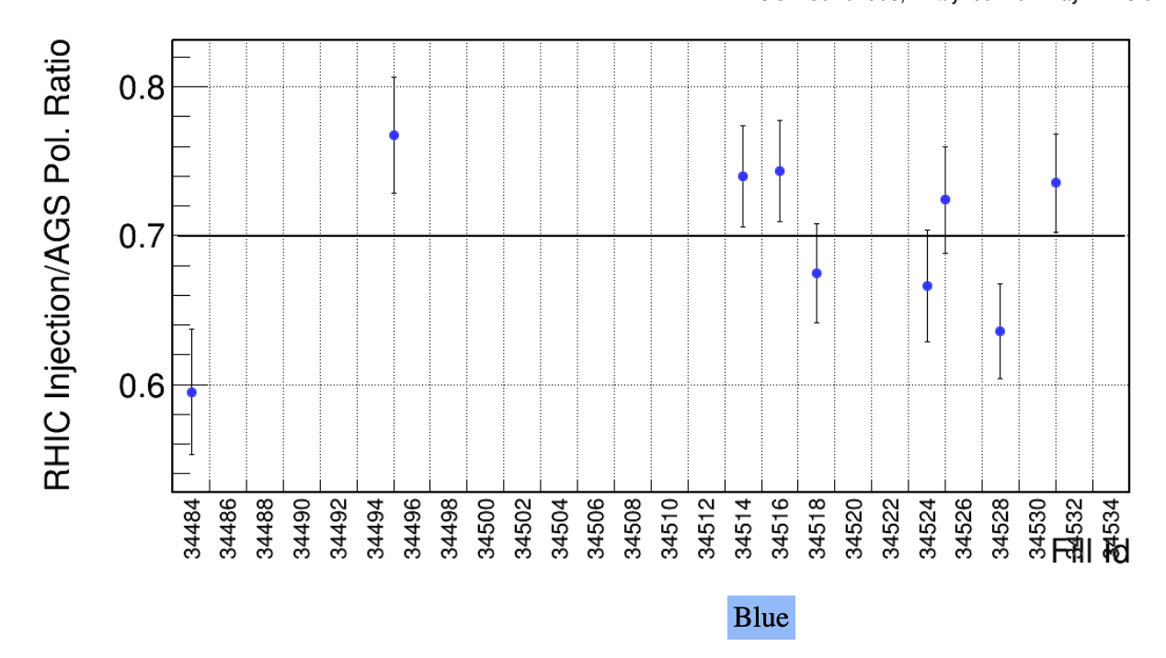
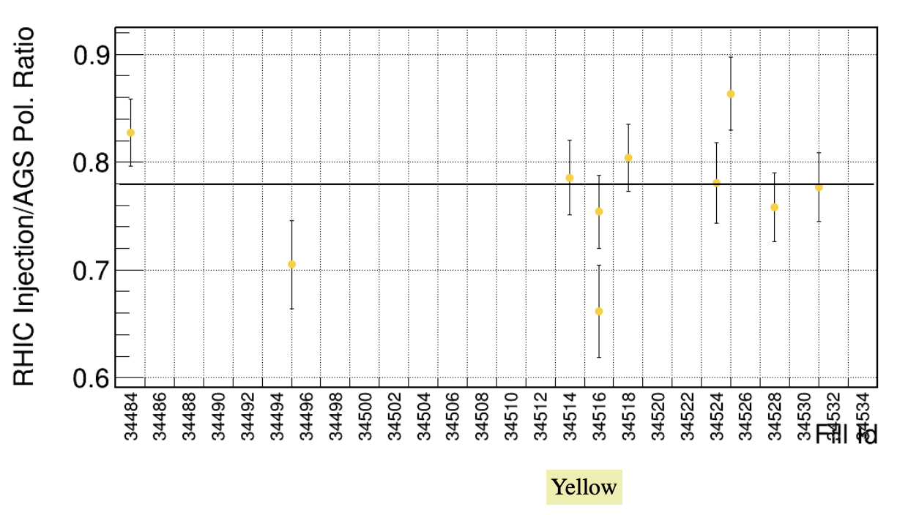
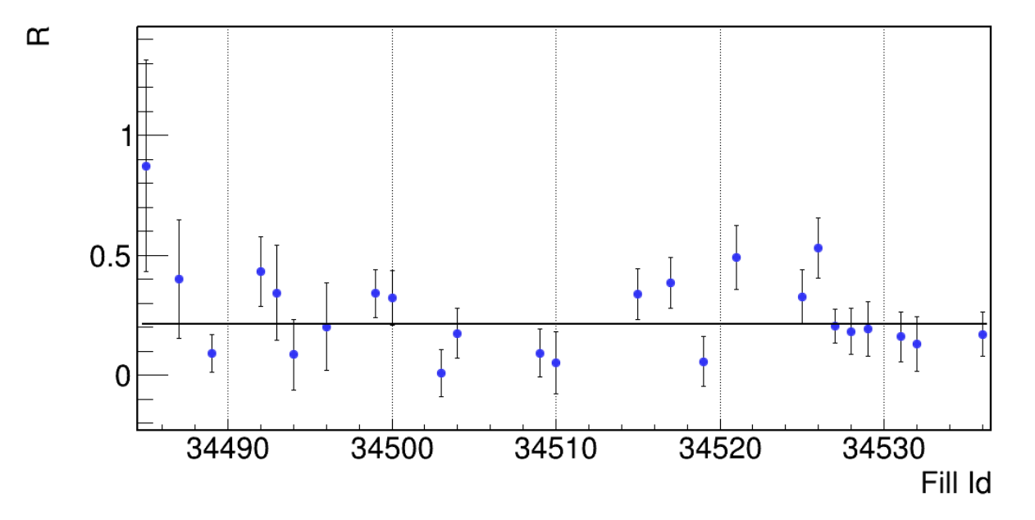
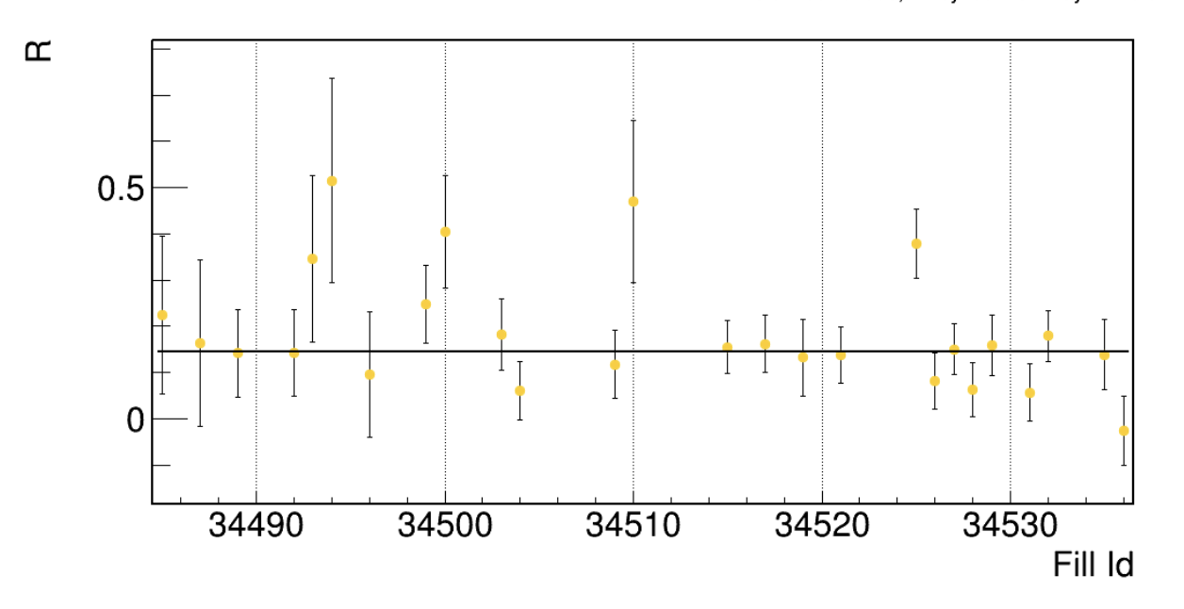
Beam polarizations
Polarization transfer efficiency from AGS to RHIC injection, normally > 80% for previous years
Beam polarization measurements by H-jet at IP12
Blue: 38%
Yellow: 43%
70%
Yellow improves recently
Polarization profile: $P=P_{0}{I(x,y)}^{R}$, where $I(x,y)$ is beam intensity in the transverse plane
$R=0$ means polarization is uniformly distributed across the beam
78%
Blue: R=0.21
Yellow: R=0.15
Energy ramp efficiency: > 90%; rotator ramp efficiency: ~100%;
from pC polarimetry at IP12
At $E_{beam}=254$ GeV from run22, R ~ 0.15, at $E_{beam}=100$ GeV from run15, R ~ 0.1

Slide 4
Outlook
Goal: Luminosity = 170 1/pb and Figure of Merit (FoM = P²L) = 55 1/pb assuming 57% polarization quoted from CAD
At current pace, we would fall well short our goals, 1/3 of Luminosity and 1/5 of FoM
We are already in the ~4 weeks normally reserved for ramping up the collider
Mid-rapidity high energy jet events (JP2)
Forward-rapidity high electro-magnetic energy events
Luminosity
FoM, $P_{Blue}^{2}L$
STAR recommend to concentrate on polarization too, given FoM

