Slide 1
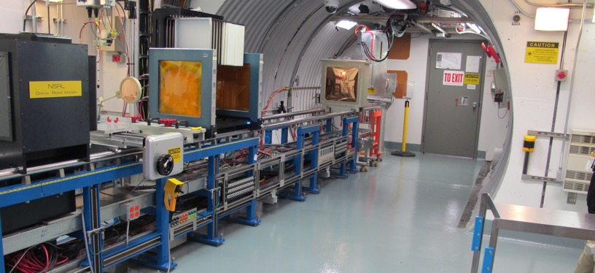
NSRL Time Meeting Report
28 May 2024
Michael Sivertz

Slide 2
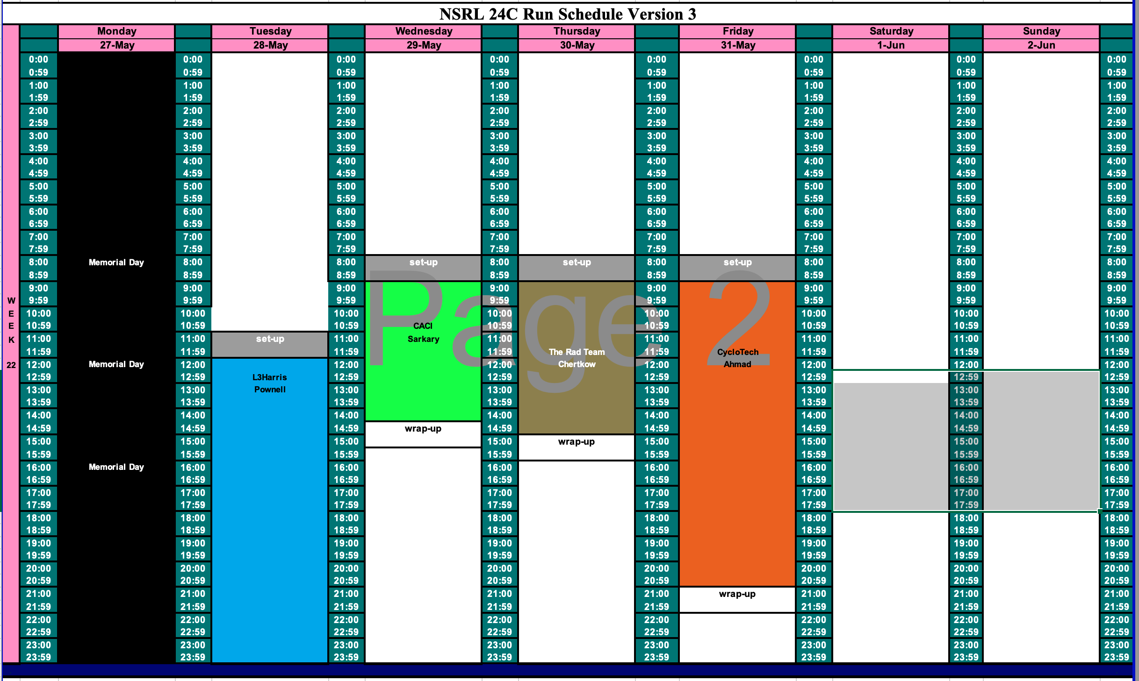
Schedule for this week

Slide 3
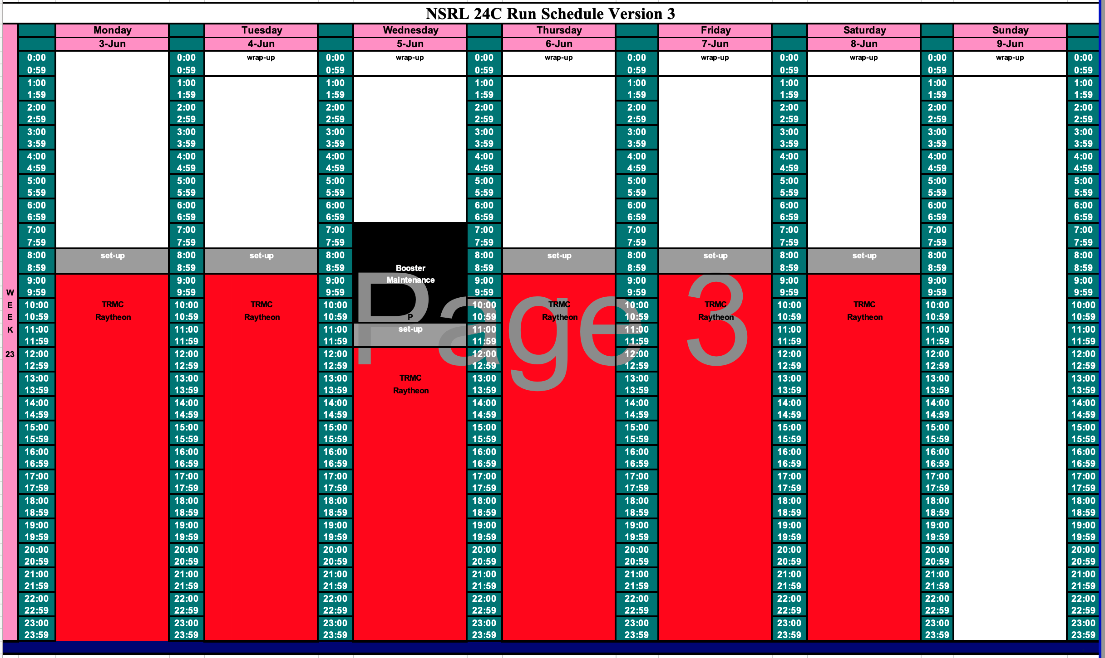
Schedule for next week

Slide 4
Future Schedule
Work on Thursday for The Rad Team is scheduled for 6 hours but will likely run late.
TRMC/MDA begins next week with 16-hour days running 6-days a week.

