Slide 1
Preinjectors Status
D. Raparia
Time Meeting
June 04, 2024

Slide 2
Tandem
External Users :
- Last week: No user , MP 7 open for maintenance
Heated wafer issues, send back for investigation
- This week: No user

Slide 3
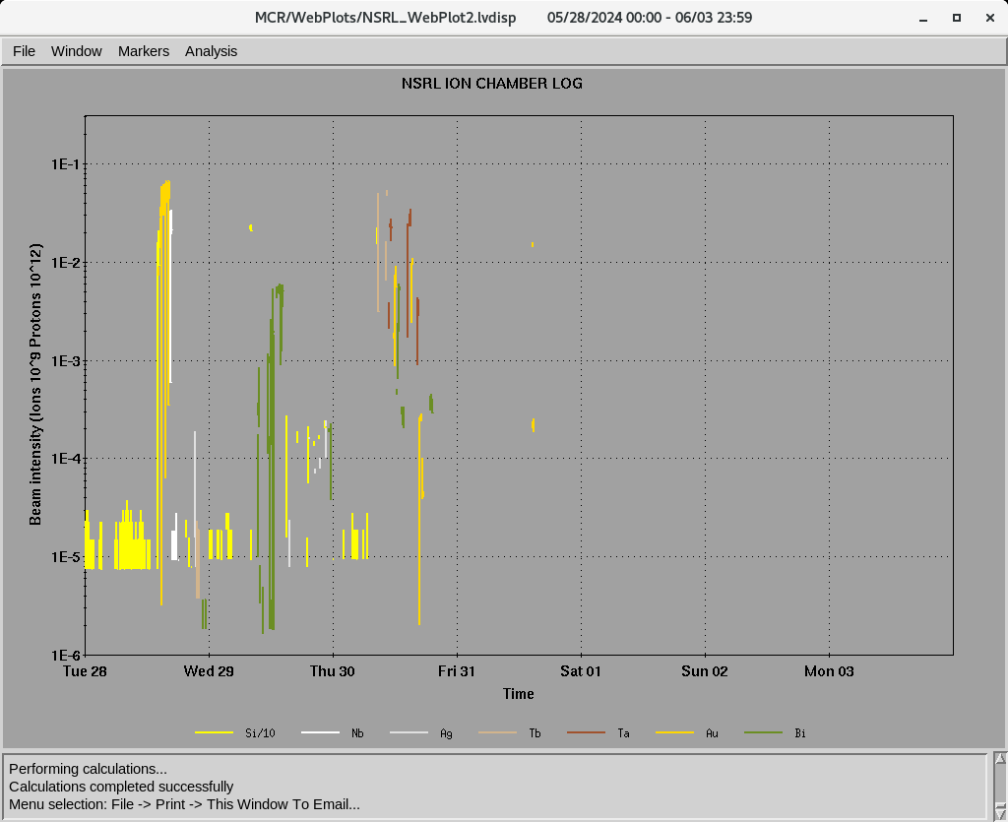
EBIS
Au development for RHIC
- Power dip on Friday caused EBIS linac down
- Still investigation continue
Last week ions for NSRL : Si⁺¹¹ Nb⁺²³, Ag⁺²⁹ , Tb⁺³⁵, Ta⁺³⁸ Au⁺³², Bi⁺⁴³
16hours/day , 5 days/week
Ion to NSRL

Slide 4
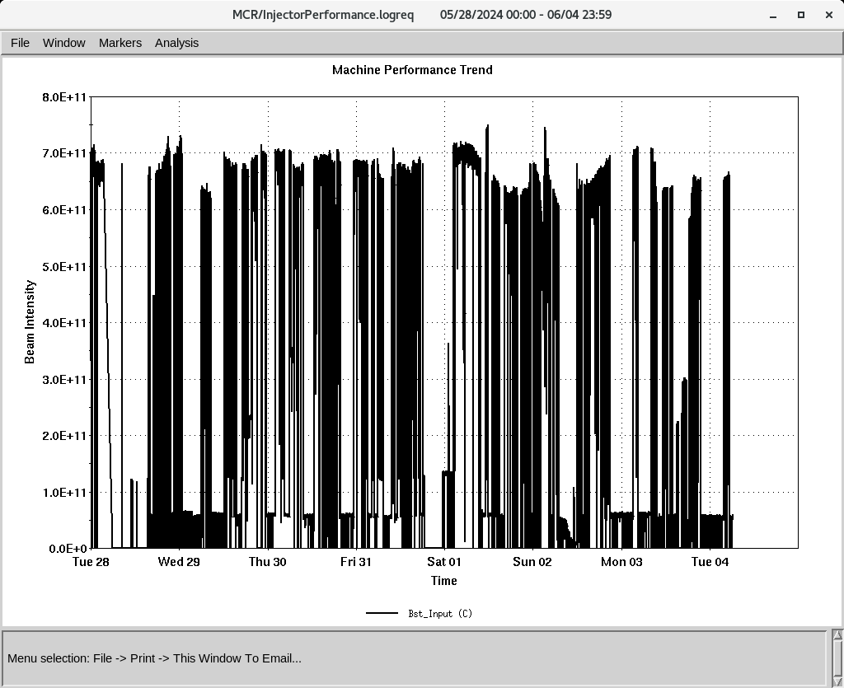
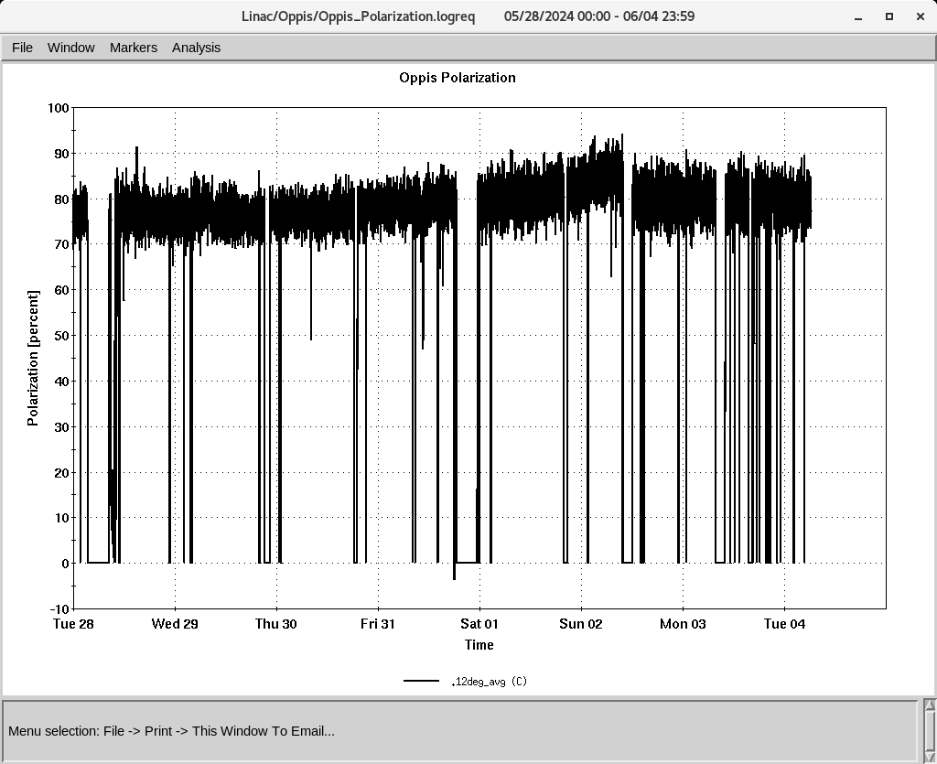
Linac
200 MeV Beam to BLIP , NSRL, Booster
BLIP
6/3-6/14: Th, 200 MeV, 150 𝞵A
polarized H-
To Booster
OPPIS
Normal current and polarization, (conditioning)
Added Rb on Sunday
Down time (<8 HRS)
- Power dip , (6 HRS )
source 1 changed source 2
- RF trips and reset: RFQ, Mod 5, mod2
Tank3, Q33,Q35,Q36 needed may adjustments
RF Mod 3: Frequent mis-pulsing need attention
Polarization @ 200 MeV

