Slide 1
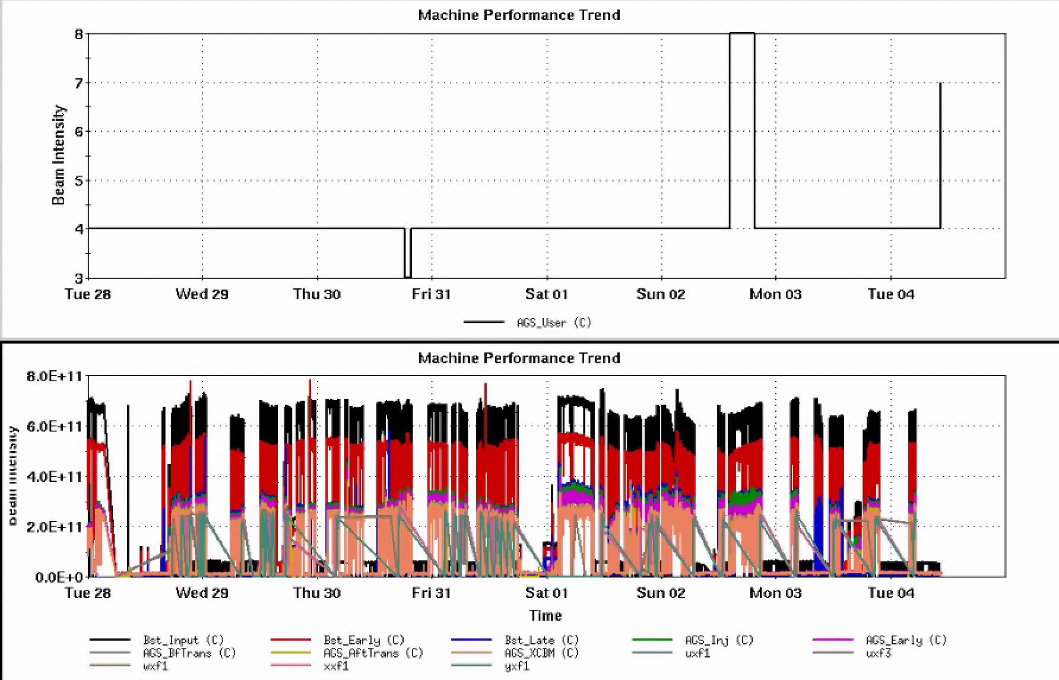
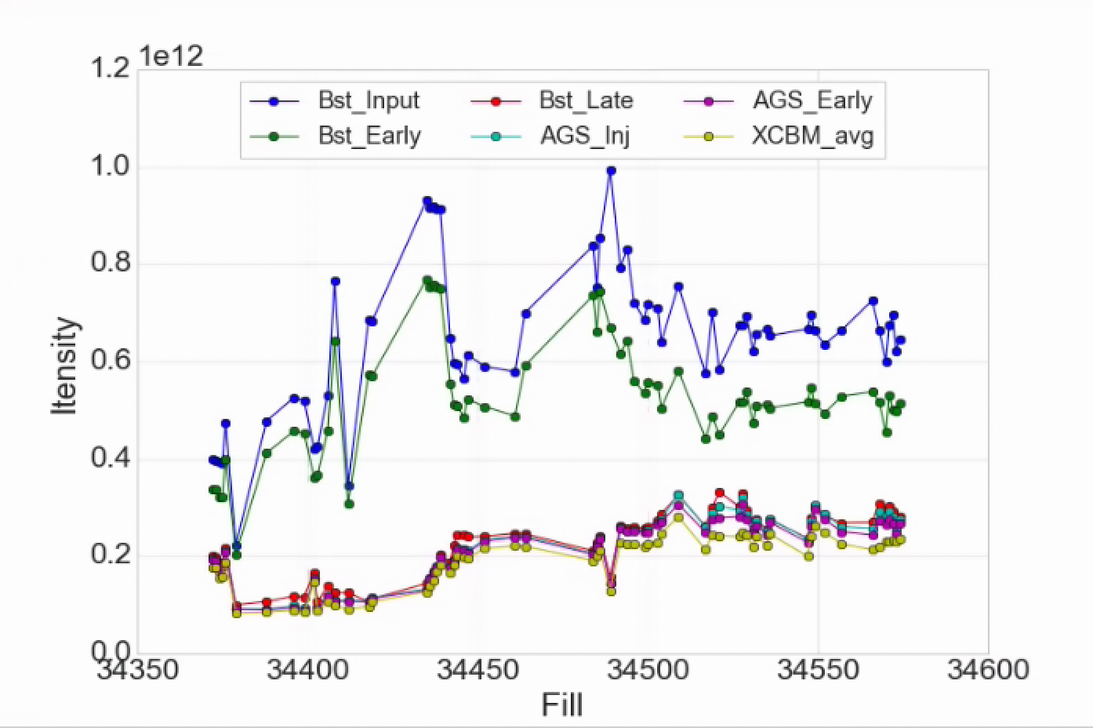
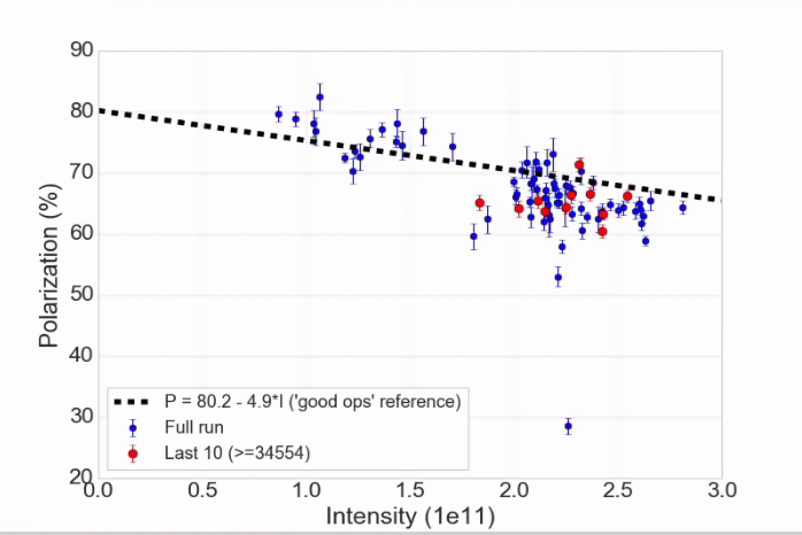
Injector Status, 6/4/24
Operations overview
Operations
RHIC Stores taking 2.2-2.4x10¹¹ AGS late
Polarization just under ‘good performance’ reference
Likely a combination of a few points from source and AGS emittance
Source intensity stability improved
Helps injector development
AGS cold snake: increased helium consumption since power dip last week
Ramping down whenever AGS idle
Developments still permitted
AGS User
Intensity
Development
Polarization development on user 8, 1 shift (skew quad resonance correction)
Helium setup beginning for polarimetry APEX later in the month (user 7)
AGS Pol by Fill
AGS Pol by Intensity (for fills)
(not a fit)

Slide 2
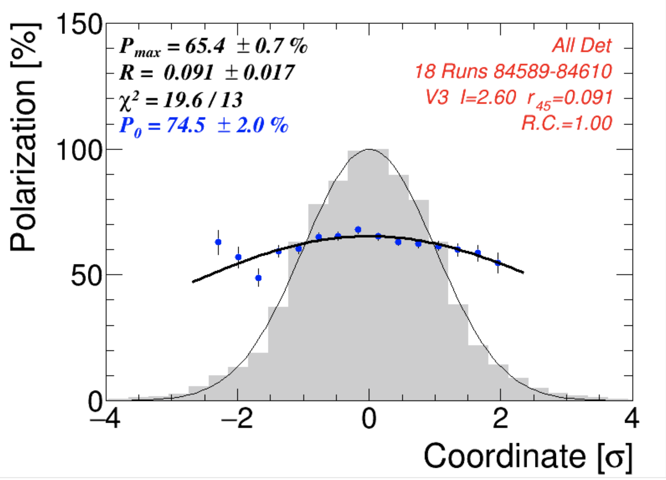
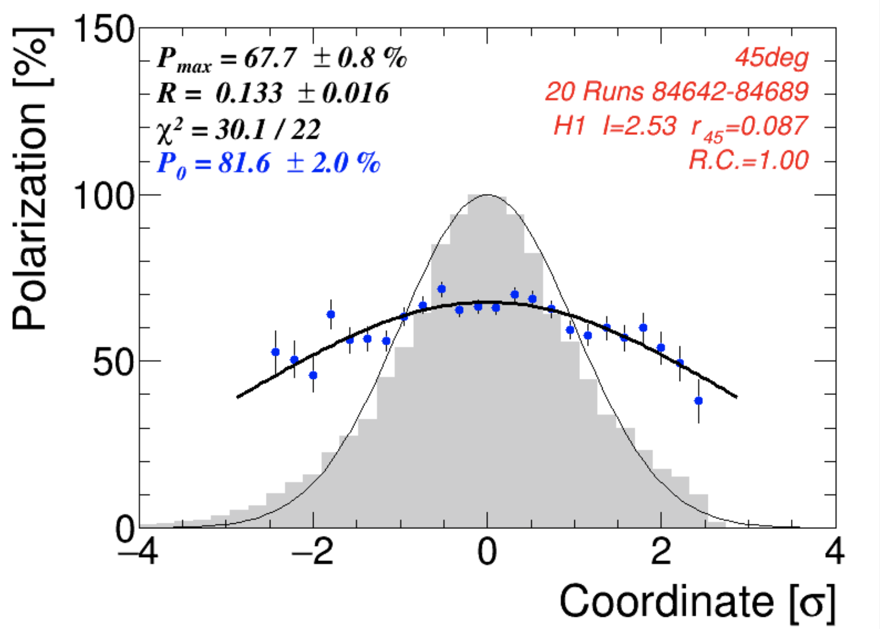
AGS polarization profiles
Horizontal
Profiles near normal
Vertical maybe slightly steeper than optimal (0.1)
Operations taking a detailed look at the tune supply function, behavior of readbacks
Careful adjustments near major resonances
Vertical

