Slide 1
sPHENIX status
Kin Yip
sPHENIX Director of Operations
Time meeting
June 4, 2024

Slide 2
Status of sPHENIX: Physics Running
Global Timing Module/Global Level 1 has been upgraded to firmware v66. This fixes the live/scaler trigger vectors that are now available and verified to work.
  This finally allows us to reliably put in various trigger mixes in data taking that we can easily identify in data reconstruction.
The TPC group have continued to work towards a set of sustainable working points, including High Voltages and temperature/dew-points.
Detector groups (esp. TPC and MVTX) are all trying to cope with and understand the beam backgrounds. E.g. the beam may contribute to the sparking in TPC. This is why we asked for single-beam to study the beam effects on TPC and MVTX.

Slide 3
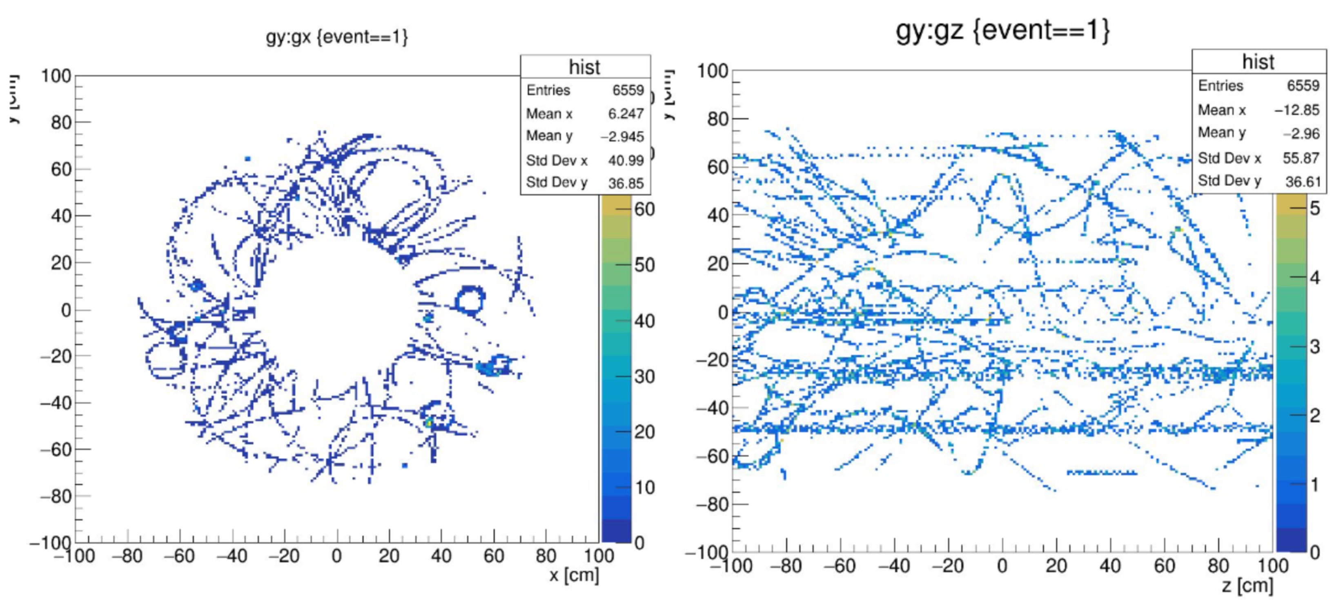
TPC dimensions and backgrounds
Horizontal tracks in TPC

Slide 4
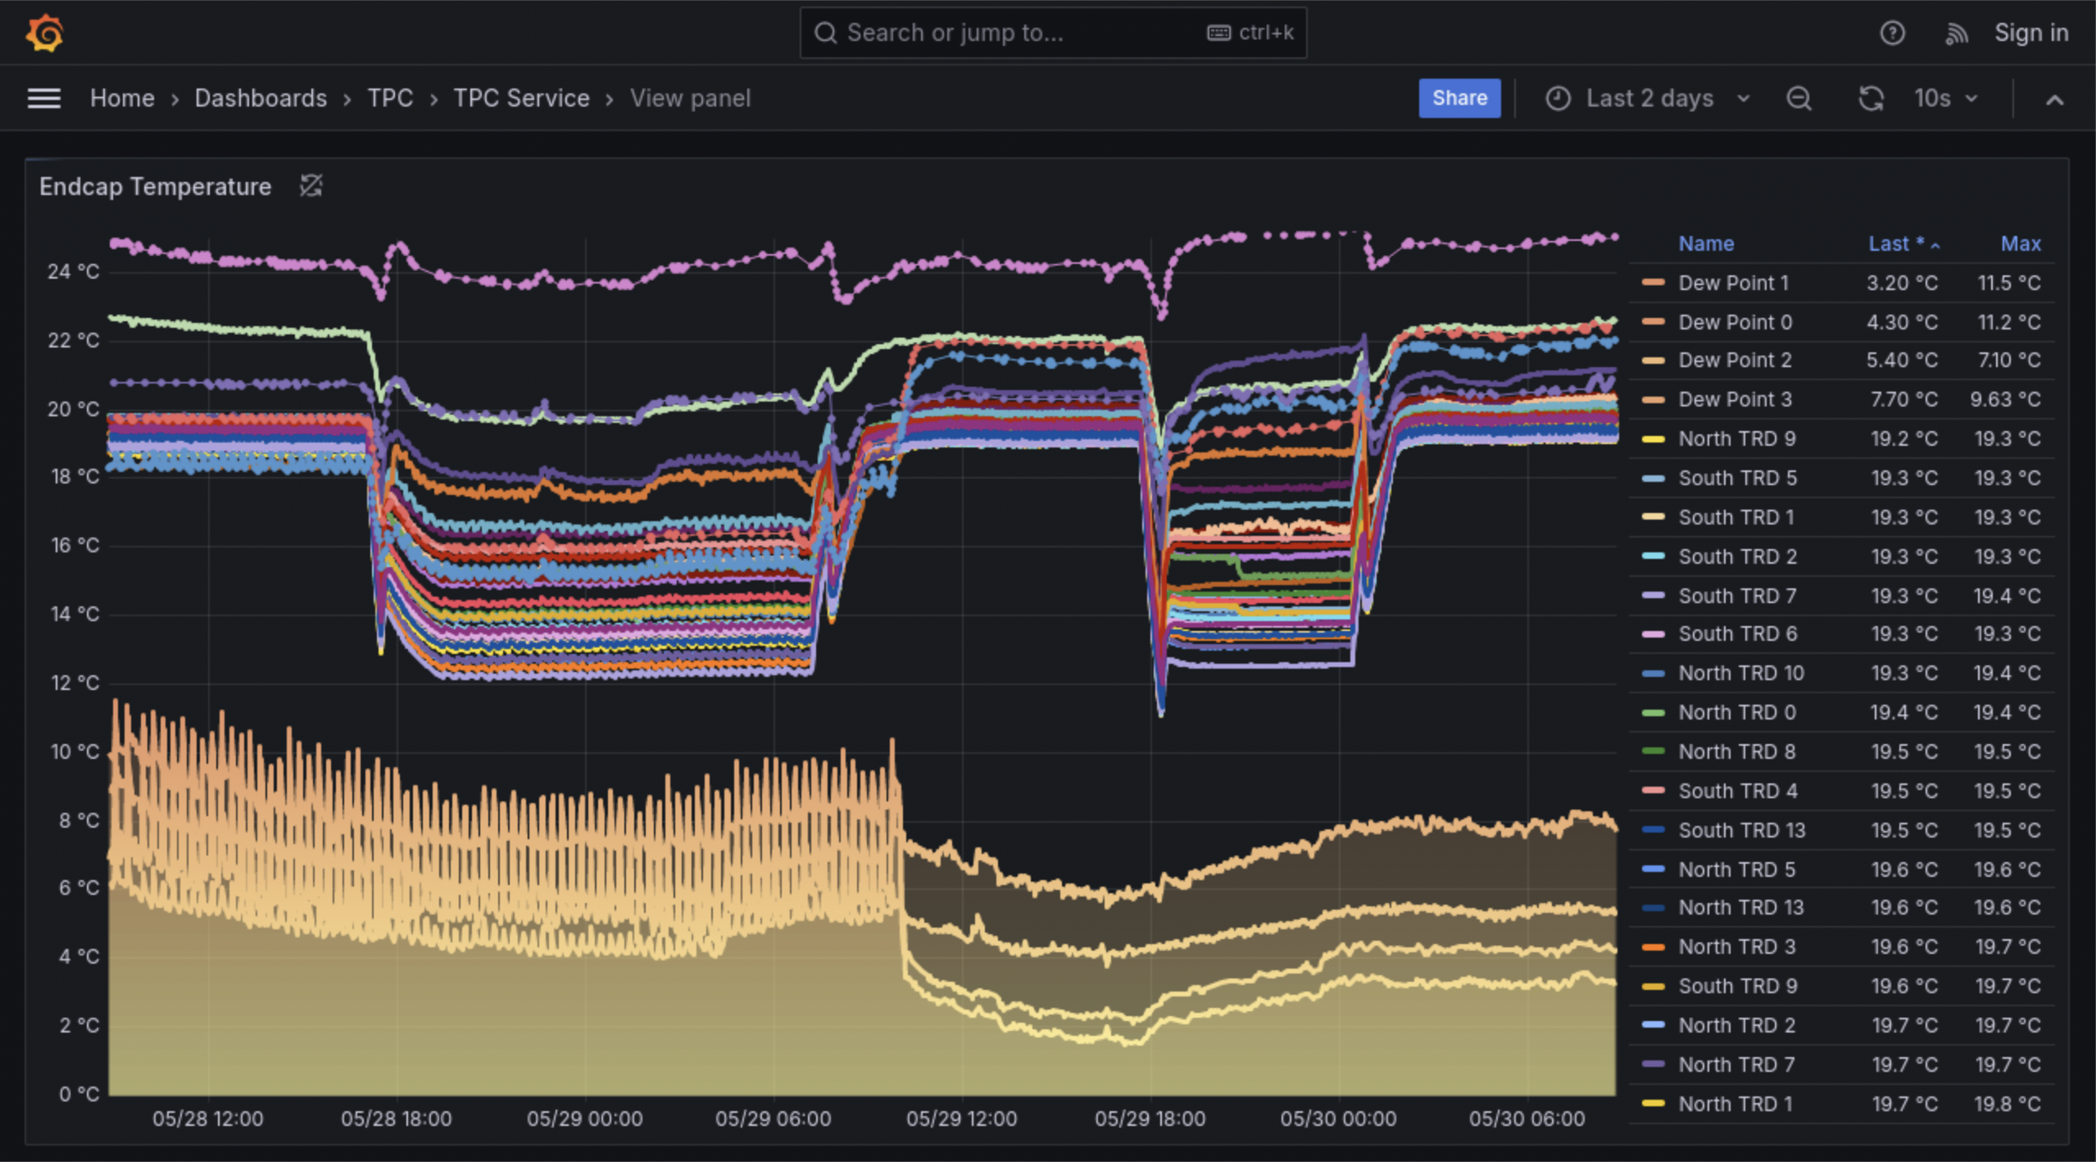
TPC humidity issue has been improved after we replaced air-conditioners with dehumidifiers in the north bore
TPC on
Dew point sensors inside the magnet bore
Thanks Marianna (ES&F) for lending us the dehumidifiers.
Replace north portable air conditioners with dehumidifiers

Slide 5
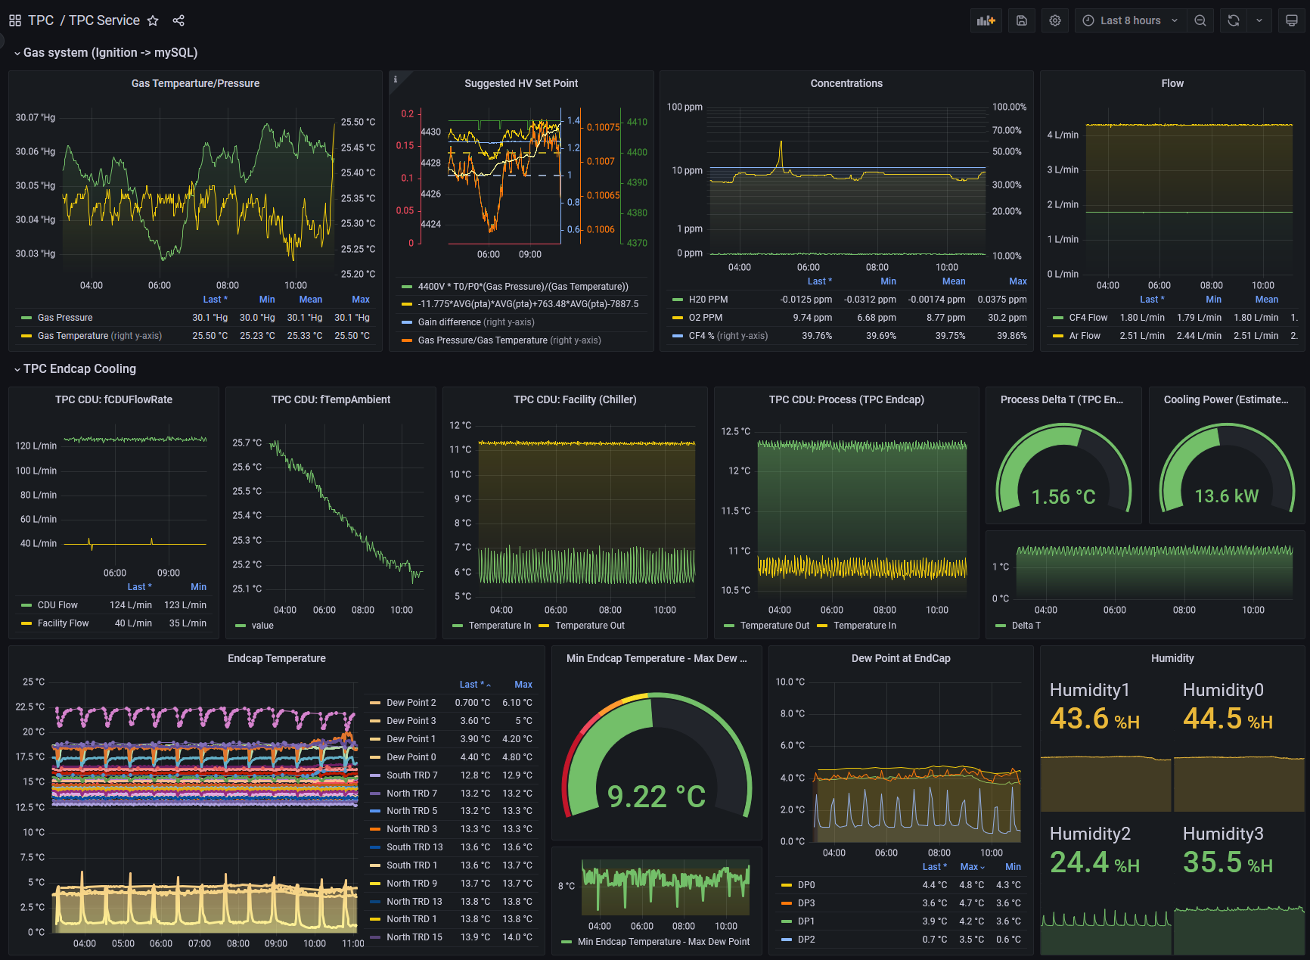
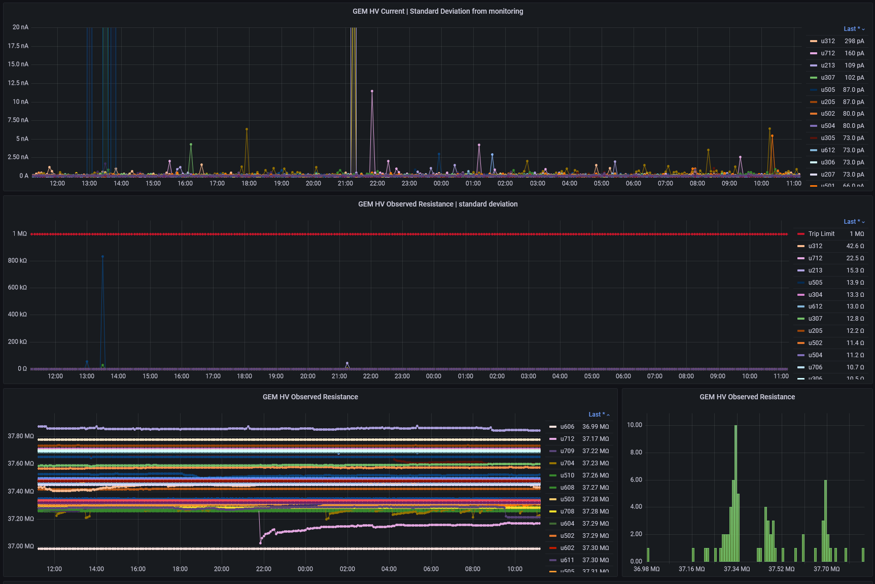
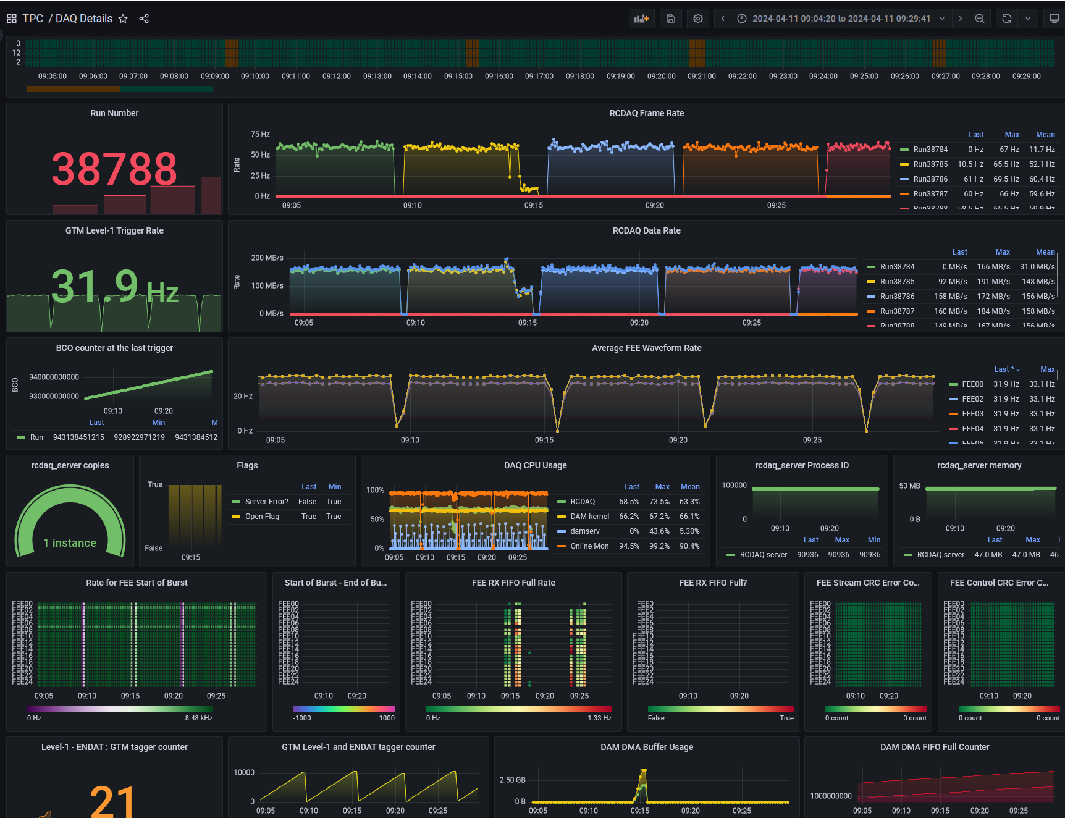
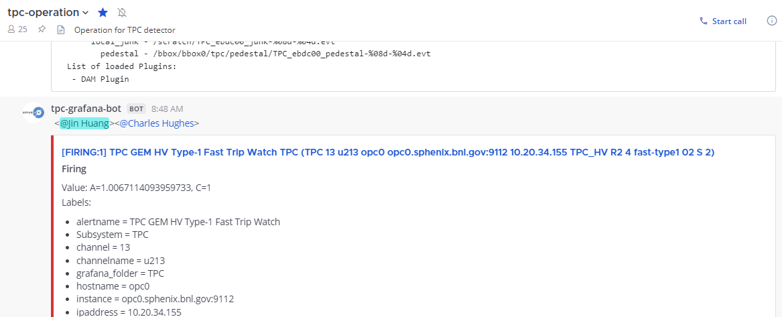
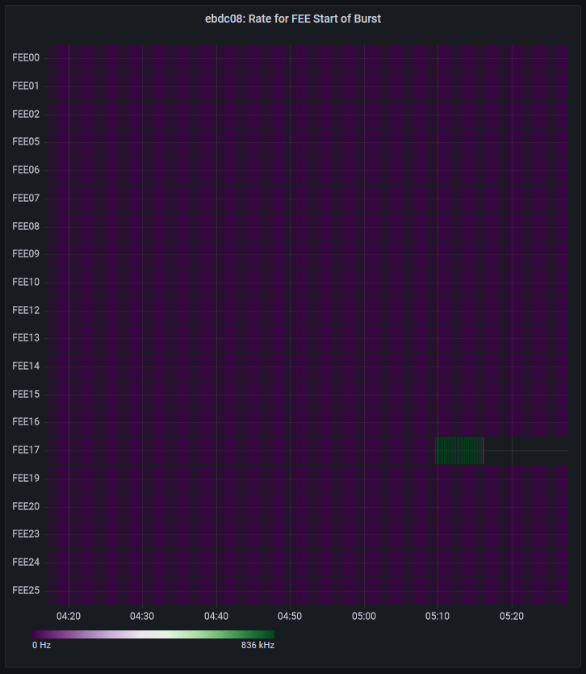
Sophisticated monitoring for TPC
TPC service HV system DAQ pipeline
Automated GEM HV trip notification
Automated stuck
FEE masking

Slide 6
Run 2024 DAQ for MVTX
• Lots of work went into MVTX driver, firmware and software improvements
• Start of run, MVTX recorded data in 89 μs windows
⇒ now tunable to different windows: 10 μs and 5 μs would be most common
• We saw increased data errors at 5 μs and so “Standard” became 10 μs
• Unfortunately, DAQ rate became unstable
• Two issues:
  Data rate would fluctuate and fill DMA,
  then DMA stops
  Clock error would stop data from one end
  point
• We’re investigating improvements to
RCDAQ plugin for better data transfer
• Also looking at FELIX firmware for better data transfer
• Increase of DMA size from 4 GB to 8 GB did not solve the issue

Slide 7
Expected local asymmetry established
After sorting out event alignment problem, our ZDC/SMD/polarization group in sPHENIX has managed to find the expected local polarization asymmetries in IP8.
This is after a lot of efforts in optimizing the operating conditions (HV, thresholds, timing etc.)
Production time (~hours) may need to be speeded up.
Forward
Forward

