Slide 1
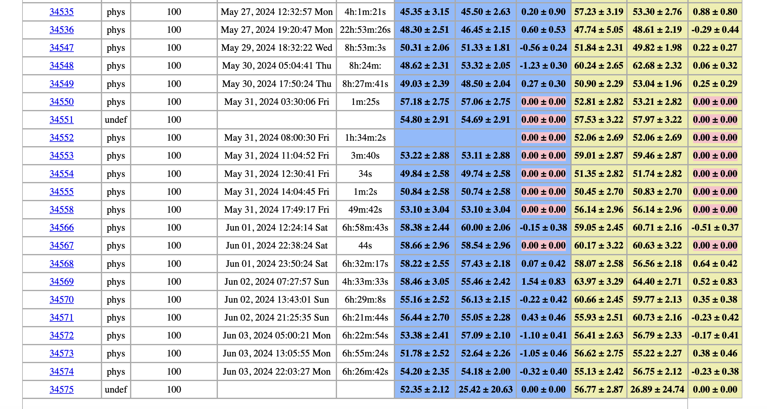
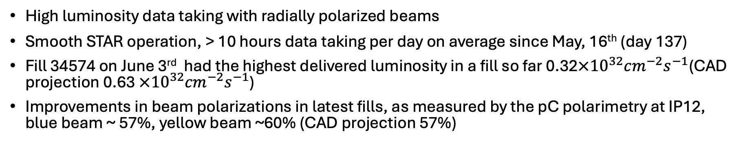
STAR Weekly Time Report, 05/28 – 06/03
Zilong Chang (CEEM, Indiana University)
High luminosity data taking with radially polarized beams
Smooth STAR operation, > 10 hours data taking per day on average since May, 16th (day 137)
Fill 34574 on June 3rd had the highest delivered luminosity in a fill so far 0.32$×{10}^{32}{cm}^{−2}s^{−1}$(CAD projection 0.63 $×{10}^{32}{cm}^{−2}s^{−1}$)
Improvements in beam polarizations in latest fills, as measured by the pC polarimetry at IP12, blue beam ~ 57%, yellow beam ~60% (CAD projection 57%)

Slide 2
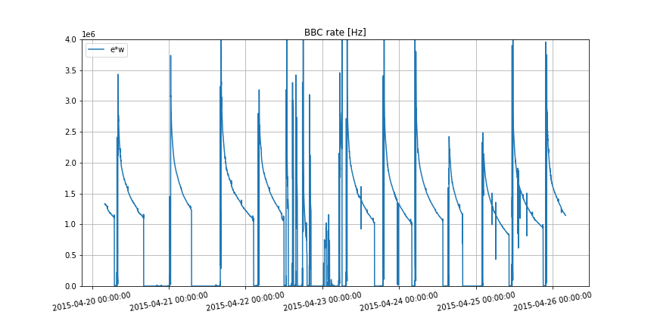
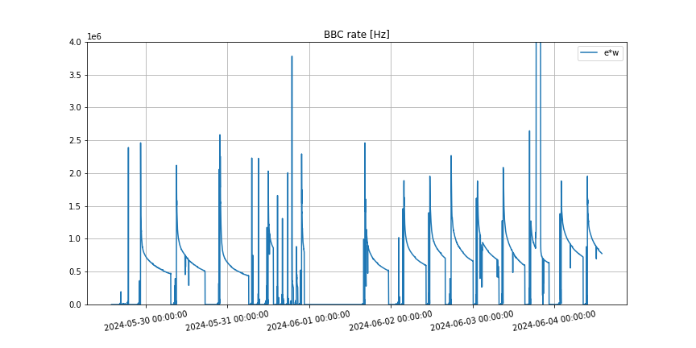
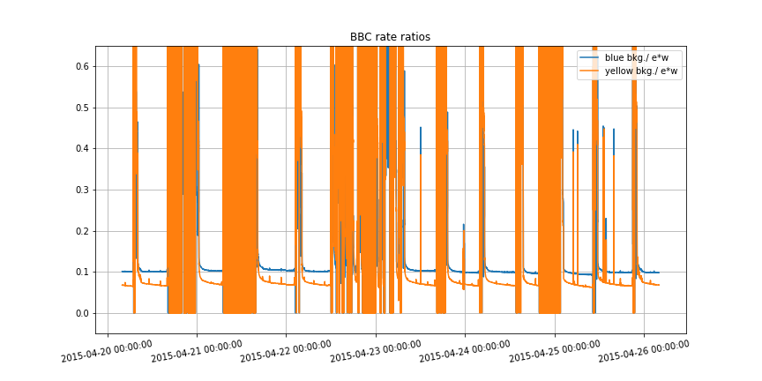
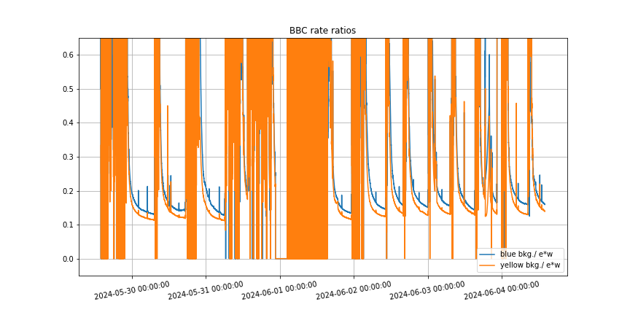
Beam conditions
Run15
Run24
BBC E&W
A factor of ~2 difference in luminosity
Blue bkg (E delayed & W) and Yellow bkg (W delayed & E) normalized by E&W
Blue bkg / E&W
Yellow bkg / E&W
Higher background for blue beam than for yellow beam, especially at the beginning of a fill

Slide 3
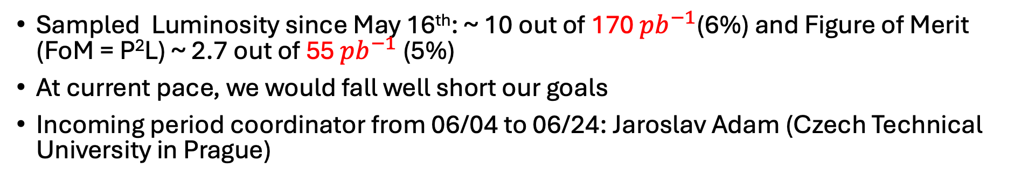

Outlook
Sampled Luminosity since May 16th: ~ 10 out of 170 ${pb}^{−1}$(6%) and Figure of Merit (FoM = P²L) ~ 2.7 out of 55 ${pb}^{−1}$ (5%)
At current pace, we would fall well short our goals
Incoming period coordinator from 06/04 to 06/24: Jaroslav Adam (Czech Technical University in Prague)
Mid-rapidity high energy jet events (JP2)
Forward-rapidity high electro-magnetic energy events
Luminosity
FoM, $P_{Blue}^{2}L$

