Slide 1
Data courtesy C. Naylor

Slide 2
Data courtesy C. Naylor

Slide 3
Data courtesy C. Naylor

Slide 4
Data courtesy C. Naylor

Slide 5
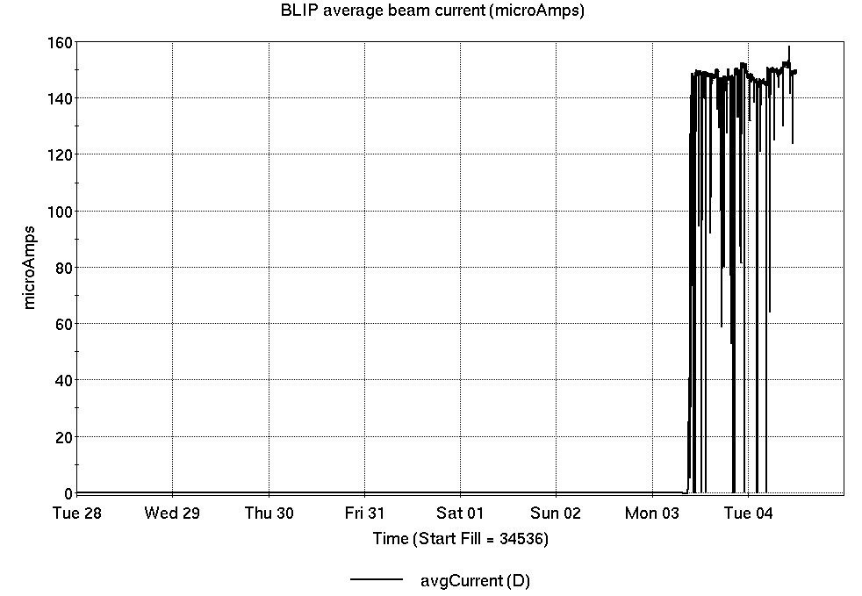
Operations for BLIP
5/28-6/4/2024:
200 MeV Th target resumed Monday. Beam current from Source #2 variable
20.45 hr Production
1.97 hr Setup
0.58 hr Failure
Availability: 97.5%
No BLIP
this past week

Slide 6
NSRL activity past week: 5/21-28/2024 (as of 0800)
NSRL: multiple users and setups last week. This week’s user pending, due to EBIS failure.
7 EBIS ions in use. (Si, Nb, Ag, Tb, Ta, Bi, Au)
Running 24-C schedule since 22 May. Schedule posted, details updating; beam into November.
Availability: 79.6%

Slide 7
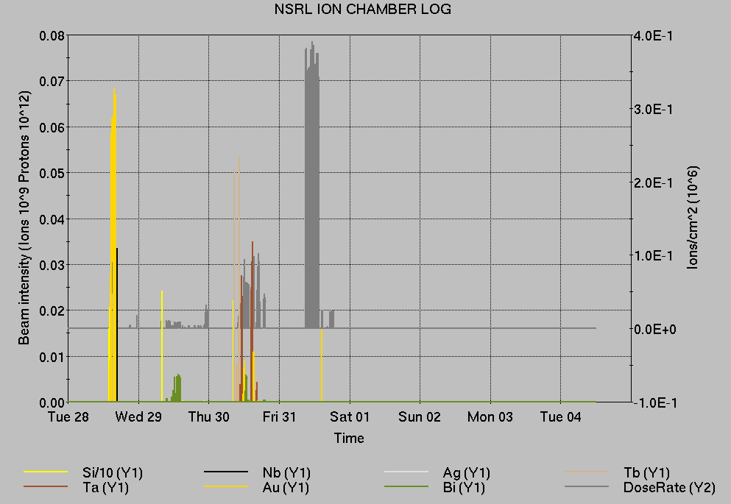
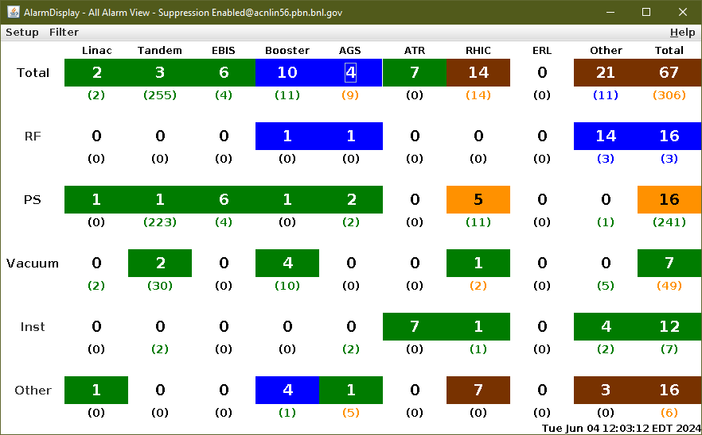
Notes from Operations
Notable failures (>1 hr)
Recovery from last week’s power outage; delayed dump in RHIC
Power dip Friday evening, affecting multiple systems across all accelerators
EBIS Linac failure, ongoing
Loss monitor beam aborts (9x), ramp tuning
RF YA2 QEI failure, access to replace; trip to Safe Access from VODH system
Blue QLI at accramp, beam induced
VODH and Cryo comm failures, lead flow trips
Yellow snake quench, FEC memory errors
Booster F4 BLW failure, fuse replaced
Other notes
Linac H⁻ source #1 off, ongoing; source #2 in use
AGS cold snake ramping slower; preferred at zero due to LHe usage
Permit interlocks
VODH intermittent communication failures; Cryo isolation system disabled
Various other trips, resets, repairs behind stores… 92+ lines of failure/resets logged in total
Double digits…

Slide 8
Reminder from Operations
MCR continues Operations for:
BLIP – continues through 14 June.
NSRL user running scheduled Mon-Sat this week (pending EBIS repairs) and next with additional make-up time TBD.
AGS/Booster polarized proton setup continues, additional to RHIC physics.
Polarized proton setup curtailed due to AGS cold snake failure.
Setting up multiple (proton) AGS PPM Users; extraction for split/merge cycle pending
Injector Au, h setup as yet untested.
Skew quad testing continues as beam time allows.
RHIC beam for Physics stores.
Other MD, Maintenance, APEX as noted in schedule
RHIC Tunnel sweeps remain under ODH-1 restrictions.
CHECK AND EDIT YOUR OWN CONTACT INFO
http://directory.pbn.bnl.gov/
CHECK YOUR CALLIN LIST: WCC and ECP updates needed
https://www.cadops.bnl.gov/Operations/personnel/call_in_lists/
Note: Core Electrical contacts listed/managed on ESSHQ callin list https://www.cadops.bnl.gov/Operations/personnel/call_in_lists/call_in_list.php?group=esshq

Slide 9
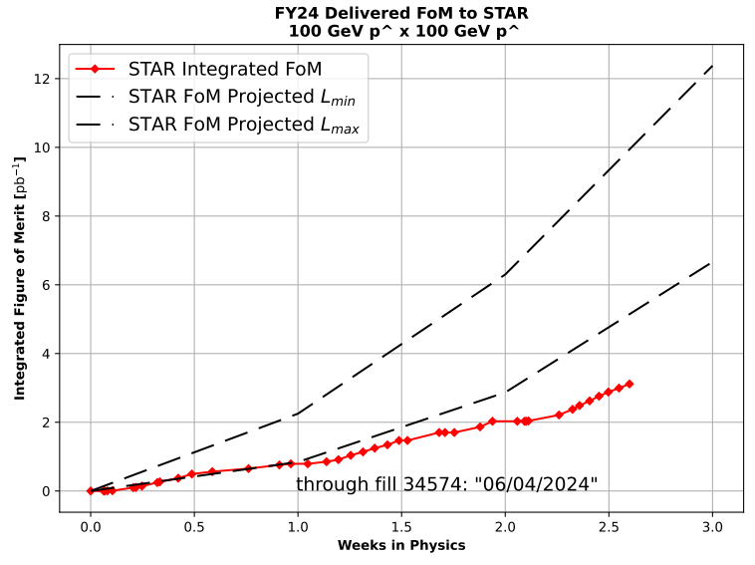
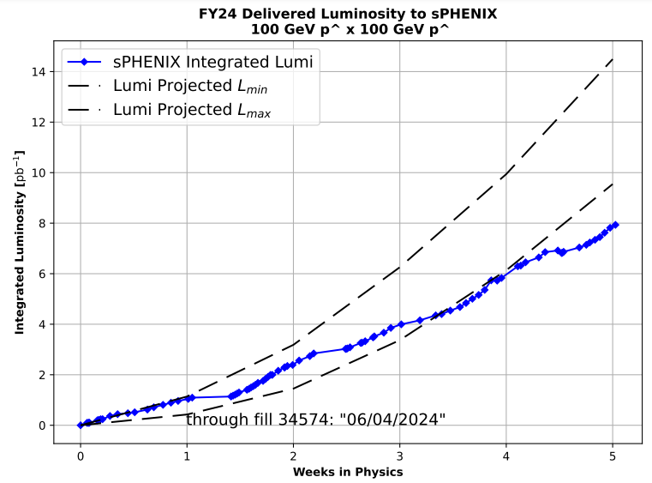
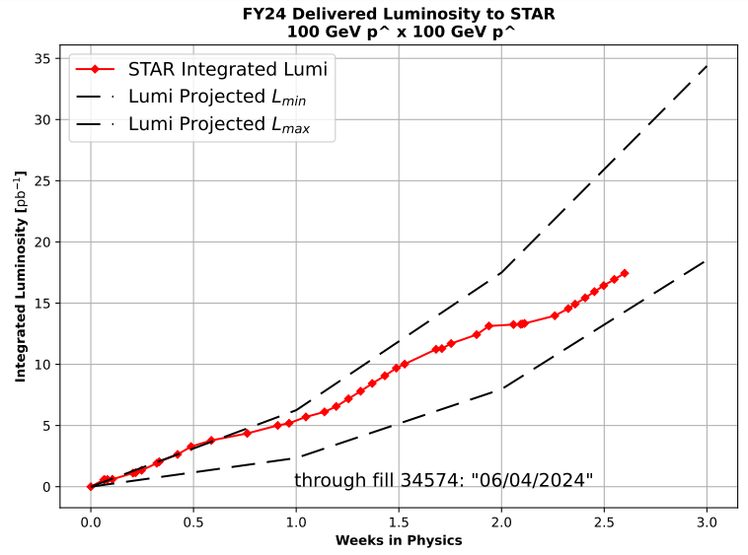
Preliminary delivered Luminosity, Figure of Merit (LP²) data for RHIC
Courtesy R. Terheide

Slide 10
Data courtesy C. Naylor

Slide 12
Availability, expected beam hours
$$Availability=\frac{actual beam time}{scheduled beam time}≡\frac{Beam use time}{Calendar time−scheduled interruptions}$$
$$RHIC \\ Availability=\frac{Physics+Machine Development+Machine Setup+Experiment Setup+Accelerator Experiments}{(Physics+Machine Development+Machine Setup+Experiment Setup+Accelerator Experiments)+Failures}$$
$$\text{DOE} \text{expected} \text{beam} \text{hours}=(\# of weeks −1 week overhead)×\left(\frac{160 available hours}{1 week}\right)×0.8$$
Notes:
Normally hidden. Explains how the 85% from DOE comes in to play, & general availability metrics

