Slide 1
Preinjectors Status
D. Raparia
Time Meeting
June 11, 2024

Slide 2
Tandem
External Users :
- Last week: No user , MP 7 maintenance
repaired ion pumps and steerers in the termina
closed and conditioning now l
- This week: No user
- Next Week: GVS

Slide 3
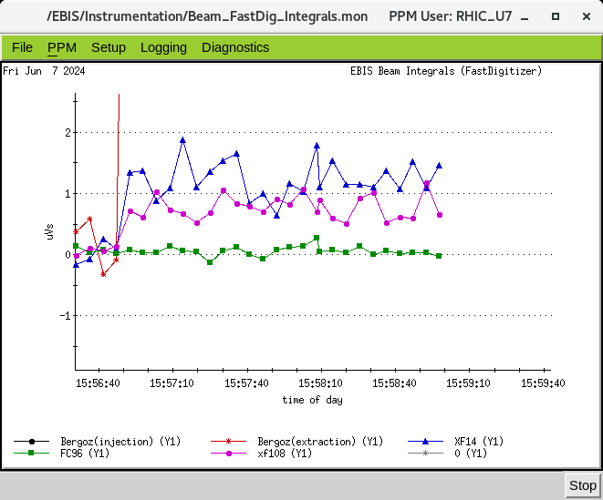
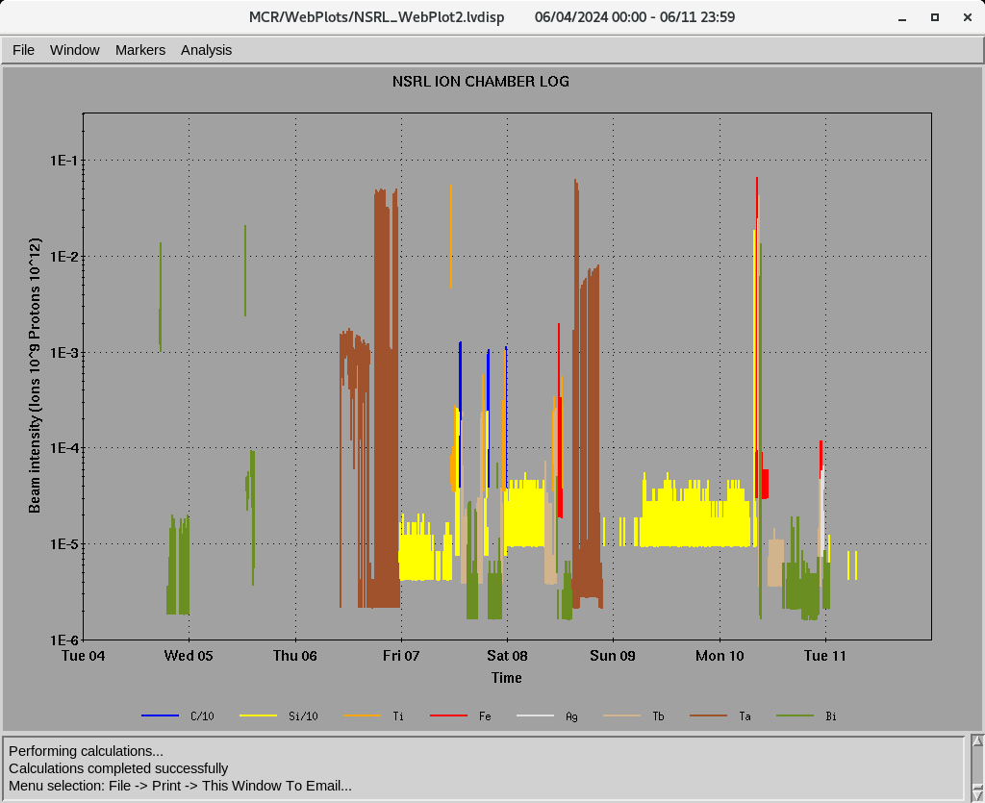
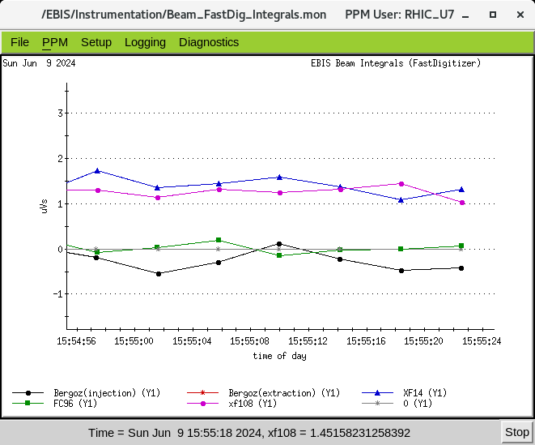
EBIS
Au development for RHIC
- Au development July 8-21
- D development for NSRL from Tandem July 8-9
Worked on He-3 development on the weekend
Two Au pulses at 5 Hz Last night
Last week ions for NSRL : C⁺⁵, Si⁺¹¹ Ti⁺¹⁷, Fe⁺²⁰ ,Ag⁺²⁹ , Tb⁺³⁵, Ta⁺³⁸ , Bi⁺⁴³
16hours/day , 6 days/week
Friday, 6/7/2024
Ion to NSRL
Sunday , 6/7/2024

Slide 4
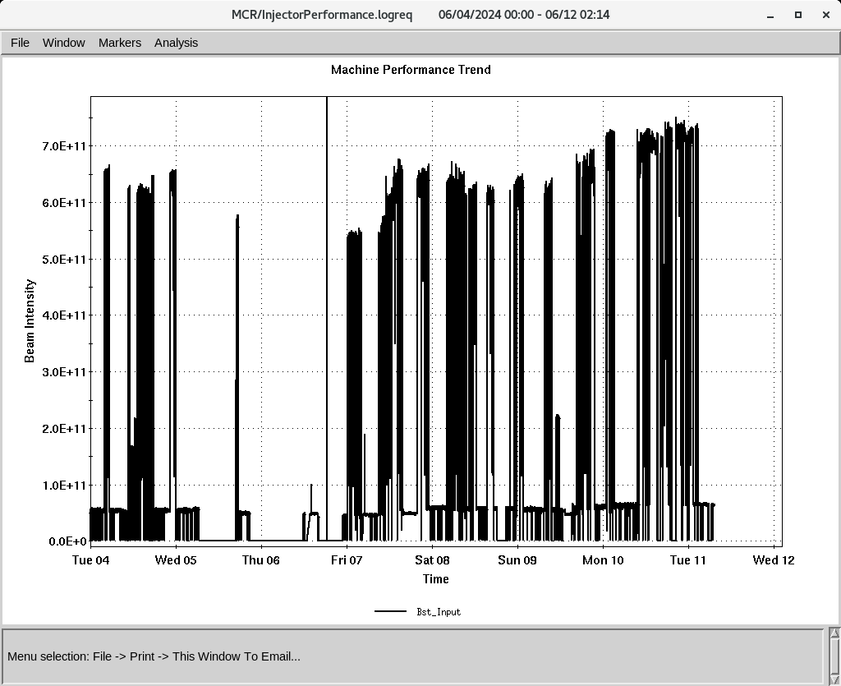
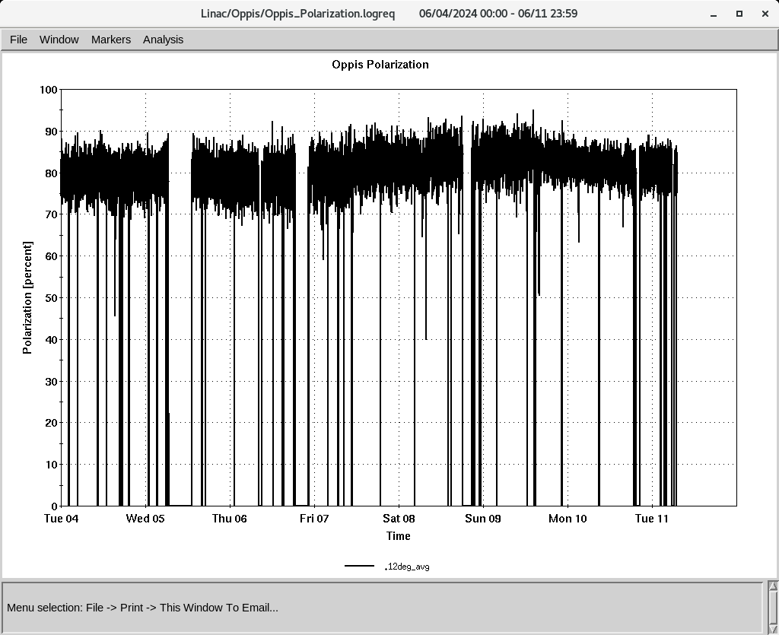
Linac 200 MeV Beam to BLIP , Booster
To Booster
BLIP
6/3-6/14: Th, 200 MeV, 150 𝞵A
Likely to extended
6/18-6.21: La, 117 MeV, 62 𝞵A
OPPIS
Normal current and polarization
(350-370 , 𝞵A ~ 80%,)
Added Rb on Sunday
H-Jet running smoothly
Polarization @ 200 MeV
Down time (<15 HRS)
- RF trips and reset: Buncher, RFQ, Mod 5, mod 9
6/6: RF Mod 5, 4CW25K PS replaced (4 HRS)
6/9: RF Mod 7, 8616 tube replaced ( 3 HRS)
6/10: Mod 7, tripped (1 HRS)
6/11: Mod 7, tripped (1 HRS)

