Slide 1
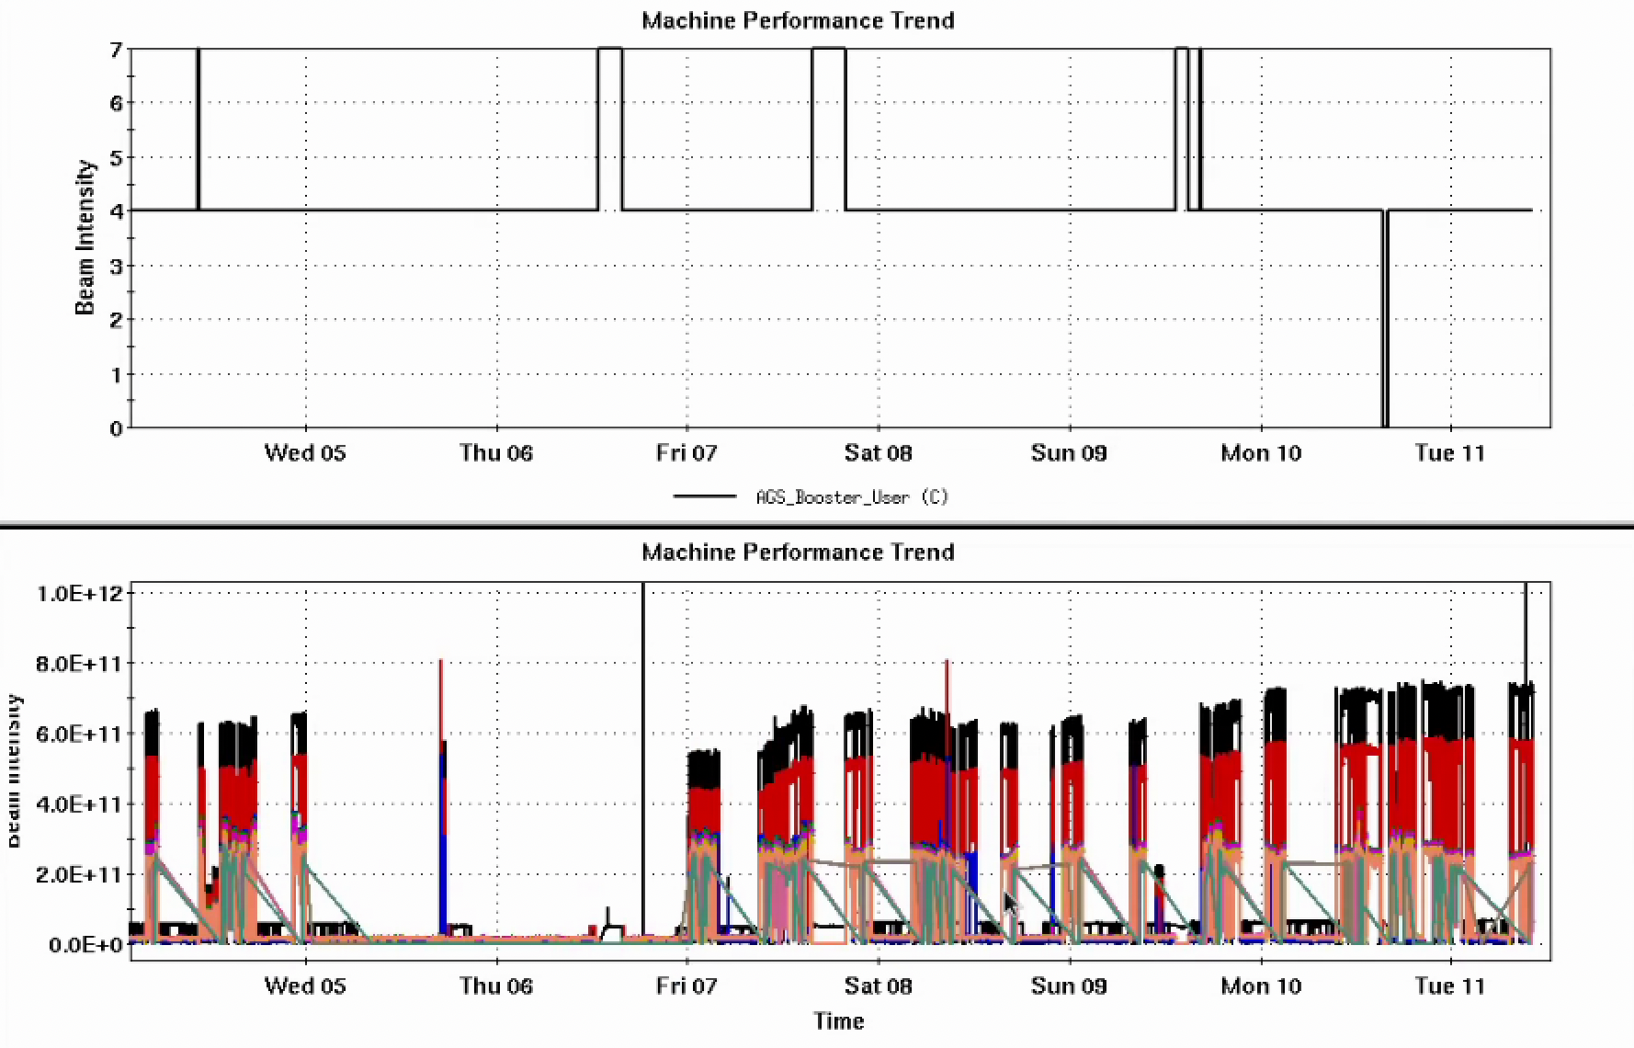
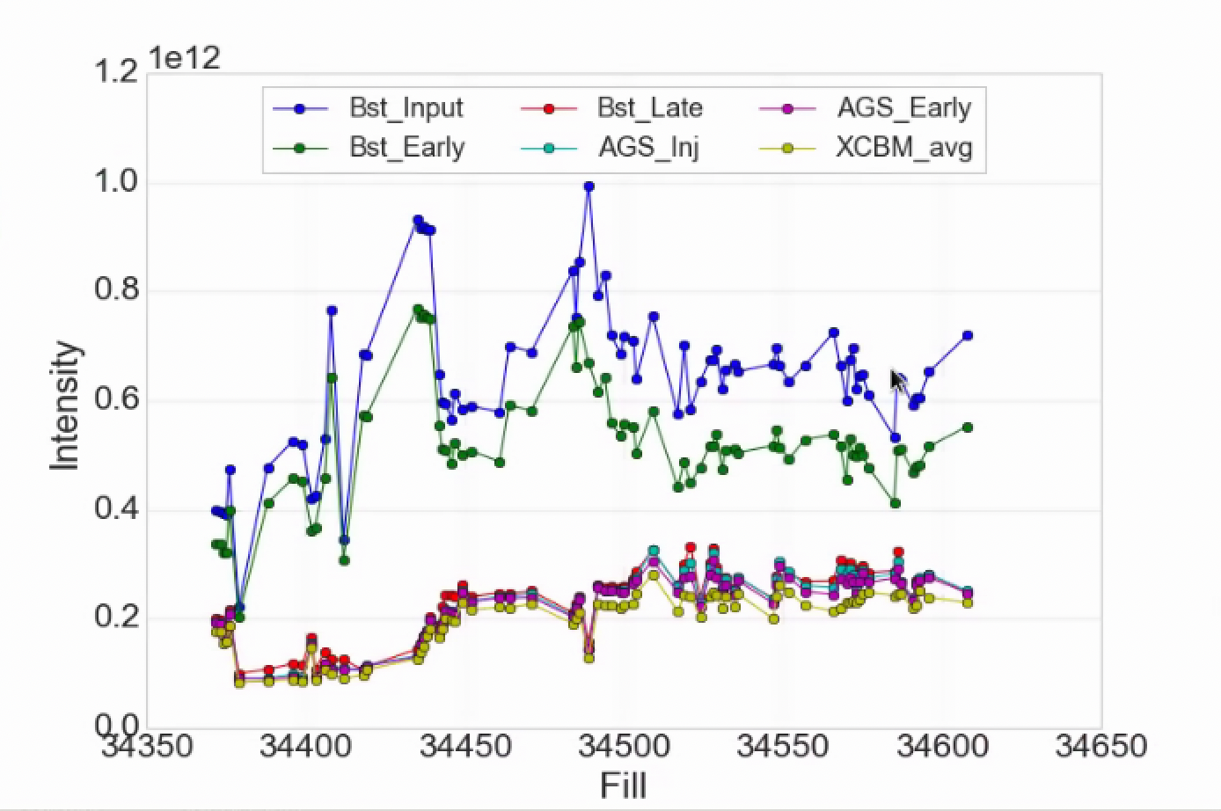
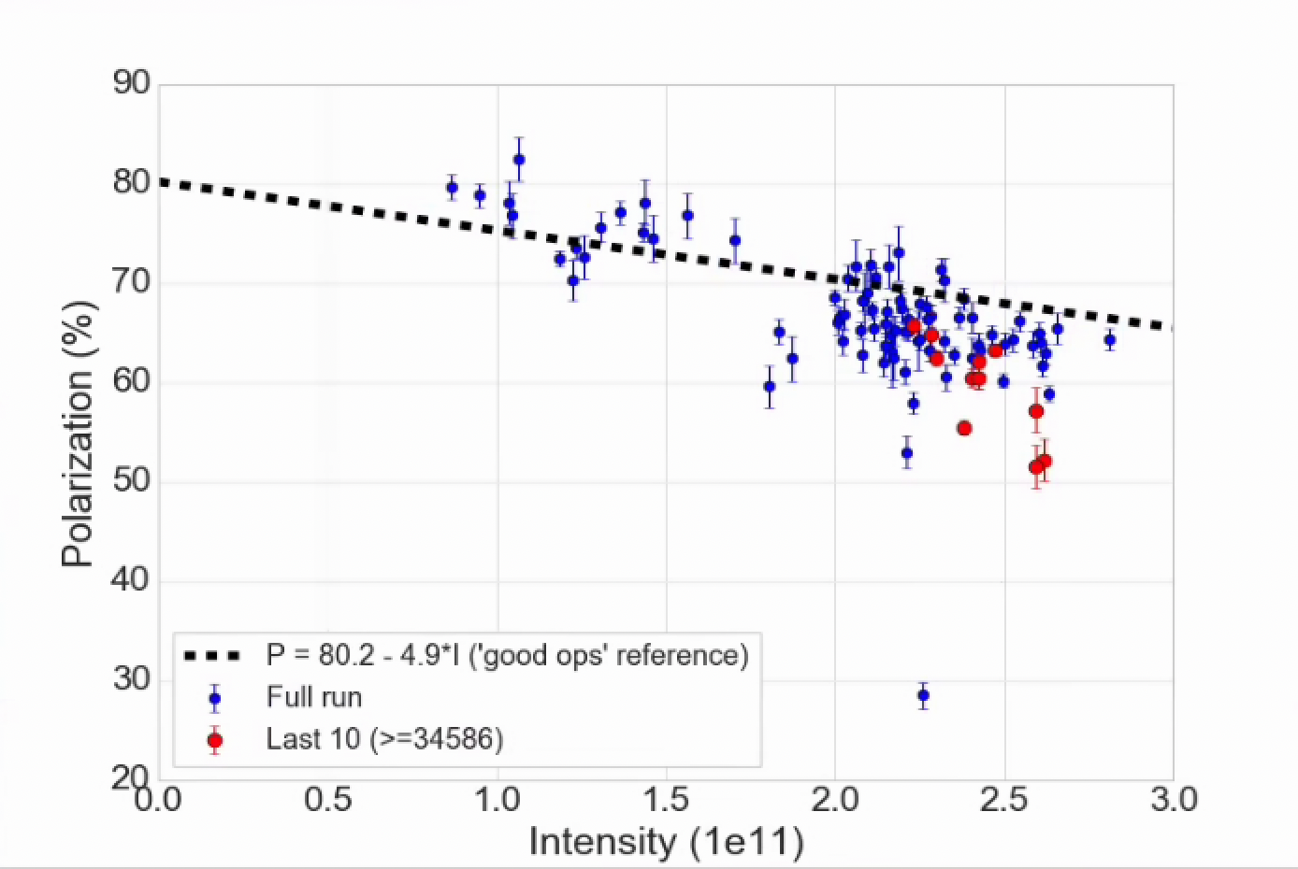
Injector Status, 6/11/24
Operations overview
Operations
RHIC Stores taking 2.2-2.4x10¹¹ AGS late
Polarization drop over the weekend
Looks better as of last fill (#34608)
AGS cold snake: sudden drop in He over the weekend, refilled on Sunday (thanks to all involved)
Plan is to warm up ~2200 tonight
Refill and restore tomorrow (mid-APEX)
Plan to be back by 1800 Wed.
AGS User
Intensity
Development
Setup of 3He cycles, without beam (in prep for APEX)
Injector Intensity by Fill
AGS Pol by Intensity (for fills)
(not a fit)

