Slide 1
sPHENIX status
Kin Yip
sPHENIX Director of Operations
Time meeting
June 11, 2024

Slide 2
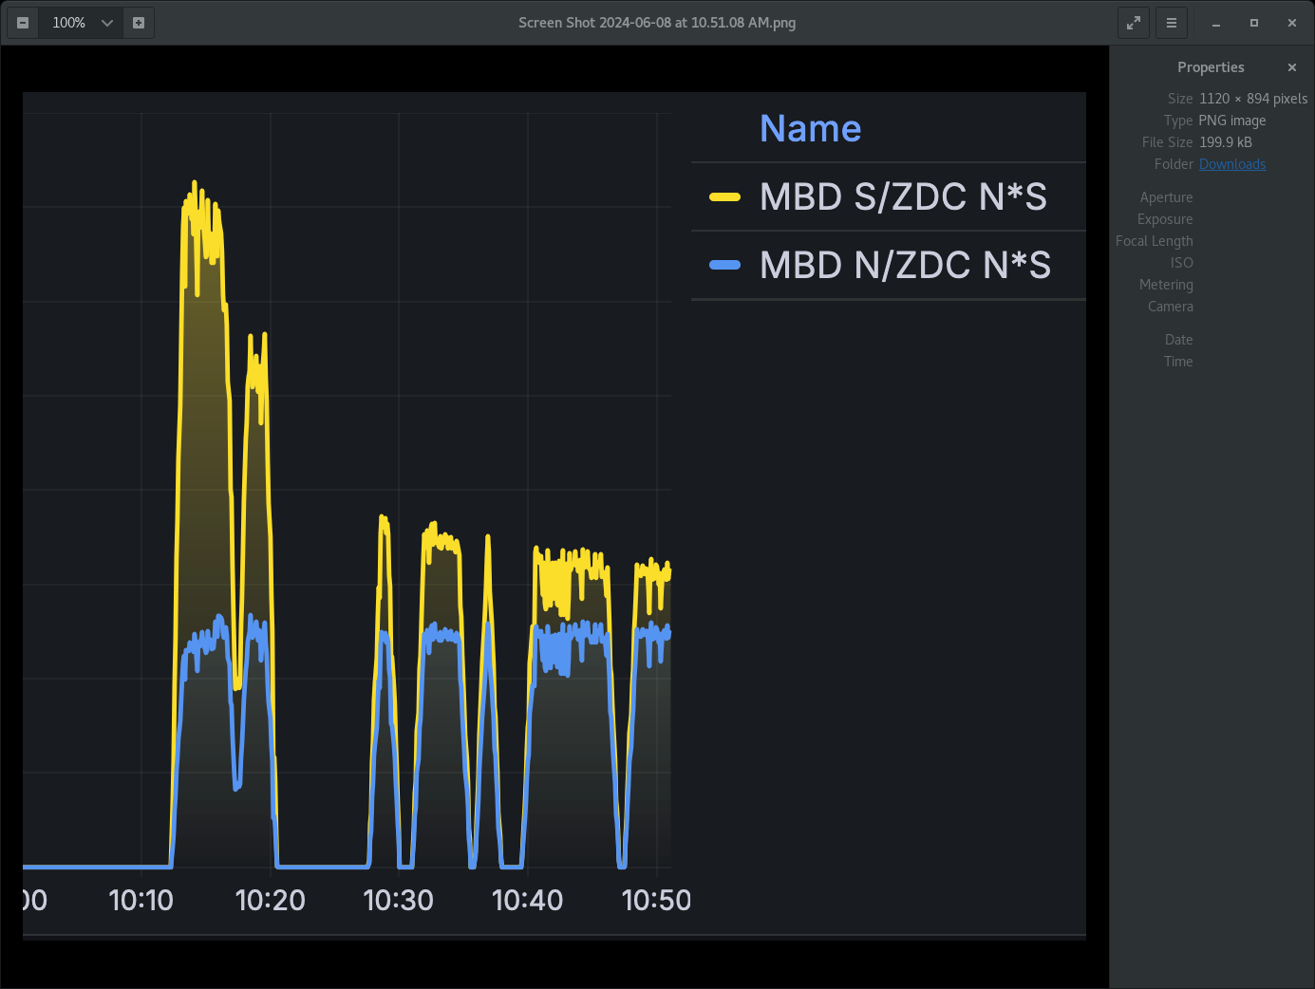
Status of sPHENIX: Physics Running
Combating background:
Yellow collimator changes both vertically and horizontally have helped reduce the yellow backgrounds (from the North side of IP8) as seen in the MBD.
Made technical arrangements so Angelika Drees is able to see our MBD signals directly (with her SDCC account).

Slide 3
Status of sPHENIX: Physics Running
Growth of EMCAL SiPM leakage current has continued despite decrease of measured backgrounds. (Not flattened yet ?)
TPC group is adding nitrogen in the gas mixture to avoid discharge at operating voltages.
MVTX group is working to figure out a solution to avoid “stops” during data taking.

Slide 4
Last week, we established the expected local asymmetry.
What’s new :
Updated firmware and DAQ software correctly records bunch-by-bunch luminosity (to correct for luminosity dependent polarization) enabling start of sPHENIX cold-QCD/polarization program on Sunday (~2 am on June 9).
Forward
Forward

Slide 5
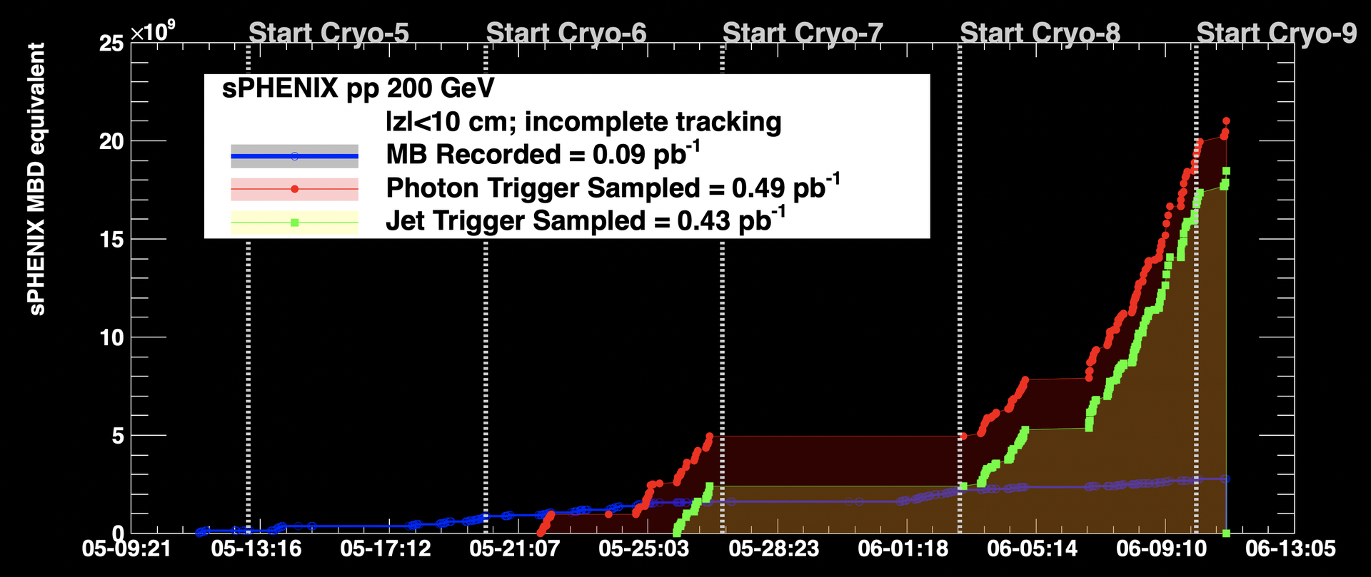
Integrating luminosities …

