Slide 1
Data courtesy C. Naylor

Slide 2
Data courtesy C. Naylor

Slide 3
Data courtesy C. Naylor

Slide 5
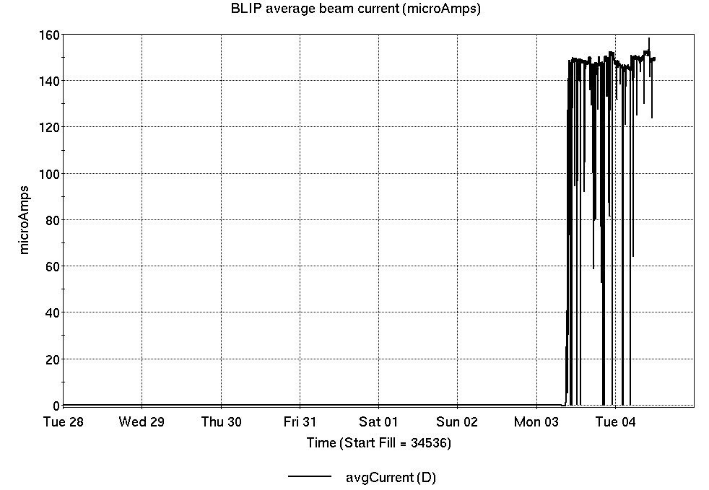
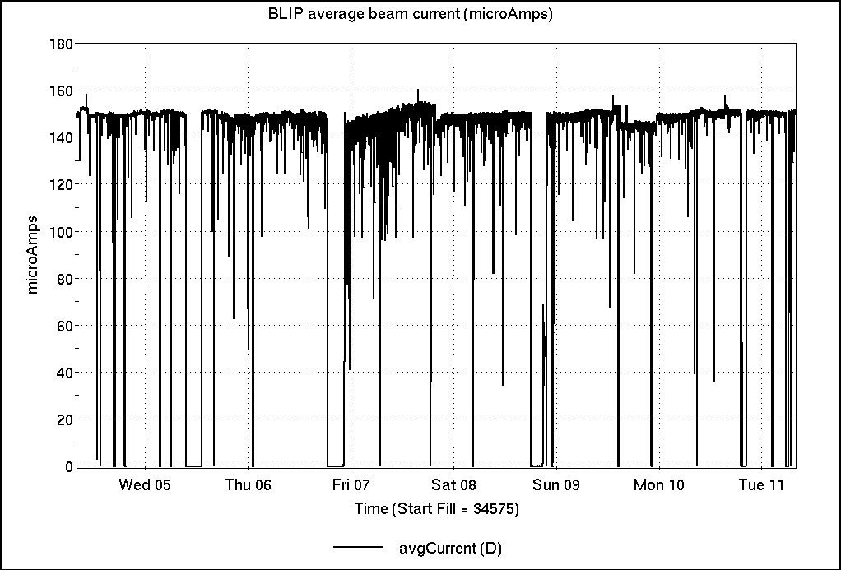
Operations for BLIP
6/4-6/11/2024:
200 MeV Th target resumed Monday. Beam current from Source #2 variable
151.67 hr Production
0.97 hr Setup
11.58 hr Failure
3.78 hr Maintenance
Availability: 92.9%
No BLIP
this past week

Slide 6
NSRL activity past week: 6/4-6/11/2024 (as of 0800)
NSRL: same user last week and this week, MDA.
8 EBIS ions in use. (Si, Fe, Ag, Tb, Ta, Bi, C, Ti)
Running 24-C schedule since 22 May. Schedule posted, details updating; beam into November.
Availability: 82.3%

Slide 7
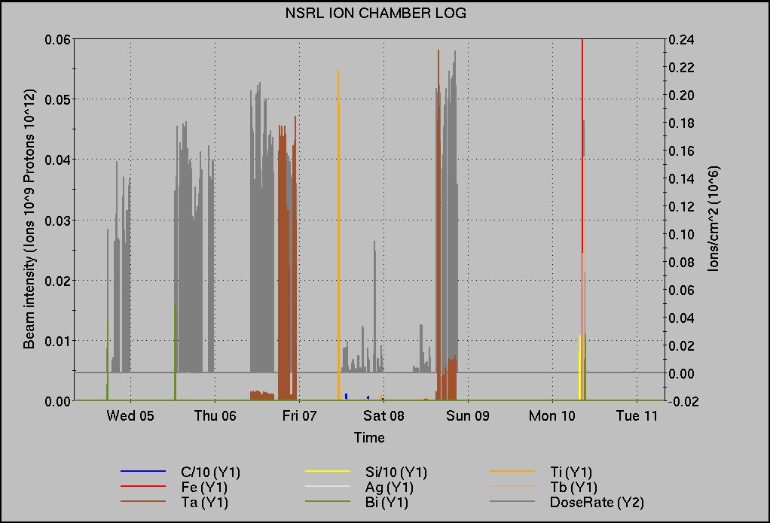
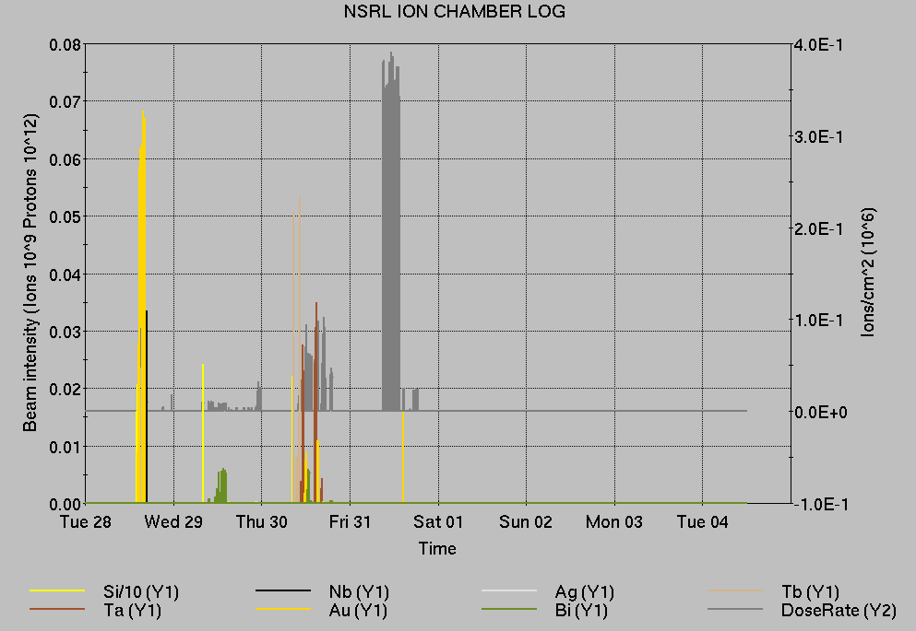
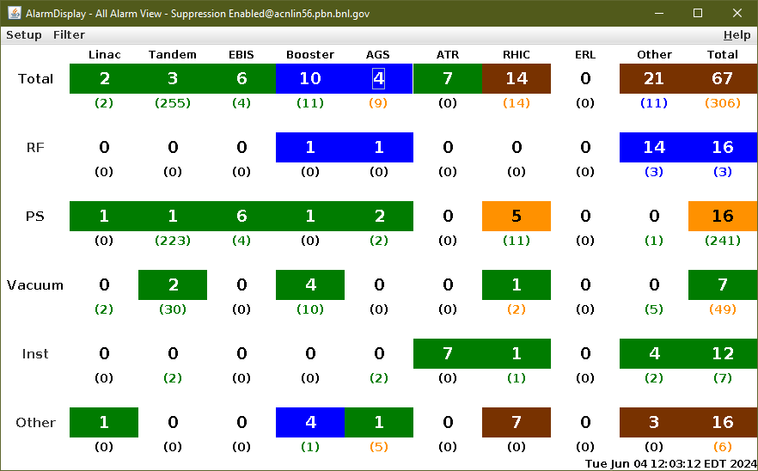
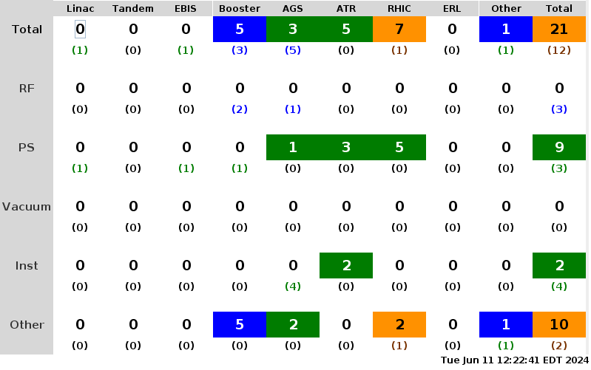
Notes from Operations
Notable failures (>1 hr)
AMMPS – circuit boards in exciter PS replaced
AGS Loss Monitor – PS and MADC replaced (cold snake loss permit dropped with no beam in AGS)
LINAC RF mod 5 – 4CW25K grid supply replaced
AGS cold snake LHe refill
sPHENIX access to work on EMCal
AMMPS trip – Fast 95 switch reset
AGS cold snake – ramp down/up between stores
(problem with cold head, repair during overnight)
RHIC sector 8 dropped to SA & lost sweep 7z1
(hardware fault – replace regulator on gate current loop)
Some trouble with bi5-qf9 last night
Other notes
ODH alarm 1004E – Oxigraf replaced
A/C problem A10 house – portable units installed (workorder submitted to fix a bad compressor)
STAR trim west magnet trips (2x)
EBIS LINAC – 4Ω resistors and 10A fuse replaced (reseated relay to clear a phase failure)
D6 septum trips on high temp/water flow faults
(replaced leaking heatsink and damaged circuit boards)
Power Dip – relatively short recovery
Double digits…

Slide 8
Reminder from Operations
MCR continues Operations for:
BLIP – continues through 14 June.
NSRL user scheduled to run Mon-Sat this week.
AGS/Booster polarized proton setup continues, additional to RHIC physics.
Polarized proton setup curtailed due to AGS cold snake trouble. Repairs due to begin this evening and go through the overnight until tomorrow evening.
APEX on Wednesday will use unpolarized beam until AGS cold snake is ready.
Injector Au, h setup as yet untested.
Skew quad testing continues as beam time allows.
RHIC beam for Physics stores.
Other MD, Maintenance, APEX as noted in schedule
RHIC Tunnel sweeps remain under ODH-1 restrictions.
CHECK AND EDIT YOUR OWN CONTACT INFO
http://directory.pbn.bnl.gov/
CHECK YOUR CALLIN LIST: WCC and ECP updates needed
https://www.cadops.bnl.gov/Operations/personnel/call_in_lists/
Note: Core Electrical contacts listed/managed on ESSHQ callin list https://www.cadops.bnl.gov/Operations/personnel/call_in_lists/call_in_list.php?group=esshq

Slide 9
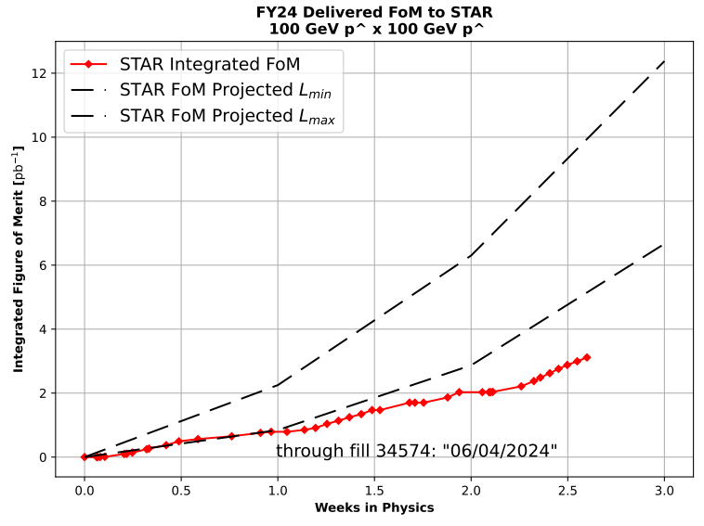
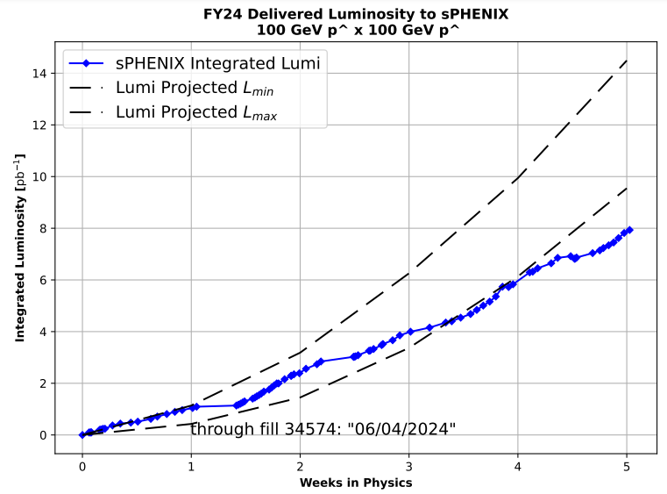
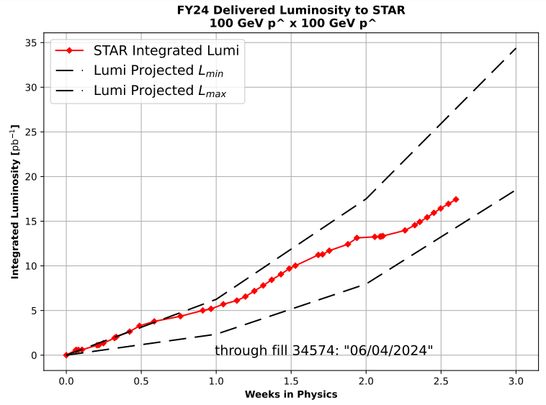
Preliminary delivered Luminosity, Figure of Merit (LP²) data for RHIC
Courtesy R. Terheide

Slide 10
72.6%
Avg. Availability: 77.3%

Slide 12
Availability, expected beam hours
$$Availability=\frac{actual beam time}{scheduled beam time}≡\frac{Beam use time}{Calendar time−scheduled interruptions}$$
$$RHIC \\ Availability=\frac{Physics+Machine Development+Machine Setup+Experiment Setup+Accelerator Experiments}{(Physics+Machine Development+Machine Setup+Experiment Setup+Accelerator Experiments)+Failures}$$
$$\text{DOE} \text{expected} \text{beam} \text{hours}=(\# of weeks −1 week overhead)×\left(\frac{160 available hours}{1 week}\right)×0.8$$
Notes:
Normally hidden. Explains how the 85% from DOE comes in to play, & general availability metrics

