Slide 1
Preinjectors Status
D. Raparia
Time Meeting
June 25, 2024

Slide 2
Tandem
External Users :
- Last week: GVS
- This week: tunning TTB for Deuterons

Slide 3
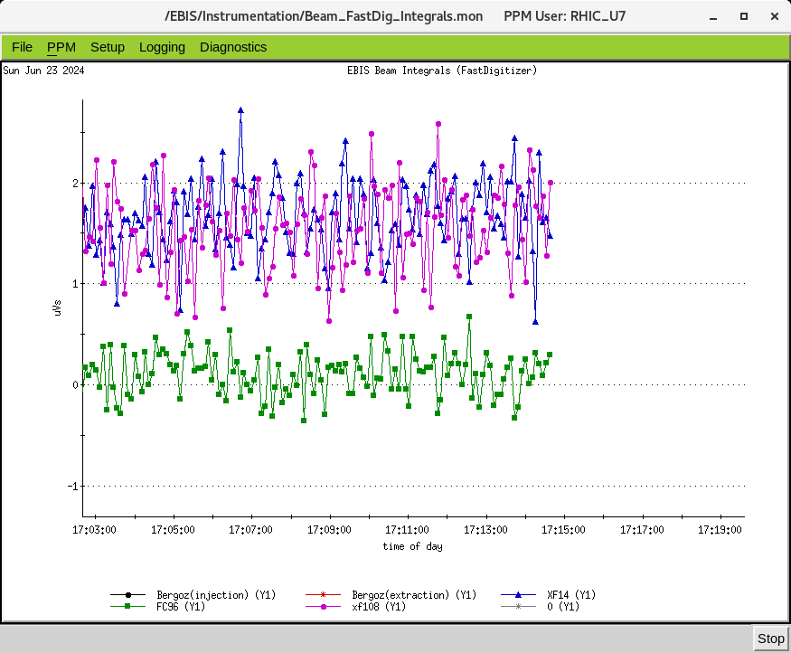
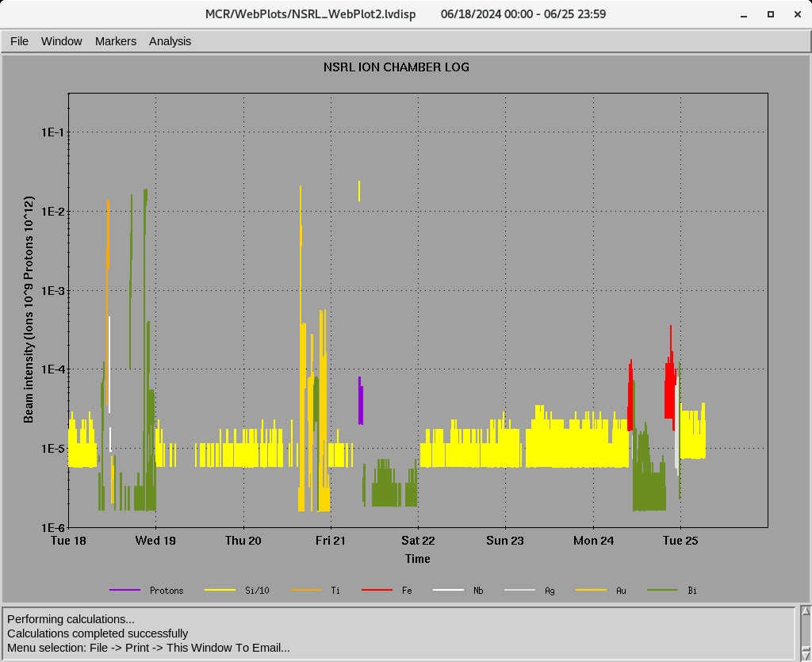
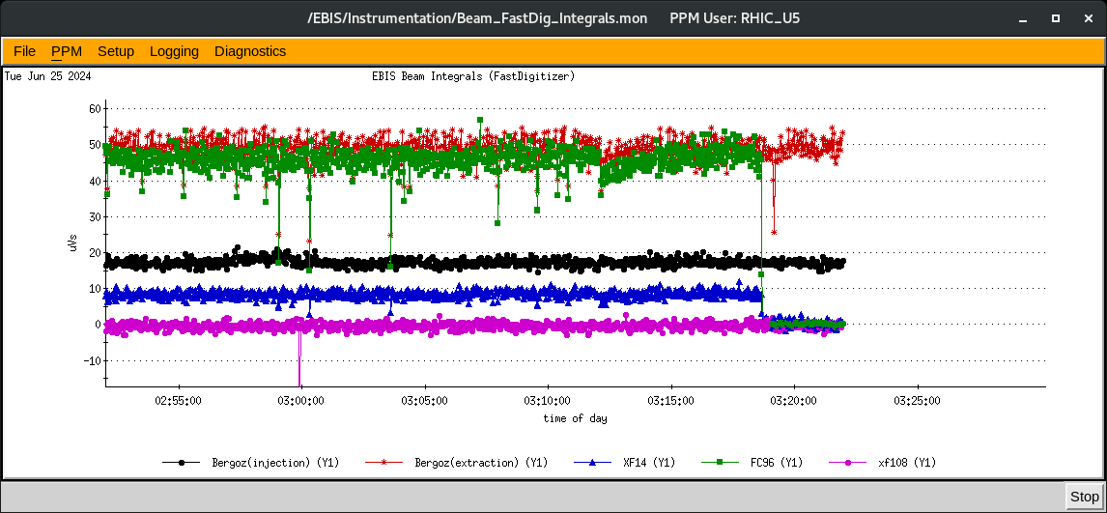
EBIS
Au development for RHIC
- Au development July 8-21
- D development for from Tandem July 8-9
worked on He3⁺⁺ weekend improved intensity , only short trap
Au two pulses Last night
Last week ions for NSRL : P, Si⁺¹¹ Ti⁺¹⁷, Fe⁺²⁰ ,Nb⁺²³, Ag⁺²⁹ , Au⁺³² , Bi⁺⁴³
16hours/day , 5 days/week
6/20: lost internet , several hours
EBIS linac trips
He3⁺² Sunday , 6/23/2024
Ion to NSRL
Au 2 pulses

Slide 4
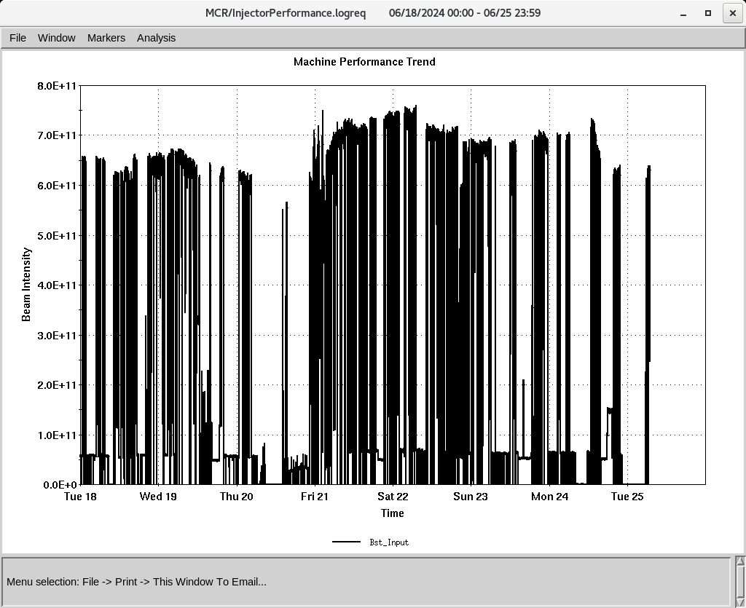
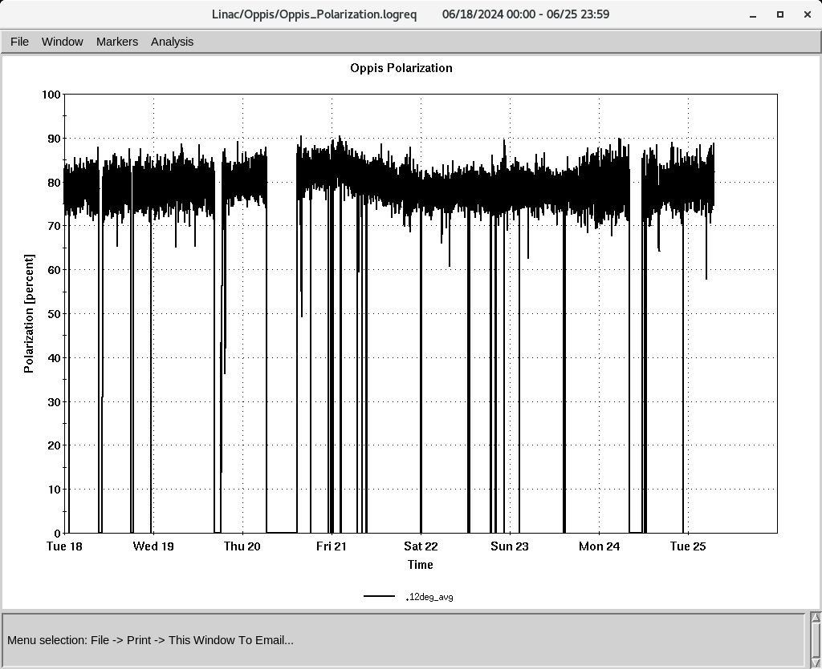
Linac 200 MeV Beam to BLIP , Booster
To Booster
BLIP
6/18-6.21( 9AM): La, 117 MeV, 62 𝞵A
6/28-7/9: Th, 200 MeV, 150 𝞵A,
OPPIS
Normal current and polarization
(350-370 , 𝞵A ~ 80%,
H-Jet warm-cool cycle , Running
Polarization @ 200 MeV
Down time (<1.5 HRS)
RF trips and reset: Mod 5, mod 7, Mod 9
6/18: Power dip (<15 min)
6/20 Access Control ( <3.5 HRS)
6/24 Mod 2, Changed ignitron

