Slide 1
sPHENIX status
Kin Yip
sPHENIX Director of Operations
Time meeting
June 18, 2024

Slide 2
Status of sPHENIX: Physics Running
MVTX group has fixed the issue related to writing to buffers and is now working on solving the “clock error” which may be due to temperature being too high around their transceivers.
The sPHENIX Control Room has further optimized and streamlined the data taking operation for the shifters. Once the sPHENIX clock is aligned, we start to prepare the detectors for operation.
TPC group has used the gas mixture of 65:25:10 (Ar:CF₄:N₂) which shows some improvement over the old mixture of 60:40 (Ar:CF₄). But it may not be good enough and we’re pursuing the possibility of using isobutane to get to more efficient operating voltages for the TPC in sPHENIX.

Slide 3
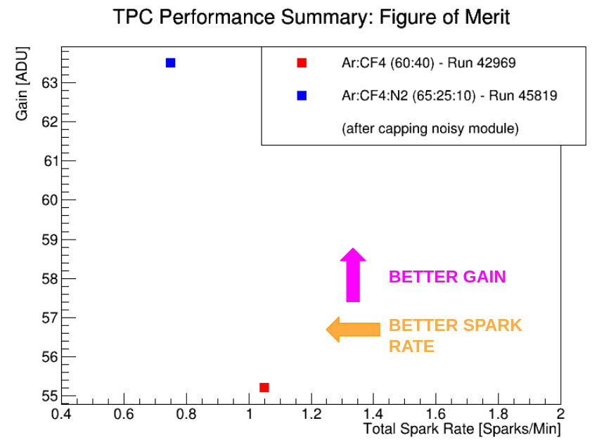
Improvement with the new TPC gas mixture
Both at 4.2 kV
Discharge is ~ μJ

Slide 4
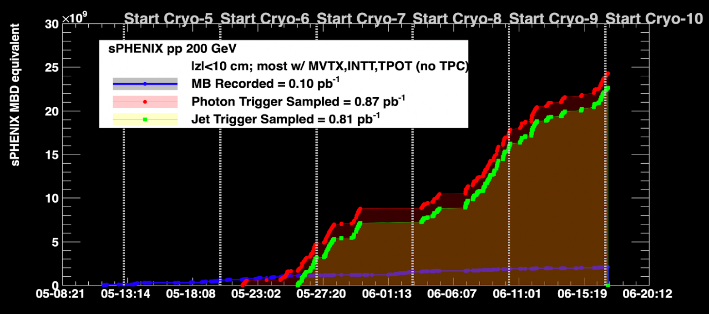
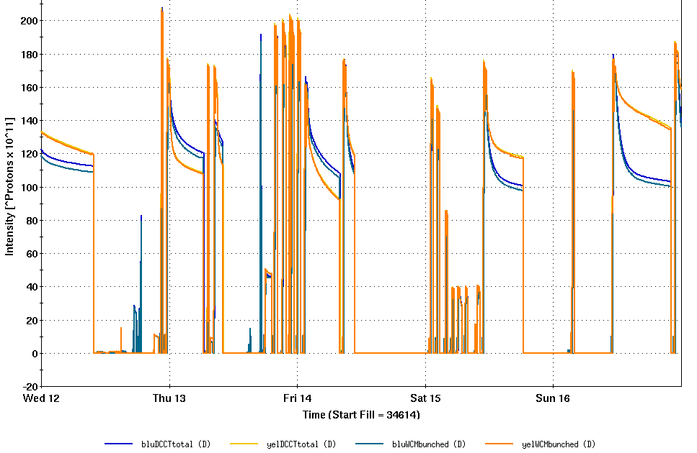
Luminosities & intensities
Collecting data whenever we can
Last Friday evening , we also suffered from a false fire alarm which turned off all detector racks in the IR and it took ~ 5 hours to recover, with the help of many of us and CAS.

