Slide 1
Data courtesy C. Naylor

Slide 2
Data courtesy C. Naylor

Slide 3
Data courtesy C. Naylor

Slide 4
Data courtesy C. Naylor

Slide 5
Data courtesy C. Naylor

Slide 6
Data courtesy C. Naylor

Slide 7
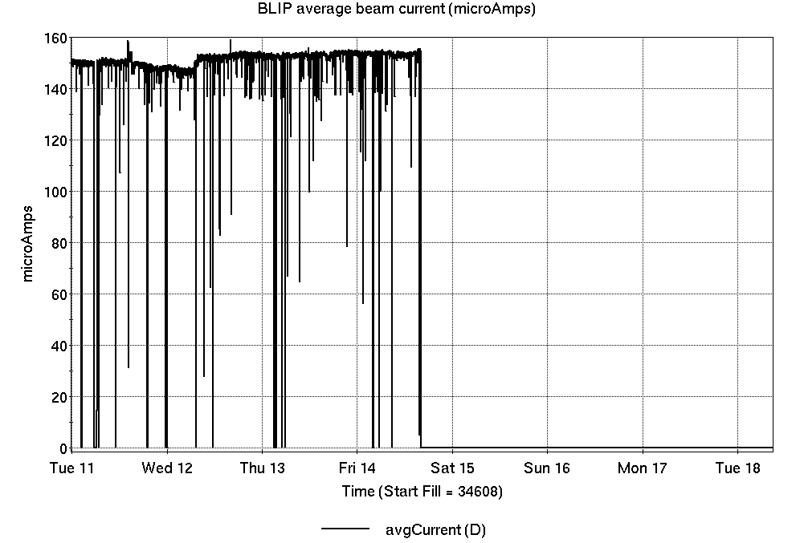
Operations for BLIP
6/11-18/2024:
200 MeV Th target production concluded Friday. (source #2)
117 MeV La run starts today.
79.13 hr Production
0.87 hr Failure
Availability: 98.9%
No BLIP
this past week

Slide 8
NSRL activity past week: 6/11-18/2024 (as of 0800)
NSRL: same user last week and this week, MDA.
9 EBIS ions in use. (Si, Ti, Fe, Nb, Ag, Tb, Ta, Bi, Au)
Running 24-C schedule since 22 May. Schedule posted, details updating, including Tandem beam; beam into November.
Availability: 91.0%

Slide 9
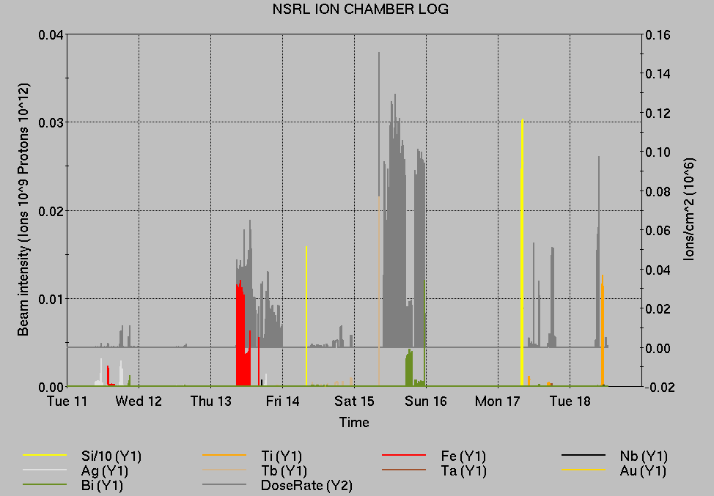
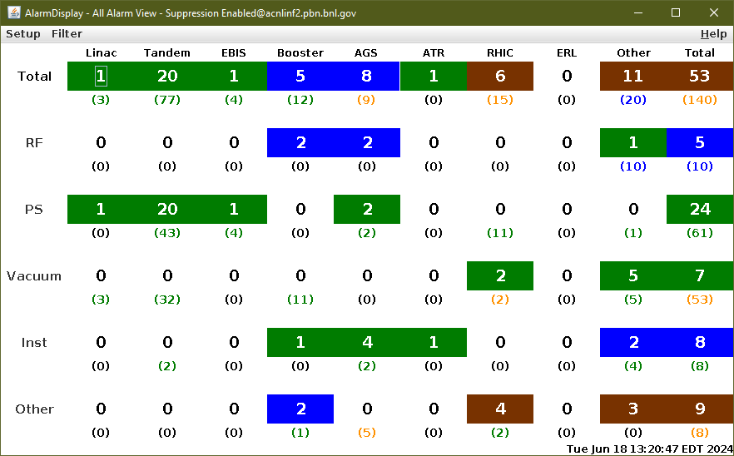
Notes from Operations
Notable failures (>1 hr)
Cryo PLC comm failures, lead flow interlocks (3x)
CeC, STAR, sPHENIX access for various failures
BA1 RF repair, access required
yo4-tq6-ps replacement
QLI, yi12-dh0 trip
y6-q89 PS work
Y10 quench protection switch contactor repairs
Weather stand-down for storms
10a-blm2 FEC failure, chassis replaced
D6 septum PS trips, repairs for overtempt and other issues
Other notes
Various Linac Mod trips, resets
Loss monitor interlocks, RHIC beam aborts (15x)
Other misc EBIS, injector, beamline trips
Double digits…

Slide 10
Reminder from Operations
MCR continues Operations for:
BLIP – resumes today, through 21 June.
NSRL user scheduled to run Mon-Fri (except holiday) this week and next.
AGS/Booster polarized proton setup continues, additional to RHIC physics.
Polarized proton setup limited by AGS cold snake trouble.
Injector Au, h setup as yet untested.
Skew quad testing continues as beam time allows.
RHIC beam for Physics stores.
Other MD, Maintenance, APEX as noted in schedule
RHIC Tunnel sweeps remain under ODH-1 restrictions.
CHECK AND EDIT YOUR OWN CONTACT INFO
http://directory.pbn.bnl.gov/
CHECK YOUR CALLIN LIST: WCC and ECP updates needed
https://www.cadops.bnl.gov/Operations/personnel/call_in_lists/
Note: Core Electrical contacts listed/managed on ESSHQ callin list https://www.cadops.bnl.gov/Operations/personnel/call_in_lists/call_in_list.php?group=esshq

Slide 11
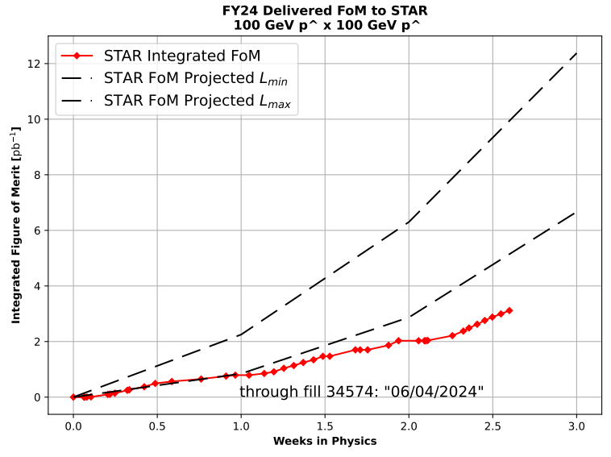
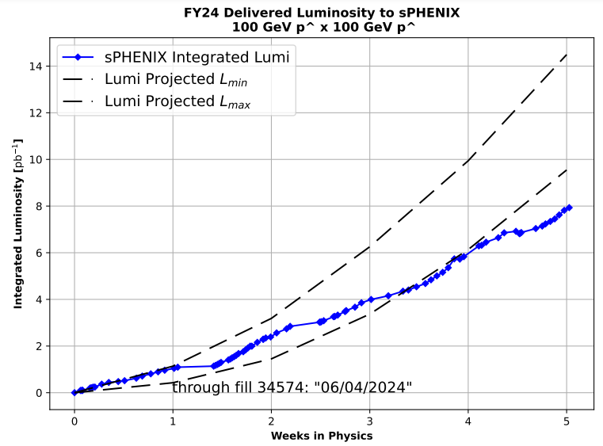
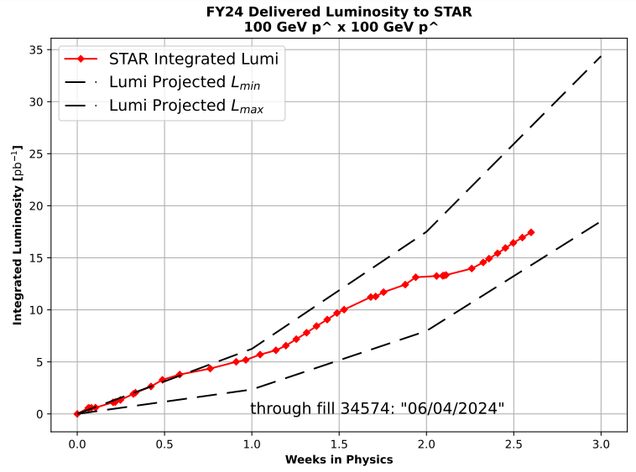
Preliminary delivered Luminosity, Figure of Merit (LP²) data for RHIC
Courtesy R. Terheide

Slide 14
Availability, expected beam hours
$$Availability=\frac{actual beam time}{scheduled beam time}≡\frac{Beam use time}{Calendar time−scheduled interruptions}$$
$$RHIC \\ Availability=\frac{Physics+Machine Development+Machine Setup+Experiment Setup+Accelerator Experiments}{(Physics+Machine Development+Machine Setup+Experiment Setup+Accelerator Experiments)+Failures}$$
$$\text{DOE} \text{expected} \text{beam} \text{hours}=(\# of weeks −1 week overhead)×\left(\frac{160 available hours}{1 week}\right)×0.8$$
Notes:
Normally hidden. Explains how the 85% from DOE comes in to play, & general availability metrics

