Slide 1
TAKE FIVE for Safety- Department of Energy Safety Day of Reflection
Frank Craner
June 25, 2024

Slide 2
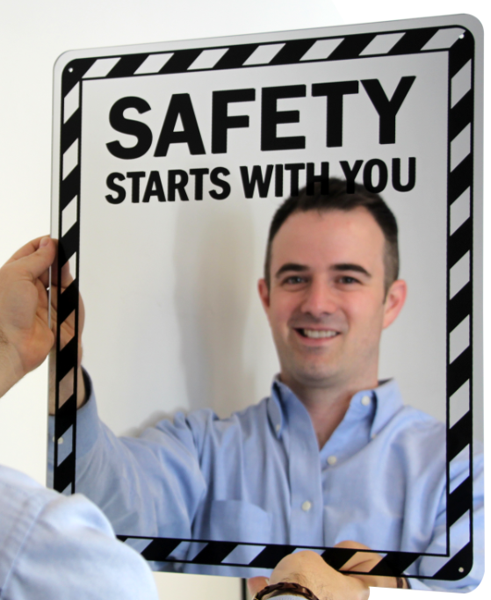
DOE Day of Reflection June 26, 2024
ME
DOE’s Day of Reflection: intended to create an emotional connection to safety and raise awareness of the impact that workplace injuries can have on families, friends, colleagues, and our DOE missions.
In-person presentations from BNL staff
Video montage on how injuries and incidents have impacted staff and the lessons learned
“Safety Starts with Me” virtual memory board for staff to add stories and reflect
Mirror Presentation, “I Reflect Safety”
Rolling Safety Pause across BNL – each group will take 30 min pause sometime during the Day of Reflection for a discussion on how we can improve safety in each group.
Emphasis on SCoR principle - Learning Never Stops

Slide 3
Tomorrow’s Day of Reflection
An event will be hosted by Associate Lab Director for Environment, Safety & Health Sharon Kohler at 10 a.m. in the Physics Large Seminar Room (Bldg. 510). This is open to all employees and will be livestreamed for those who cannot attend in person.
Online Engagement: Share your safety stories on the Safety Reflections page. This platform allows you to post personal experiences and discuss the impact of safety in the workplace on you and your colleagues.
Safety Pause: Supervisors and managers are encouraged to hold a 30-minute safety pause with their teams on June 26 to reflect on safety practices and enhance awareness.

Slide 4
C-AD Implementation
Refer to June 21 Five Minute Safety message
Each group to dedicate 30 minutes
Consider- Can work or a job be done differently/safer/more effectively if you had a….?
A different/newer tool?
Adjust steps of the job.
Equipment could be rearranged.
Procedure walkdown
Housekeeping.
Additional ESH support
Also consider the Hierarchy of Controls

Slide 5
Feasible Controls
To decide if a control is feasible, consider how well it can protect workers and whether it can be implemented successfully.
Is the control:
• Right for the hazard
• Appropriate, given how likely injuries/illnesses are
• Consistent with employer policies, laws, and regulations
• Not too burdensome to workers
• Recognized as an appropriate practice in the industry
• Effective, reliable, and durable
• Readily available
• Cost-effective, short- and long-term

Slide 6
Can hazards be eliminated or better controlled?
Examples
Installation of air monitoring equipment that can be lowered foir maintenance, reducing the need for personnel climbing and working at heights.
Reconfiguration of a confined space to improve access
Remote operation of electrical switchgear
Substitution of toxic chemical
Improvements to walking/working surfaces
Reduction of hazardous chemical inventory
Please report ideas and feedback to C-AD ESSHQ

