Slide 1
sPHENIX status
Kin Yip
sPHENIX Director of Operations
Time meeting
July 2, 2024

Slide 2
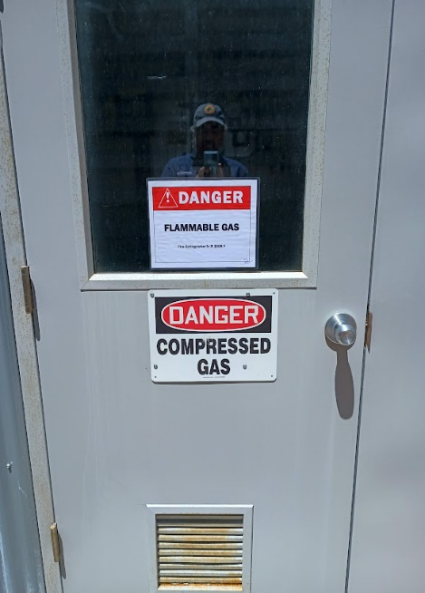
sPHENIX: Data taking
“Photon/Jet triggers” have been accumulating a lot of physics data.
Better: turn-on curve (in the lookup table) is going to be sharpened.
We have worked with ESSHQ of C-AD and BNL SME in the USI process in order to use up to 5% isobutane to get to more efficient operating voltages for the TPC in sPHENIX.
They want to confirm with BHSO before giving us the USI approval.
We’re making the necessary implementation of hardware/software (in the IR & Gas-Mixing House) and will use N₂ to test the controls.
MBD group has been making progress (firmware/software) toward MBD vertex trigger — important for the tracking/tracking-detectors.

Slide 3
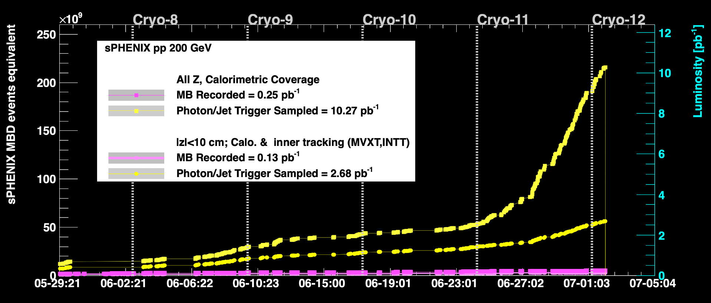
0-mrad crossing angle has boosted our data taking especially outside |z| <10 cm (Full physics program is based on sampling at least 45/pb for |z| < 10 cm.)

Slide 4
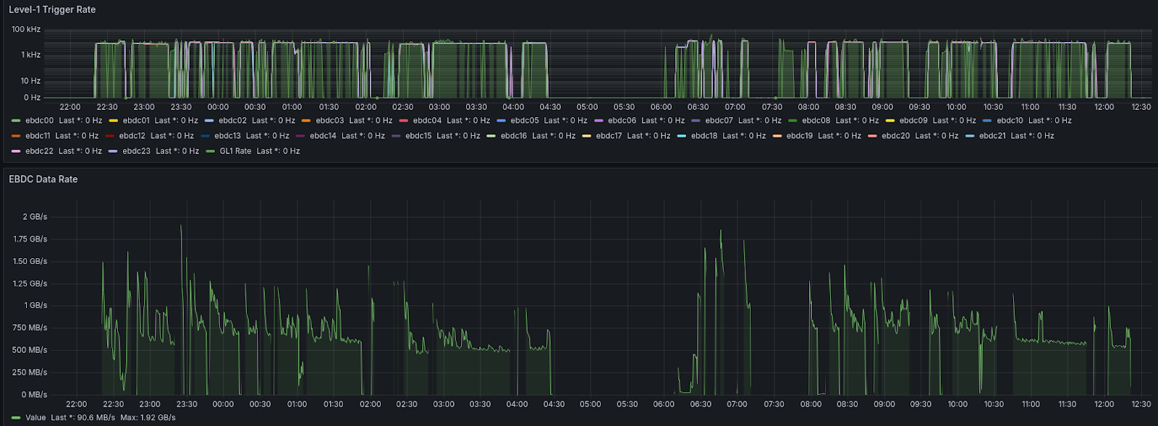
TPC is getting zero-suppression to work ..
GL1/EBDC (Event Buffer & Data Compresso) trigger rates
EBDC data rate
Bright spots are noisy FEEs maksing out over time)

Slide 5
INTT is going towards running in “Streaming Mode”

