Slide 1
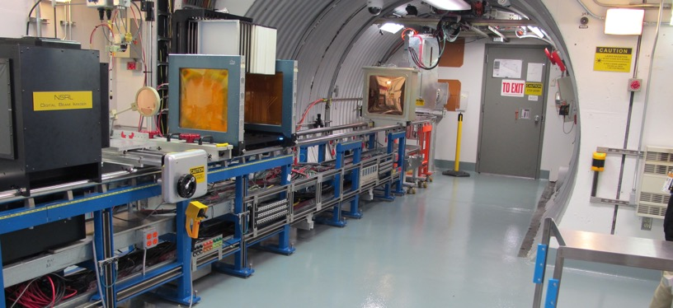
NSRL Time Meeting Report
2 July 2024
Michael Sivertz

Slide 2
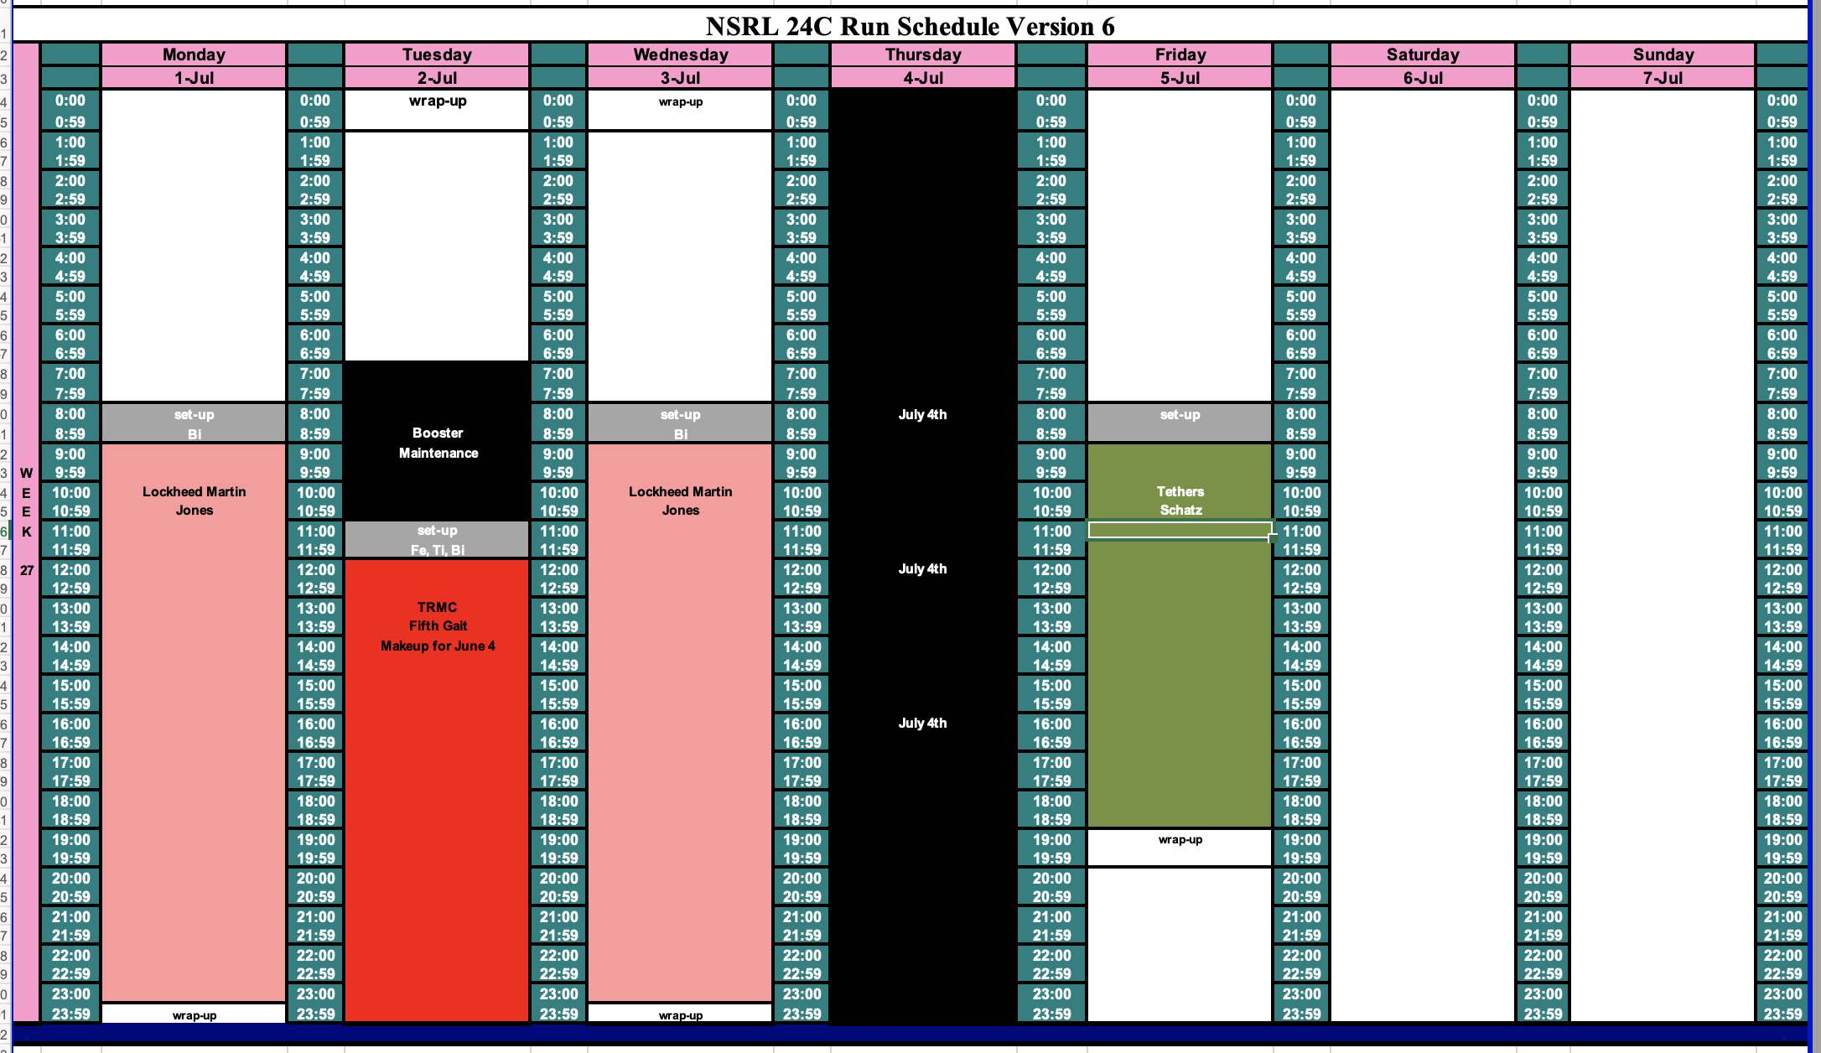
Schedule for this week

Slide 3
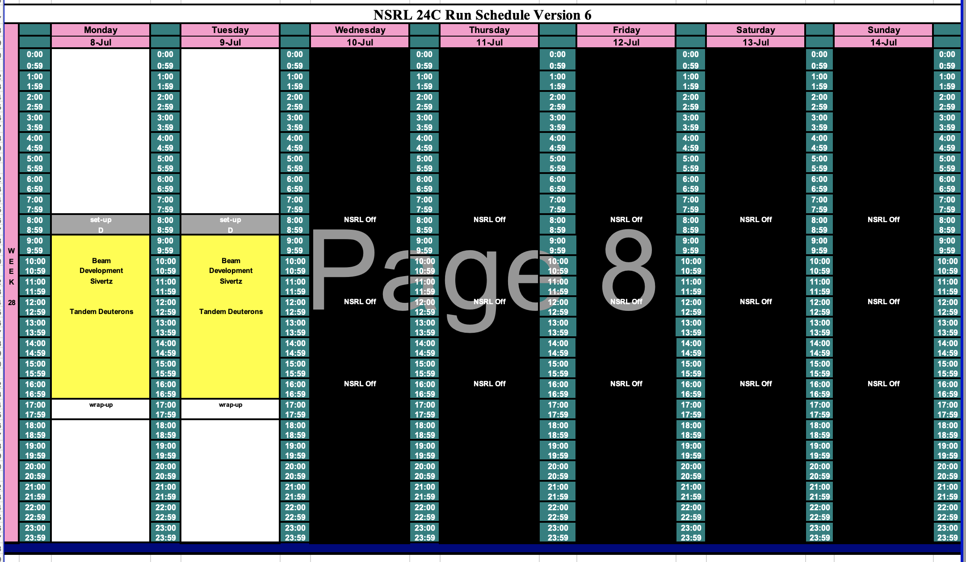
Schedule for next week

Slide 4
Future Schedule
Electronics testing continues this week with 16-hour days running 4-days a week.
NSRL is off for the July 4th Holiday.
Maintenance Day falls on Tuesday.
Beam Development for deuterons from Tandem on 8 - 9 July 2024.
NSRL is shut down 10 – 21 July for EBIS work on RHIC Gold.

