Slide 1
Data courtesy C. Naylor

Slide 2
Data courtesy C. Naylor

Slide 3
Data courtesy C. Naylor

Slide 4
Data courtesy C. Naylor

Slide 5
Data courtesy C. Naylor

Slide 6
Data courtesy C. Naylor

Slide 7
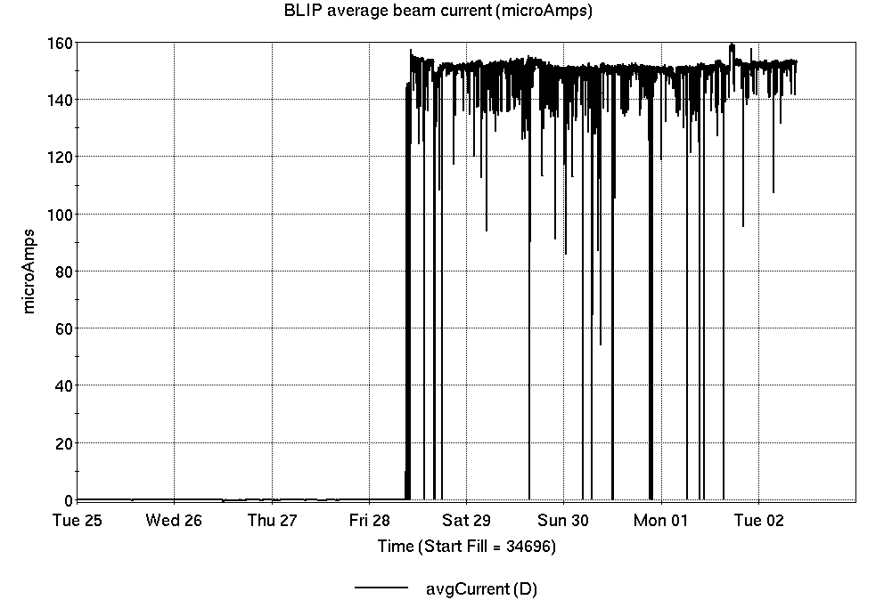
Operations for BLIP
6/25-7/1/2024:
200 MeV Th target production began Friday and continues through the week.
93.12 hr Production
1.18 hr Setup
0.7 hr Failure
Availability: 99.3%
No BLIP
this past week

Slide 8
NSRL activity past week: 6/25-7/2/2024 (as of 0800)
NSRL: no beam on holiday, multiple users.
Protons, 6 EBIS ions in use. (Si, Fe, Ag, Tb, Bi, Au)
Running 24-C schedule since 22 May. Schedule posted, no users 6-21 July: Tandem d, EBIS Au beam development; beams & users into November.
Availability: 95.5%

Slide 9
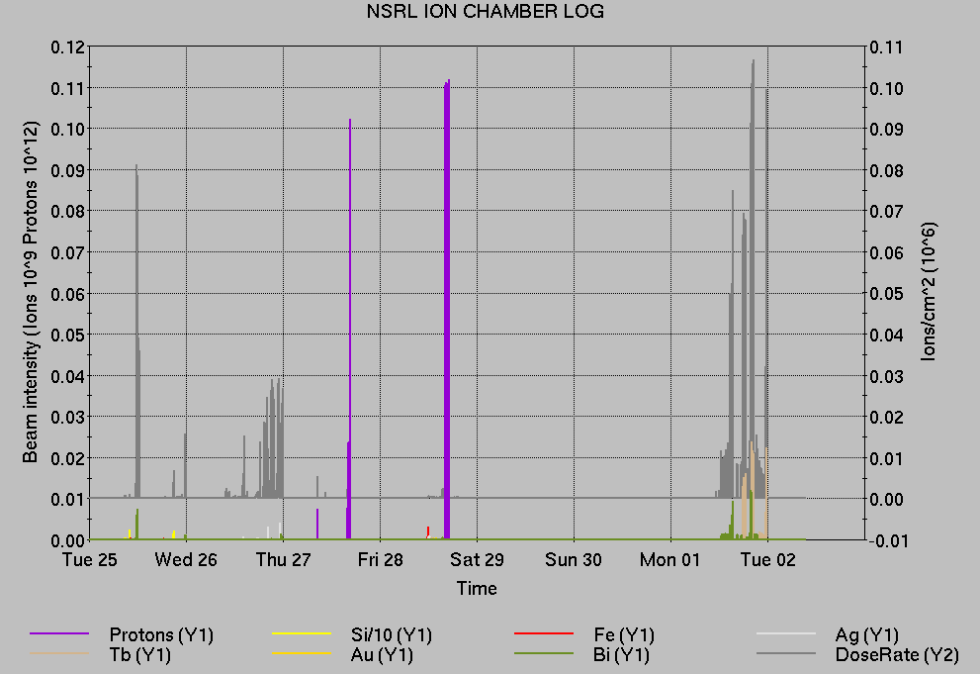
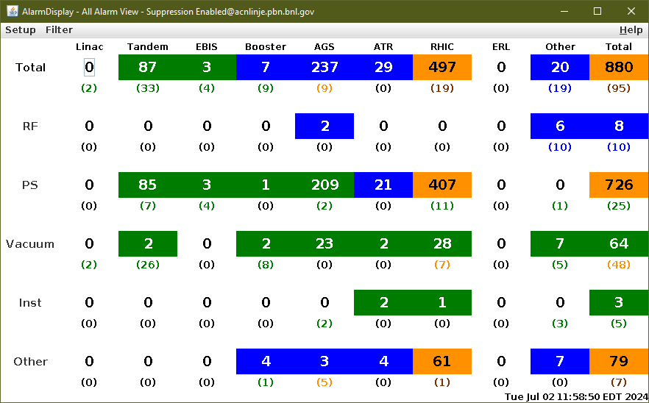
Notes from Operations
Notable failures (>1 hr)
Cryo lead flow interlocks (2x), replaced HW in Yellow sector 11.
AGS cold snake ramp problems (sPHENIX access concurrent to delay).
Linac Mod 1 failure, 50kV PS fan replacement .
Power dip, affecting many systems complex-wide. Subsequent EBIS, injector beam recovery was extensive.
PASS system failures interlocked RHIC beam (2x)
AGS E20 warm snake PS failure, additional blower motor work.
RHIC yo1-tq6 PS failure/abort, current regulator card replaced.
Other notes
Weather stand-down
Various Linac Mod, RFQ trips/resets
Loss monitor interlocks, RHIC beam aborts (6x)
Other misc EBIS, injector, beamline, RF trips. Some long repairs occur behind RHIC stores.
Maintenance day…

Slide 10
Reminder from Operations
MCR continues Operations for:
BLIP – continues into next week ending 9 July.
NSRL user scheduled to run Mon-Fri this week (except holiday); Development only next week.
AGS/Booster setups continue, additional to RHIC physics.
Injector Au setup as yet untested.
Injector h setup requires additional work.
Skew quad testing, other polarized beam setups continue as beam time allows.
Tandem d setup for NSRL pending.
RHIC beam for Physics stores.
Other MD, Maintenance, APEX as noted in schedule
RHIC Tunnel access, sweeps remain under ODH-1 restrictions.
CHECK AND EDIT YOUR OWN CONTACT INFO
http://directory.pbn.bnl.gov/
CHECK YOUR CALLIN LIST: WCC and ECP updates needed
https://www.cadops.bnl.gov/Operations/personnel/call_in_lists/
Note: Core Electrical contacts listed/managed on ESSHQ callin list https://www.cadops.bnl.gov/Operations/personnel/call_in_lists/call_in_list.php?group=esshq

Slide 11
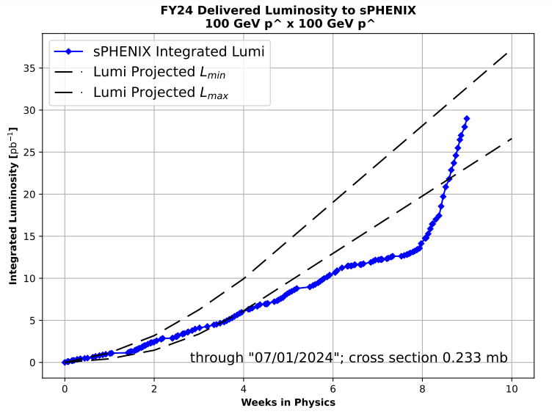
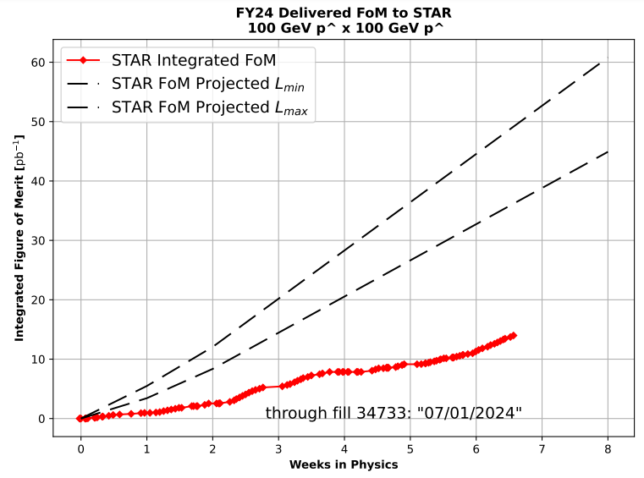
Preliminary delivered Luminosity, Figure of Merit (LP²) data for RHIC
Courtesy R. Terheide

Slide 14
Availability, expected beam hours
$$Availability=\frac{actual beam time}{scheduled beam time}≡\frac{Beam use time}{Calendar time−scheduled interruptions}$$
$$RHIC \\ Availability=\frac{Physics+Machine Development+Machine Setup+Experiment Setup+Accelerator Experiments}{(Physics+Machine Development+Machine Setup+Experiment Setup+Accelerator Experiments)+Failures}$$
$$\text{DOE} \text{expected} \text{beam} \text{hours}=(\# of weeks −1 week overhead)×\left(\frac{160 available hours}{1 week}\right)×0.8$$
Notes:
Normally hidden. Explains how the 85% from DOE comes in to play, & general availability metrics

