Slide 1
TAKE FIVE for Safety- Department of Energy Safety Day of Reflection Feedback
Frank Craner
July 9, 2024

Slide 2
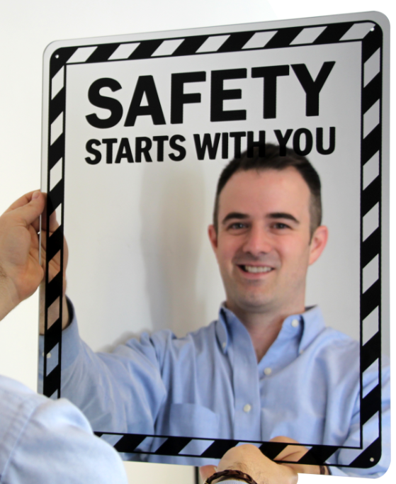
DOE Day of Reflection June 26, 2024
ME
DOE’s Day of Reflection: intended to create an emotional connection to safety and raise awareness of the impact that workplace injuries can have on families, friends, colleagues, and our DOE missions.
In-person presentations from BNL staff
Video montage on how injuries and incidents have impacted staff and the lessons learned
“Safety Starts with Me” virtual memory board for staff to add stories and reflect
Mirror Presentation, “I Reflect Safety”
Rolling Safety Pause across BNL – each group will take 30 min pause sometime during the Day of Reflection for a discussion on how we can improve safety in each group.
Emphasis on SCoR principle - Learning Never Stops

Slide 3
Heavy/Bulky Material Handling Concerns
Many groups reported challenges with handling or moving heavy materials or equipment.
Examples:
Large water hoses
Acid flush cart
Garage sway Lift
Moving heavy equipment in/out of Tandem vessels
Power supplies

Slide 4
Walking/Working Surface Concerns
Many groups identified areas where walking or working surfaces affected the work:
Use of scaffolding rather than manlift due to training
Staircase to VJR Lines
Removable ramps for passing through Doorway entrances
Elevated Work Platform for Tandem Power Supplies
1004 IP Bridge
Staircase at 7GE1
Carrying tools up and down steep staircases

Slide 5
Taking Action
Facility related feedback will be provided to Research Space Managers
Work Control Coordinators can review material handling tasks with ESH to identify mechanical assistance
Supervisors can review available material handling equipment

Slide 6
Ergonomic Guidance in SBMS
Risk Factors for Manual Handling Tasks
A risk factor is: |  |  | A corrective action plan may be:
1 | Carrying greater than 25 lbs. manually more than 25 ft. |  | Use a cart or reduce the weight
2 | Extending the arms more than 24 inches from the body while holding over 5 lbs. |  | Get closer or use a support
3 | Maintaining static postures for long periods (e.g. crouching) |  | Reposition postures frequently
4 | Using maximum force to push or pull an object with the body |  | Use a mechanical device or get help
5 | Lifting an object above or below shoulder height |  | Raise or lower the load or person, if possible
6 | Lifting more than 50 lbs occasionally or more than 25 lbs. frequently |  | Get help or reduce the weight
7 | Working with back bent without support to move an object |  | Raise the load or lower the person, if possible
8 | Reaching above shoulder height repeatedly |  | Raise or person or lower the load, if possible
9 | Twisting the body without moving the feet |  | Redesign the task
10 | Reaching behind the body frequently |  | Move the parts or tools in front of the body
11 | Using the same motion with little variation every few seconds |  | Rest, take breaks, or redesign the task
12 | Using high hand force (e.g. pinching an unsupported object) |  | Use tools and aids to reduce pinch force
13 | Having repeated impact to hand or any body part repeatedly (e.g. using a hammer) |  | Use tools specific for the task
14 | Gripping an unsupported object and squeezing |  | Use tools specific for the tack
15 | Working with wrist bent repeatedly |  | Reposition the work or work station to reduce bent wrist position
16 | Working with ands and elbows above shoulders for extended periods |  | Lower and reposition the work
17 | Working with elbows out from sides |  | Reposition the work
18 | Working with neck bend forward/backwards |  | Reposition work station to reduce the need to bend the neck
19 | Working with power tools or equipment with constant vibration to hands, arms, and upper extremities |  | Use vibration dampening materials
20 | Working in extreme temperatures (<45F or >90F) |  | Wear appropriate clothing and rehydrate as necessary
Safety Guide | ES&H (bnl.gov)

