Slide 1
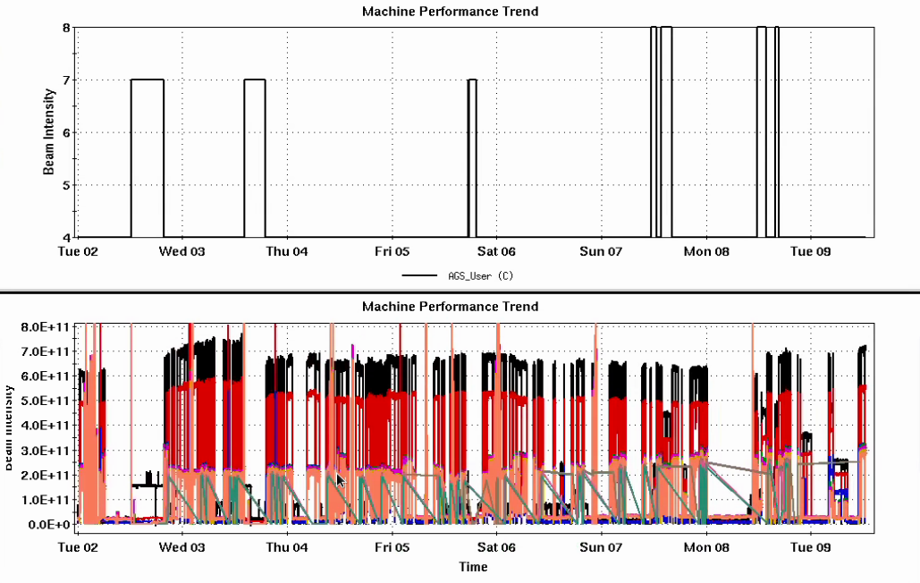
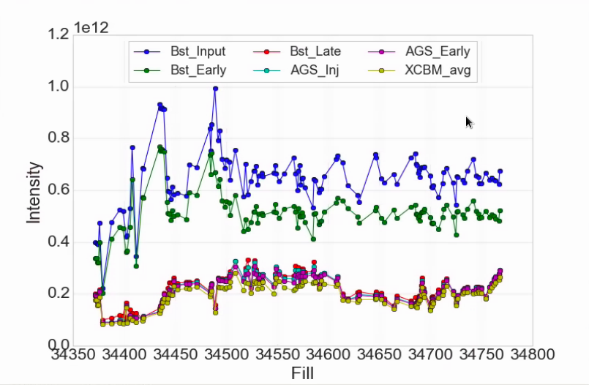
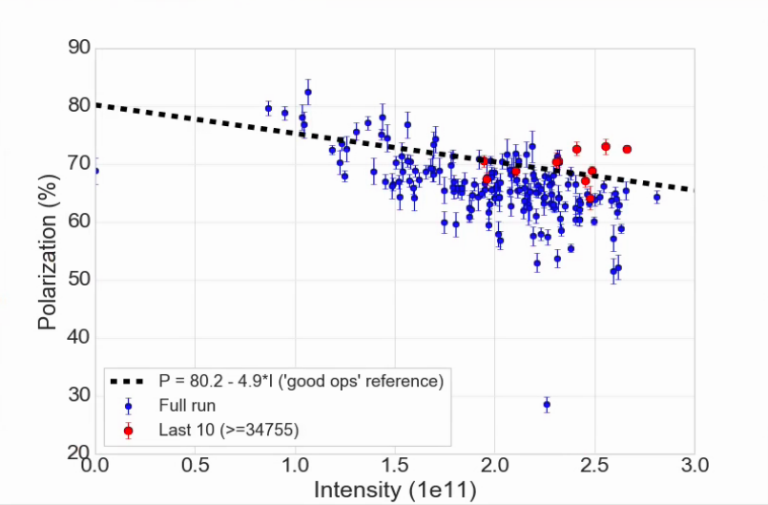
Injector Status, 7/09/24
Operations overview
RHIC taking up to 2.5e11 out of the AGS
Polarization up around the ‘good ops’ line
Timing scan of the tune jump
”dead layer” calibration
EBIS working on Au at the source for the next two weeks
AGS User
Intensity
Developments
3He extracted to W-dump, 1e10/bunch
Resonance correction skew quad development during AGS acceleration
Good progress on orbit control
No impact on polarization yet
Injector Intensity by Fill
AGS Pol by Intensity (for fills)
(not a fit)

Slide 2
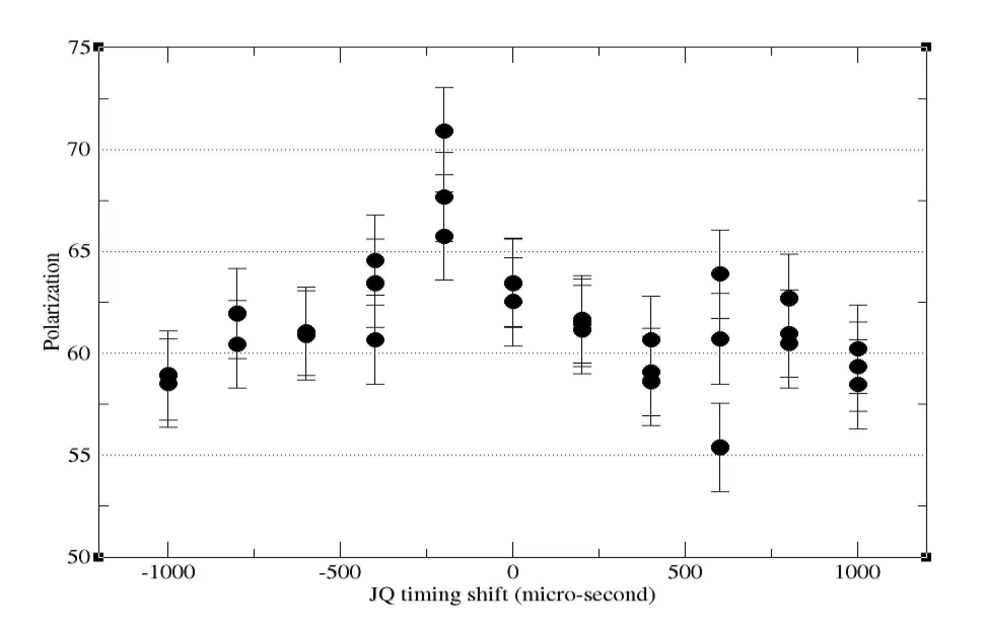
Tune jump timing scan
The 200 us advance is ‘normal’
The peak is abnormally narrow around the optimum

Slide 3
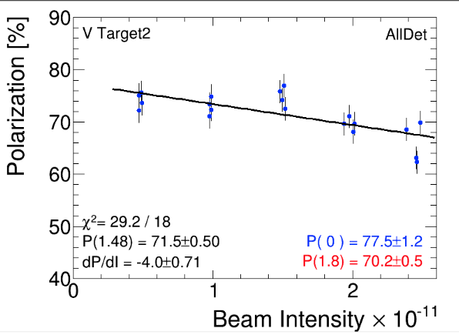
Intensity scan
Taken with new target (V2), after timing scan, but still previous calibration
Anything at or better than -5%/1e11 is good

