Slide 1
Preinjectors Status
D. Raparia
Time Meeting
July 09, 2024

Slide 2
Tandem
External Users :
- Last week: Deuteron for booster setup, International rectifier
- July 8-19: Education program RENEW
- Next 3 weeks: electric work

Slide 3
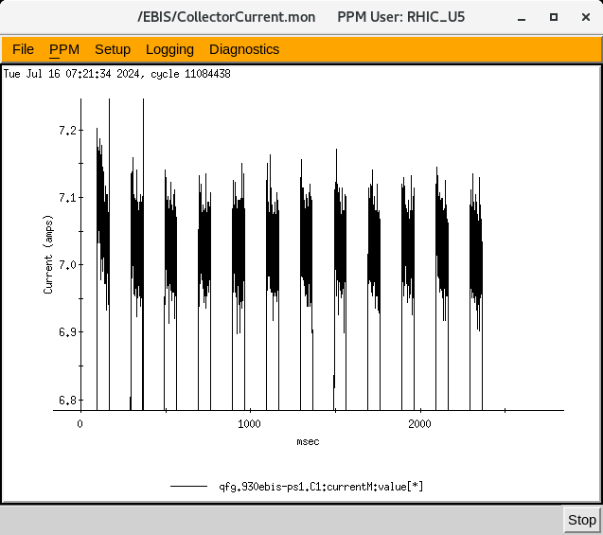
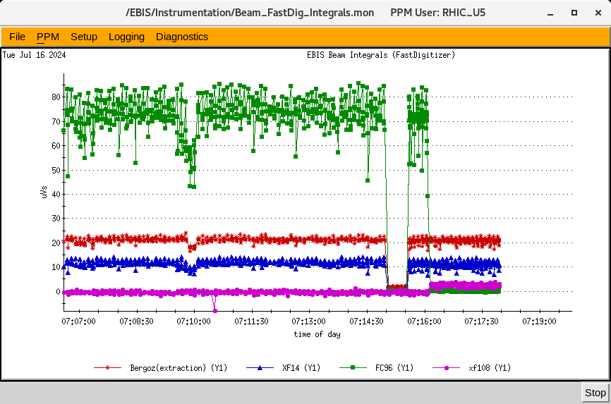
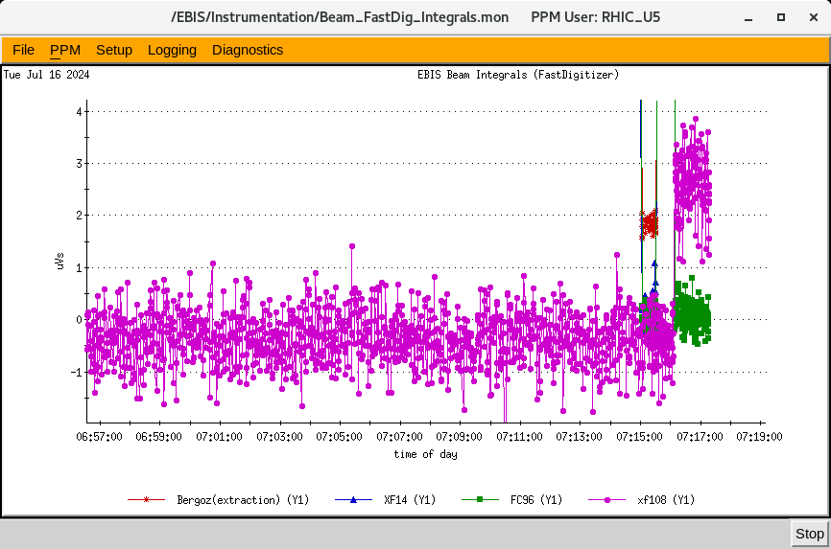
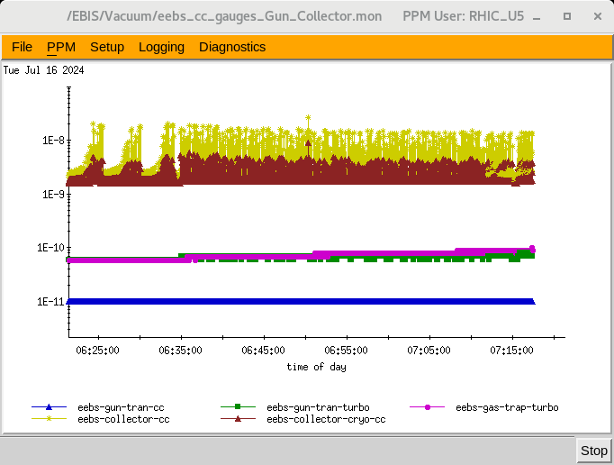
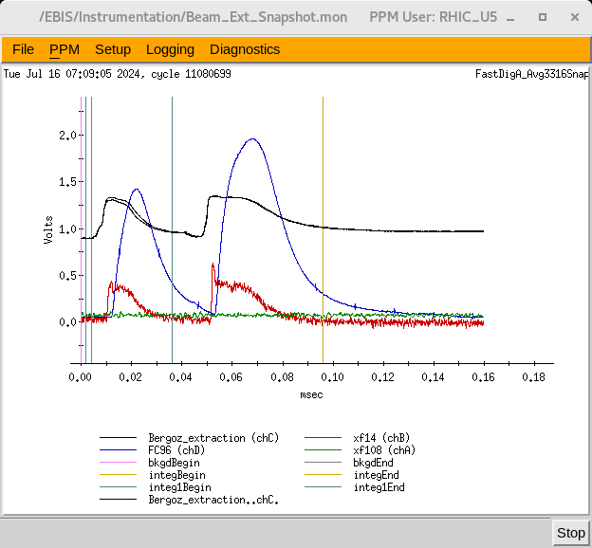
EBIS
Electron beams between 6.5 and 7.5 A, ~ 70 ms pulses
Extracted ion pulses optimized for Au+32 up to 12 P/SC@ 2.5- 5 Hz for super cycle 4.2 and 6.6 sec
Highest Average output obtained for 6P and 12P/SC at xf108: ~3.3uVs for Au32+ (9.2E8 ions/pulse)
The goal for the two weeks period is ~1E9 Au32+ ions/pulse
Pulse amplitude stability occurs for 5Hz rates; under investigation
12 pulses, 5 Hz, 2.2-3.7 uVs at xf108, above 70 uVs at fc96.

Slide 4
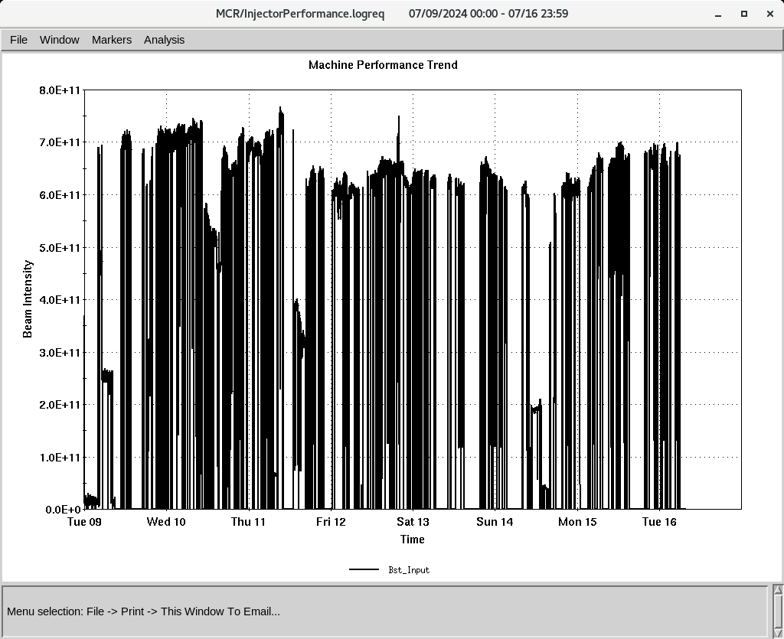
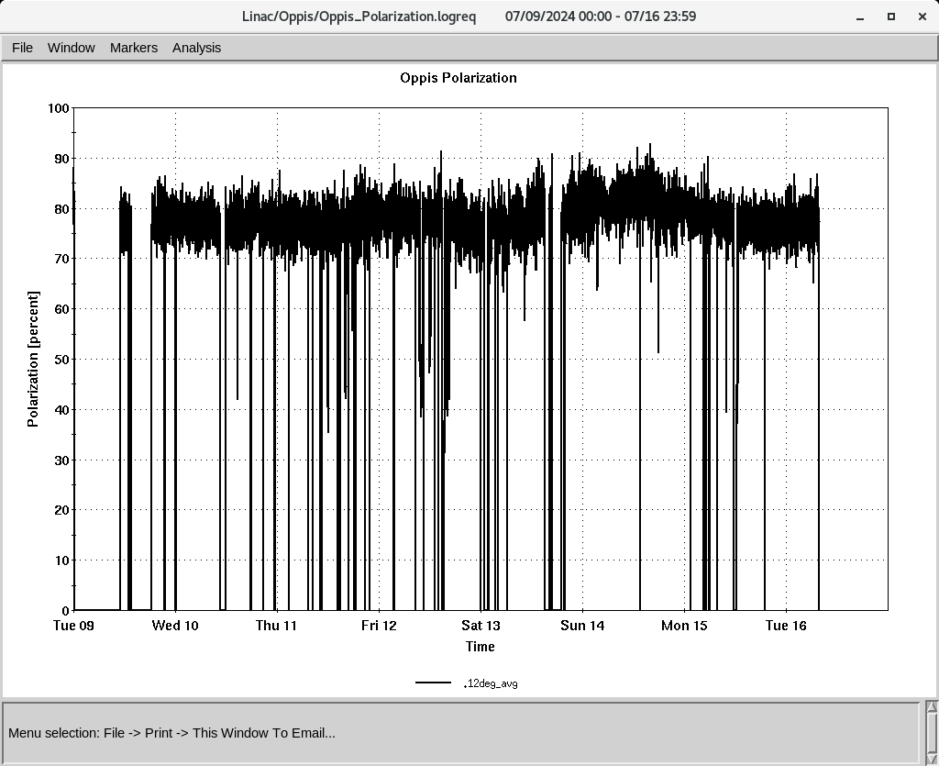
Linac 200 MeV Beam to BLIP , Booster
To Booster
BLIP
6/16-6/17: Dy Foil, 200 MeV, 3 𝞵A
6/17-6/18: As , 116 MeV, 50 𝞵A
OPPIS
Normal current and polarization
350-370 , 𝞵A ~ 80%,
- Added 6 g Rb on Sunday
H-Jet running smoothly,
Polarization @ 200 MeV
Down time (<1 HRS)
RF trips and reset: RFQ, Mod 3, Mod 5, MOD7
6/9:Replaceed 4616 for RFQ
6/9: Replaced 4CR2500 tube in Mod 3
6/10: Changed source 2 to source 1
6/10:Tune BLIP for 3 𝞵A
6/16: Replaced LPT32 in Mod 9

