Slide 1
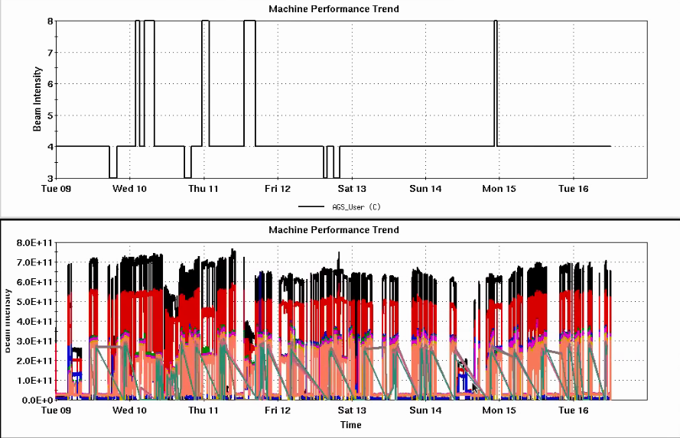
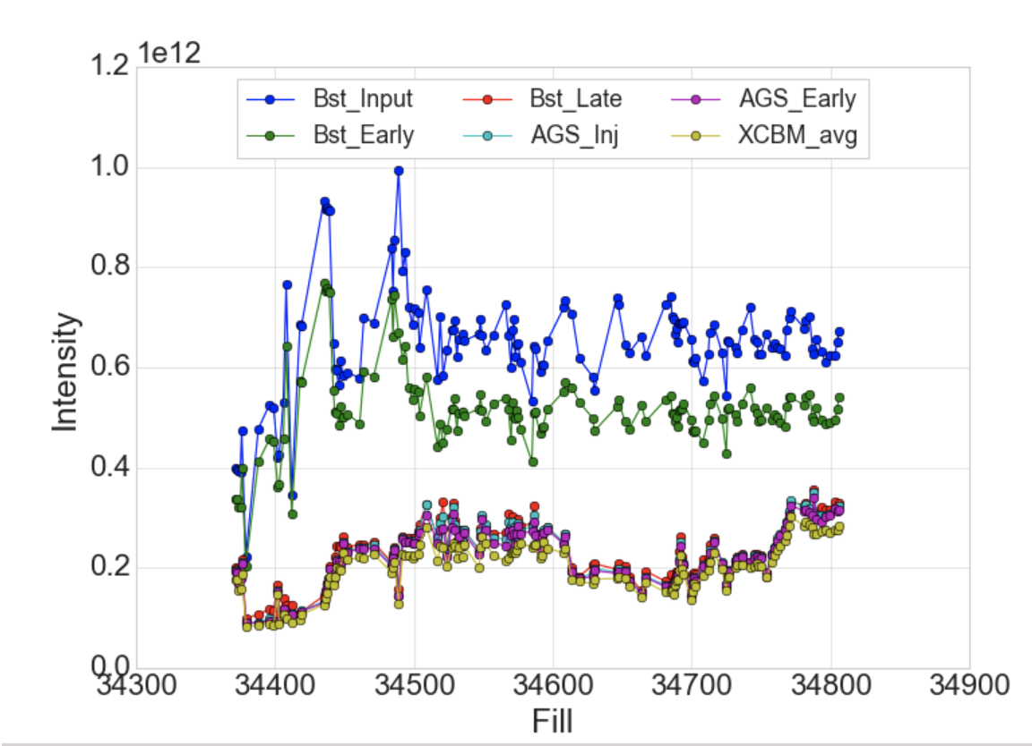
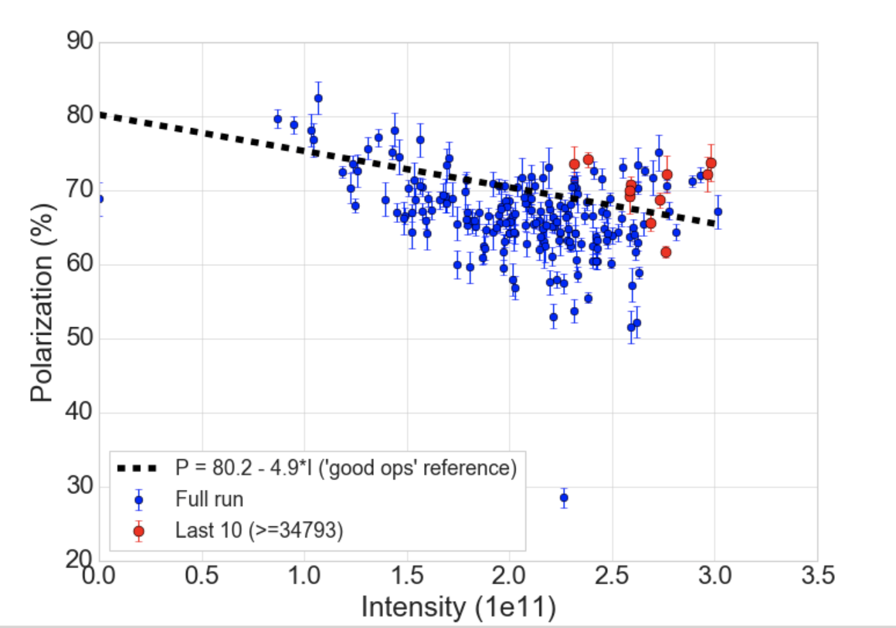
Injector Status, 7/16/24
Operations overview
RHIC taking up to 2.5e11 out of the AGS
Polarization up around the ‘good ops’ line
AGS polarization seems unusually high, still investigating effects of changes to target and detector calibration
RHIC injection emittance larger recently
May be related to
higher intensity in AGS
injector inefficiencies over the weekend. Some addressed already (e.g. RF cavity work)
Injection kicker problem (forced more intensity in AGS for same RHIC intensity
AGS User
Intensity
Developments
Resonance correction skew quad development during AGS acceleration
Iterating on orbit control
Offline investigations into calculation of the resonance phases during the ramp
Ramp asymmetry measured for resonance timing
Injector Intensity by Fill
AGS Pol by Intensity (for fills)
(not a fit)

