Slide 1
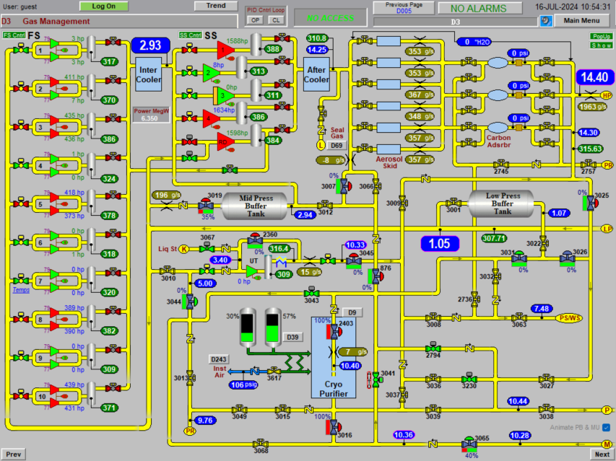
C-AD Cryo Group, 7/16/24
RHIC and AGS snake maintenance and events since last RHIC time meeting
RHIC Central Plant has been generally running well
AGS cold snake: steady operations, need to fill make-up gas next maintenance day → Need 16 hours to fill (maintenance + overnight store ?)
On-going search for source of increased helium leak rate. Focus on warm high-pressure areas.
7/12 Power Dip, recovered quickly
7/10 9Q14 corrector flow repair
1005H Control Screen

