Slide 1
sPHENIX status
Kin Yip
sPHENIX Director of Operations
Time meeting
July 16, 2024

Slide 2
Flowing isobutane in TPC of sPHENIX
Agreement to implement the July 12 version of the USI.
There will be an AESRC review tomorrow and after that, the USI would be ready for signatures.
We are also updating procedures, alarm instructions and necessary training.
Walkthrough will be scheduled in consultation with AESRC.
Target date for operation: earlier next week.

Slide 3
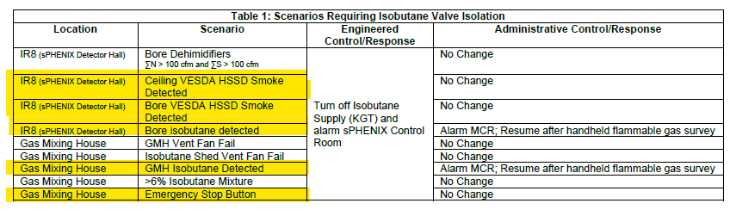
We are implementing the above controls necessary for sPHENIX to flow isobutane from the Gas Mixing House to the IR.
  The firmware and software implementation/changes are done by an outside company as well as a BNL software engineer.
Fans in the isobutane shed and the Gas Mixing House are being restored.
Ventilation in the IR bore (~ inside Magnet doors) needs to be maintained continuously.

Slide 4
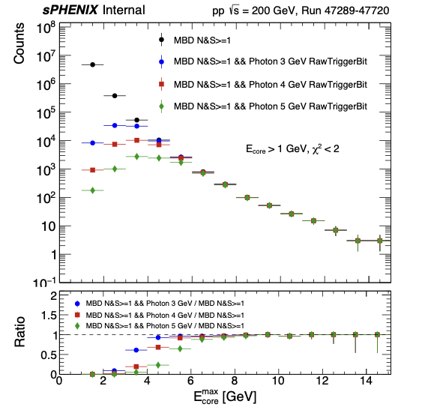
sPHENIX : Physics Running
New trigger firmware for Photon/Jet trigger looks good,
which is now well verified via offline by multiple people.
New MBD calibrations now enables “MBDNS>=1,
vertex < 10 cm selection”.
Now taking data at high rates for all detectors, Global
L1 / timing variations are causing (new) problems for
triggers, which are being resolved.
  Uptime > 60%
Though not being able to use the gas chamber, TPC colleagues continue to test zero-suppression firmware/electronics.
Even without using the gas, TPC colleagues continue to test zero-suppression.

Slide 5
Newest luminosity curves
( Full physics program is based on sampling at least 45/pb for |z| < 10 cm.)

