Slide 1
Data courtesy C. Naylor

Slide 2
Data courtesy C. Naylor

Slide 3
Data courtesy C. Naylor

Slide 5
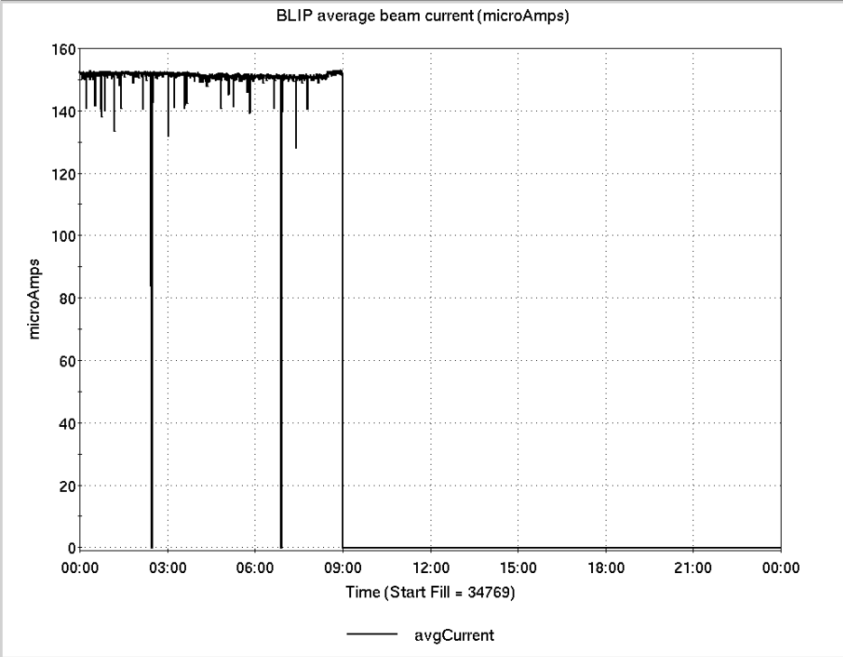
Operations for BLIP
7/9-7/16/2024:
200 MeV Th run ended Tuesday. Next run 7/29-8/4
1.0 hr Production
0.0 hr Setup
0.0 hr Failure
0.0 hr Maintenance
167.0 Shutdown
Availability: 100.0%
No BLIP
this past week

Slide 6
NSRL activity past week: 7/9-7/16/2024 (as of 0800)
NSRL: Deuteron setup/development on
Tuesday.
Shut down for remainder of week and next week. Run 24C due to begin again on Monday 7/22.
Running 24-C schedule since 22 May. Schedule posted, details updating; beam into November.
Availability: 69.1%

Slide 7
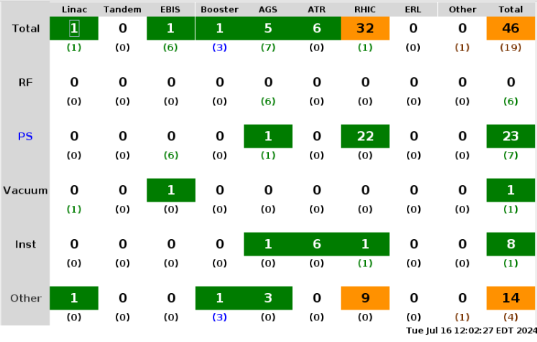
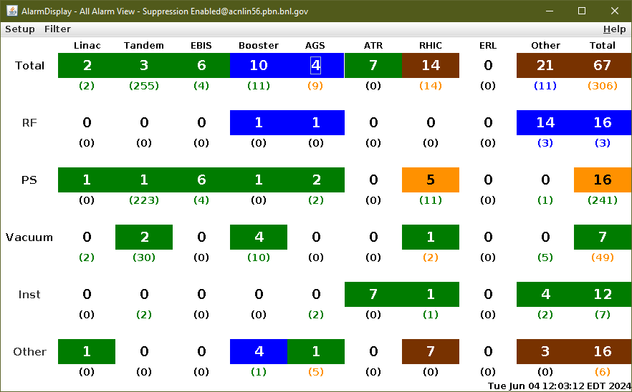
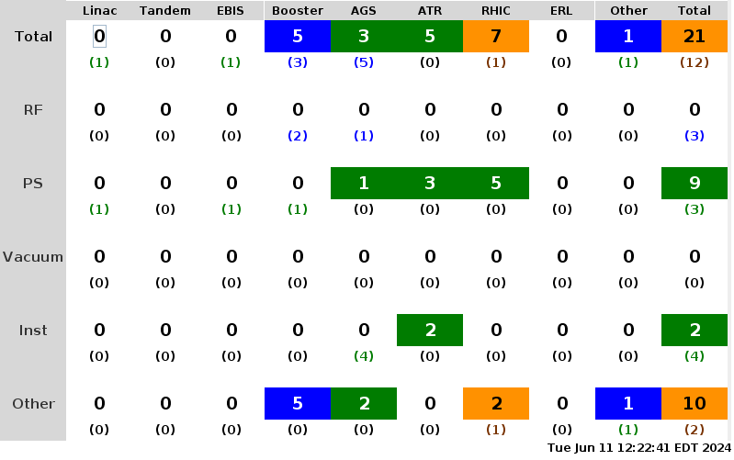
Notes from Operations
Notable failures (>1 hr)
Access for sPHENIX – controller for TPOT, PS for EMcal
RHIC RF BA1 – access to replace QEI
Cryo lead flow 9Q14 – replaced analog input card
Cooling trouble (1000P) – tripped AtR PSs
sPHENIX access to work on EMCal
RHIC PS – ground current yi7-sxd-ps sextupole tree
Power Dip (7/13) – several hours to recover
PASS sector 8 – access trouble for sPHENIX
RHIC PS – replaced controller board & current
regulator card to bi5-qf3-ps
QLI thi morning – trouble y2-dh0
Other notes
Multiple Rad Mon Interlocks
Cold Snake Quad B1 trips
STAR PS trips
Controls Hardware replaced cfe-f18-vme chassis
AGS access to replace SSFB amp to station IJ
AGS RF station currently down – Acopian/TCR
PS trouble – located beneath cavity controller

Slide 8
Reminder from Operations
MCR continues Operations for:
BLIP – 200MeV run has ended. Next run 7/29 – 8/4.
NSRL – no user scheduled this week. Due to begin again next week.
AGS/Booster polarized proton setup continues in addition to RHIC physics.
Maintenance scheduled for tomorrow.
Other MD, APEX as noted in schedule
RHIC Tunnel access/sweeps back to ODH-0 restrictions.
CHECK AND EDIT YOUR OWN CONTACT INFO
http://directory.pbn.bnl.gov/
CHECK YOUR CALLIN LIST: WCC and ECP updates needed
https://www.cadops.bnl.gov/Operations/personnel/call_in_lists/
Note: Core Electrical contacts listed/managed on ESSHQ callin list https://www.cadops.bnl.gov/Operations/personnel/call_in_lists/call_in_list.php?group=esshq

Slide 9
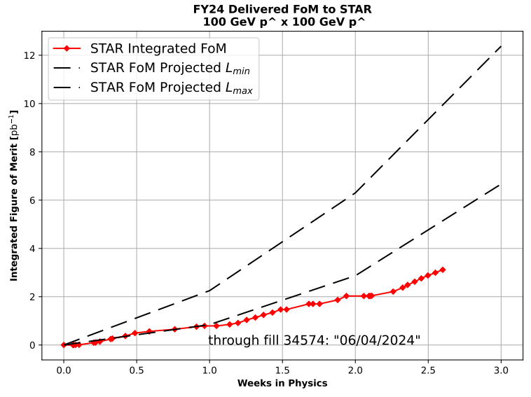
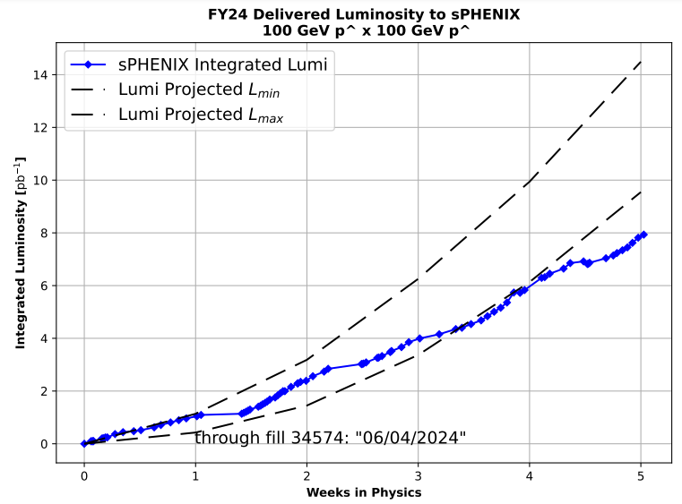
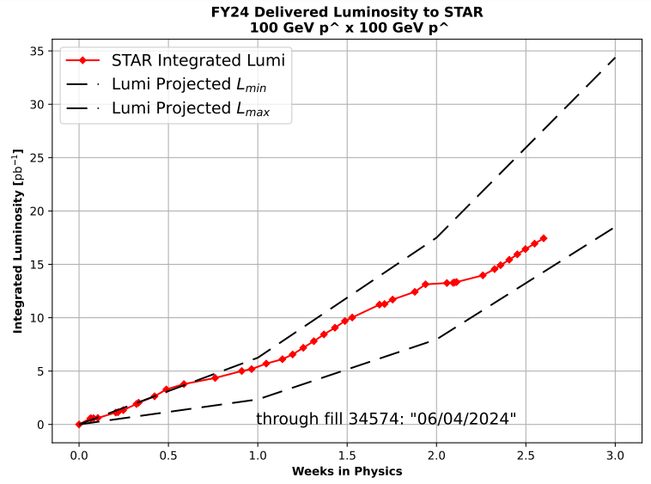
Preliminary delivered Luminosity, Figure of Merit (LP²) data for RHIC
Courtesy R. Terheide

Slide 10
72.6%
Avg. Availability: 77.7%

Slide 12
Availability, expected beam hours
$$Availability=\frac{actual beam time}{scheduled beam time}≡\frac{Beam use time}{Calendar time−scheduled interruptions}$$
$$RHIC \\ Availability=\frac{Physics+Machine Development+Machine Setup+Experiment Setup+Accelerator Experiments}{(Physics+Machine Development+Machine Setup+Experiment Setup+Accelerator Experiments)+Failures}$$
$$\text{DOE} \text{expected} \text{beam} \text{hours}=(\# of weeks −1 week overhead)×\left(\frac{160 available hours}{1 week}\right)×0.8$$
Notes:
Normally hidden. Explains how the 85% from DOE comes in to play, & general availability metrics

