Slide 1
APEX Report
RHIC Time Meeting, July 16, 2024

Slide 2
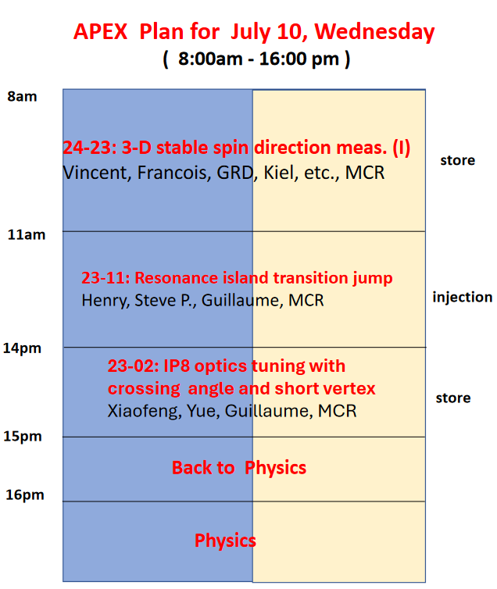
Used 4 hours
Used 2 hours
Used 1 hours

Slide 3
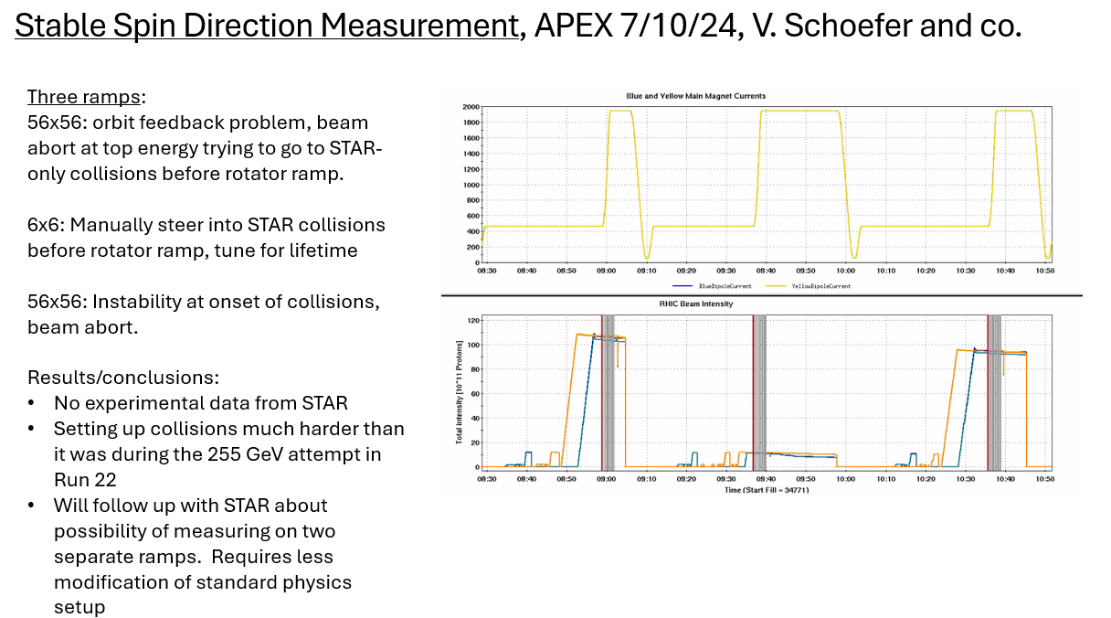

Slide 4
Exp 23-2: IP8 optics tuning with crossing angle and short vertex Xiaofeng, William, Guillaume, Yue, MCR, Brendan

Slide 5
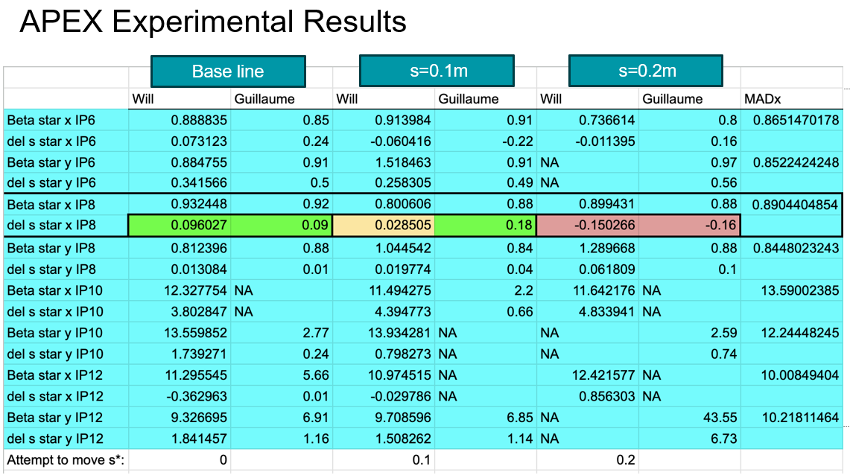

Slide 6
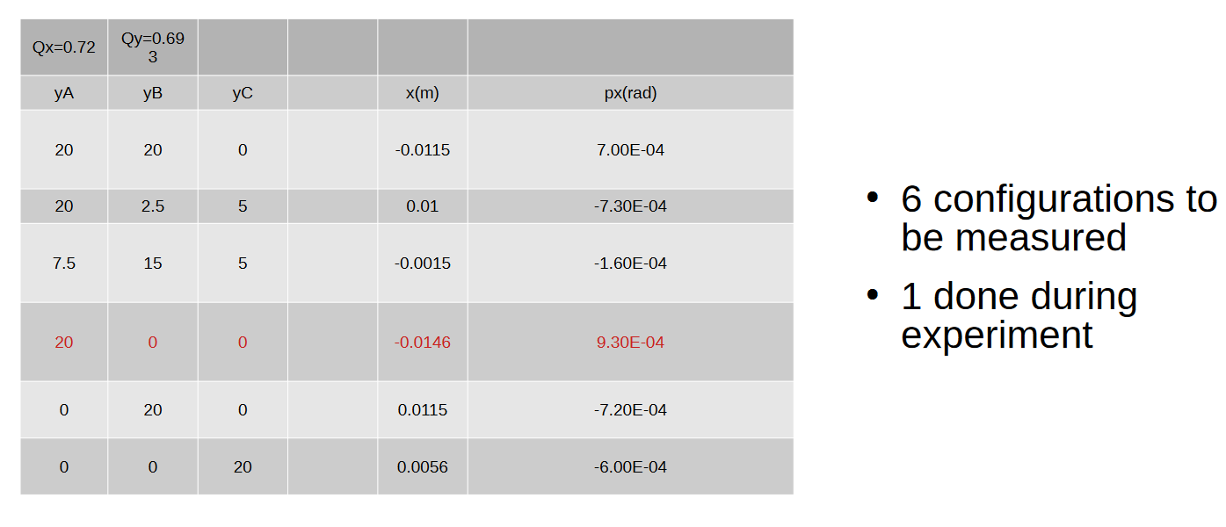
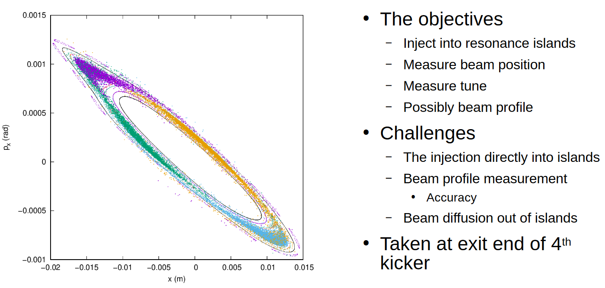
23-11: Resonance Island Transition Jump Part I Henry Lovelace III, Steve Peggs, Guillaume Robert-Demolaize, Angelika Drees

Slide 7
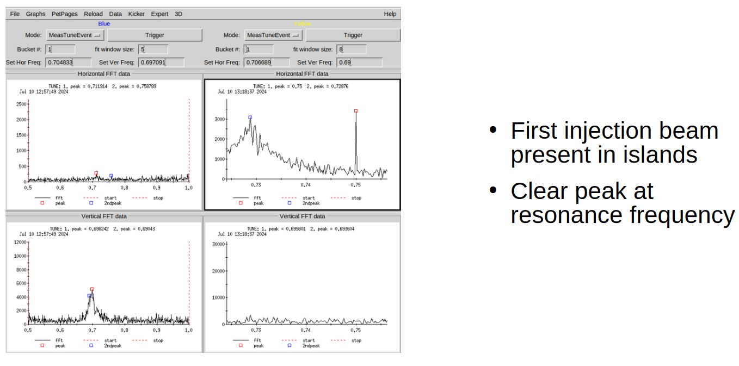
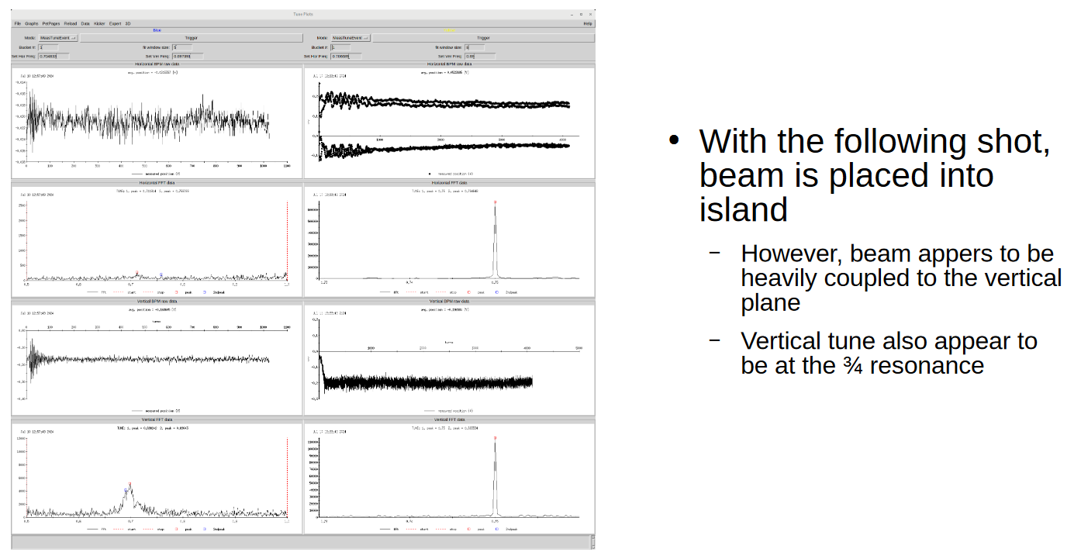

Slide 8
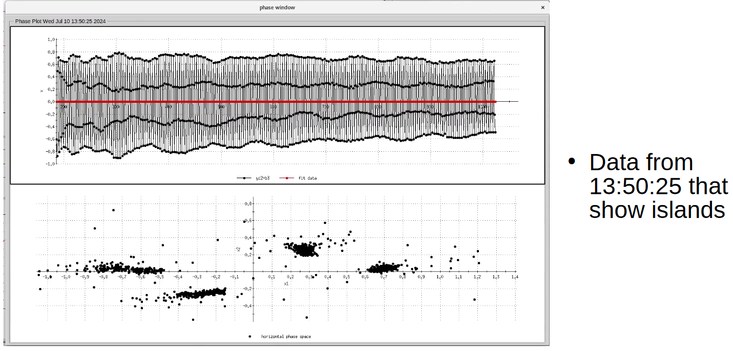
July-10 experiment Summary:

Slide 9
For July 24 APEX Session:
We will focus on “setup for Test of tagging He3+ breakup in Hjet and initial measurement “.

