Slide 1
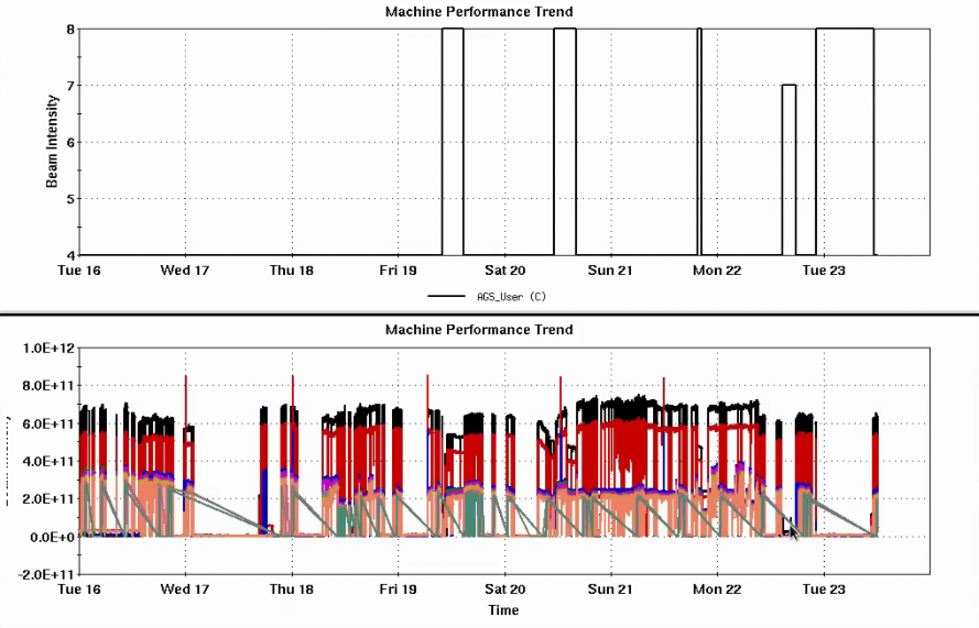
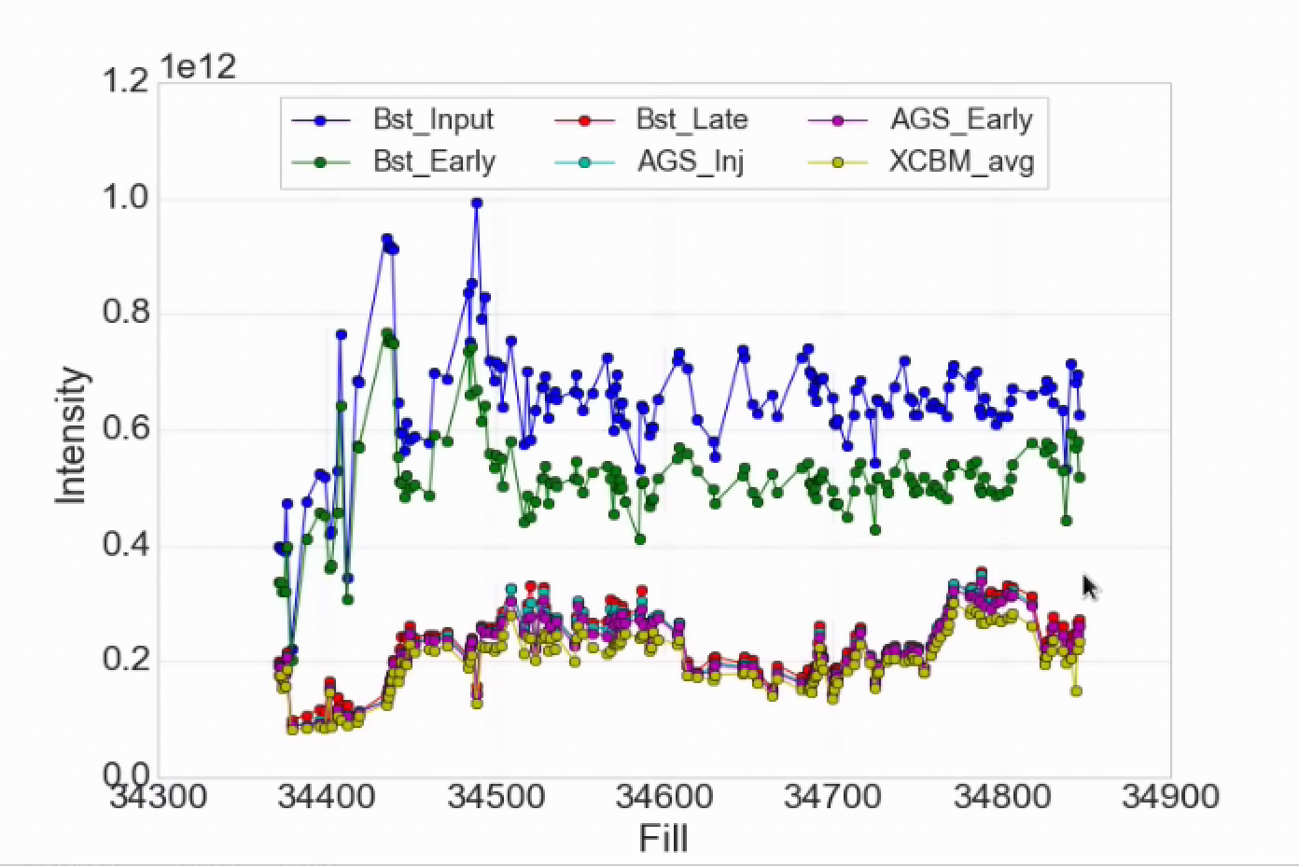
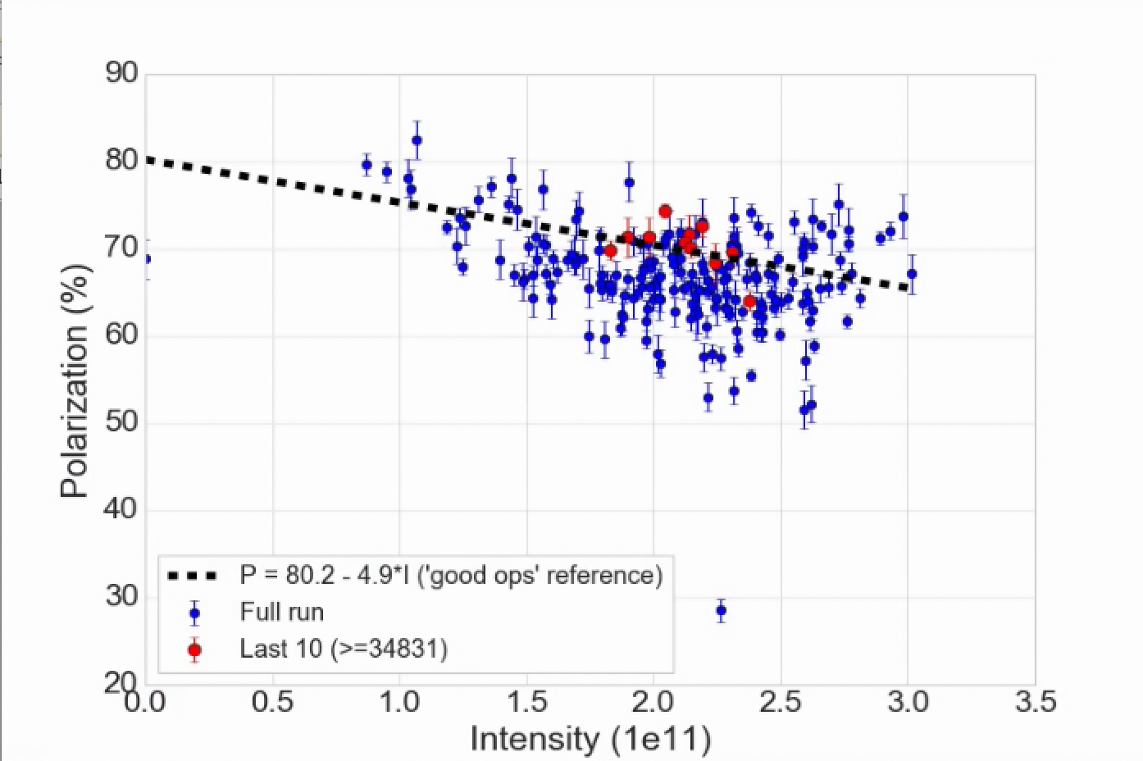
Injector Status, 7/23/24
Operations overview
RHIC taking 2-2.5e11 out of the AGS
Polarization up around the ‘good ops’ line
In line with historical good running
Some incremental changes to polarimetry
Good transverse emittances
AGS User
Intensity
Developments
Resonance correction skew quad development during AGS acceleration
First observation of polarization gain on the ramp!
Indication that early resonance correction is harming polarization (to be investigated)
3He development for APEX
Injector Intensity by Fill
AGS Pol by Intensity (for fills)
(not a fit)

Slide 2
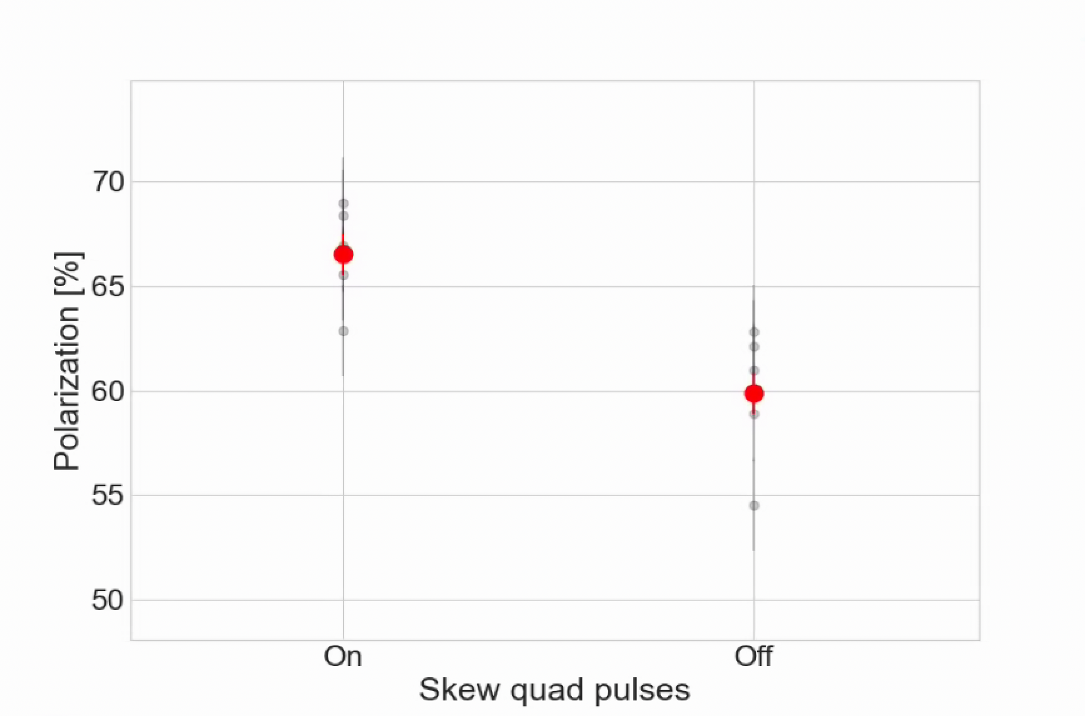
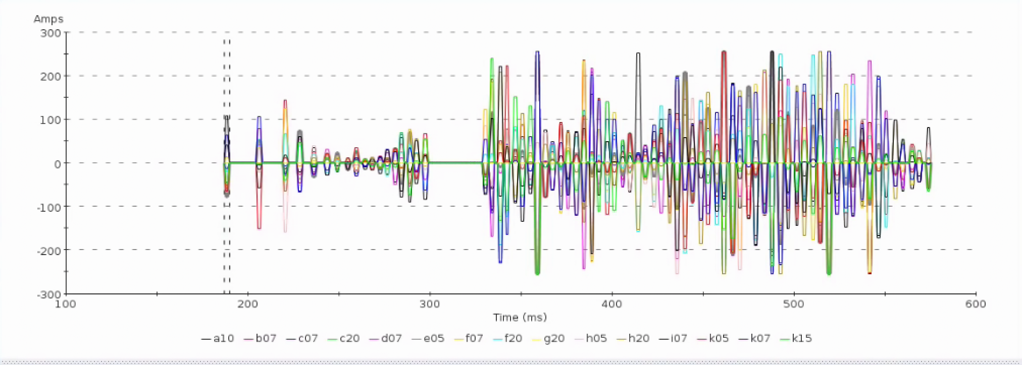
Polarization increase from skew quad resonance correction
 | Ramp Correction, only resonance after transition active
 | Omitting res: 27,28,33,39,40
 | On |  | Off
 | Pol | err | Pol | err
 | 68.958 | 2.2 | 60.995 | 2.2
 | 62.874 | 2.2 | 62.1 | 2.2
 | 68.37 | 2.2 | 54.53 | 2.2
 | 65.56 | 2.21 | 58.87 | 2.27
 | 66.93 | 2.21 | 62.83 | 2.23
 | Averages
 | 66.538 | 0.986 | 59.865 | 0.993
Gain factor | 1.111
Correction on/off comparison (GƔ > 17 only)
Full correction function
Measured gain factor comparable to tune jump
Baseline polarization could be higher with normal optimizations
Plan to study dependence on correction amplitude, timing
Characterize intensity dependence after first iteration of optimizations
Start outlining a plan to swapping this user into operation
Transition gap
Pre-transition

