Slide 1
Preinjectors Status
D. Raparia
Time Meeting
July 30, 2024

Slide 2
Tandem
External Users :
- 3 weeks: electric work continue
- Preparation for Au run

Slide 3
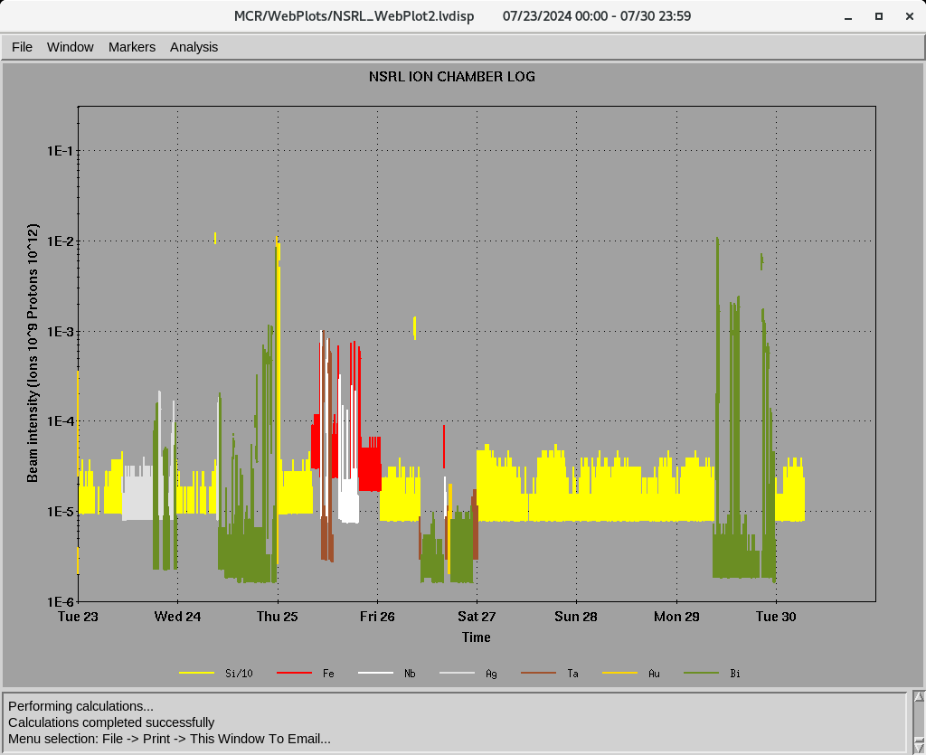
EBIS: NSRL
Ions for NSRL :
Si⁺¹¹, Fe⁺²⁰, Nb⁺²³, Ti⁺¹⁷
Ag⁺²⁹, Ta⁺³⁸, Au⁺³², Au⁺⁴³, Bi⁺⁴³
7/24: ³He⁺⁺ for APEX
7/29: Two power dip ,
EBIS linac RF, 0.5 ohm resistor fail (8 HRS)

Slide 4
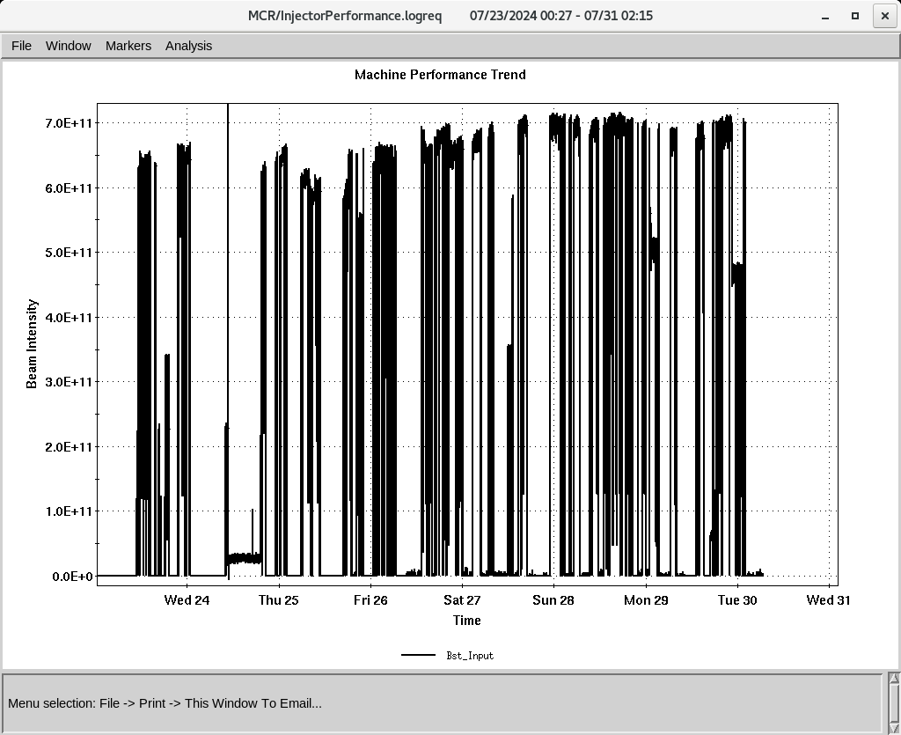
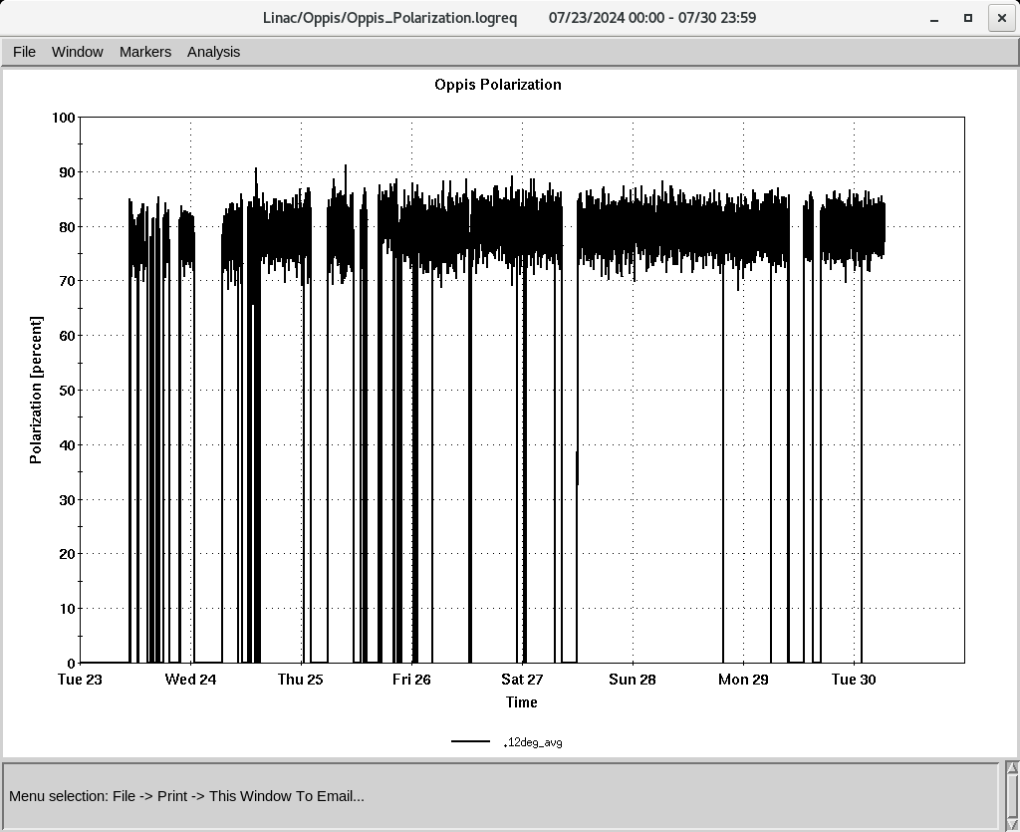
Linac 200 MeV Beam to BLIP , Booster
To Booster
BLIP
7/26-8/01: Th, 200 MeV, 150 𝞵A (last)
7/25: BLIP beam test
OPPIS
Normal current and polarization
320-350 , 𝞵A ~ 80%,
- Added 4 g Rb on 7/25
H-Jet running smoothly,
Polarization @ 200 MeV
Down time (<21 HRS)
RF trips and reset: RFQ, Mod 3, Mod 5, MOD7
-7/24: RF MOD , 8616 tubes, etc, replaced (13.5 HRS)
7/25: Replaced 7835 for Mod 7 (2.5 HRS)
7/29: 2 power dips, weather standdown (4.5HRS)

