Slide 1
Time Meeting – RHIC Ops
7/30/2024

Slide 2
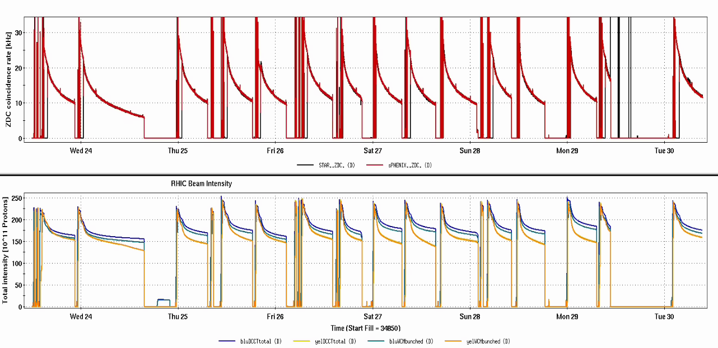
Very good week of running
APEX
Power
dips

Slide 3
Highlights
Most failures were hidden behind stores
AC has been kept under control
Rebucketing losses in yellow are currently our limiting factor*
Power dip on Monday took out most of the complex for the day, but sPHENIX was able to get their TPC cosmic run in with the new gas mix

