Slide 1
Data courtesy C. Naylor

Slide 2
Data courtesy C. Naylor

Slide 3
Data courtesy C. Naylor

Slide 4
Data courtesy C. Naylor

Slide 5
Data courtesy C. Naylor

Slide 6
Data courtesy C. Naylor

Slide 7
Data courtesy C. Naylor

Slide 8
Data courtesy C. Naylor

Slide 9
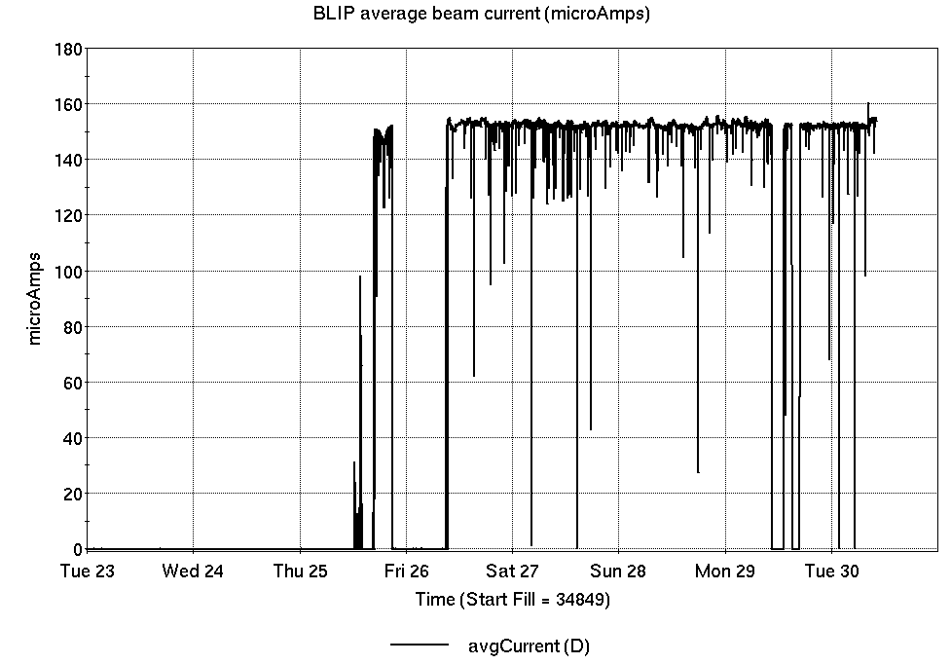
Operations for BLIP
7/23-30/2024:
200 MeV Th target production began Friday and continues through the week.
90.0 hr Production
4.33 hr Setup
4.6 hr Failure
Availability: 95.4%
No BLIP
this past week

Slide 10
NSRL activity past week: 7/23-30/2024 (as of 0800)
NSRL continues running for multiple users.
Protons, 8 EBIS ions in use. (Si, Ti, Fe, Nb, Ag, Ta, Bi, Au)
Running 24-C schedule since 22 May. Schedule posted, updates into September for beams & users up to November.
Availability: 82.3%

Slide 11
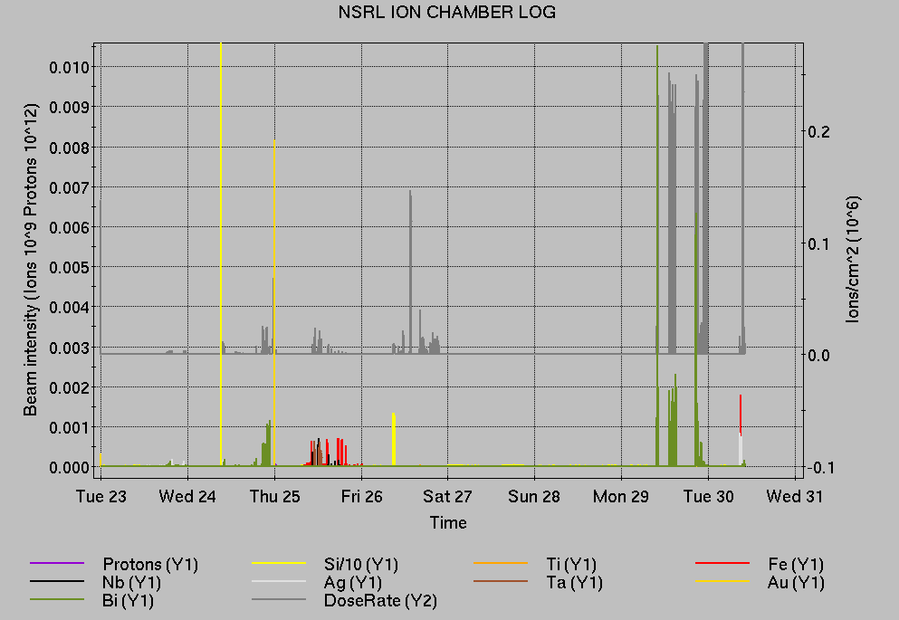
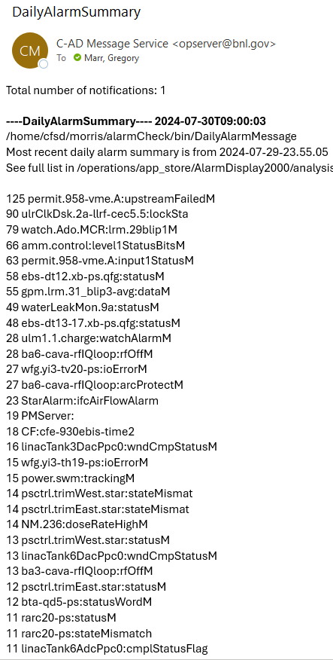
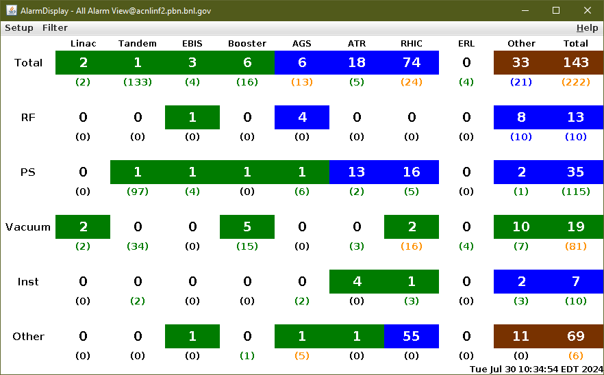
Notes from Operations
Notable failures (>1 hr)
Linac Mod 5 failure (10x), repairs to many components
Multiple storm-related power dips, affecting all programs and many systems
STAR cooling and chilled water extended failure time, in part
Yellow abort and injection kicker issues, diagnosis ongoing for intermittent failure
Booster D6 septum failure required multiple interventions
QLI, ramping down helion test ramps
Cooling system PLC failure trips RHIC RF
Experiment accesses for failures
Other notes
Booster circulating beam current transformer continues to exhibit intermittent noise issues
Loss monitor interlocks, RHIC beam aborts (5x); other beam orbit issues
Other misc EBIS, injector, RF trips, injector access Some long repairs occur behind RHIC stores.
Has it been repeating often?
Is it still alarming now?

Slide 12
Reminder from Operations
MCR continues Operations for:
BLIP – continues until 1 August; no further irradiations scheduled.
NSRL – users scheduled to run Mon-Fri this week and next.
AGS/Booster setups continue, additional to RHIC physics.
Injector Au setup as yet untested. Tandem Au setup pending.
Injector h setup, mode switching.
Skew quad testing, other polarized beam setups continue as beam time allows.
RHIC beam for Physics stores.
Other MD, Maintenance, APEX as noted in schedule
CHECK YOUR CALLIN LIST: WCC and ECP updates needed
Initial failure response often involves ECP consult. Ensure your Group callin list contains this information.
Callin lists should be accurate in terms of personnel and time off.
https://www.cadops.bnl.gov/Operations/personnel/call_in_lists/
Note: Core Electrical contacts listed/managed on ESSHQ callin list https://www.cadops.bnl.gov/Operations/personnel/call_in_lists/call_in_list.php?group=esshq
CHECK AND EDIT YOUR OWN CONTACT INFO
http://directory.pbn.bnl.gov/

Slide 13
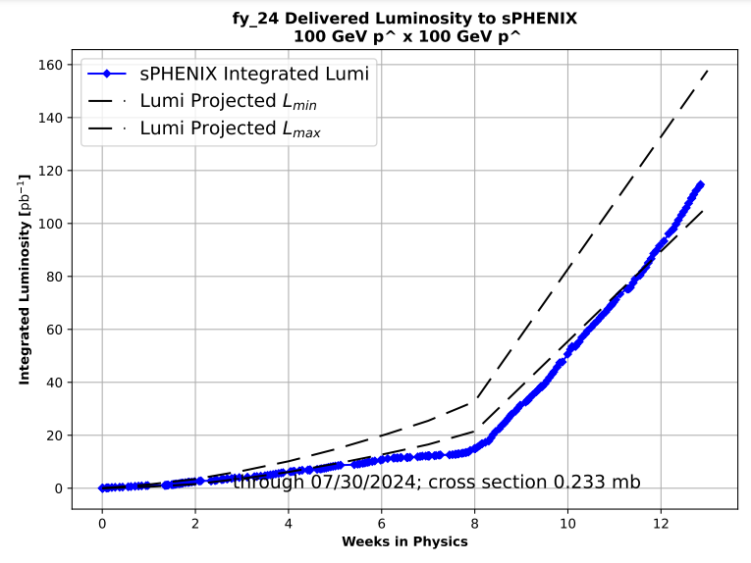
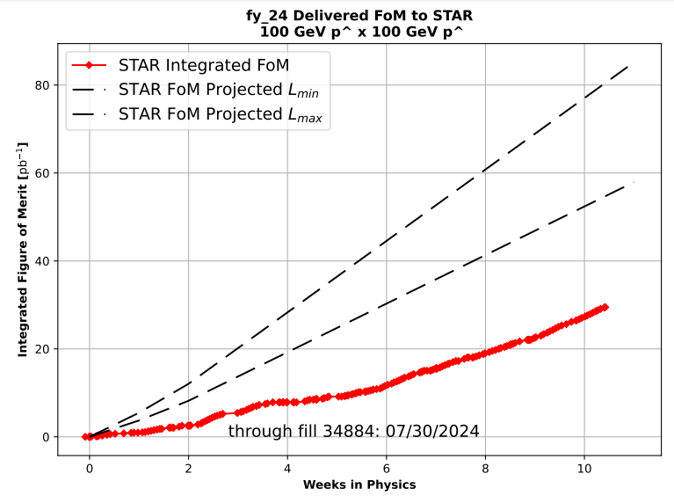
Preliminary delivered Luminosity, Figure of Merit (LP²) data for RHIC
Courtesy R. Terheide

Slide 15
Notes:
Reliability comparisons to previous runs

Slide 16
Availability, expected beam hours
$$Availability=\frac{actual beam time}{scheduled beam time}≡\frac{Beam use time}{Calendar time−scheduled interruptions}$$
$$RHIC \\ Availability=\frac{Physics+Machine Development+Machine Setup+Experiment Setup+Accelerator Experiments}{(Physics+Machine Development+Machine Setup+Experiment Setup+Accelerator Experiments)+Failures}$$
$$\text{DOE} \text{expected} \text{beam} \text{hours}=(\# of weeks −1 week overhead)×\left(\frac{160 available hours}{1 week}\right)×0.8$$
Notes:
Normally hidden. Explains how the 85% from DOE comes in to play, & general availability metrics

