Slide 1
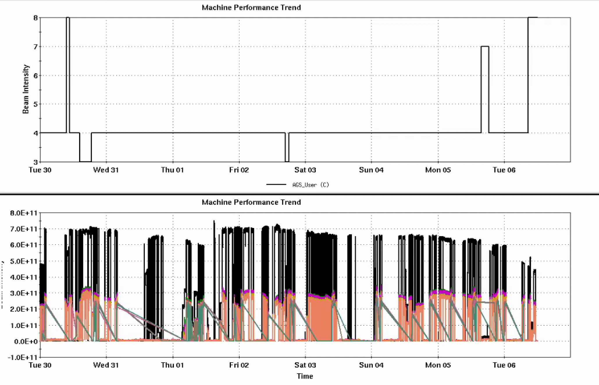
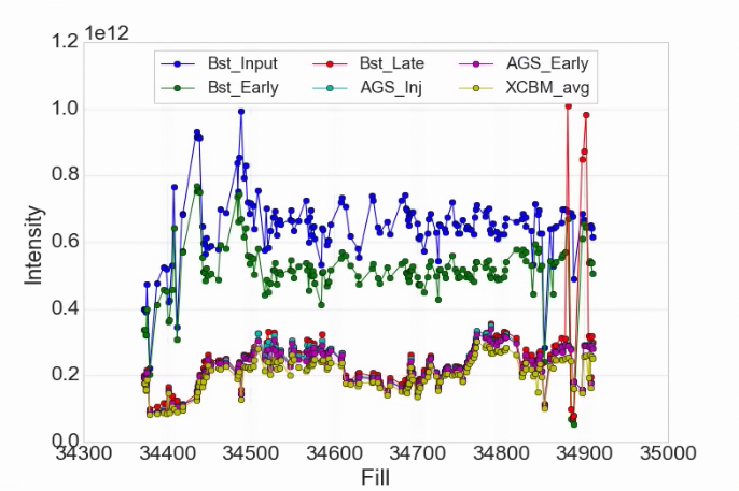
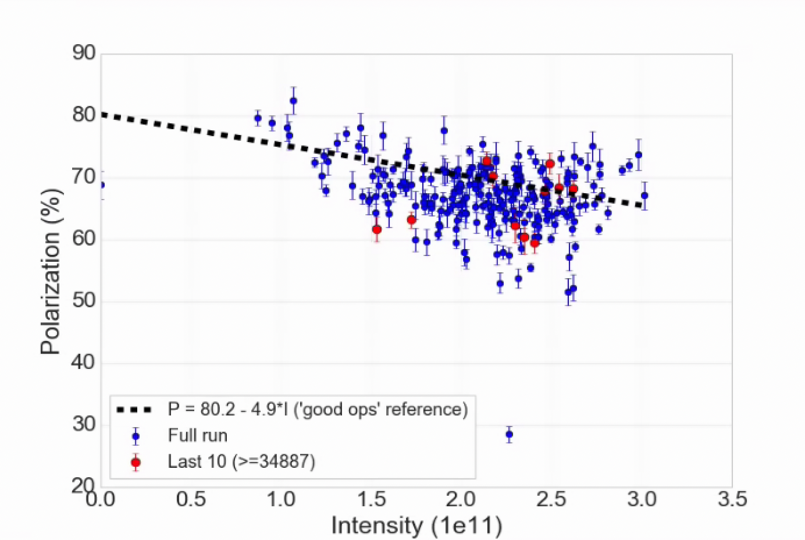
Injector Status, 8/6/24
Operations overview
RHIC taking 2-2.5e11 out of the AGS
Polarization
Definite lurch in the energy vs time in the AGS, recalculated times, now seems stable
AGS polarimeter
detector problem (measurement still possible with upper 45 deg detectors)
Vertical targets missing after replacement
Tune meter power supply problems
Recent decrease in Linac output
Affects emittance (lumi + polarization)
AGS User
Intensity
Developments
Limited availability (weather, F3 kicker)
Opportunisty work on split/merge, skew quads
Verification of 3He
Injector Intensity by Fill
AGS Pol by Intensity (for fills)
(not a fit)

