Slide 1
sPHENIX status
Kin Yip
sPHENIX Director of Operations
Time meeting
Aug. 6, 2024

Slide 2
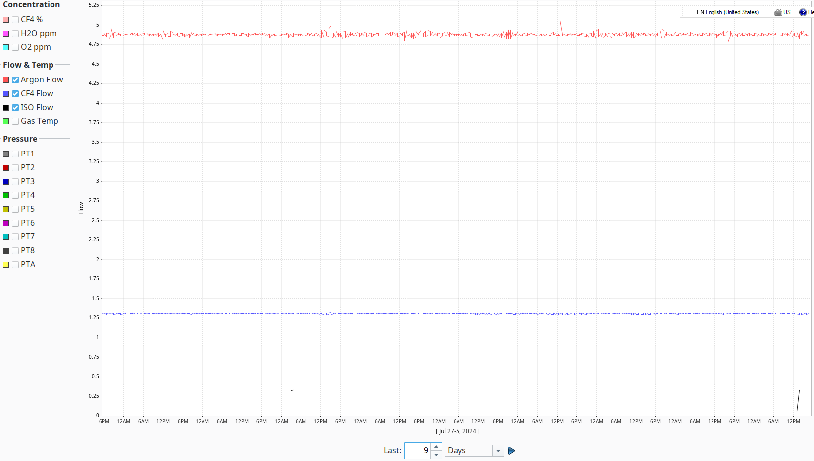
Physics data taking together with TPC testing
Two modes of running :
TPC testing at various beam conditions (cosmics, 6×6, 28 ×28, 56×56)
Jet/photon triggered data taking
We are also pushing out a new compression scheme in our RCDAQ.
We just used up two 22-lb bottles of isobutane on Monday (Aug. 5).

Slide 3
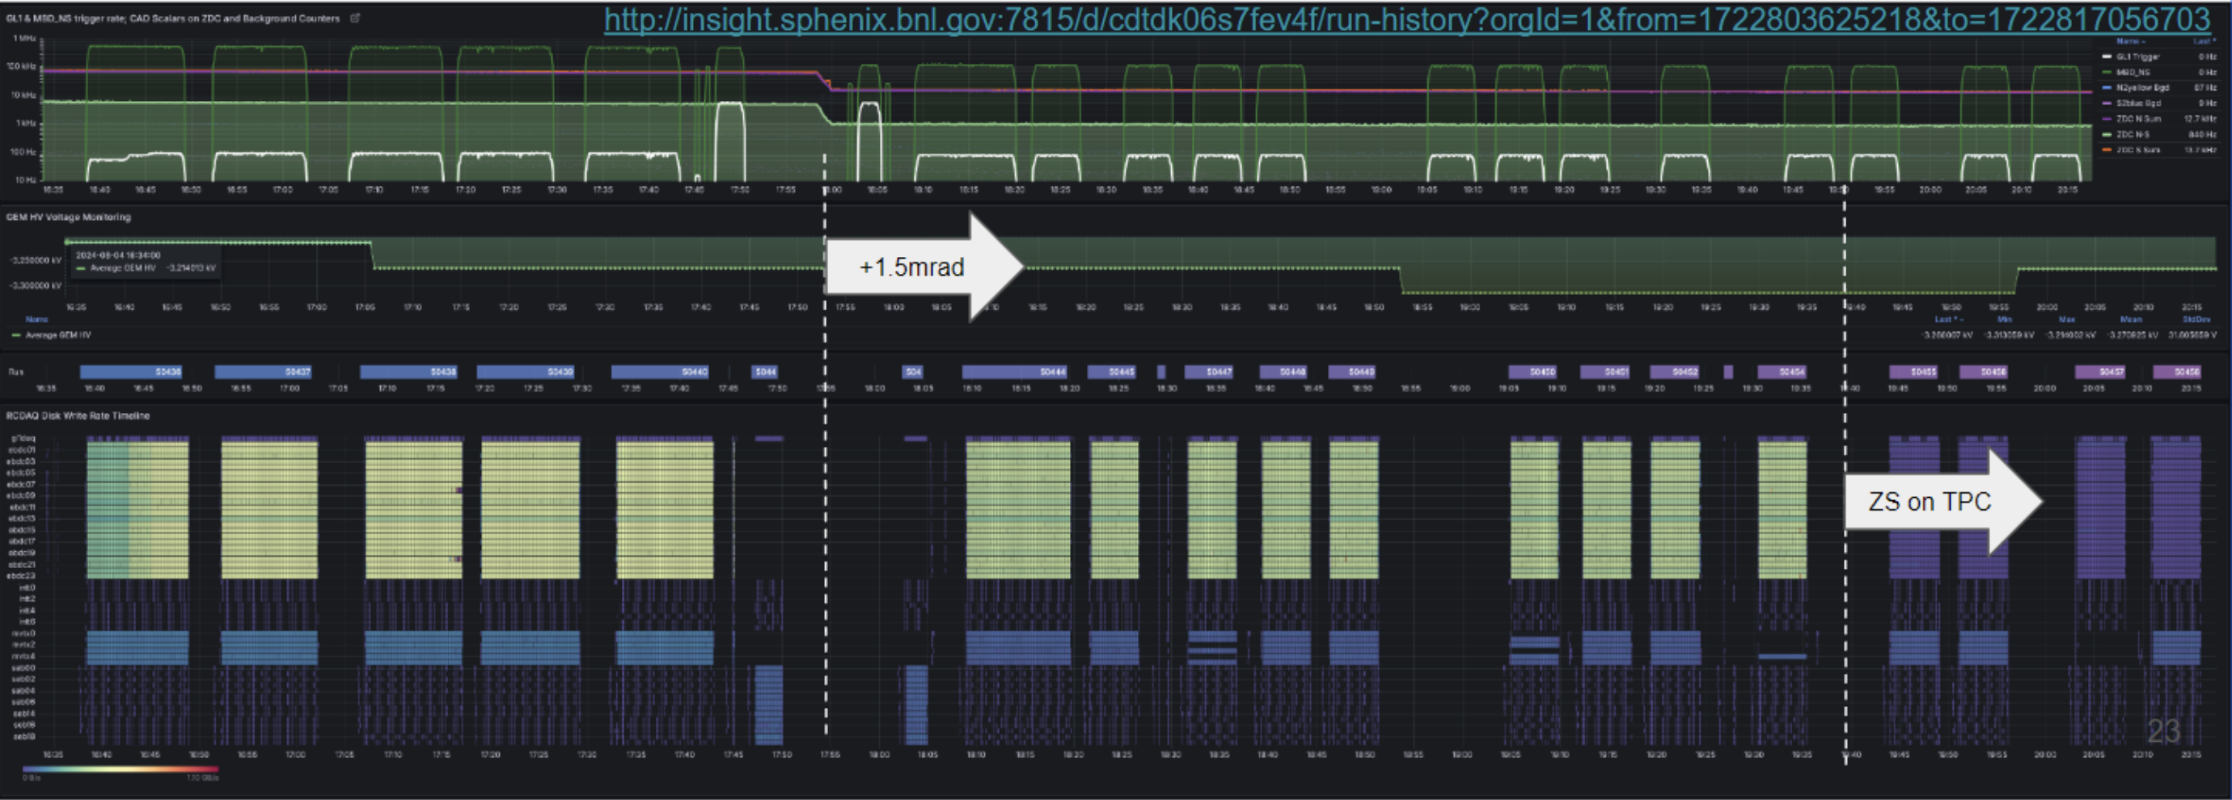
TPC, 56×56, 1.5×10¹¹, (x-ing: 0 → 1.5 mrad)
Success
GEM’s were stable
Data volume test with zero-suppression :
rough data volume check supports 100% streaming
but the “elink dropping” issue at high-rate operation still needs to be fixed

Slide 4
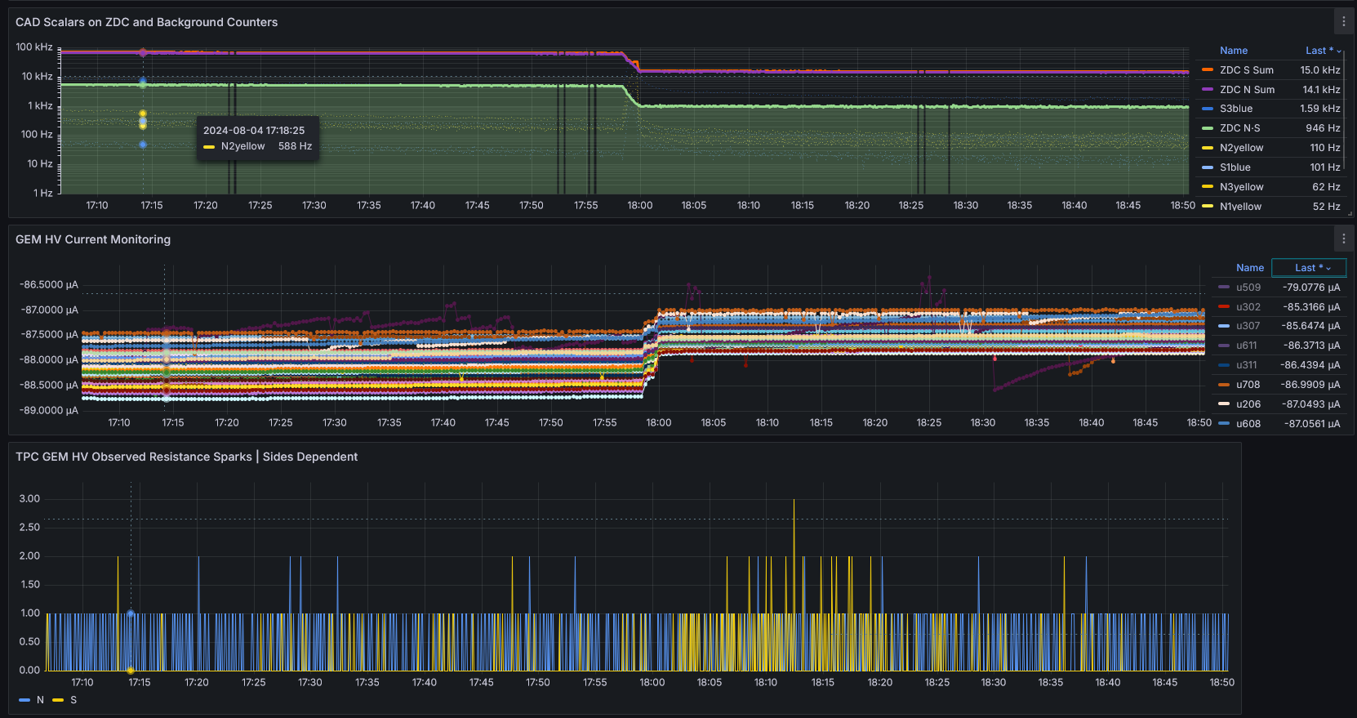
0mrad ⇒ +1.5mrad transition, without lowering GEM HV
0 mrad →+1.5mrad, reduction in collision rate and vertex sizes
Observable drop in GEM current load
Insignificant change to discharge rate (beam background dominated)
(Short busy period on south shortly after x-ing angle switching)

Slide 5
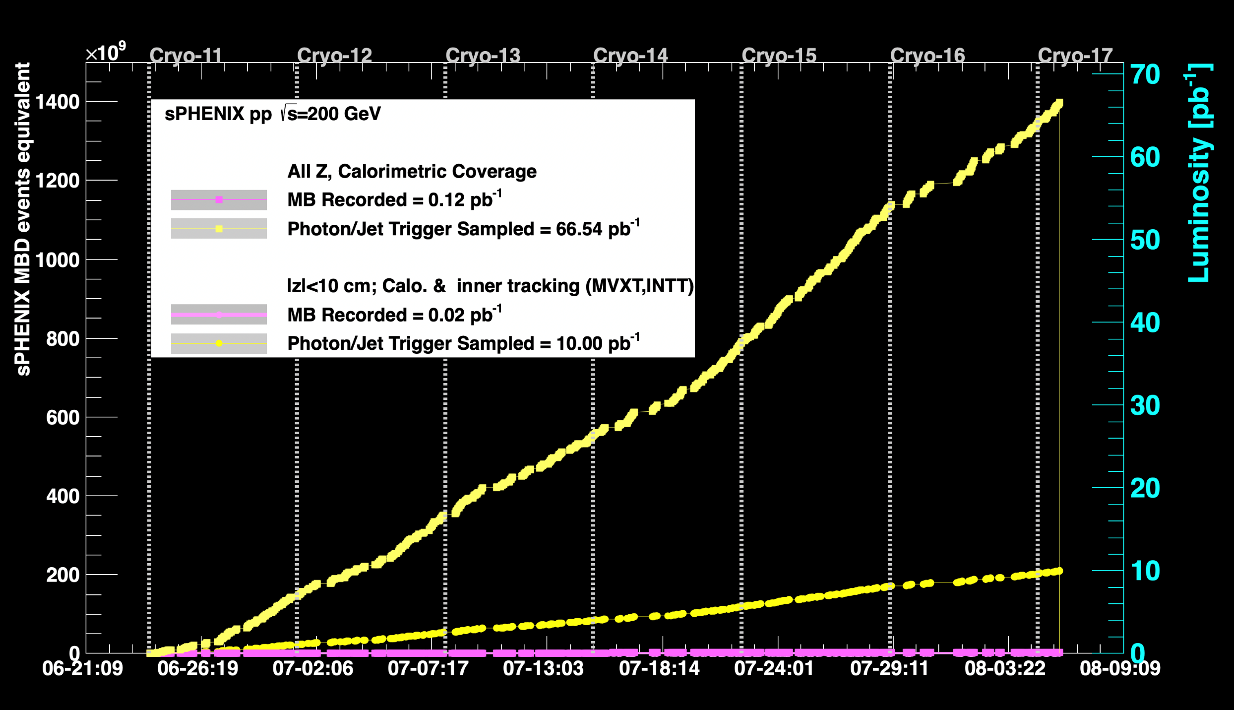
Newest luminosity curves ( Full physics program is based on sampling at least 45/pb for |z| < 10 cm.)

