Slide 1
Data courtesy C. Naylor

Slide 2
Data courtesy C. Naylor

Slide 3
Data courtesy C. Naylor

Slide 4
Data courtesy C. Naylor

Slide 5
Data courtesy C. Naylor

Slide 6
Data courtesy C. Naylor

Slide 7
Data courtesy C. Naylor

Slide 8
Data courtesy C. Naylor

Slide 9
Data courtesy C. Naylor

Slide 10
Data courtesy C. Naylor

Slide 11
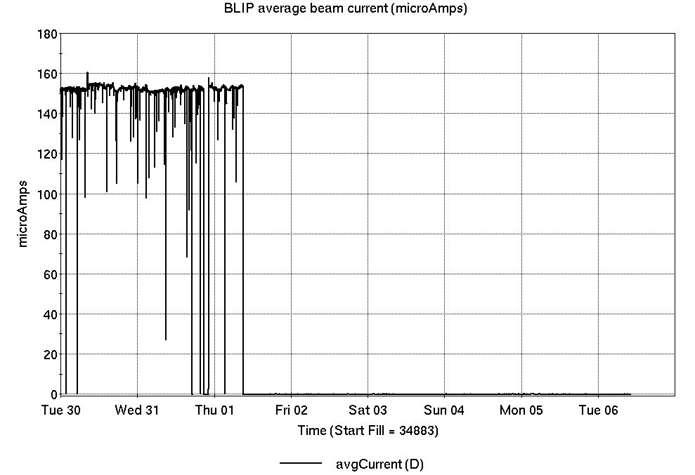
Operations for BLIP
7/30-8/6/2024:
200 MeV Th target production concluded Thursday, marking end of season for BLIP production.
47.55 hr Production
1.45 hr Failure
Availability: 97%
96.2% for FY24 overall; over 3200 hours beam on targets.
Longest streak, >130 hours without failure.
No BLIP
this past week

Slide 12
NSRL activity past week: 8/6-13/2024 (as of 0800)
NSRL continues running for multiple users.
Linac protons, 4 EBIS ions in use. (Fe, Nb, Ta, Au)
Running 24-C schedule since 22 May. Schedule posted, updates into September & October for beams & users up to November.
Availability: 97.2%

Slide 13
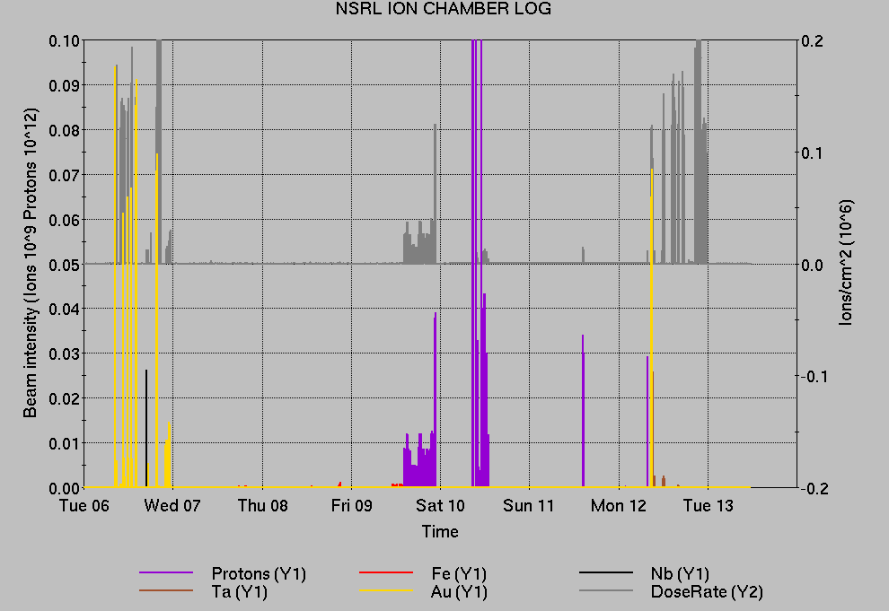
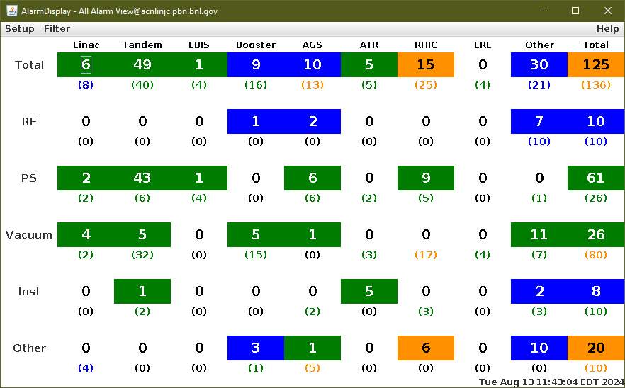
Notes from Operations
Notable failures (>1 hr)
Power dip and weather stand-down, affecting both programs and multiple systems.
Access Controls failure, sector 6 hardware fault
Experimental accesses for STAR ZDC, sPHENIX TPOT cooling, other troubleshooting
RHIC PS failure involving Blue main dipole, b8-dhx Quench Protection & PS, b4-dhx PS, building 1004B HVAC
Cryo lead flow interlock, PLC analog input card replaced
Failed network switch, 7B alcove; FEC resets also required.
Other notes
AGS tunemeter charging supply failure affects polarized beam tuning and development.
Booster F3 extraction kicker PS fuse failure; store extended
Linac RFQ trip, modulator & driver replaced
Linac Mod 1 trip, bias PS circuit breaker reset
AGS RF station BC repaired, feedback amp replaced
AGS RF station B breaker overheating, repaired
Loss Monitor beam aborts (2x), failed ramps/rebucketing
Position Monitor beam aborts, failed corrector PS excluded
AGS cold snake LHe refill behind other failures and interruptions
Other misc trips, resets Some long repairs occur behind RHIC stores. (logged 29 failures, mild+severe, with duration >1 hour; 19 short failures; 24 resets)

Slide 14
Reminder from Operations
MCR continues Operations for:
BLIP – pending additional production run.
NSRL – users scheduled to run Mon-Fri this week and next.
AGS/Booster setups continue, additional to RHIC physics.
Injector Au setup as yet untested. Tandem Au setup pending.
Injector h setup no longer required for APEX
Skew quad & other polarized beam setups continue with limited instrumentation.
RHIC beam for Physics stores.
Other MD, Maintenance, APEX as noted in schedule
CHECK YOUR CALLIN LIST: WCC and ECP updates needed
Initial failure response often involves ECP consult. Ensure your Group callin list contains this information.
Callin lists should be accurate in terms of personnel and time off.
https://www.cadops.bnl.gov/Operations/personnel/call_in_lists/
Note: Core Electrical contacts listed/managed on ESSHQ callin list https://www.cadops.bnl.gov/Operations/personnel/call_in_lists/call_in_list.php?group=esshq
CHECK AND EDIT YOUR OWN CONTACT INFO
http://directory.pbn.bnl.gov/

Slide 15
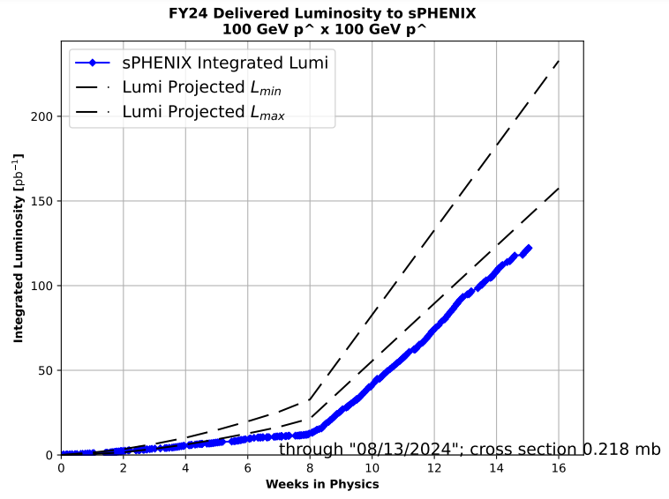
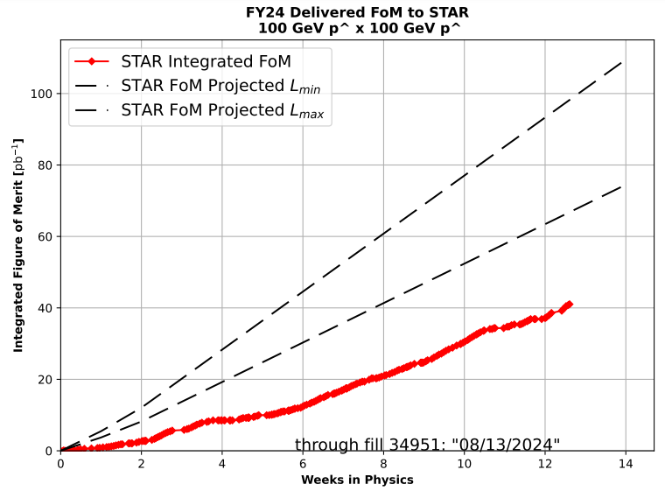
Preliminary delivered Luminosity, Figure of Merit (LP²) data for RHIC
Note: singles corrections applied to integrated lumi plot
Courtesy R. Terheide

Slide 17
Notes:
Reliability comparisons to previous runs

Slide 18
Availability, expected beam hours
$$Availability=\frac{actual beam time}{scheduled beam time}≡\frac{Beam use time}{Calendar time−scheduled interruptions}$$
$$RHIC \\ Availability=\frac{Physics+Machine Development+Machine Setup+Experiment Setup+Accelerator Experiments}{(Physics+Machine Development+Machine Setup+Experiment Setup+Accelerator Experiments)+Failures}$$
$$\text{DOE} \text{expected} \text{beam} \text{hours}=(\# of weeks −1 week overhead)×\left(\frac{160 available hours}{1 week}\right)×0.8$$
Notes:
Normally hidden. Explains how the 85% from DOE comes in to play, & general availability metrics

