Slide 1
Data courtesy C. Naylor

Slide 2
Data courtesy C. Naylor

Slide 3
Data courtesy C. Naylor

Slide 4
Data courtesy C. Naylor

Slide 5
Data courtesy C. Naylor

Slide 6
Data courtesy C. Naylor

Slide 7
Data courtesy C. Naylor

Slide 8
Data courtesy C. Naylor

Slide 9
Data courtesy C. Naylor

Slide 10
Data courtesy C. Naylor

Slide 11
Data courtesy C. Naylor

Slide 12
Data courtesy C. Naylor

Slide 13
Data courtesy C. Naylor

Slide 14
Data courtesy C. Naylor

Slide 15
Operations for BLIP
10/1-8/2024:
BLIP program in Shutdown through January 2025.
Future schedule TBA
Availability: n/a
No BLIP
this past week

Slide 16
NSRL activity past week: 10/1-8/2024 (as of 0800)
NSRL running continues, setup for NASA and student program...
8 EBIS ions including set up of GCR modes. Development/Setup for Tandem protons took place.
Running 24-C schedule since 22 May. Schedule posted, updates to 1 November for beams & users until November shutdown. Run 25-A TBD.
Availability: 97.4%

Slide 17
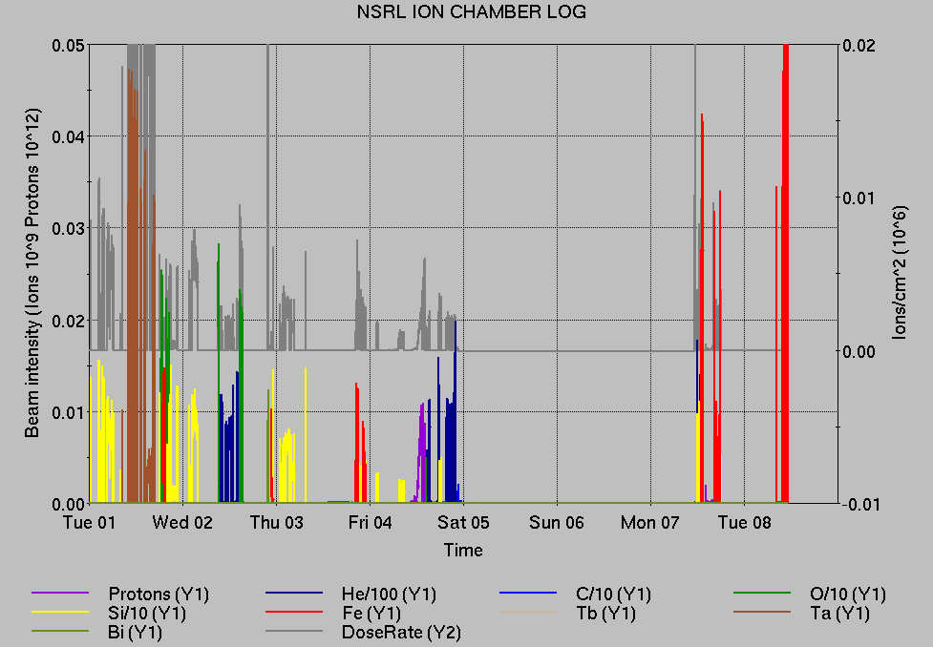
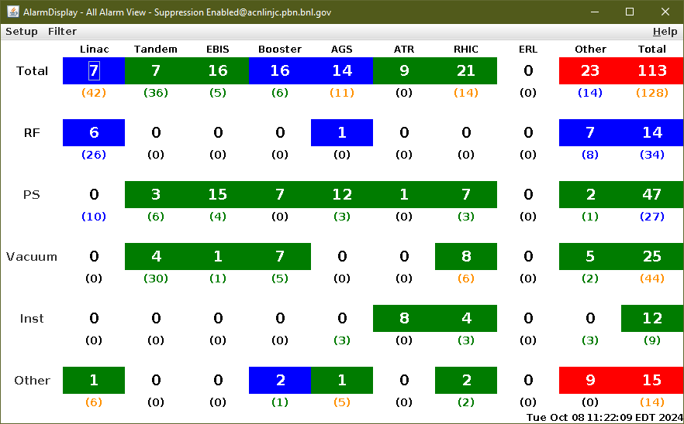
Notes from Operations
Notable failures (>1 hr)
Yellow abort kicker failure, cable and feedthrough replaced
AGS G09C extraction bump failure, ongoing; reconfigured G09, H11 BLW cables to one PS
ev-newfill event triggered, interrupts RF storage cavity conditioning (human error)
Controls FEC failure cfe-4b-rtdl fires DX heaters, other failures; local reset required.
7c-ps3 FEC failure interrupts hysteresis ramps
Blue QLI on downramp (2x); ongoing, ramp slower
1010A Loss Monitor system failure, V118 board replaced.
Yellow abort kicker failure, ALE PS replaced
Other notes
BtA vacuum gauge interlocks, bypassed
Booster F4 BLW PS failure, ongoing; retuned Booster extraction
Access for BA2 RF repairs
Booster be4-th-ps water leak repaired
Beam aborts, BPM permit
Beam aborts, BLM permit
Other various trips, resets
AGS vacuum, Yellow abort kicker, Blue Main PS issues ongoing
Over 460 failure hours logged in total (mild, concurrent, severe) across both programs.
Over 98 hours logged for CeC setup/work with electron beam

Slide 18
Reminder from Operations
MCR continues Operations for:
NSRL – 6 days this week, setup and running for NASA biology.
EBIS 2 MeV protons insufficient for Booster operation. Tandem H established; availability limited by RHIC program.
AGS/Booster setups continue, additional to RHIC physics.
Injector performance limited pending PPG repairs.
Au/proton TtB mode switch, GCR setup continues.
RHIC beam for setup, experiment setup, Physics stores until Monday 0800.
Switch to Au setup; beam in RHIC pending other work.
CHECK YOUR CALLIN LIST: WCC and ECP updates needed
Initial failure response often involves ECP consult. Ensure your Group callin list contains this information.
Callin lists should be accurate in terms of personnel and time off.
https://www.cadops.bnl.gov/Operations/personnel/call_in_lists/
Note: Core Electrical contacts listed/managed on ESSHQ callin list https://www.cadops.bnl.gov/Operations/personnel/call_in_lists/call_in_list.php?group=esshq
CHECK AND EDIT YOUR OWN CONTACT INFO
http://directory.pbn.bnl.gov/

Slide 19
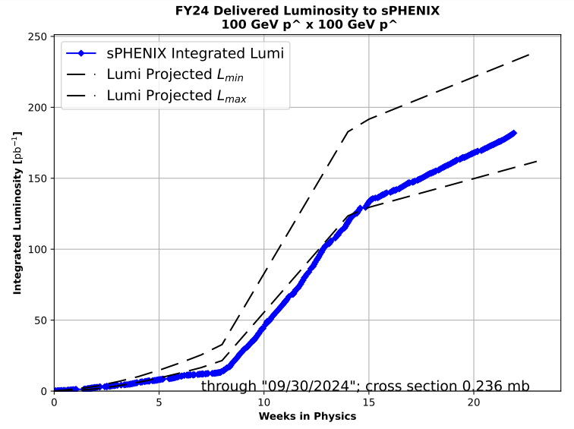
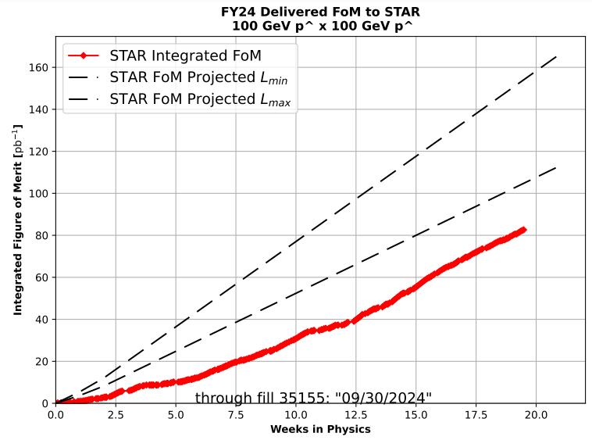
Preliminary delivered Luminosity, Figure of Merit (LP²) data for RHIC
Note: singles corrections applied to integrated lumi plot; updated projection includes crossing angle considerations
Courtesy R. Terheide

Slide 21
Notes:
Reliability comparisons to previous runs

Slide 22
Availability, expected beam hours
$$Availability=\frac{actual beam time}{scheduled beam time}≡\frac{Beam use time}{Calendar time−scheduled interruptions}$$
$$RHIC \\ Availability=\frac{Physics+Machine Development+Machine Setup+Experiment Setup+Accelerator Experiments}{(Physics+Machine Development+Machine Setup+Experiment Setup+Accelerator Experiments)+Failures}$$
$$\text{DOE} \text{expected} \text{beam} \text{hours}=(\# of weeks −1 week overhead)×\left(\frac{160 available hours}{1 week}\right)×0.8$$
Notes:
Normally hidden. Explains how the 85% from DOE comes in to play, & general availability metrics

