Slide 1
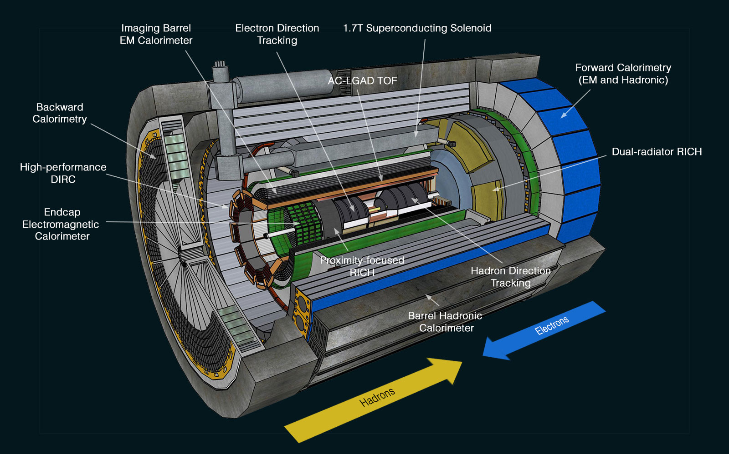
ePIC Membership Application:
American University in Cairo
ePIC Collaboration Council Meeting
April 26th, 2024
Ahmed M. Hamed – American University in Cairo (AUC)

Slide 2
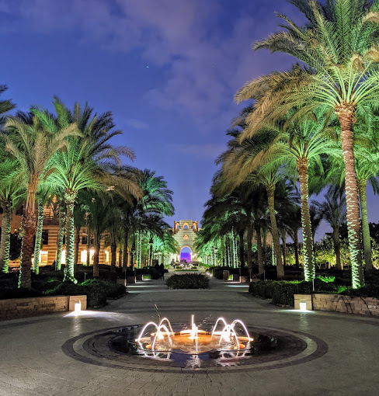
American University in Cairo (AUC)
Founded in 1919 (the region’s premier English-language university)
2 Campuses (Tahrir, and Fifth Settlement)
Total Enrollment: 6000 students (50 countries)
AUC accredited from the
Middle States Commission on Higher Education in the United States.
Located in Cairo, New Cairo (~ 35 min driving from Cairo International Airport)
Includes 5 schools:
School of Business,
School of Sciences and Engineering,
School of Global Affairs and Public Policy,
School of Humanities,
Social Sciences, School of Continuing Education.

Slide 3
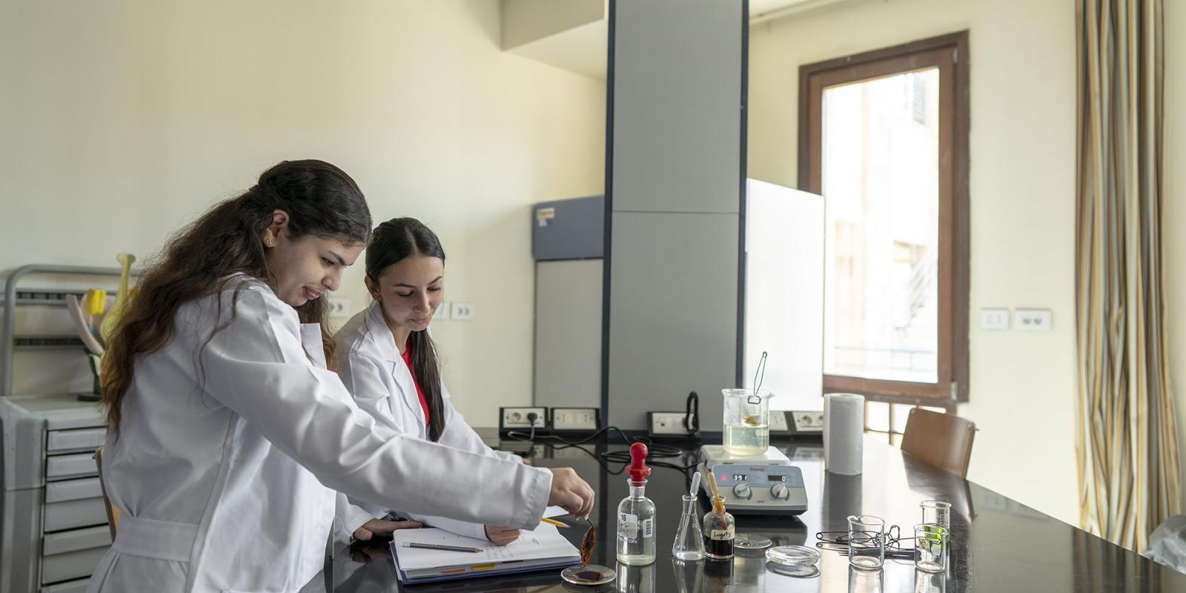
Dep. Of Physics @ School of Sciences and Engineering
School of Science & Engineering:
Vibrant and dynamic school
2400+ students
11 Departments (50 Programs)
100+ Faculty
4 research centers
Department of Physics:
Undergraduate and graduate programs (M.Sc.)
11 Faculty
4 Different research areas:
Atomic, Molecular, and optical physics
Biological Physics
Condensed matter Physics,
Nuclear and Particle Physics

Slide 4
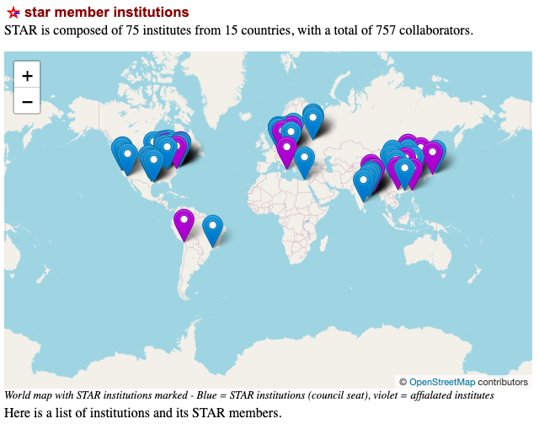
Nuclear and Particle Physics Group -I
Experimental group: 12 people:
2 Ph.D.
4 Research Assistants
5 Graduate students
1 Undergraduate students
The only independent member institution from Africa, at the STAR experiment at BNL.

Slide 5
Nuclear and Particle Physics Group -II
Ahmed M. Hamed
Associate Professor
Member of STAR since 2003
Ph.D. from Wayne State University in STAR (2006) supervised by Prof. Thomas M. Cormier
Dissertation on Direct photon analysis (Yields & Elliptic Flow)
Established the electromagnetic transverse shower profile analysis using STAR Barrel Electromagnetic Calorimeter (BEMC)
Established level 2-gamma online trigger for the heavy ion collisions at STAR
Served as Period Coordinator, Shift leader, Detector operator, and shift crew at STAR
Worked on soft physics and hard physics analyses
Postdoc:
Dr. Fatma El-Sawy (University of Padova-–Italy)
Research Assistants (M.Sc. holders)
Muhmmad Abdel Hamid
Aliaa rafaat
Alhussain Sedky
Mahmoud Rateb
Graduate Students (M.Sc.)
Omar Mazhar
Nermin Kamal
Marwa Selim
Mohamed Sobh
Ahmed Khaled
Undergraduate Students
Mostafa El-Boghdady

Slide 6
Nuclear and Particle Physics Group -III
AUC hosted the STAR Collaboration Meeting back in Oct. 2023

Slide 7
Group research commitments and interests in ePIC
Members:
Ahmed M. Hamed (Associate Professor)
Fatma El-sawy (Postdoctoral Research Associate)
Aliaa Rafaat (Research Assistant)
Omar Mazhar (Graduate Student)
Mostfa El-Boghdady (Undergrad student)
Infrastructure:
Local computing Cluster
Member of African Engineering and Technology Network (Afretec)
Support:
Local grants
Grant via Afretec
AUC group members are currently active and contributing to the simulations analysis (Tracking & Pid)
at ePIC collaboration @ the inclusive PWG.
Task assignments by Dr. Salvatore Fazio; the inclusive PWG convener:
"Electron ID - Track-cluster matching” is a task assigned to Ms. Aliaa Rafaat supervised by Dr. Tyler Kutz
"Resolution-weighted electron energy reconstruction” is a task assigned to Dr. Fatma El-Sawy supervised by Dr. Tyler Kutz
3rd task of Bin size optimization, stability, and purity for each reconstruction method is to be assigned either to Mr. Omar Mazhr or Mr. Mostafa El-Boghdady
AUC group will help promoting ePIC in Africa via the Afretec for more manpower
AUC group initial plan is mainly focused on the direct photon measurements as well as on all Calorimeter based-analysis

Slide 8
Backup slides

Slide 9
African Engineering and Technology Network (Afretec)
https://engineering.cmu.edu/afretec/index.html
The American University in Cairo (AUC) is actively collaborating with the African Engineering and Technology Network (Afretec), a joint initiative led by CMU-Africa.
Afretec aims to unite technology-focused universities to drive inclusive digital growth across the continent through collaborating on teaching and learning, knowledge creation, and entrepreneurship activities within the realm of engineering and technology.
Afretec Members
Carnegie Mellon University Africa (Kigali, Rwanda)
The American University in Cairo (Cairo, Egypt)
University of Lagos (Lagos, Nigeria)
University of Nairobi (Nairobi, Kenya)
University of Rwanda (Kigali, Rwanda)
University of the Witwatersrand (Johannesburg, South Africa)

