Slide 1
Introducing IIT Mandi Group to ePIC Collaboration
Prabhakar Palni & Amal Sarkar
School of Physical Sciences
Indian Institute of Technology Mandi
April 26, 2024
Notes:
‹#›

Slide 2
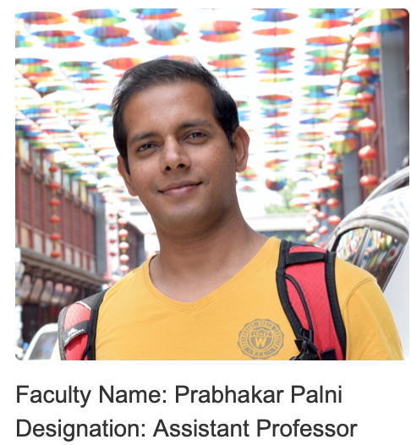
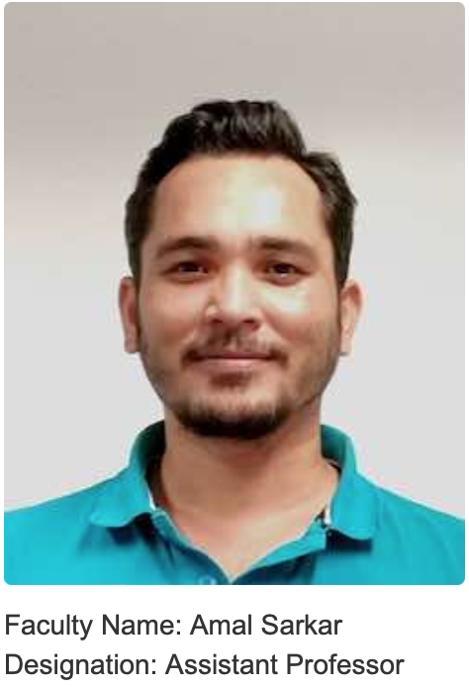
Introduction to the Faculty Members
We, Prabhakar Palni and Amal Sarkar from the School of Physical Sciences at the Indian Institute of Technology Mandi, would like to express interest in joining the ePIC Collaboration.
We have a experience working in major collider based experiments like CMS, ATLAS, CDF, ALICE, and STAR
Currently, in the group 6 PhD, 2 iPhD, 1 Project Associate, 6 masters and 2 B.Tech students are working.
HEP lab acquired nearly 200 m² space and developing facilities like clean room, characterization & mechanical room
Prabhakar Palni: Assistant Professor, IIT Mandi, Kamand, HP, India [Experimental High Energy Physics] 2014: Ph.D. Experimental Particle Physics, University of New Mexico, Albuquerque (CDF Collaboration), 2014–2015: Visiting Research Scholar, NSCL Michigan State University, Michigan (SPiRIT Collaboration) 2015–2018: Post-doctoral Fellow, Central China Normal University (CCNU), Wuhan (ALICE Collaboration) 2018–2020: Post-doctoral Fellow, AGH University of Science & Technology, Krakow (ATLAS Collaboration) 2020–2023: Assistant Professor, Goa University, Goa (ATLAS, EIC Collaboration)
Amal Sarkar: Assistant Professor, IIT Mandi, Kamand, HP, India [Experimental High Energy Physics] 2015: Ph.D. Experimental Particle Physics, Indian Institute of Technology Bombay (in STAR at RHIC, BNL) 2016: Research associate at IIT Bombay worked in ALICE and STAR experiment (at INFN Padova and BNL) 2016–2018: Post-doctoral Fellow, ALICE experiment at the LHC (NRF TLABS, Cape Town, SA) 2018–2020: Post-doctoral Fellow, CMS experiment at the LHC (University of Los Andes, Bogota D.C) 2020–2023: Assistant Professor, RKMRC, Kolkata, India CMS (2020 - 2021), STAR (2021-2023) EIC(2020-2023)
More details in backup
prabhakar@iitmandi.ac.in; amal@iitmandi.ac.in IIT Mandi, HP, India
Notes:
‹#›

Slide 3
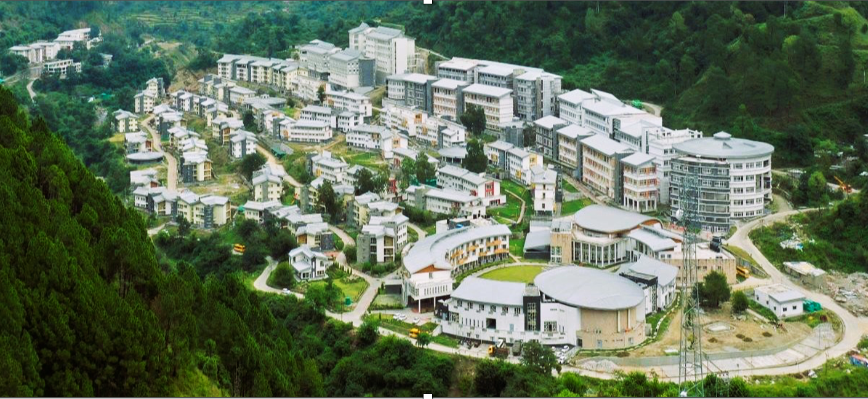
Introduction to IIT Mandi
Indian Institute of Technology Mandi is a premier institute established on 24th February 2009
Institute’s vision is “To be a leader in science and technology education, knowledge creation, and innovation in an India marching towards a just, inclusive and sustainable society”.
On the industry and academic collaboration front, IIT Mandi continuously worked towards expanding its outreach with national and international partners throughout the year.
Institute has been involved with various Research and Development (R&D) projects. Institute has signed a MoU with many international and national universities, companies, research centres, and organizations. Institute has over 50 active MoUs with national and international partners.
IIT Mandi is set to scale new heights of research and development in the coming years.
prabhakar@iitmandi.ac.in; amal@iitmandi.ac.in IIT Mandi, HP, India
Notes:
‹#›

Slide 4
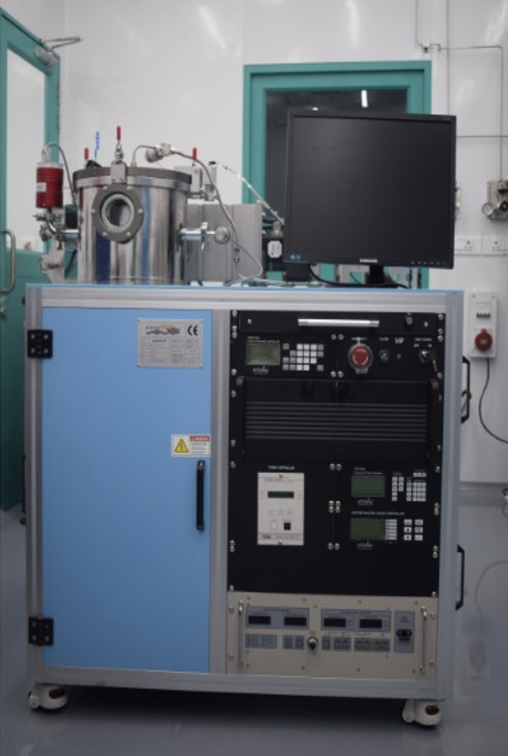
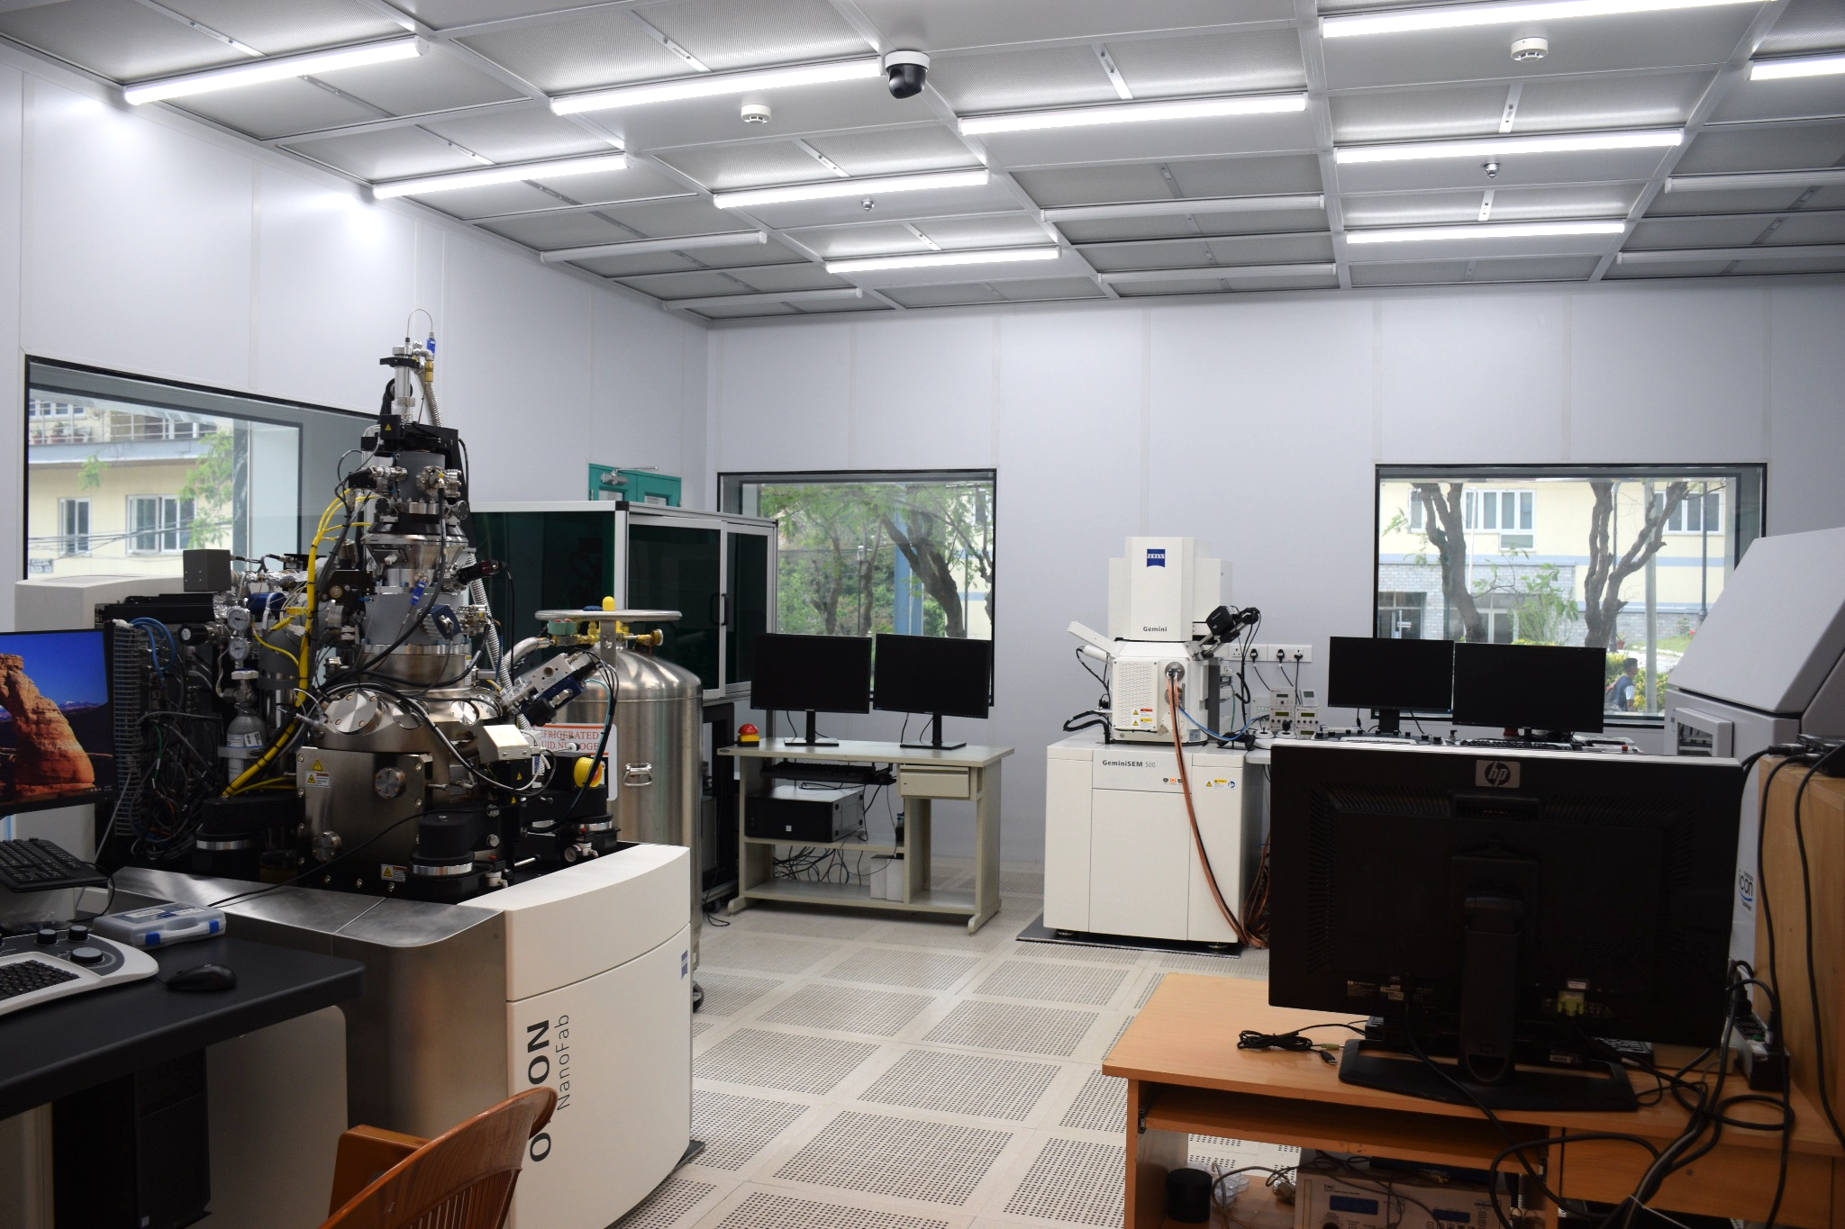
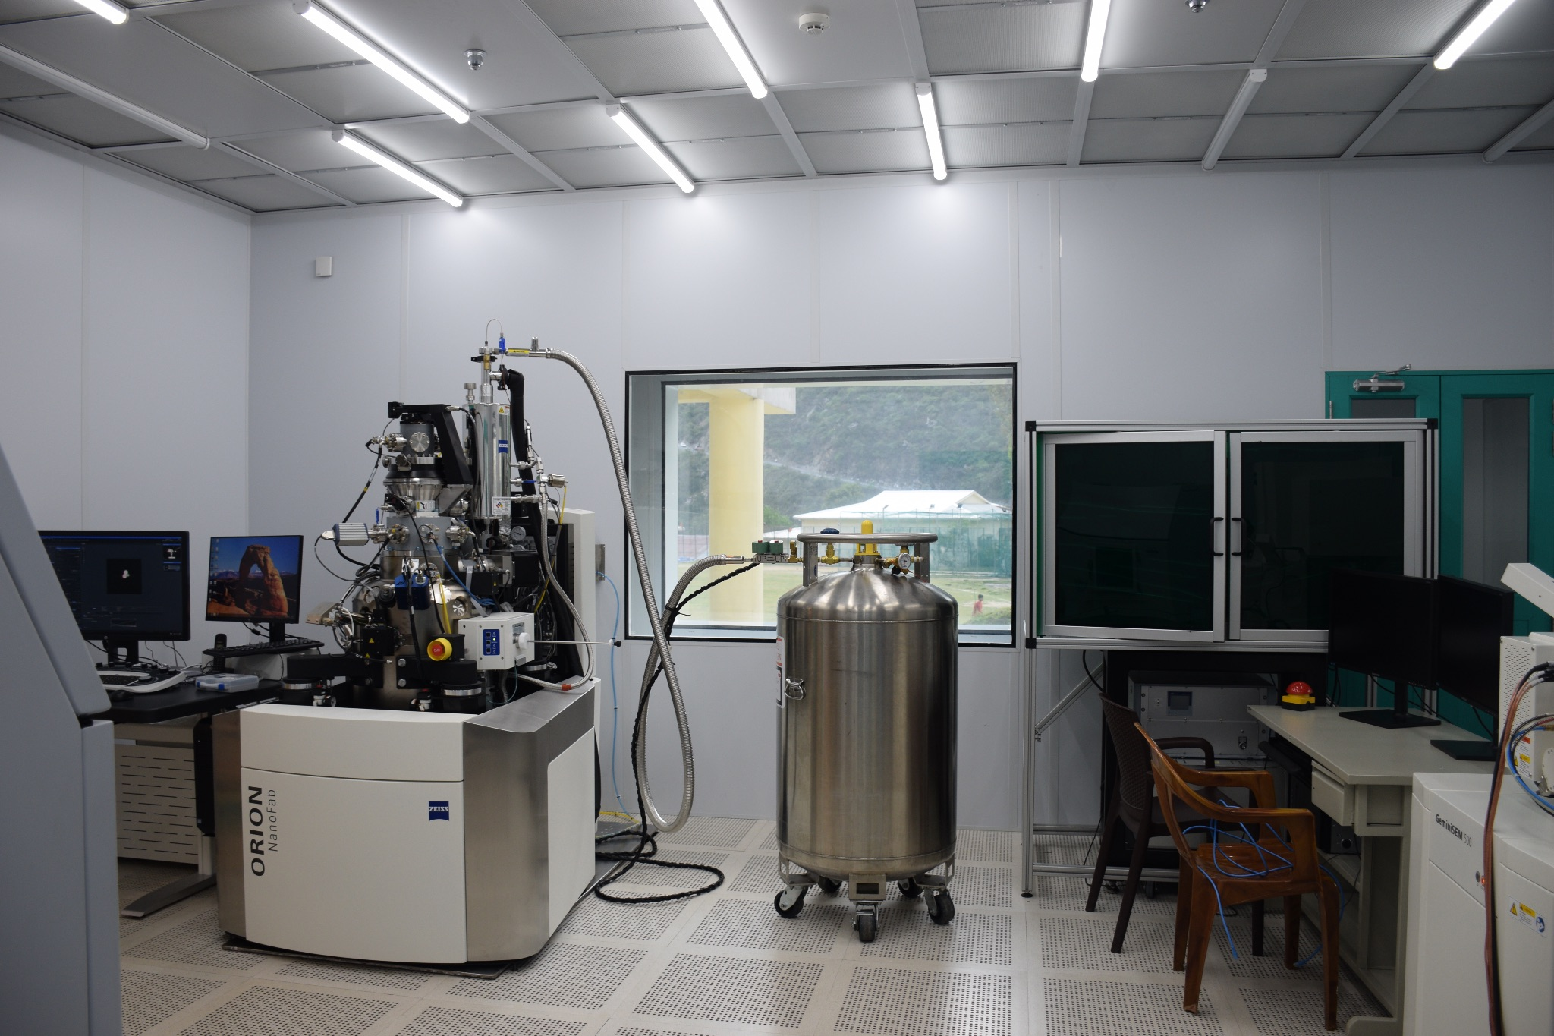
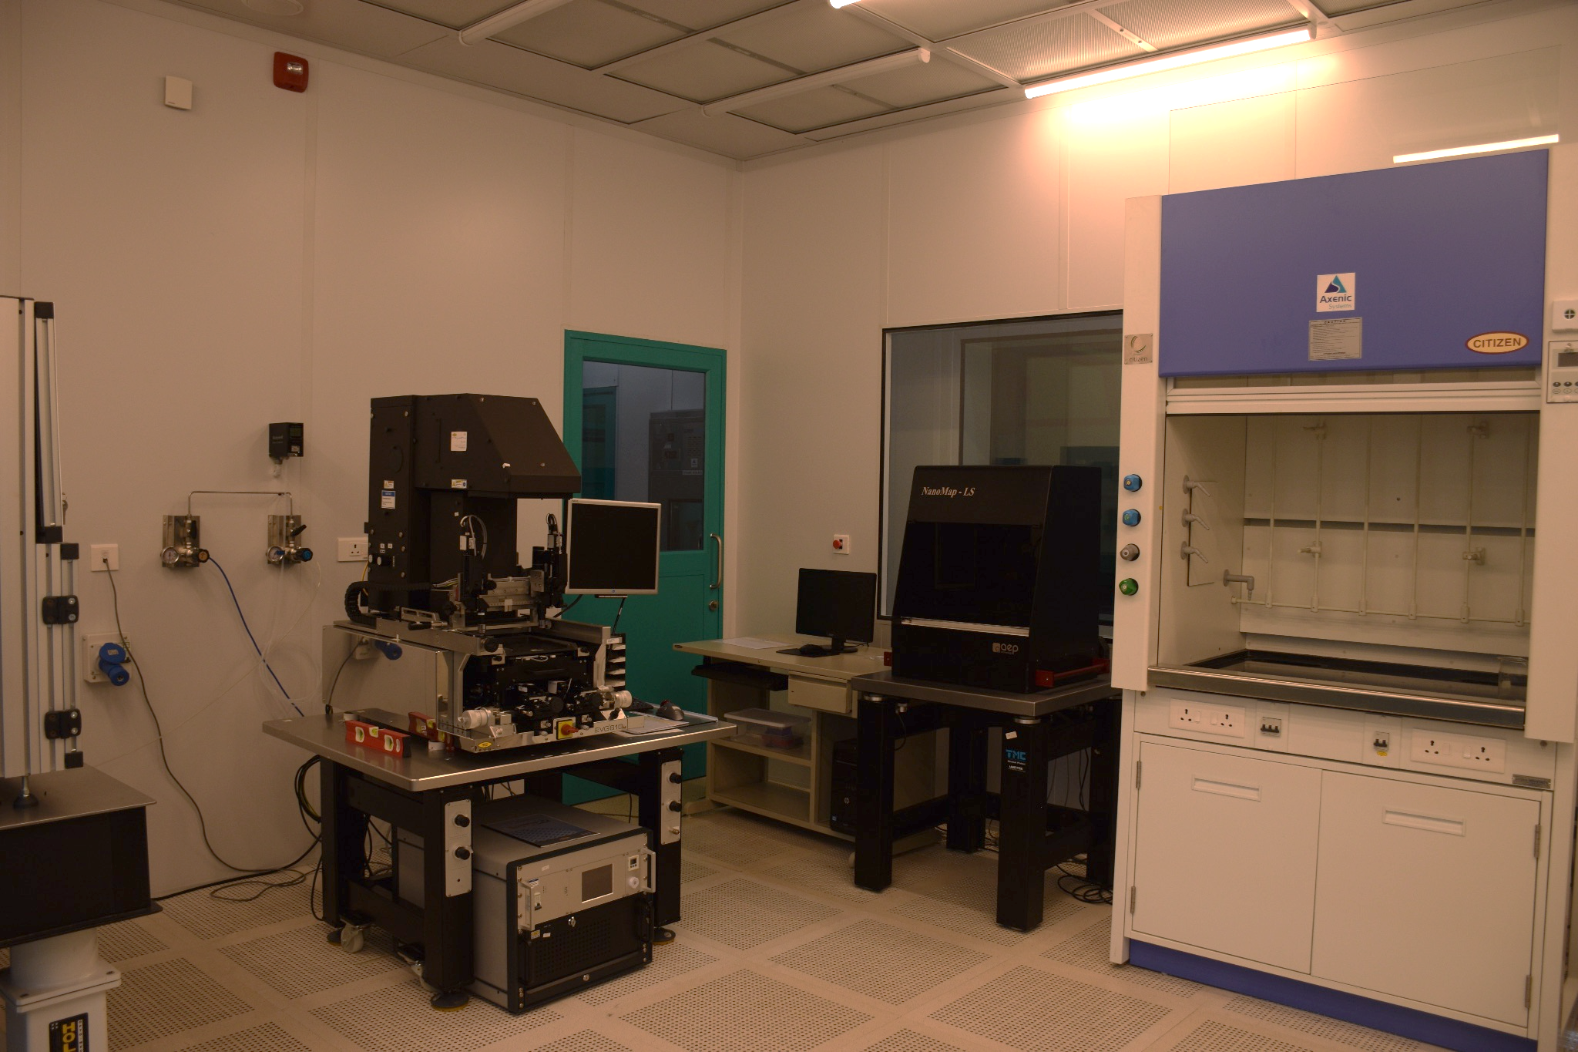
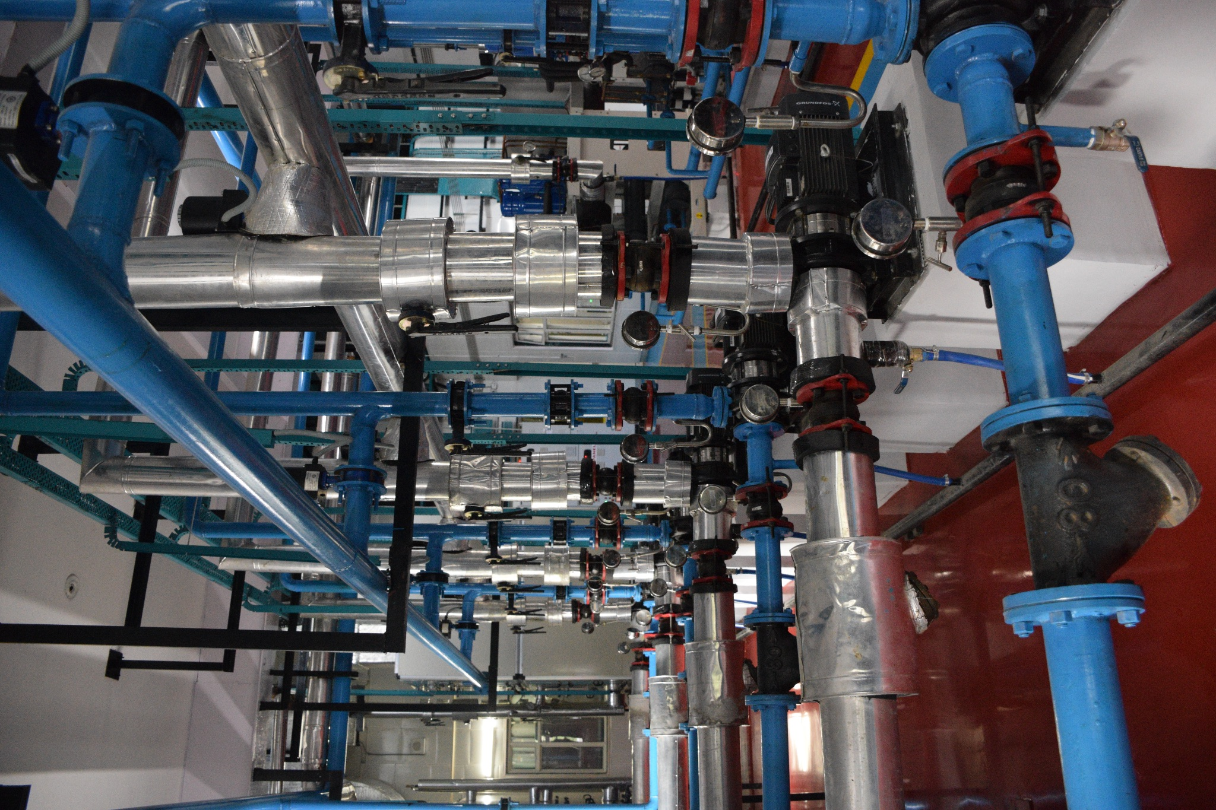
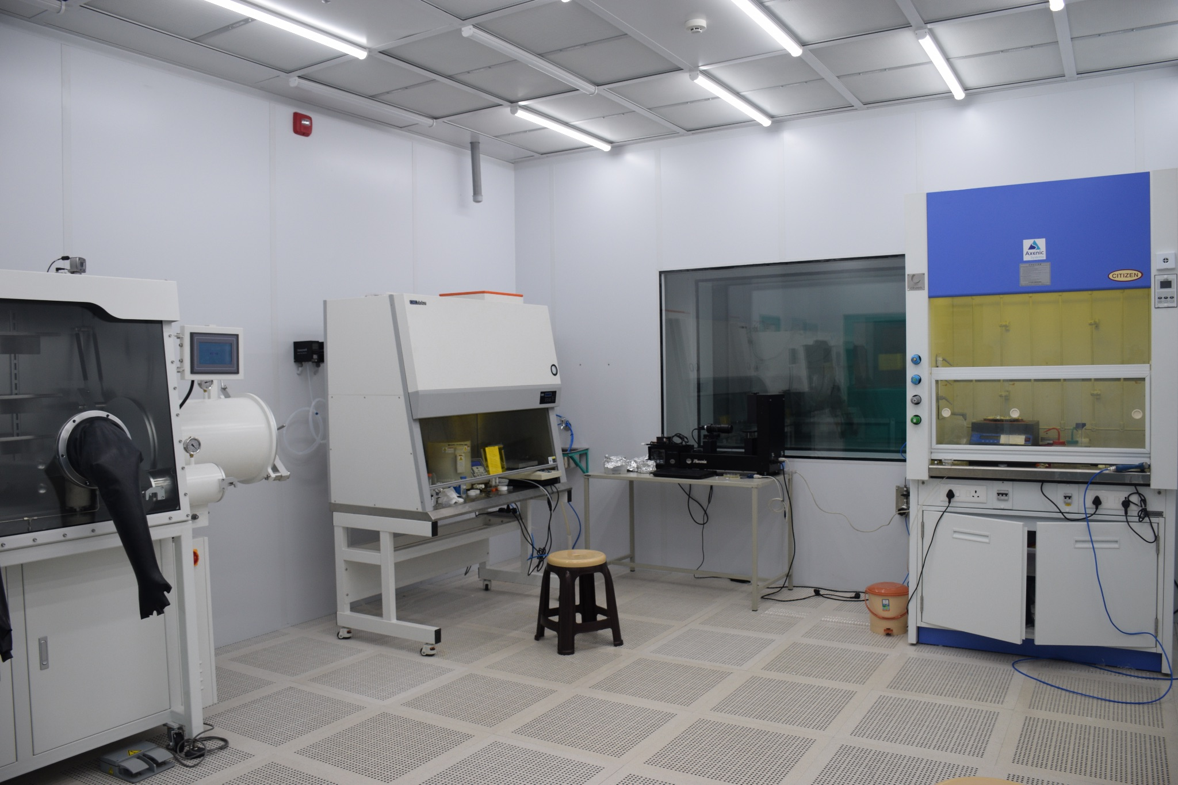
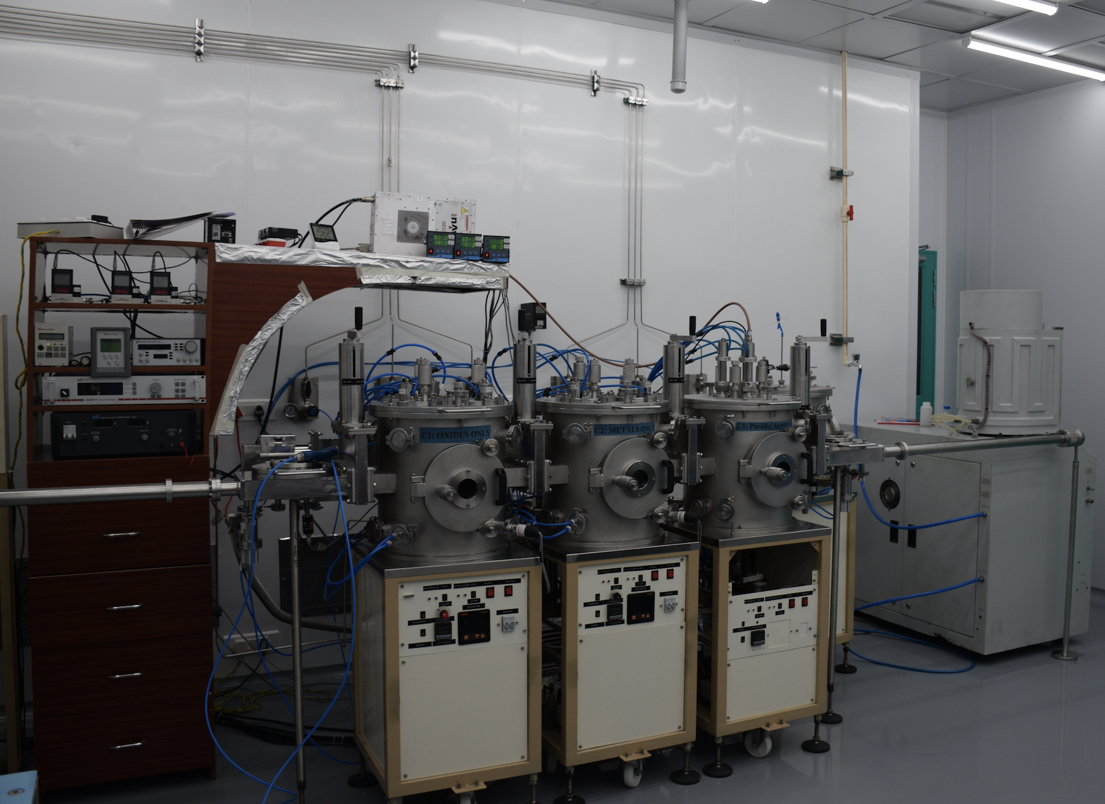
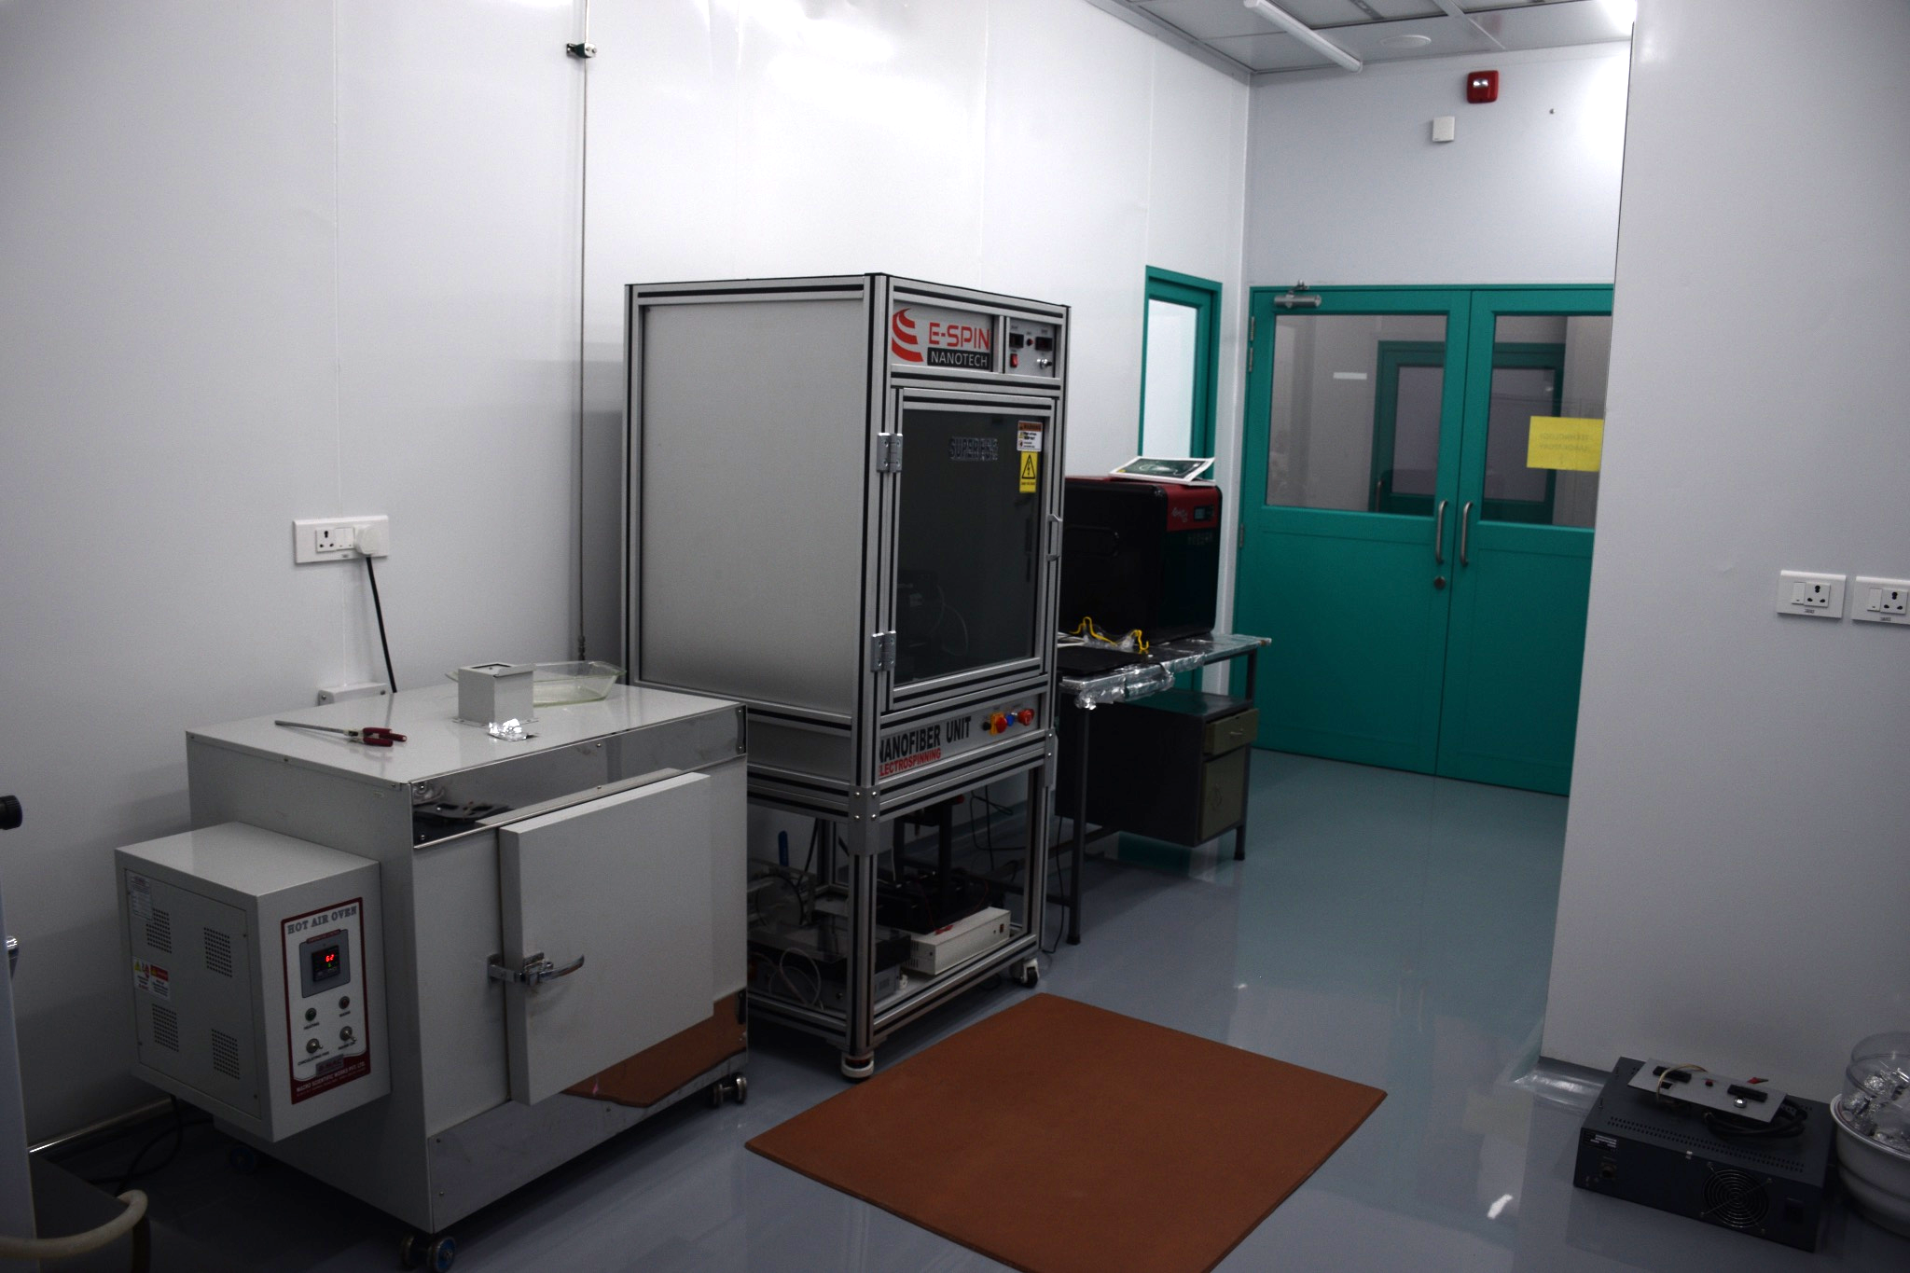
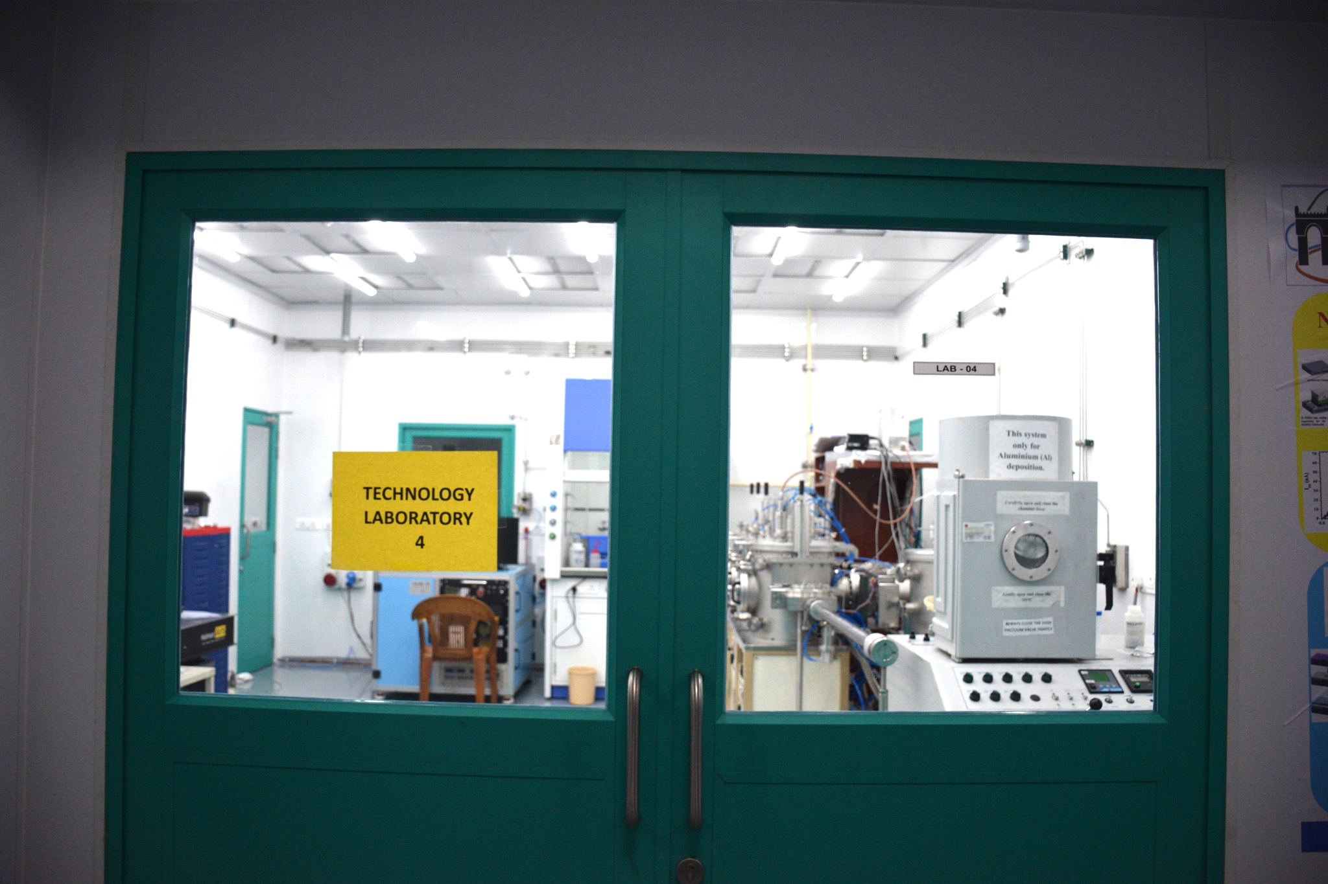
Infrastructure at IIT Mandi (C4DFED)
Centre For Design & Fabrication of Electronic Devices (C4DFED) [21 fabrication instruments]
Unique world-class facility for multidisciplinary research on electronic device design and fabrication
Centre has class 100, Class 1000 & Class 10000 laboratories where high-end sophisticated electronic device design, fabrications, and characterizations tools are installed & housed
This facility has a huge potential in terms of assembling AC-LAGAD devices and its characterization
Helium Ion Beam lithography
Ellipsometer, FESEM, AFM
Resistive Ion Etching
HIBL
EVG Hard mask Lithography
Chillers for clean rooms
Glove Box, Clean bench
Sputtering Systems
Hot Air Oven, E-Spin for nano
Clean room: Techno Lab
prabhakar@iitmandi.ac.in; amal@iitmandi.ac.in IIT Mandi, HP, India
Notes:
‹#›

Slide 5
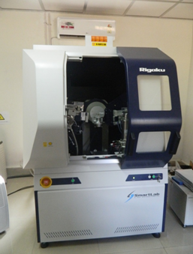
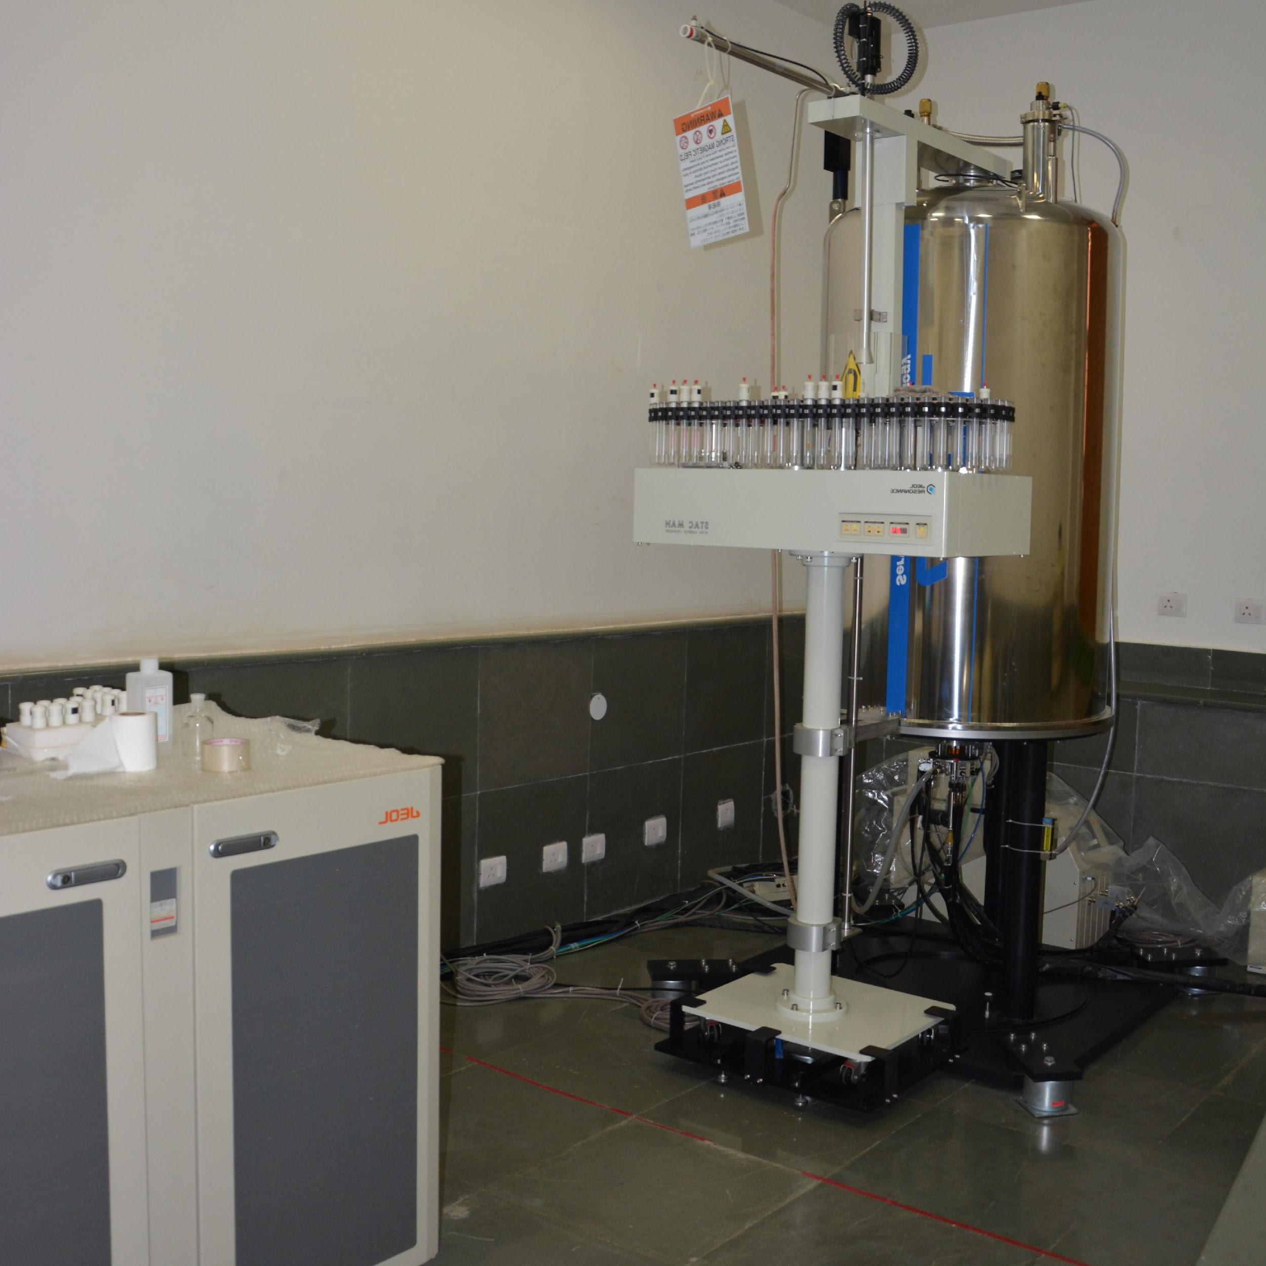
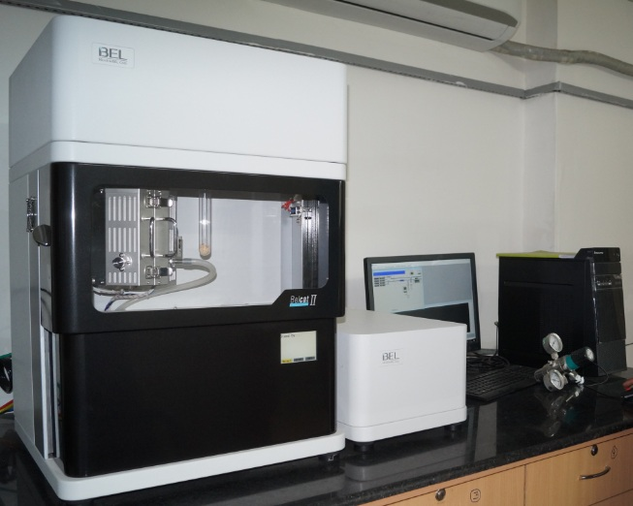
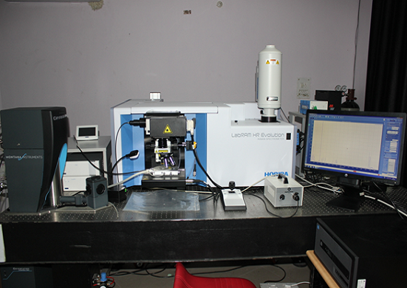
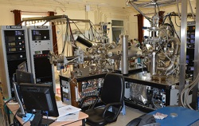
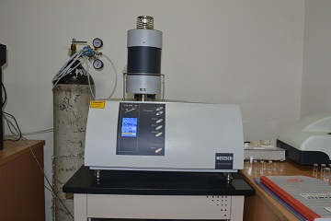
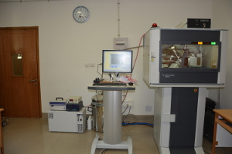
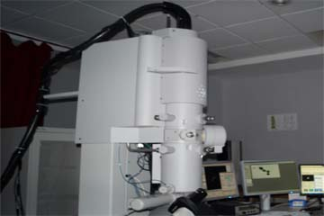
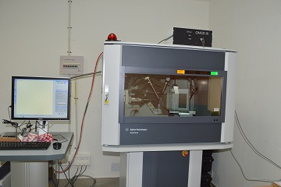
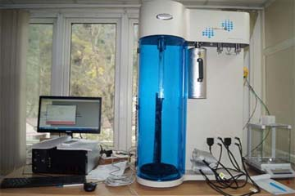
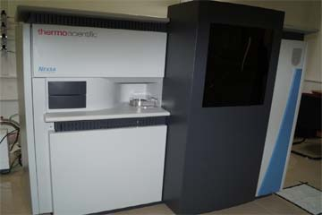
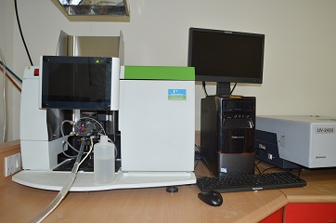
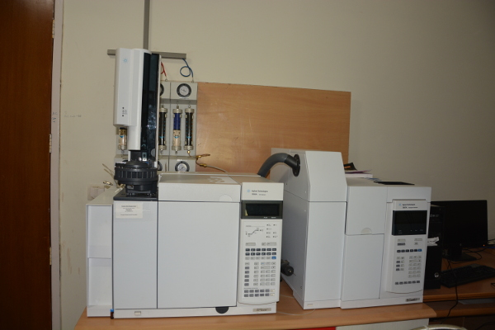
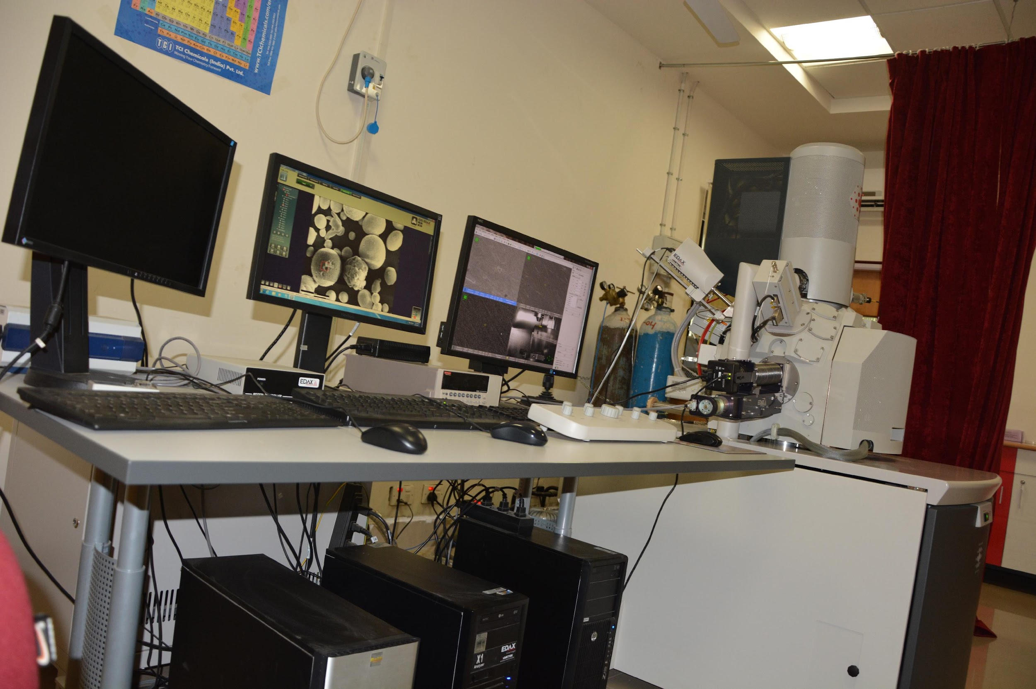
Infrastructure at IIT Mandi (AMRC)
Advanced Material Research Center (AMRC)
A state-of-the-art instrumentation facility, housing more than 46 ancillary equipment, some of them are:
Raman & photoluminescence spectrometer
Photoemission Spectroscopy
Powder X-ray
Diffractometer
Nuclear Magnetic Resonance Spectrometer - 500 MHz
Chemisorption-analyser (BEL CAT2)
Single Crystal X-ray Diffractometer
Raman & photoluminescence spectrometer
Thermo Gravimetric Analyzer coupled with Differential Scanning Calorimetry
(TEM-EDS)
Single Crystal X-ray Diffractometer
X-ray photoelectron spectroscopy
Atomic Absorption spectrophotomete
Field Emission Scanning Electron Microscopy
BET surface area
Gas Chromatography
prabhakar@iitmandi.ac.in; amal@iitmandi.ac.in IIT Mandi, HP, India
Notes:
‹#›

Slide 6
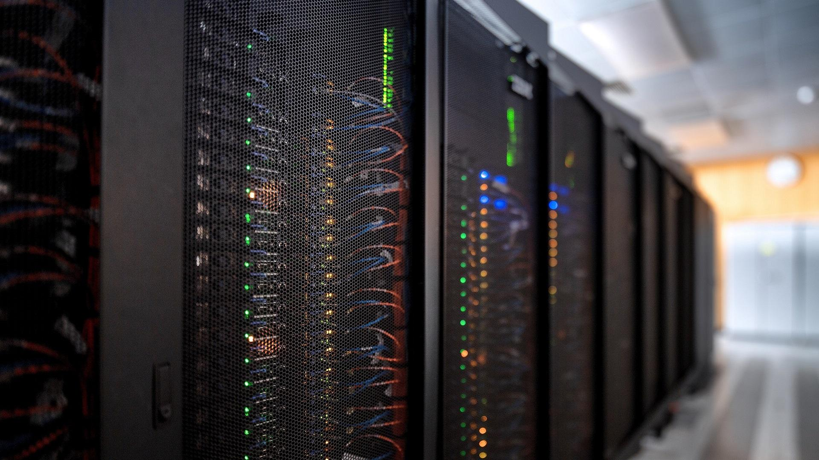
Infrastructure at IIT Mandi _{PARAM, CAIR, MEW}
Computing Facilities:
Supercomputer PARAM Himalaya (established under Phase-2 of the National Supercomputing Mission): it consists of 166 (CPU+GPU) compute nodes with a total peak computing capacity of 838 (CPU+GPU) TFLOPS, 1.0 PB Primary storage.
High Performance Computing (HPC) Cluster facility: Cluster facility has 171 compute nodes with (Xeon Gold/Bronze processors) 64 to 128 Gb of RAM with 10G connectivity & 8 to 24 threads on each node.
Mechanical and Electrical workshop: facility of 700 m² equipped with state-of-the-art rapid prototyping equipment (3D printers), CNC machine tools, conventional lathes and milling machines, and welding and fabrication equipment.
Centre for Artificial Intelligence and Robotics (CAIR): AI-based robotics lab, Medical/Healthcare robotics lab, Indoor Drone Testing facility, AI lab, Tinkering lab, and Underwater robotics lab.
prabhakar@iitmandi.ac.in; amal@iitmandi.ac.in IIT Mandi, HP, India
Notes:
‹#›

Slide 7
Research Interests (Physics, Hardware & Software)
Physics interest:
Physics data analyses
Light & Heavy flavour studies
Jets and its substructure measurement
Detector development:
We will align with different India-EIC groups and explore the possibilities of contributing to hardware activities in the future.
We are keen to explore opportunities in the planned EIC detector R&D and commissioning
We are particularly interested to work on following areas (details on next slide):
AC-LGAD based tracking and PID
MPGD based tracking
Software development and Data reconstruction:
Participate in the software development and reconstruction of data (both of us been working since 2020)
prabhakar@iitmandi.ac.in; amal@iitmandi.ac.in IIT Mandi, HP, India
Notes:
‹#›

Slide 8
Research Interests (AC-LGAD & MPGD)
AC-LGAD TOF:
Contacted AC-LGAD TOF convener Zhangbu Xu and expressed our interests in a meeting on 27 March 2024
Plan to contribute in module assembly, testing, characterization
Followed up with Mathieu Benoit and discussed the technical details of module assembly tasks
Two of our PhD students with Auto-CAD and Micro Lithography experience will be working on the this.
We will work on design of lithography which will be sent by Mathieu.
In touch with Simone Mazza regarding our plans for AC-LGAD testing
MPGD:
Contacted Kondo Gnanvo and expressed our interests in MPGD-DSC general meeting on 4 April 2024
Looking into the details of software design of MPGD shared and suggested by Mathew
One PhD student will work on it, who has experience on the design of Micro-Megas and ANSYS simulation
Possibilities of contributing towards the PCB construction and testing.
Group members suggested to check the possibilities of large GEM foil production in India especially with Micropack pvt ltd. who had produced GEM foils for CMS.
PID:
Had a group meeting with Salvatore Fazio and Rosi Reed on 22 February 2024
Task assigned to IIT Mandi to work on PID and its improvement in different kinematic regions.
Two master students started working on this project (going through the tutorials)
prabhakar@iitmandi.ac.in; amal@iitmandi.ac.in IIT Mandi, HP, India
Notes:
‹#›

Slide 9
Summary
IIT Mandi have well-established master's and Ph.D. programs in physics with a good standing area in High Energy Physics and the institute is authorized to supervise Ph.D. and postdoctoral researchers.
Institute will provide all kinds of support regarding lab space, computing facilities, manpower, support for a leave on deputation.
IIT Mandi is ready to provide additional support in addition to the existing facilities if we have added responsibilities for EIC experiment.
Our research goals are well aligned with the physics program of the EIC experiment, and is best suited for continuing these works, which will provide an excellent opportunity for us.
With our experience and expertise in both particle and heavy ion physics, we hope to make significant contribution to EIC experiment through India-EIC collaboration. The EIC provides better scope for both of us, both in the Nuclear as well as in Heavy ion Physics.
We would be able to devote almost 70% of our research time to the EIC experiment. (IIT Mandi Director has also shown his interest to expand the group by hiring more faculties in experimental HEP)
Thank you for giving us this opportunity to present.
prabhakar@iitmandi.ac.in; amal@iitmandi.ac.in IIT Mandi, HP, India
Notes:
‹#›

Slide 10
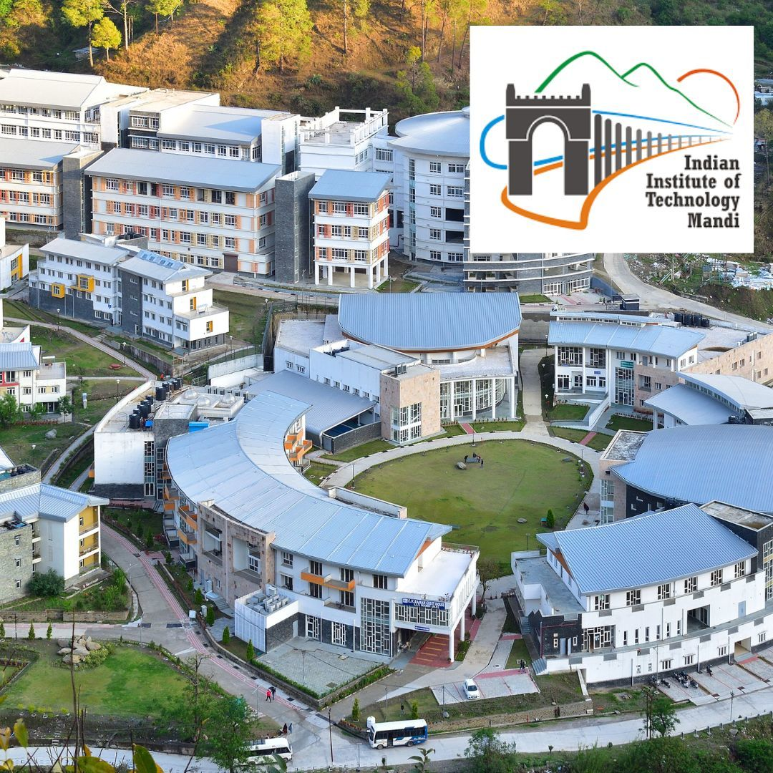
Thank You!
prabhakar@iitmandi.ac.in; amal@iitmandi.ac.in IIT Mandi, HP, India
Notes:
‹#›

Slide 11
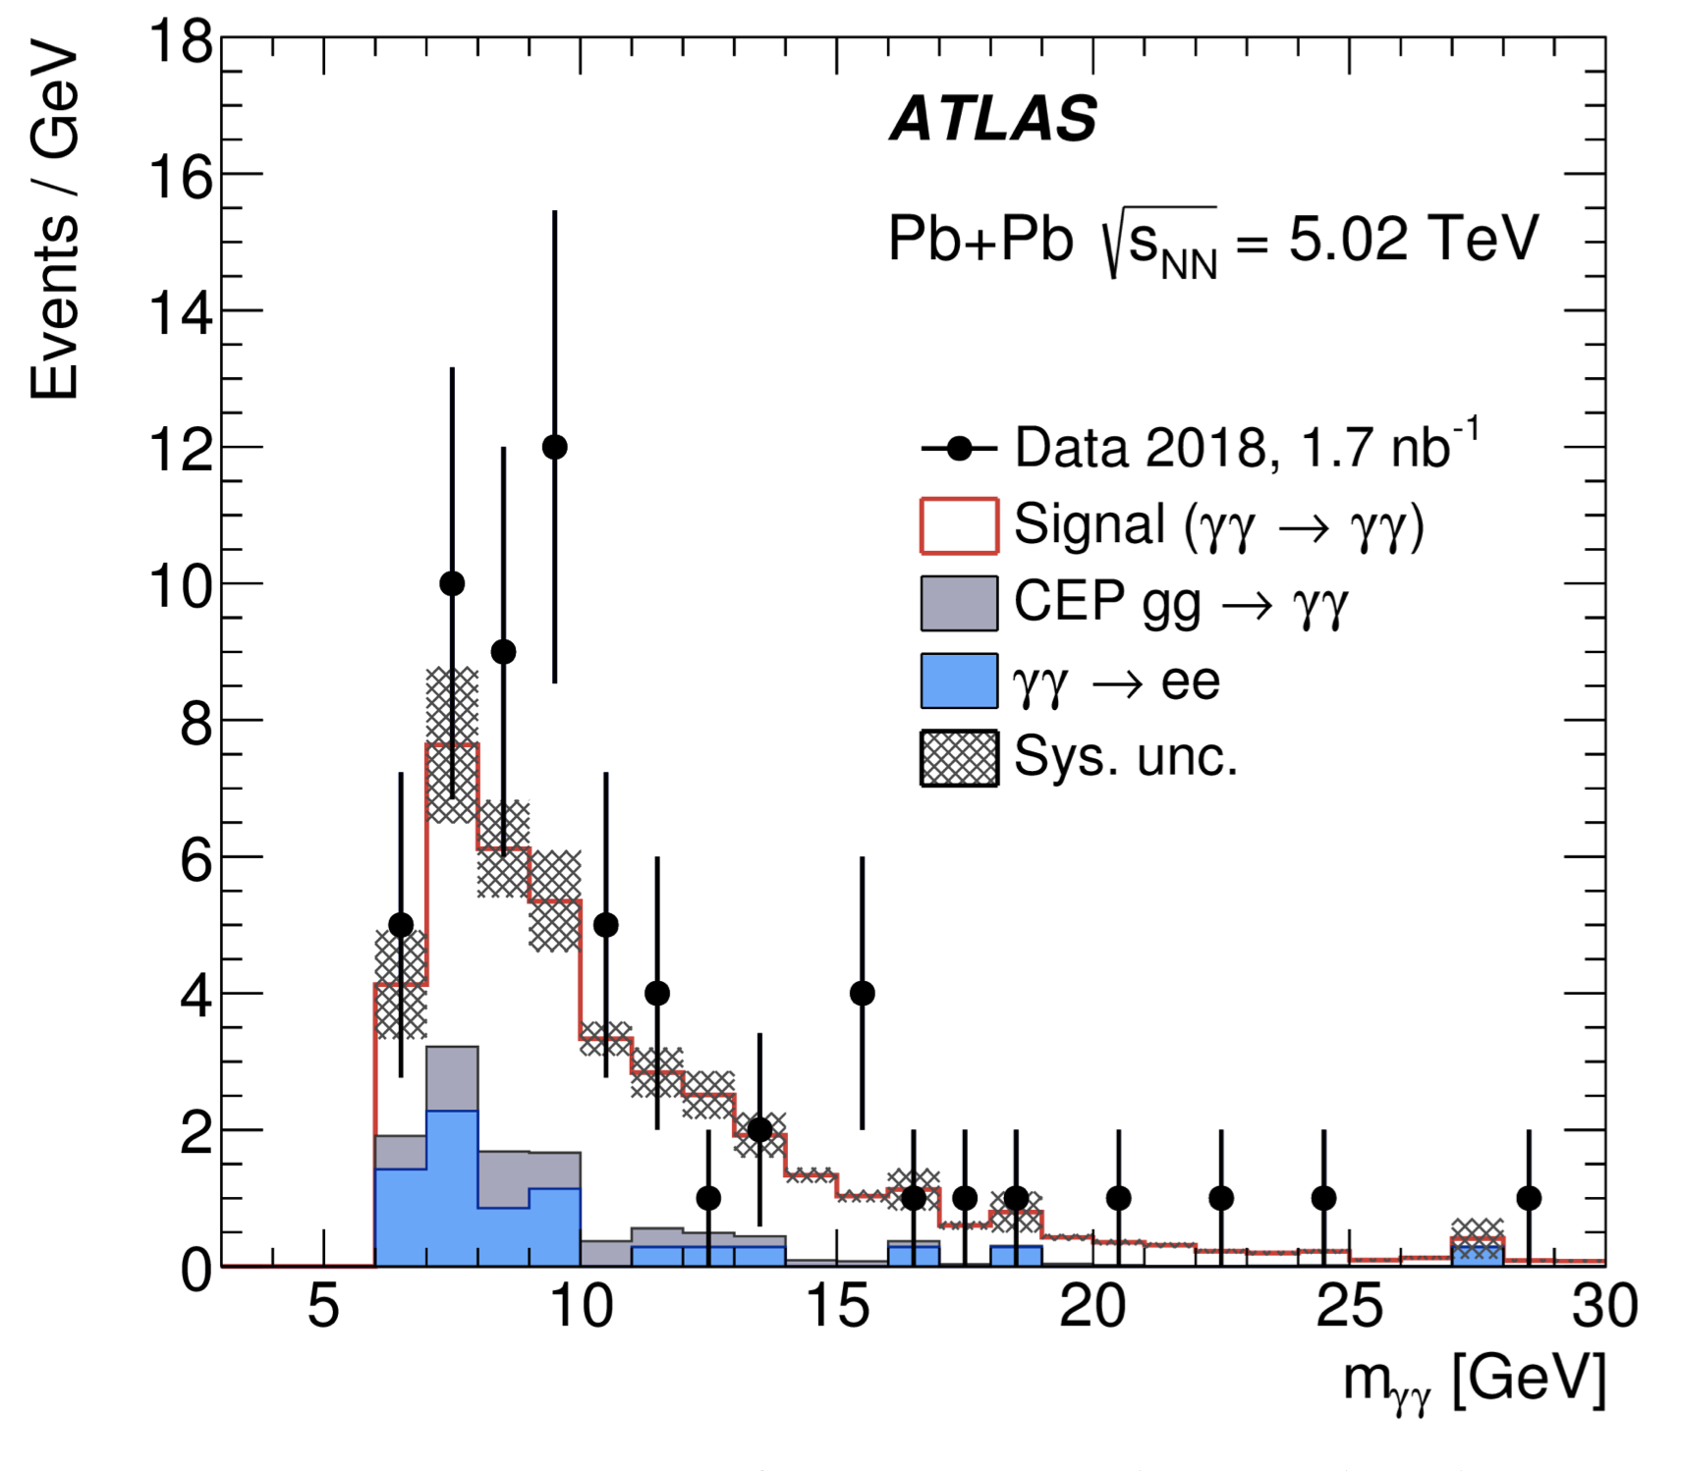
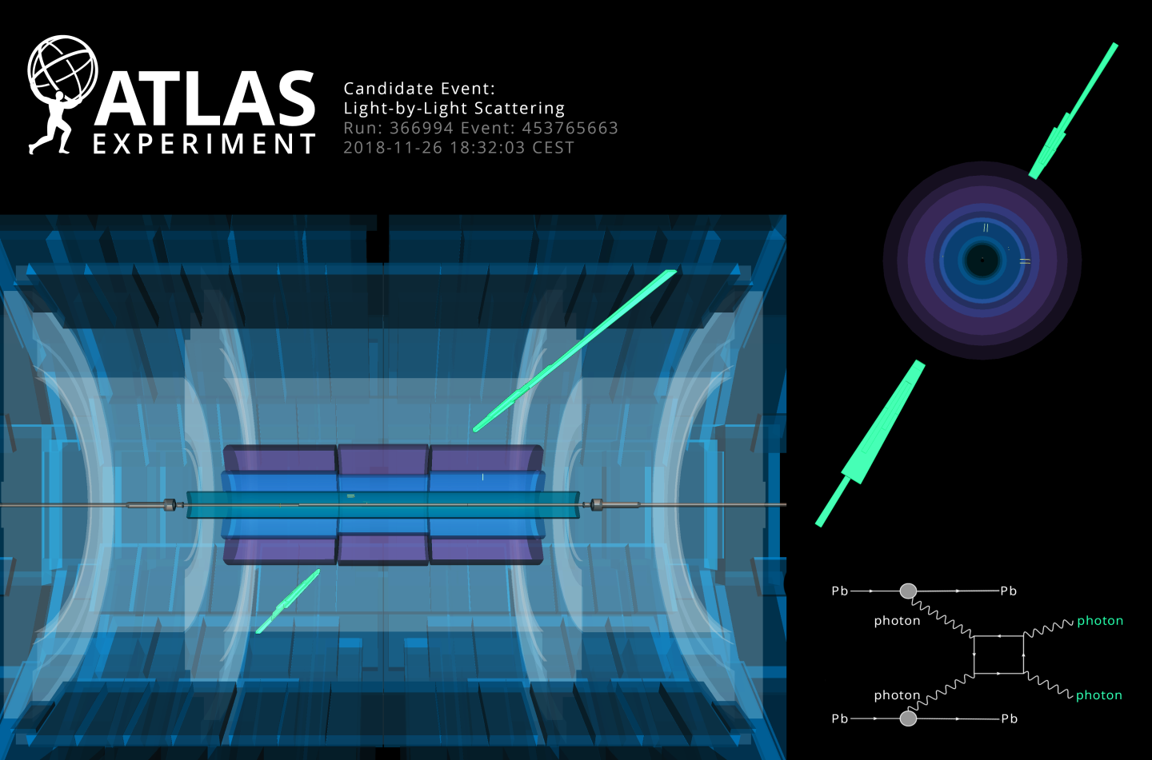
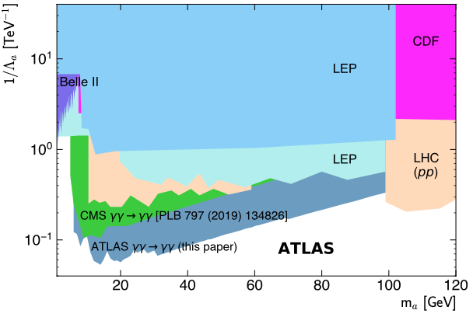
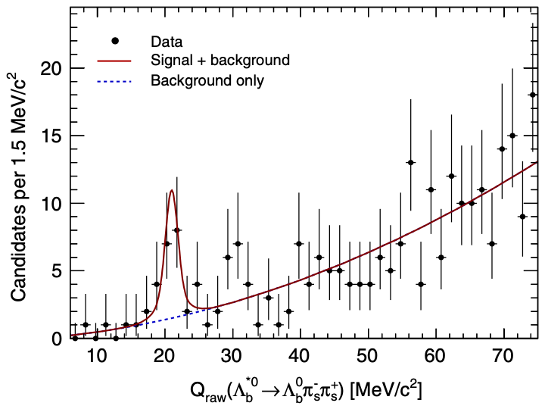
Research Experience P. Palni _{(Physics Analysis)}
Light-by-light Scattering (ATLAS Collaboration)
Discovered Light-by-light scattering at LHC with ATLAS Detector [Phys. Rev. Lett. 123, 052001 (2019)] [One of the Primary Author]
Search for axion-like particles and differential cross-sections of LbyL
scattering [JHEP 03, 243, (2021)] [One of the Primary Author]
Top Physics (ATLAS Collaboration)
Measurement of top-quark pair production in proton-lead collisions at 8.16 TeV [ANA-TOPQ-2018-43-INT-1] [Lead Author]
B Physics (CDF Collaboration)
Found the first evidence of the new excited Bottom Baryon resonance state 𝛬_{b}*0 using the data recorded by the CDF II detector [Phys. Rev. D 88, 071101 (Rapid Comm.), (2013)] [One of the Primary Author]
Strangeness Production (ALICE Collaboration)
Multiplicity dependence of (multi-)strange hadron production in proton-proton collisions
at √s = 13 TeV [Eur. Phys. J. C, 80, 167, (2020)] [One of the Primary Author]
Evolution of strange and multi-strange hadron production with relative transverse multiplicity activity in underlying event [Eur. Phys. J. C, 80, 919, (2020)] [Lead Author]
Pseudorapidity distributions of charged particles as a function of mid & forward rapidity multiplicities in pp collisions at √s = 5.02, 7 & 13 TeV [Eur. Phys. J. C, 81, 630, (2021)] [Lead Author]
prabhakar@iitmandi.ac.in; amal@iitmandi.ac.in IIT Mandi, HP, India
Notes:
‹#›

Slide 12
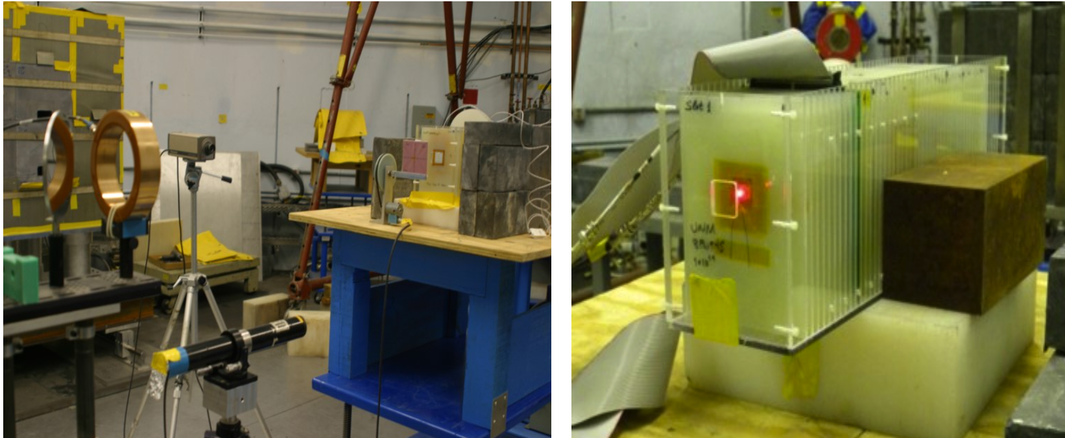
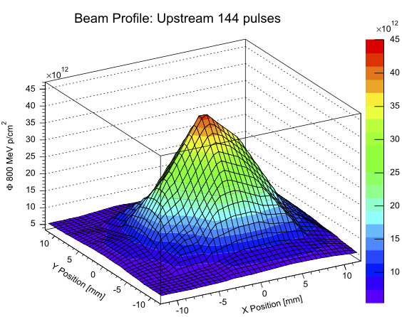
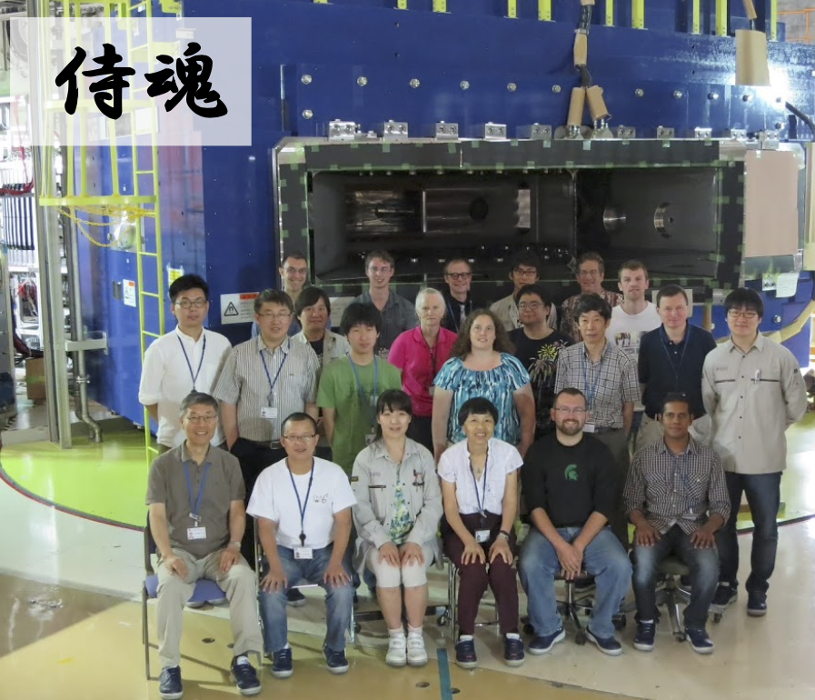
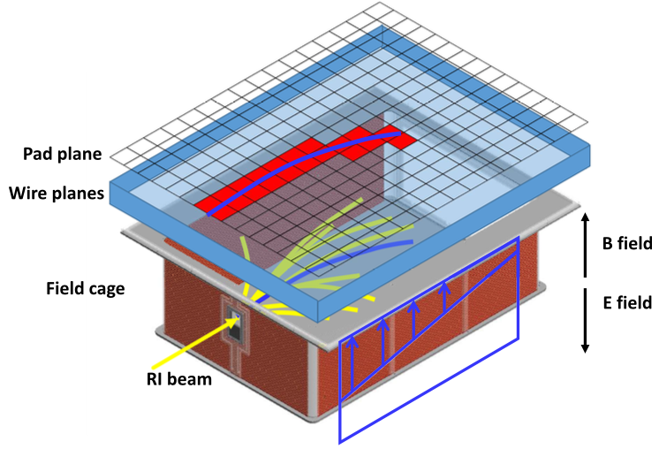
Research Experience P. Palni _{(Hardware & Software)}
Devised a new method for real-time monitoring of charged particle beam profile and fluence (for upcoming HL LHC runs) and demonstrated at Los Alamos National Lab. [Nuclear Inst. and Methods, Physics Research, A. 735, 213-217, (2014)] [Led Paper committee] [Solid-State Electronics, 116, 38-45, (2016)] [Paper committee]
Developed interface of the SuperChic event generator with ATHENA framework in ATLAS. SuperChic is a MC event generator for central exclusive production at parton level, for a range of SM final states including ALP production for BSM searches. [ATLAS service work project]
Development of the SPiRITROOT software framework and contributed to the simulation, digitization, and reconstruction of the events inside the SAMURAI Pion-Reconstruction and Ion-Tracker (SPiRIT) Time Projection Chamber (TPC) [Led the Development]
Produced a large inclusive B/Charm Physics Monte Carlo (MC) Sample in CDF B-Physics Group [https://inspirehep.net/literature/1370796] [Lead Author]
prabhakar@iitmandi.ac.in; amal@iitmandi.ac.in IIT Mandi, HP, India
Notes:
‹#›

Slide 13
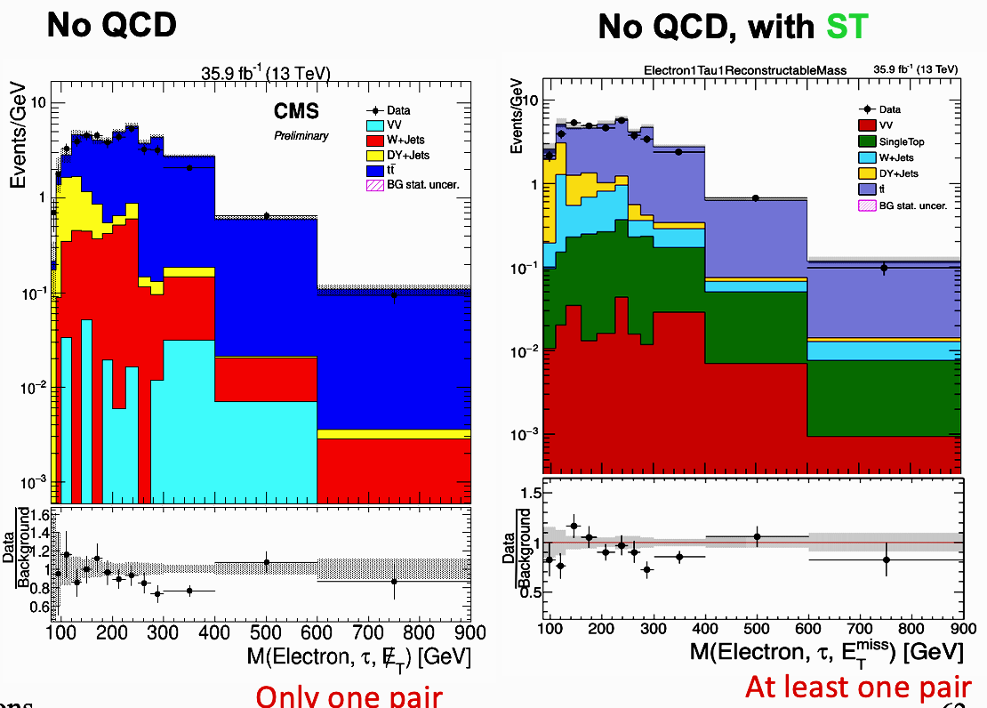
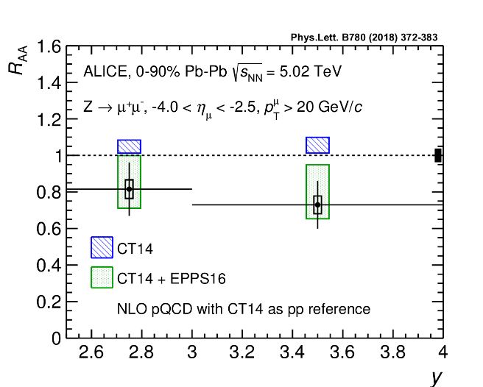
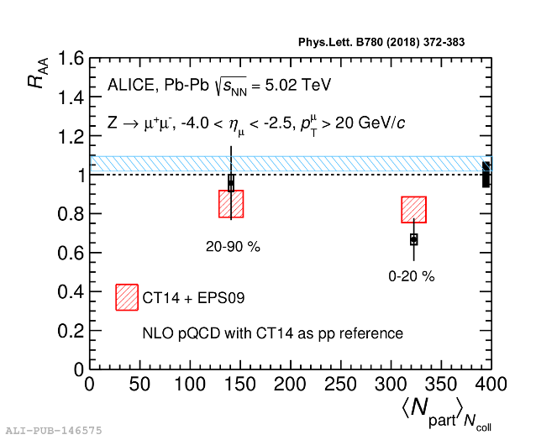
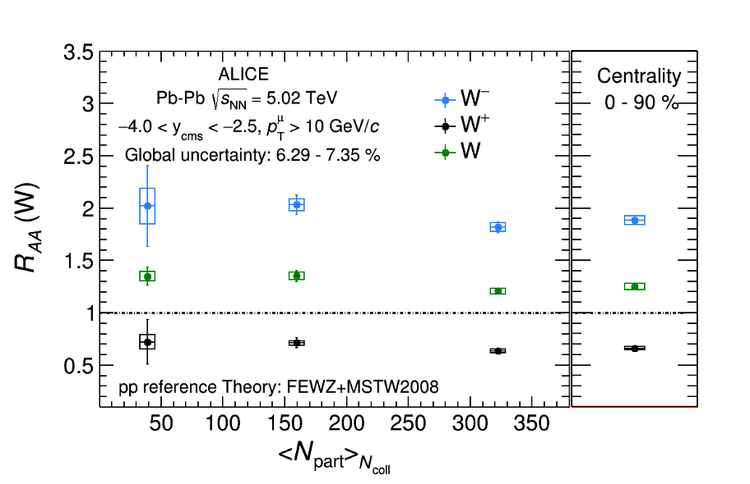
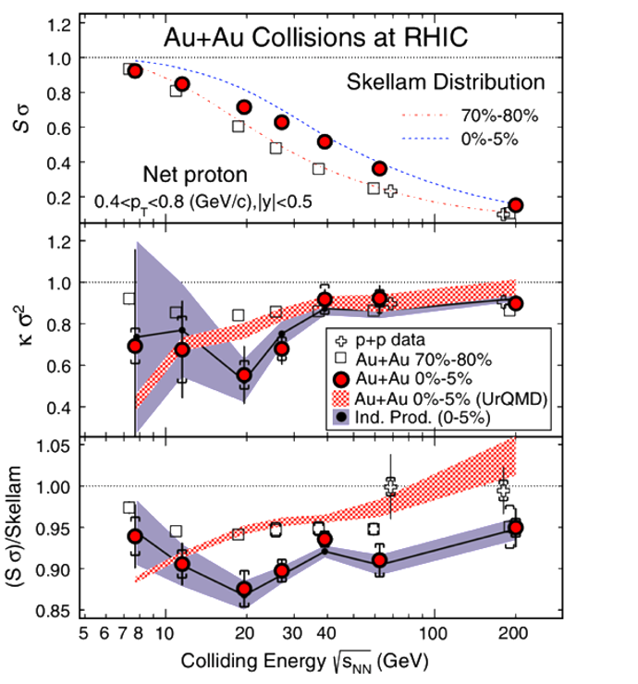
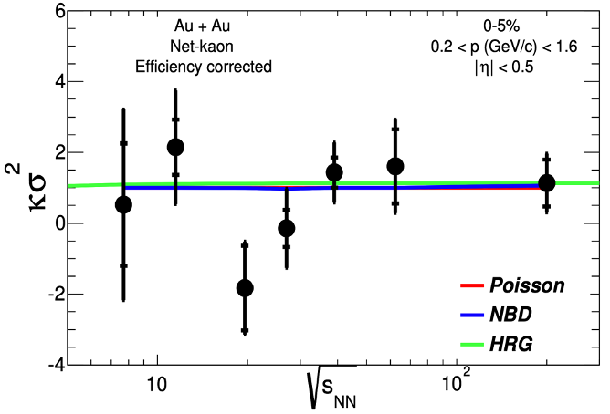
Research Experience A. Sarkar _{(Physics Analysis)}
Particle Physics:
Search of Z’ boson production in p-p collisions at √s = 13 TeV in CMS experiment
Measurement of W boson production in p-p collisions at √s_{NN} = 13 TeV in ALICE experiment
D⁰ meson production study in four daughter decay channel in pp collision at 8 TeV in ALICE experiment
Heavy Ion Physics
Z boson measurement in ALICE experiment at LHC in p-Pb and Pb-Pb collisions [Phys. Lett. B 780, 372 (2018)]
Measurement of W production in Pb-Pb heavy ion collisions at √s_{NN} = 5.02TeV in ALICE experiment at the LHC [ALICE-ANA-2013/2018, JHEP 36 (2023)]
Heavy Flavour study in proton-proton and Pb-Pb collisions in ALICE experiment
Higher Moments Measurement of particle Multiplicity Distribution in the Search for the QCD Critical Point [Phys. Rev. Lett. 112, 032302 (2014), Phys. Rev. Lett. 113, 092301 (2014), Phys. Rev. Lett. B 785, 551-560 (2018), Nucl. Phys. A 931, 796 (2014)]
Phenomenology:
Fluctuation study in Polyakov loop enhanced Nambu-Jona-Lasinio (PNJL) model, [Few Body Syst. 59, no. 4, 55 (2018), arxiv 2002.00034 (2023), axxiv.2209.07130 (2022)]
prabhakar@iitmandi.ac.in; amal@iitmandi.ac.in IIT Mandi, HP, India
Notes:
‹#›

Slide 14
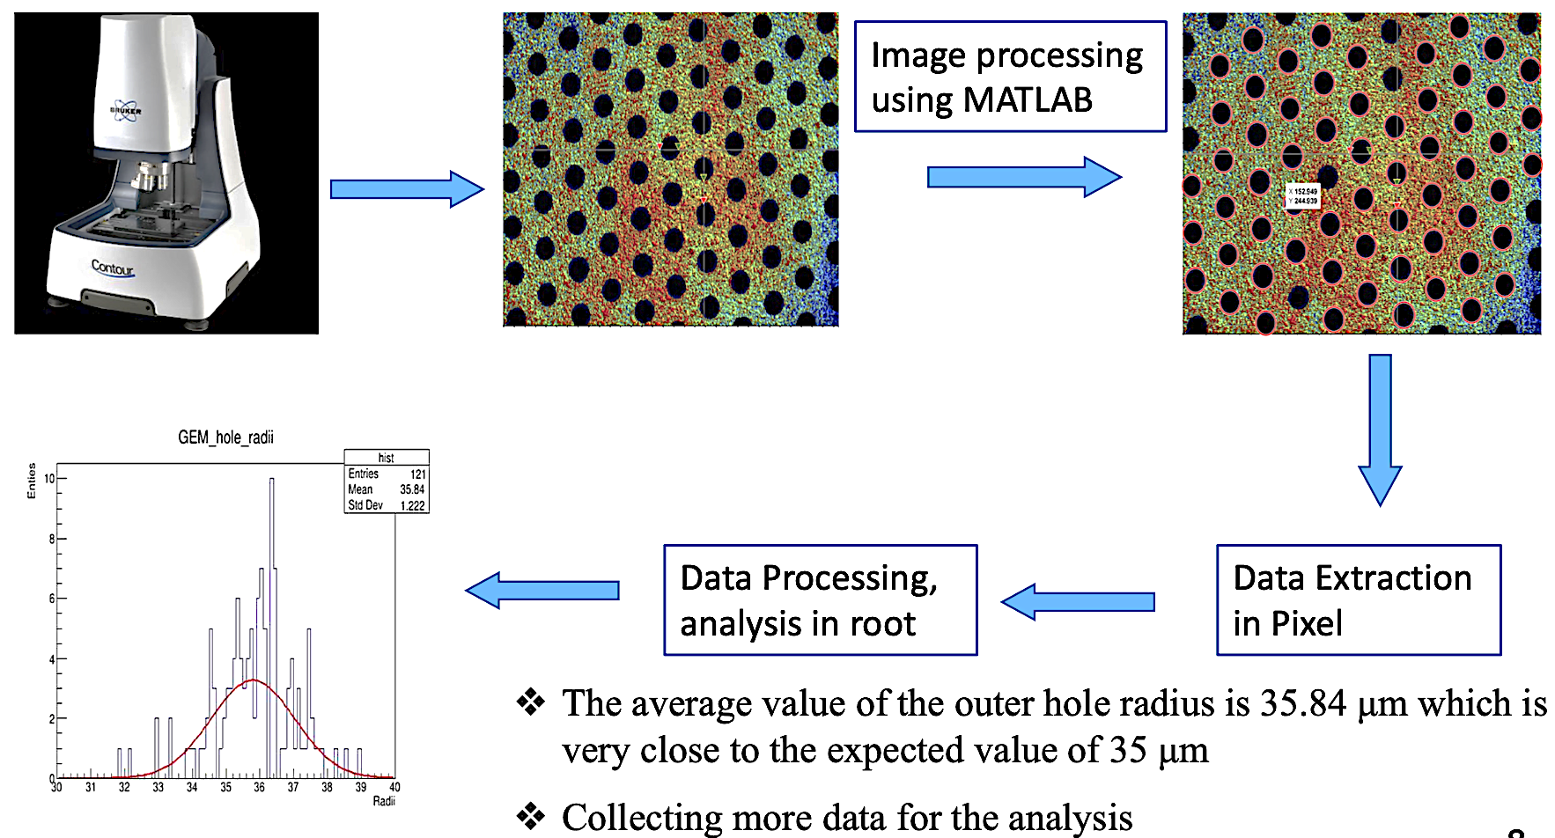
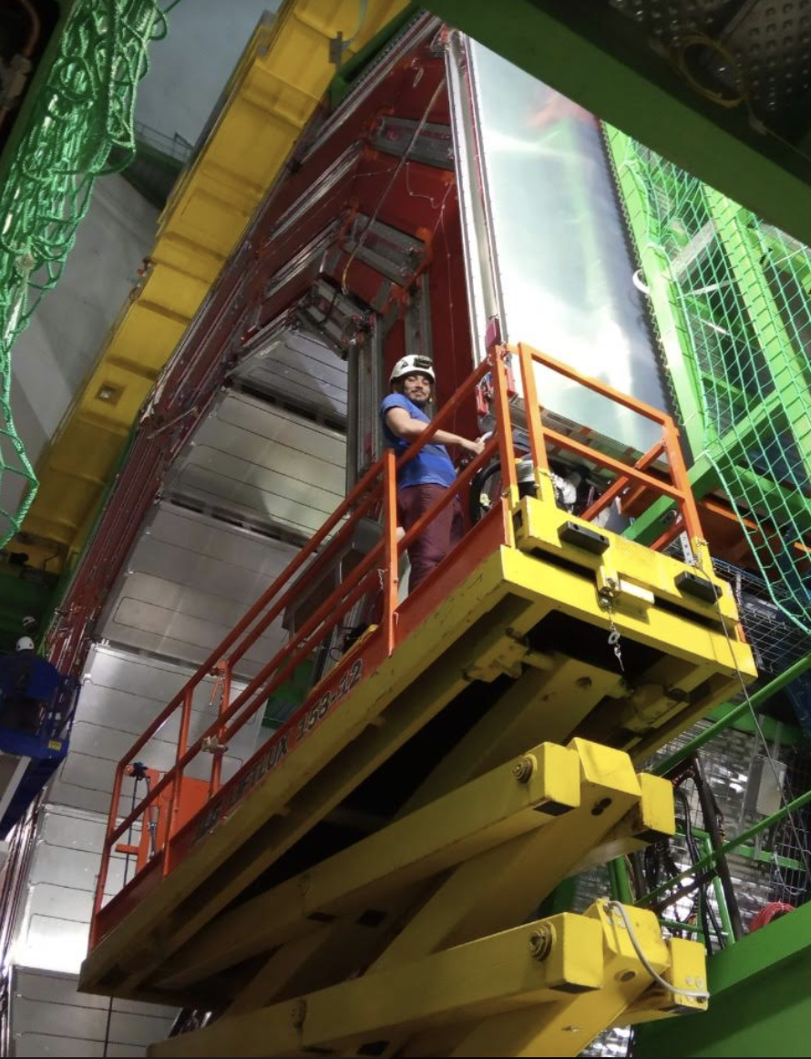
Research Experience A. Sarkar _{(Hardware & Software)}
Study and characterization of Gas Electron Multiplier (GEM) foil for multi GEM detector development, SERB Sponsored
Setting up lab for MPGD based detector development
Working on cost effective GEM foil and foil for MPGD based detector
Worked for CMS RPC maintenance and upgrades: learned assembling, calibrating and optimizing Resistive Plate Chambers (RPCs) for the CMS
Worked as an on-call expert [Calibrating, optimising and operating] ALICE Muon arms at the LHC for a period of two years.
Efficiency and Transverse Momentum (p_{T}) Resolution study of STAR Time Projection Chamber (TPC) at the Relativistic Heavy Ion Collider (RHIC). Based on the study, STAR TPC was realigned and re-calibrated.
Simulation and Testing on a Gaseous Detector using Garfield: Developing particle detectors with different geometry and different electric and magnetic fields using the Garfield simulator.
Full and fast simulation development using GE4, Jana, Jana2
prabhakar@iitmandi.ac.in; amal@iitmandi.ac.in IIT Mandi, HP, India
Notes:
‹#›

Slide 15
Human Resources at IIT Mandi
Faculty members at IIT Mandi can dedicate sufficient time to their research activities.
Teaching activities are roughly one course per semester (4-6 hours/week) of teaching activities.
Faculty members can be deputed for research-related travel corresponding to 2 months each in the summer and winter, along with any urgent travel required during the semester for a short duration.
Doctoral students and postdocs may travel for extended periods to fulfil the research requirements like shifts, service work, training, workshops, etc.
The School of Physical Sciences has over fifty research scholars pursuing their Ph.D. and the institute supports external Ph.D. candidates through DST Inspire fellowship, CSIR, etc. Moreover, institute also supports Ramanujan fellow and post-doctoral researchers.
Institute allows faculty members to guide 7 (institute funded) PhD students and no limit on additional PhD students through CSIR and externally funded projects
prabhakar@iitmandi.ac.in; amal@iitmandi.ac.in IIT Mandi, HP, India
Notes:
‹#›

Slide 16
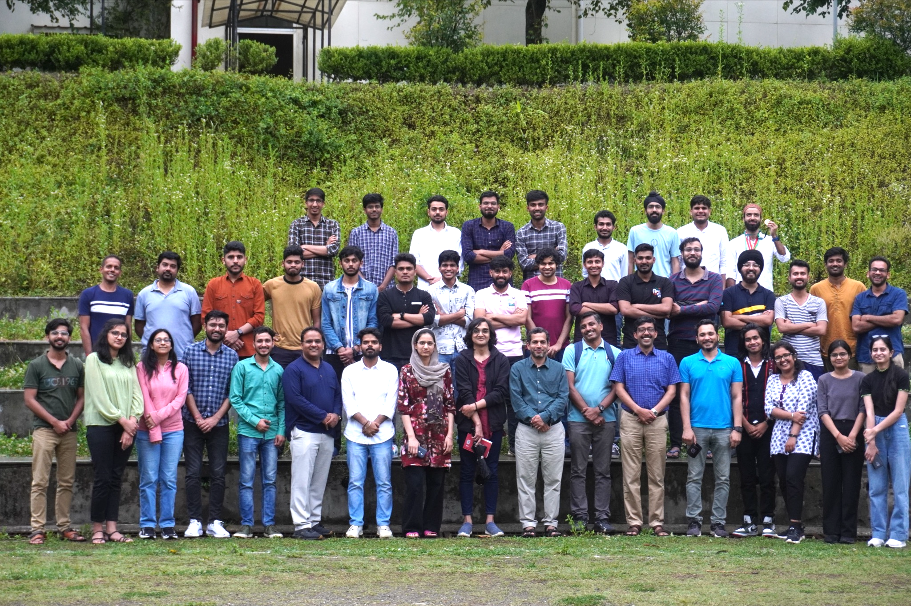
Introduction to School of Physical Sciences
The School of Physics Sciences has eighteen bright faculties conducting research in cutting-edge themes of physics ranging from the physics of molecules, atoms, and quarks to the dynamics of black holes and the early universe.
Currently, the strength is 74 Master, 23 Integrated Ph.D., and over 50 Ph.D. students
We offer a great research ambiance with state-of-the-art experimental and computing facilities. Moreover, we provide an opportunity for collaboration with other engineering departments for software and detector hardware development.
SPS houses HPC Cluster facility, which has a multi-purpose Linux cluster and is devised to address problems that involve heavy computation.
HEP laboratory acquired 200 m² of space and developing facilities like a clean room, characterization, and mechanical room. We are establishing the Micro Pattern Gaseous Detector (MPGD) and Low Gain Avalanche Diode (LGAD) development center in the HEP laboratory.
prabhakar@iitmandi.ac.in; amal@iitmandi.ac.in IIT Mandi, HP, India
Notes:
‹#›

Slide 17
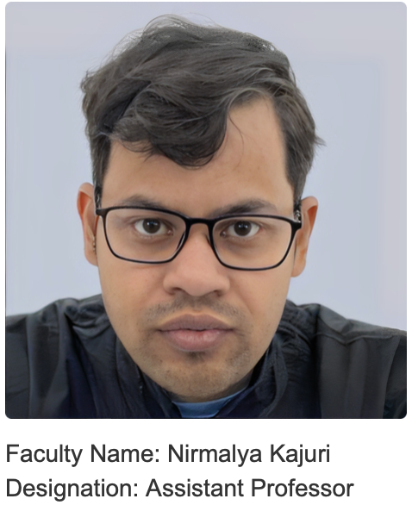
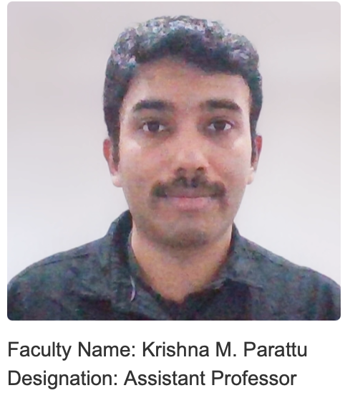
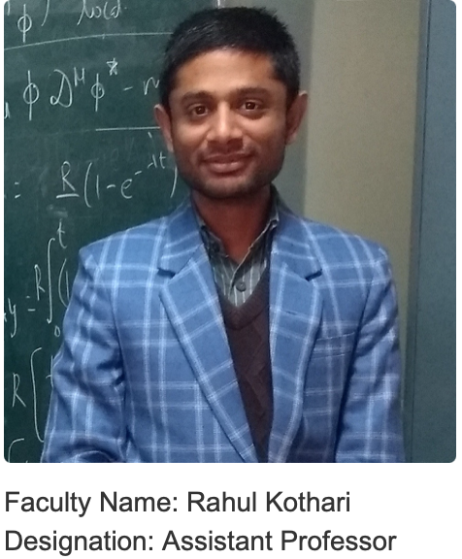
Introduction to School of Physical Sciences
The SPS has eighteen bright faculties conducting research in cutting-edge themes of physics ranging from the physics of molecules, atoms, and quarks to the dynamics of black holes and the early universe.
The High Energy Physics group (experiment & theory) has five faculty members researching heavy flavor & BSM physics, top physics, collider and QCD phenomenology, AdS/CFT theory, quantum gravity, dark matter, and Astro particle physics.
Dr. Nirmalya Kajuri Ph.D: IMSc, Chennai Research Area: Theoretical High Energy Physics
Dr. Krishna M. Parattu Ph.D: IUCAA, Pune Research Area: Gravitation and Cosmology, Quantum Information, Mathematical Physics
Dr. Rahul Kothari Ph.D: IIT Kanpur, Kanpur Research Area: Cosmology
Dr. Prabhakar Palni Ph.D: University of New Mexico, USA Research Area: Experimental High Energy Physics
Dr. Amal Sarkar Ph.D: IIT Bombay, Mumbai Research Area: Experimental High Energy Physics
prabhakar@iitmandi.ac.in; amal@iitmandi.ac.in IIT Mandi, HP, India
Notes:
‹#›

Slide 18
Support from IIT Mandi Management
IIT Mandi management and the School of Physical Sciences is fully supportive to work in the HEP experiment
We plan on participate in the hardware (by setting up dedicated lab facilities for HEP) and computing facilities
Seed grant support of Rs. 30-40 Lacs: which can be utilized for the research activities in the HEP experiment (lab setup etc).
Institutes offer collaboration with engineering departments for new device fabrication and development
IIT Mandi management is ready to provide additional support in terms of space, manpower (Postdoc/PhD students) and basic infrastructure in an event of getting additional responsibilities from HEP experiment.
IIT Mandi will fully support to host meetings, workshops and conferences related to EIC. Institute encourages organization of conferences, workshops, and meetings
2nd Hot QCD Matter Conference in June 2024 (Host Institute)
4th Heavy Flavor Meet held in November 2023 (Local Organizing Committee Member)
Shivalik Hepcats’23 Conference held in January 2023 (Host Institute)
prabhakar@iitmandi.ac.in; amal@iitmandi.ac.in IIT Mandi, HP, India
Notes:
‹#›

