Slide 1
Jets and Heavy Flavor WG Summary
Olga & Brian
Ides of March, 2024

Slide 2
Group Information and Contacts
Mailing List: eic-projdet-jethf-l@lists.bnl.gov
  https://lists.bnl.gov/mailman/listinfo/eic-projdet-jethf-l
Meeting Indico Pages: https://indico.bnl.gov/category/420/
Wiki Page: https://wiki.bnl.gov/eic-project-detector/index.php/JetsHF
Mattermost Chat: (sign-up link) https://eic.cloud.mattermost.com/signup_user_complete/?id=i8gnmob4stdrpjfrezhegxs3ew
Conveners
  Olga Evdokimov – evdolga@uic.edu
  Brian Page – bpage@bnl.gov
Meetings
  Wednesdays 12 pm time slot - Biweekly

Slide 3
Updates
Work on Hadron-in-Jet TDR plots progressing
  Added appropriate cut on electron-jet momentum imbalance
  Working on combining Q2 bins
Contributions from new members to the group
Starting to look at jet reconstruction in the backward HCal

Slide 4
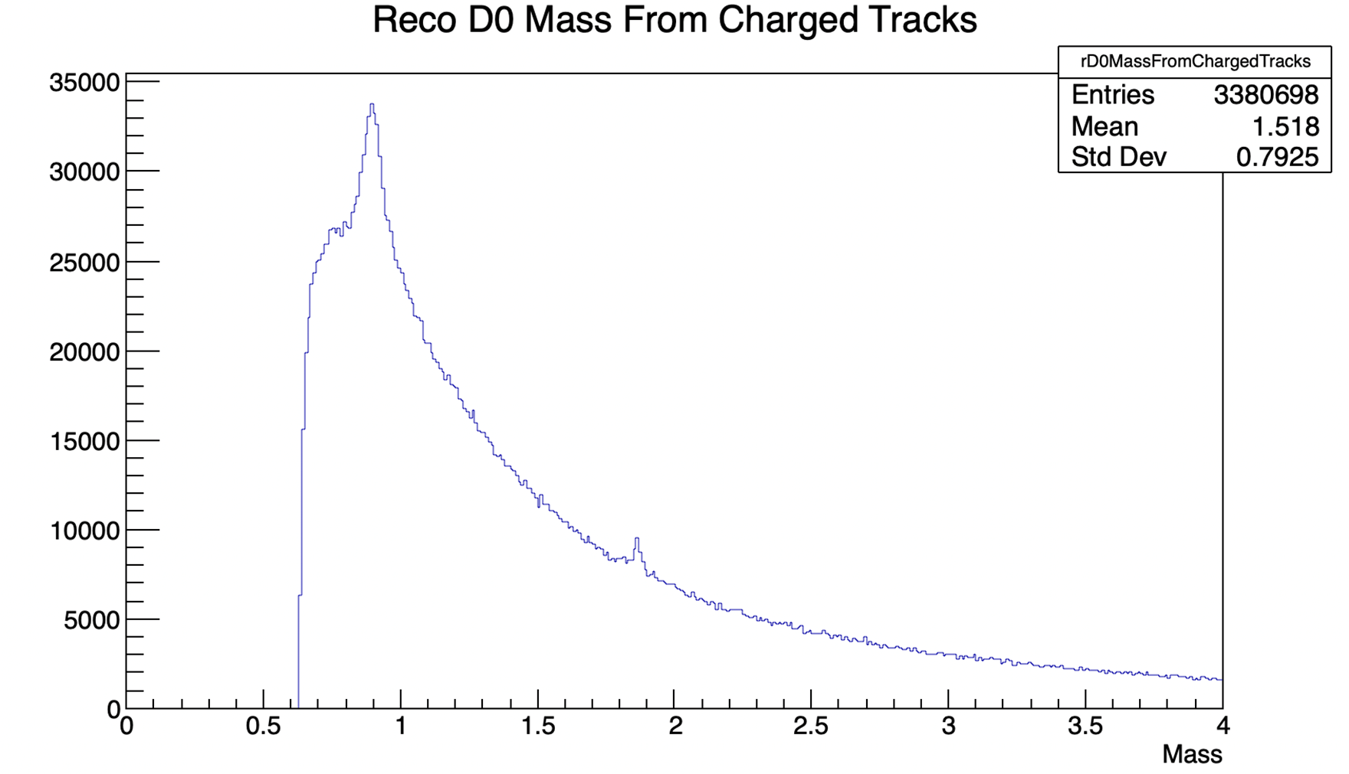
Contributions
Diptanil Roy (Rutgers): D0 – Jet Correlations

Slide 5
Contributions
Tanmay Pani (Rutgers): Full Jet Reconstrution
Double counting of track and calorimeter contributions?

Slide 6
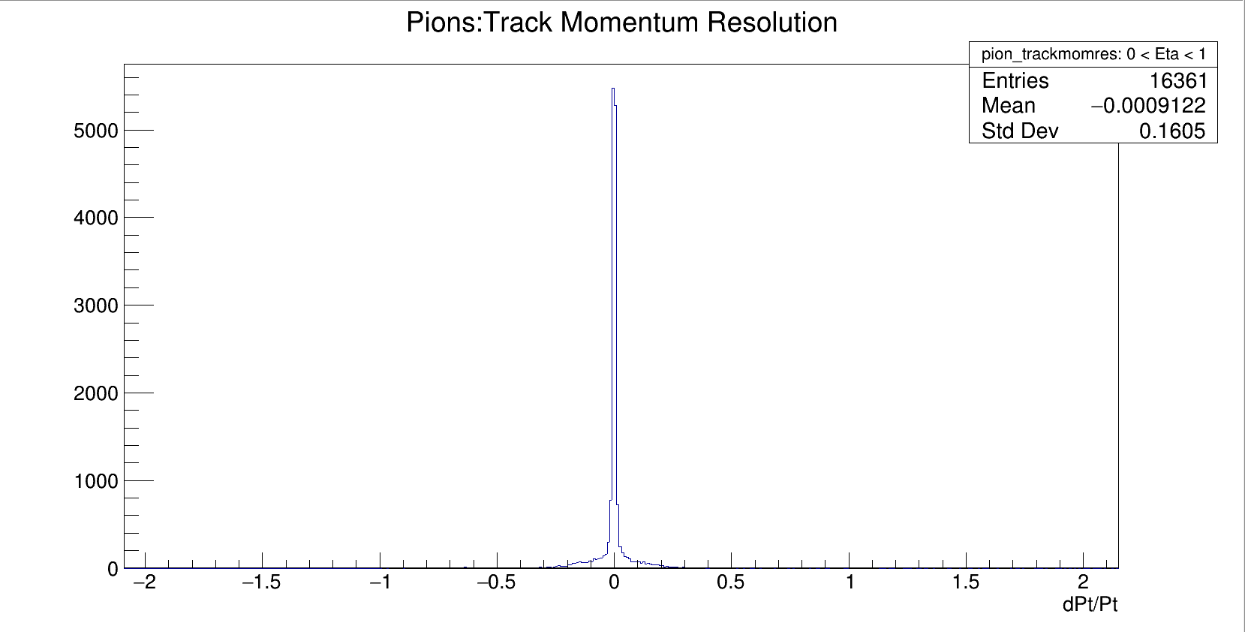
Contributions
Allan Prince (Central University of Tamil Nadu): Track Resolutions

Slide 7
Contributions
Rohit Kaundil (IIT Indor): Track Efficiency and Resolutions

Slide 8
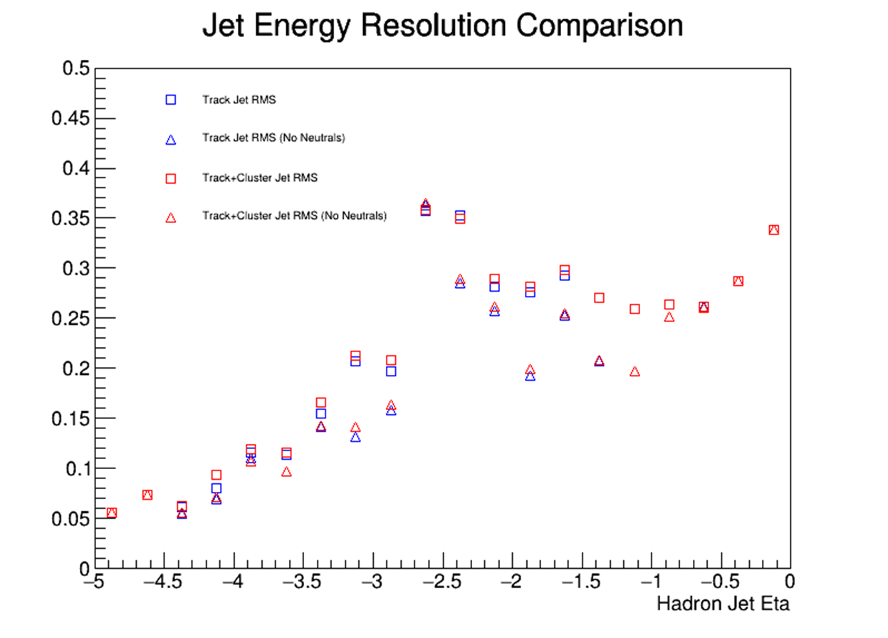
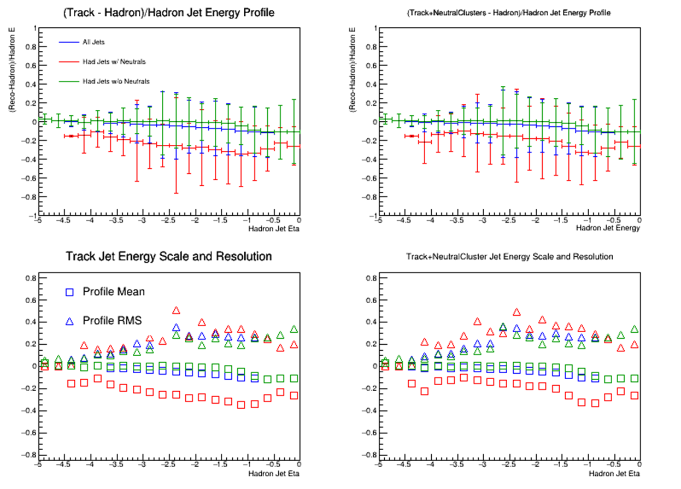
nHCal Jets
Begin looking at jet reconstruction in the negative endcap HCal
Think about use as a neutral hadron veto

