Slide 1
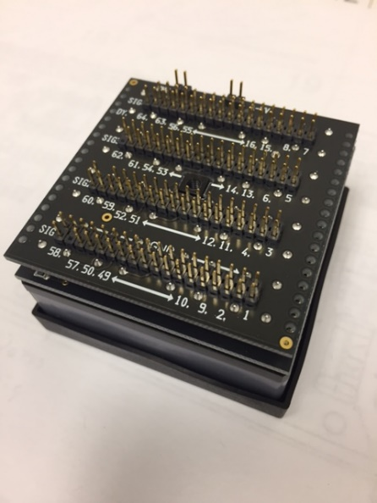
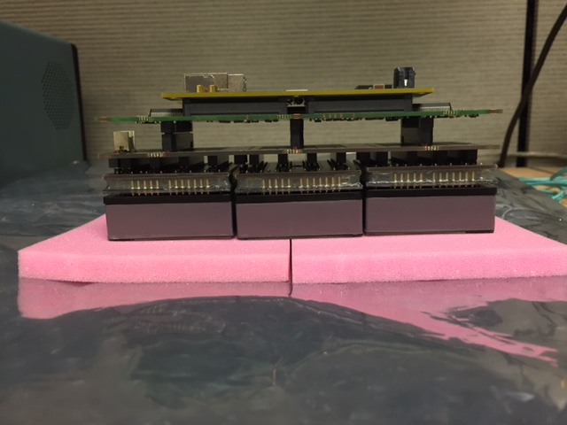
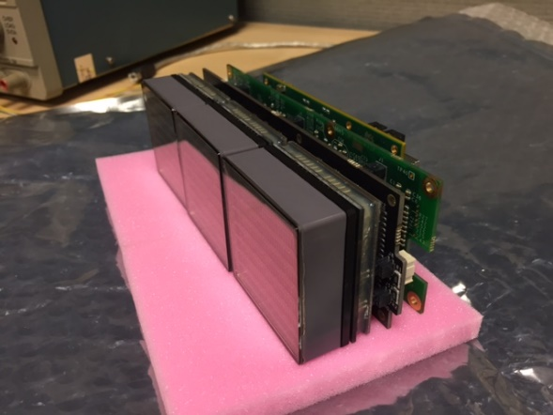
CLAS RICH & GlueX DIRC Readout Modules – Packaging example
Optical Transceiver
H12700 (8x8)
RDO
41 mm
FEB (MAROC3)
Adapter

